Slide 1
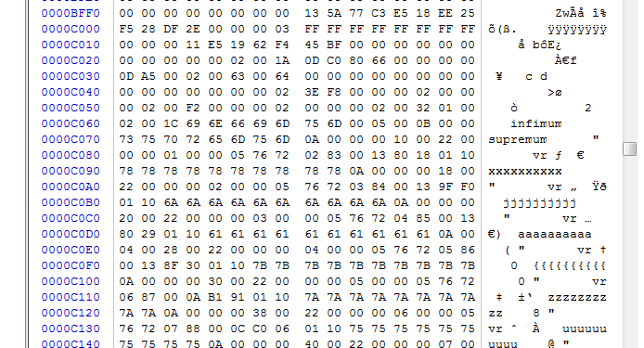
表空间中页的偏移量(4)
checksum(4)
checksum
checksum
checksum
checksum
checksum
checksum
checksum
checksum
checksum
checksum
checksum
checksum
checksum
checksum
checksum
checksum
checksum
checksum
checksum
checksum

