Slide 1
Phase 3 Project: Telecom Churn Classification
Edwin Joshua Kiuma
Moringa School
July 2025

Slide 2
Problem Statement
01 | Telecom companies lose money when customers leave.
02 | Goal: Predict if a customer is likely to churn.
03 | Use historical data to guide retention efforts.

Slide 3
Business Problem
• Churn = when a customer leaves the telecom service.
• Goal: Predict churn so the business can retain customers.
• Why it matters: Acquiring new customers is more costly than keeping existing ones.

Slide 4
Dataset Summary
• Source: bigml_59c28831336c6604c800002a.csv
• Rows: ~3,300 customers
• Features: Usage (minutes, calls), Charges, Plans (Intl, Voicemail), etc.
• Target: Churn (0 = stay, 1 = churn)

Slide 5
Data Preparation
• Encoded binary columns (Yes/No ➜ 1/0)
• Removed ID columns (Phone, State, Area Code)
• Scaled numerical features using StandardScaler
Scaled continuous variables
• Stratified train-test split (80/20)

Slide 6

Dataset Overview
3,333 records from a telecom provider.
Target: churn (Yes/No)
Features include call minutes, charges, plans.

Slide 7
Baseline Model: Logistic Regression
• Simple, interpretable model.
• Accuracy: ~86%
• Recall: ~0.38 — missed many churners
• F1 Score: ~0.52
• Confusion Matrix showed high false negatives.

Slide 8
Baseline Model: Decision Tree
Accuracy: 91%
F1 (Churn): 0.66

Slide 9
Tuned Model: Random Forest
• Used GridSearchCV to tune hyperparameters
• Best Params: n_estimators=200, max_depth=10, min_samples_split=2
• Accuracy: ~94%
• Recall: ~0.76 — major improvement in catching churners
• F1 Score: ~0.77

Slide 10
Tuned Model: Gradient Boosting
Accuracy: 94%
F1 (Churn): 0.77
Recall: 0.71

Slide 11
Model Comparison
Model | Precision | Recall | F1
Logistic Reg. | 0.53 | 0.25 | 0.34
Decision Tree | 0.69 | 0.63 | 0.66
Random Forest | 0.90 | 0.68 | 0.78
Grad. Boosting | 0.83 | 0.71 | 0.77

Slide 12
We tested four models: Logistic Regression, Decision Tree, Random Forest, and Gradient Boosting. While the baseline Logistic model had decent accuracy, it failed to capture churners well—its recall was only 25%. The Decision Tree improved this, but Random Forest performed best overall, with 94% accuracy and an F1 score of 0.78 for churn. Gradient Boosting was close, offering slightly better recall, but Random Forest had higher precision, making it the safest choice for minimizing false churn predictions.

Slide 13
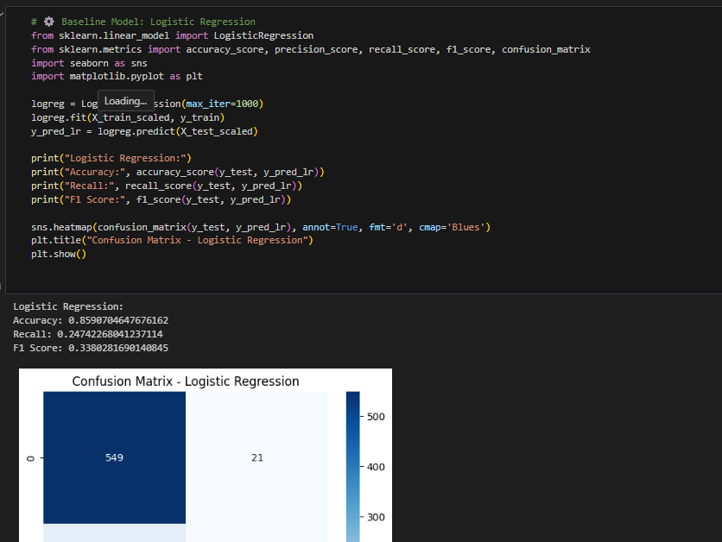

Slide 14
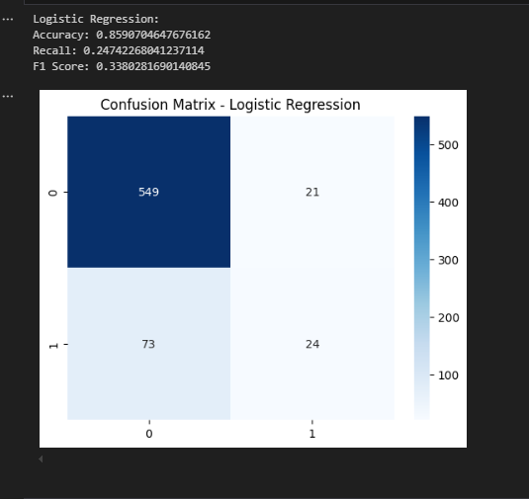

Slide 15
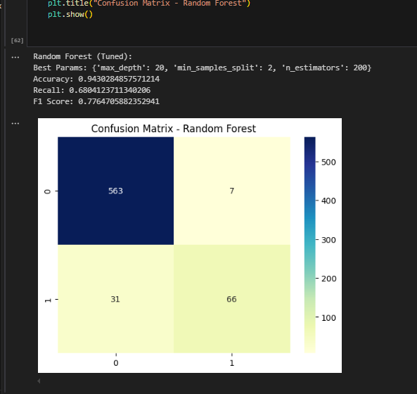

Slide 16
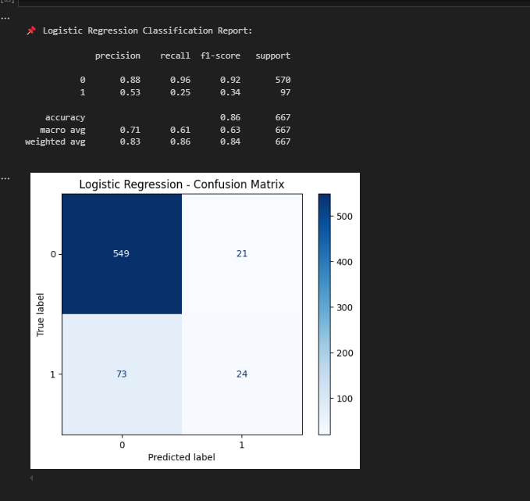

Slide 17
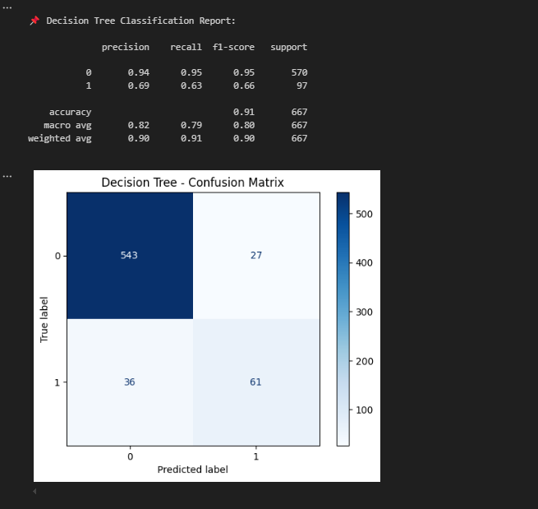

Slide 18
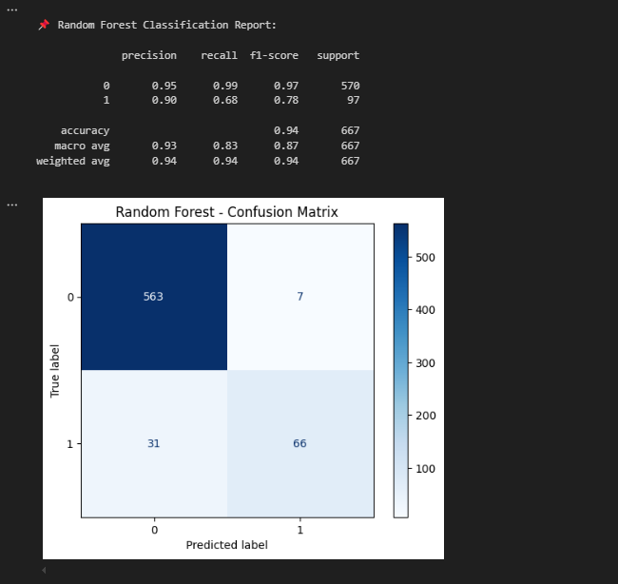

Slide 19
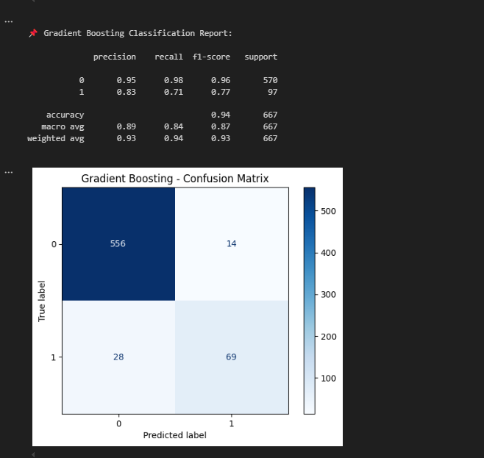

Slide 20
Model Performance Summary – Class 1: Churned Customers
Model | Accuracy | Precision (1) | Recall (1) | F1-Score (1)
Logistic Regression | 0.86 | 0.53 | 0.25 | 0.34
Decision Tree | 0.91 | 0.69 | 0.63 | 0.66
Random Forest | 0.94 | 0.90 | 0.68 | 0.78
Gradient Boosting | 0.94 | 0.83 | 0.71 | 0.77

Slide 21
Recommended Model: Random Forest
Achieves the highest precision (0.90), effectively reducing false positives.
Delivers a balanced F1-Score (0.78) and strong accuracy (0.94).
Slightly lower recall than Gradient Boosting but better overall reliability.
Use Random Forest for final deployment. Consider Gradient Boosting when higher recall is more critical (e.g., customer retention campaigns).

Slide 22
Confusion Matrix & Insights
• Random Forest reduced false negatives significantly.
• Better identification of high-risk customers.
• Business can now focus on likely churners before they leave.

Slide 23
Conclusion
Final Model: Random Forest
High precision: fewer false positives
Supports proactive customer retention

Slide 24

Future Improvements
Try SMOTE or class weights
Explore SHAP for model explainability
Deploy with Flask or Streamlit

Slide 25

Recommendations
• Prioritize outreach to customers flagged as high churn risk.
• Use model to monitor customer behavior regularly.
• Offer tailored incentives (e.g., better plans) to retain users.
• Future work: Add more features (e.g., customer support logs).

Slide 26

Q&A
Thank you! Any questions?

