Slide 1
>course
>command line interface
>instructor
>vidhya ramamoorthy
>ta
>mohammed saber
>welcome all!

Slide 2
Before we begin
CLI is fun
You can issues any command to your computer except rm –rf
Learn to read code like a novel
For anyone using windows, run the command if you want a Linux like environment setup on your machine wsl --install

Slide 3


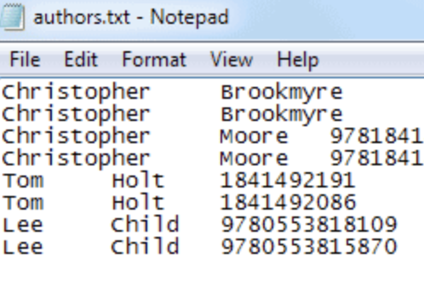
What will be learning?

Slide 4
What will be learning?
Terminal Shortcuts
Core Commands
Directory Management
File Management
Chaining Commands
Piping Commands
Search
Help

Slide 5
Terminal Shortcuts/Basics
Command | Description
CTRL L | clear the terminal
CTRL Q | close the terminal
/ | Top Level Directory
. | Current Directory
.. | Parent Directory
~ | Home Directory
sudo | allows a permitted user to execute a command as the superuser
CTRL C | Stop the command in terminal
Notes:
CTRL L = Clear the terminal CTRL D = Logout SHIFT Page Up/Down = Go up/down the terminal CTRL A = Cursor to start of line CTRL E = Cursor the end of line CTRL U = Delete left of the cursor CTRL K = Delete right of the cursor CTRL W = Delete word on the left CTRL Y = Paste (after CTRL U,K or W) TAB = auto completion of file or command CTRL R = reverse search history !! = repeat last command CTRL Z = stops the current command (resume with fg in foreground or bg in background)

Slide 6
Core Commands
Command | Description
ls | list directory contents
pwd | return working directory name
cd | change directory
echo | write arguments to the standard output
hostname | set or print name of current host system
Notes:
ls -a = list all files and folders ls = list files in folder ls -lh = Detailed list, Human readable ls -l *.jpg = list jpeg files only ls -lh = Result for file only

Slide 7
Working with Directories
rm remove directory
pushd push directory
popd pop directory
cp copy a file or directory
mv move a file or directory

Slide 8
Working with files
less page through a file
cat print the whole file
xargs execute arguments
find find files
grep find things inside files
File permissions: read (r), write (w), and execute (x)

Slide 9
Exercise
What happens when you type cd ../../?
What happens when you type cd ~
type ls -lh in your command line what do you see?
Create directories Universe/Milkyway/Sun/Earth/Yourplace

Slide 10
Editing file from command line using vim
Press the ESC key for normal mode.
Press i Key for insert mode.
Press :q! keys to exit from the editor without saving a file.
Press :wq! Keys to save the updated file and exit from the editor.
Press :w test.txt to save the file as test.txt

Slide 11
References
https://www.mprat.org/projects/terminus/
https://www.computervillage.org/articles/CommandLine.pdf
http://www.cs.columbia.edu/~sedwards/classes/2015/1102-fall/Command%20Prompt%20Cheatsheet.pdf
https://oit.ua.edu/wp-content/uploads/2020/12/Linux_bash_cheat_sheet-1.pdf
https://www.geeksforgeeks.org/linux-vs-windows-commands/
Installing Linux subsystem in Windows
https://learn.microsoft.com/en-us/windows/wsl/install
Linux terminal https://www.webminal.org/terminal/
GIT Installation https://git-scm.com/book/en/v2/Getting-Started-Installing-Git
GITHub CLI: https://docs.github.com/en/github-cli/github-cli/quickstart
GitHub GUI: https://www.sourcetreeapp.com/

Slide 12
Exercise
Write a command that prints out the string “hello, yearup” with and without quotes.
What happens when you hit enter without typing the quote?

