Slide 1
HOW TO MAKE MONEY BETTING ON 2026 MARCH MADNESS
Can we use machine learning and efficiency metrics to beat the sports bettors at their own game?
2026 Brandeis Datathon | Team ASA
Anokh Palakurthi | Samiya Islam | Aastha Chavan
Brandeis International Business School
Notes:
Hi everyone, we're Team ASA — Anokh, Samiya, and Aastha — from the MSBA program. Our project is about testing if using machine learning and advanced team efficiency metrics can help bettors find an edge in March Madness betting. We looked at 18 years of tournament data, scraped over a thousand Vegas closing lines, and tested whether our models could beat the betting market.

Slide 2
FOLLOW THE SMART MONEY ON CHAMPIONS
7 / 17
+$1,815
Market favorite wins
Net profit on $1,700 wagered
(41.2%)
(+107% ROI)
Our ML models went 0/5 on champion prediction (RF, XGBoost). Only the Neural Net got one right (UConn 2024).
The market is most efficient at champion prediction.
However, models can add value at the game level.
Notes:
We scraped pre-tournament championship futures odds from Covers.com for all years in our data set. The market favorite — the team with the lowest odds before Round 1 — has won 7 out of 17 tournaments, or 41 percent of the time. Because futures odds pay out at plus-200 to plus-500, those seven wins generated 1,815 dollars in profit on 1,700 wagered based on real odds.
Conversely, two of our ML models went 0 for 5 on champion prediction for Random Forest and XGBoost in the 2020s. Only the Neural Network got one right — UConn in 2024, which was a one seed. So the market is most efficient at the question fans care about most: who wins the whole thing. Our models add value at the game level, not the futures level. That distinction matters and it directly informed our 2026 pick.

Slide 3
OUR 2026 PREDICTIONS
DUKE
HOUSTON
ARIZONA
MICHIGAN
1-seed (East)
2-seed (South)
1-seed (West)
1-seed (Midwest)
All three ML Models picked Duke
All three ML Models picked Houston
RF & XGBoost picked Arizona, NN picked Purdue
RF & XGBoost picked Michigan. NN picked Iowa St.
CHAMPION
DUKE
Market co-favorite at +325.
For a one-shot prediction, we defer to market efficiency.
Notes:
Based on these trends, we’ve gone with Duke as our favorite, but it’s worth noting the interesting takeaways from our models before the tourney began. - All agreed on Duke being the heavy East favorite - All agreed that Florida had paper tiger potential/picked Houston - NN a bit of a chaos agent in there between Purdue and Iowa St. predictions - For our champion, we chose to go with safe pick based on smart money, but worth noting: all the ML models actually picked Michigan. This is the one area we are deferring to market odds.

Slide 4
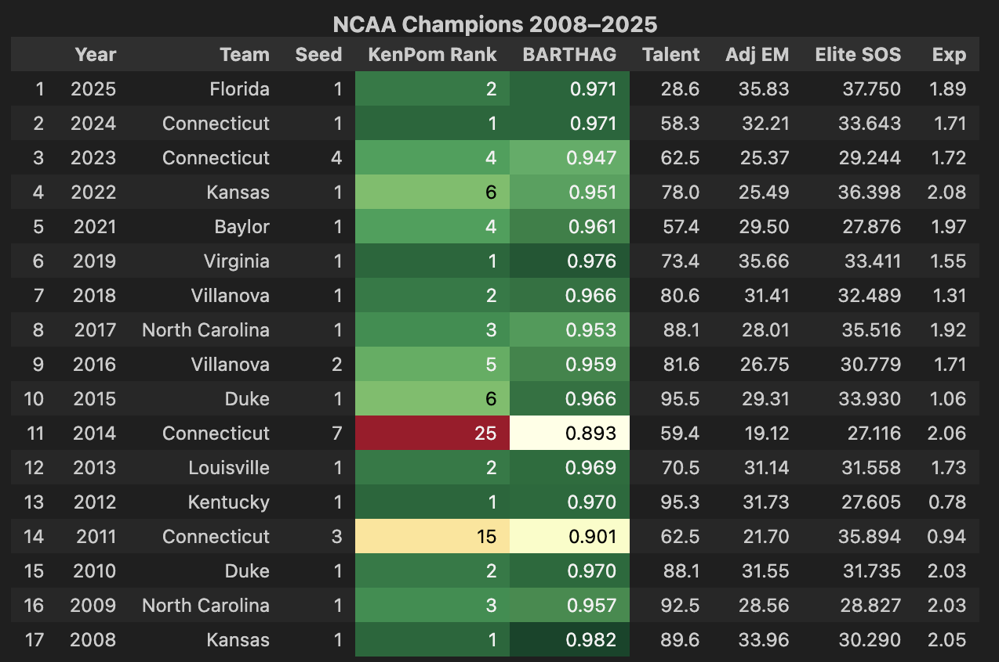
CHAMPION PROFILE WITH TEAM EFFICIENCY METRICS
We profiled all 18 champions (2008–2025) and compared 2026 contenders to the historical median.
Metric | Champion Median BARTHAG | Duke | Michigan | Arizona | Purdue
KenPom Rank | Top 5 | #1 | #4 | #3 | #6
BARTHAG | > 0.94 | #1 | Top 5 | Top 5 | Top 10
TALENT Rating | Top 10 | #1 | Top 10 | Top 5 | Top 15
ELITE SOS | Top 20 | Top 5 | Top 10 | Top 10 | Top 15
Experience (EXP) | Varies | High | High | Moderate | High
Notes:
We also profiled all 18 historical champions to understand what a winner looks like. The typical champion ranks in the top 5 of KenPom efficiency, has a BARTHAG above 0.94, and has a top-10 talent rating. 15 of 18 champions were 1 or 2-seeds. When we compare the 2026 contenders against this profile, Duke matches most closely — they're number 1 in KenPom, number 1 in TALENT, and have the highest BARTHAG in the field. Michigan and Arizona also fit the champion profile but Duke has the edge on every metric.

Slide 5
BEATING VEGAS - DATA METHODOLOGY
1,144
18
33
1,041
Tournament
Games
Seasons
(2008-2025)
Differential
Features
Vegas Lines
Scraped
Approach
Models
Train: 2008–2019 (758 games)
Validate: 2021–2024 (252 games)
Test: 2025 (63 games)
Deploy: Retrain on all data for 2026 predictions
ML: XGBoost (regularized), Random Forest, Neural Network
Baselines: Chalk (seed), KADJ EM, BARTHAG, TR RATING
External: Vegas closing lines from Sports Reference, Covers.com for futures odds before Round One
Notes:
We merged four data sources from the Kaggle dataset containing different team efficiency metrics into 1,144 tournament games. Every game becomes 33 differential features: Team A minus Team B on each metric.
We then normalized raw shooting stats within each season because a 35% three-point rate meant something different in 2008 than 2025. Our train-validate-test split is strictly chronological — train on 2008 to 2019, validate on 2021 to 2024, test on 2025. This ensures that no future data ever leaks into training.
We also independently scraped 1,041 Vegas closing lines from Sports Reference. For the three precent of events that lack Vegas odds, we simply excluded them from the set; they included play-in rounds.

Slide 6
BEATING VEGAS - MODEL PERFORMANCE ON GAME ACCURACY
Out-of-Sample Accuracy (2021–2025, 309 games)
Rank | Method | Accuracy | Type
1 | Random Forest | 71.2% | ML
2 | BARTHAG | 71.2% | Baseline
3 | TR RATING | 71.2% | Baseline
4 | Chalk (Seed) | 70.9% | Baseline
5 | KADJ EM | 70.9% | Baseline
6 | XGBoost (reg.) | 69.9% | ML
7 | Vegas Favorite | 69.9% | External
8 | Neural Net | 67.0% | ML
All methods converge on 67–72%. Vegas closing lines finish 7th. But accuracy is misleading; is there a way to beat Vegas on where it’s optimized (money line)?
Notes:
Here's the accuracy ranking across 309 out-of-sample games from 2021 to 2025. Random Forest leads at 71.2%, but look how tight the range is — the gap between first and last place is only 4.2 percentage points. Everything from picking the higher seed to our most complex ML model lands between 67 and 72 percent. The headline finding is in row 7: Vegas closing lines — the sharpest prediction market in sports, with billions of dollars flowing through it — finish 7th out of 8 methods. Obviously, however, that doesn’t mean that Vegas is failing. It’s worth remembering that Vegas optimizes for point spreads to balance the books, not for predicting who actually wins. With that said though, we still found edges in betting against Vegas money lines.

Slide 7
BEATING VEGAS - GAME-LEVEL UNDERDOG BETTING (2021-2025)
Strategy: When a model disagrees with Vegas, bet $100 on the model’s pick at underdog money line odds.
Method | Bets | Wins | Win % | Profit
Random Forest | 32 | 18 | 56.2% | +$955
TR RATING | 18 | 11 | 61.1% | +$650
KADJ EM | 21 | 12 | 57.1% | +$550
XGBoost (reg.) | 34 | 17 | 50.0% | +$570
Neural Net | 41 | 16 | 39.0% | –$220
4 of 5 methods are profitable against Vegas.
The edge exists despite Vegas optimizing for point spreads, with two baseline and two machine learning models outperforming Vegas in simulated bets.
Notes:
This is where it gets interesting. We tested a simple strategy: when one of our models disagrees with Vegas about who wins a game, we simulated betting 100 dollars on the model's pick at the actual underdog money line odds. Because we're always picking against Vegas in these spots, we're betting the underdog side, where payouts range from plus-150 to plus-500. Random Forest won 18 out of 32 such bets, generating 955 dollars in profit. Four out of five methods were profitable. The only loser was the Neural Network. The reason this works is that our models identify games where the efficiency gap tells a different story than the point spread. In those disagreement games, the efficiency metrics are right more often than Vegas.

Slide 8
LIMITATIONS
What our models can’t capture
Injuries, coaching adjustments, travel fatigue, or the psychological dynamics of single-elimination play. The 2023 tournament demonstrates how March Madness has an irreducible randomness floor.
Small sample sizes
The spread betting ROI uses 18–41 bets per method with wide confidence intervals. The futures analysis covers only five out-of-sample years.
Pre-COVID training, post-COVID testing
Our temporal split means ML models trained on 2008–2019 are evaluated on 2021–2025. Our models and approaches may be learning partially outdated patterns that don’t reflect more recent changes in basketball strategy.
Notes:
We want to be transparent about what our models can't do. First, they can't capture real-time factors like injuries, coaching adjustments, or the psychological pressure of single-elimination play. In 2023, every single method we tested got zero out of four Final Four teams correct. Second, our betting results use small sample sizes — 18 to 41 bets per method — with wide confidence intervals. We wouldn't recommend actually wagering based on five years of data. Third, our training data is entirely pre-COVID, and our test data is post-COVID. If the game changed structurally — and there's evidence it did, with higher pace and more three-point attempts — our models may be learning patterns that don't fully apply anymore.

Slide 9
TEAM ASA
Anokh Palakurthi
MS Business Analytics ’26 | appkea1012@brandeis.edu
Samiya Islam
MS Business Analytics ’26 | samiyaislam@brandeis.edu
Aastha Chavan
MS Business Analytics ’26 | aasthachavan@brandeis.edu
Notes:
Thank you for your time. We're happy to take questions about any part of our methodology, our data sources, or our predictions. All of our code is available on our GitHub.

