Slide 1
Master Your Security Incident Response Communications Program
Learn how to talk to your stakeholders about what’s going on when things go wrong.

Slide 2
Table of contents
1. Project Rationale
2. Execute the Project/DIY Guide
Phase 1: Dive Into Communications Planning Phase 2: Develop Your Communications Plan
3. Summary/Conclusion
4. Next Steps
5. Appendices

Slide 3


ANALYST PERSPECTIVE
Does your incident response plan outline a communications strategy? It should.
Cybersecurity incidents are simply unavoidable for modern organizations. Data breaches and ransomware attacks regularly make headlines, and these sorts of incidents can have a huge impact on an organization’s reputation. How well or poorly a company weathers the fallout from a security incident often depends on their communications strategy – the information they share or don’t share with stakeholder groups.
In the midst of a crisis, it can be difficult to decide what to tell stakeholders and how to deliver that information to them. While each incident is unique, the basics of effective communication remain the same in virtually every case, so many decisions can be made ahead of time. Having a communications plan ready to go helps to save time, reduce stress, and minimize reputational damage in the wake of a security incident or crisis.
Logan M. Rohde,
Consulting Analyst, Security, Risk & Compliance Info-Tech Research Group

Slide 4
Our understanding of the problem
A CISO, IT Manager, or PR Specialist who is dealing with the following:
Ineffective communications efforts leading to reputational damage or loss of stakeholder trust.
Resistance from management to develop an incident response communications strategy.
Difficulty coordinating communications between departments that collaboratively respond to incidents.
Develop an effective internal and external communications strategy for incidents of all severities.
Establish an organizational policy for security incident response communications.
Improve understanding of threat escalation protocols.
Formally track security incidents response communications.
Business stakeholders who are responsible for the following:
Improving workflow and managing operations in the event of security incidents to reduce any adverse business impacts.
Ensuring that incident response compliance requirements are being adhered to.
Efficiently allocate resources to improve incident response in terms of time, cost, and damage to organizational reputation.
Streamline regulatory required reporting to the supervisory authority and affected stakeholder groups.

Slide 5
Executive summary
Security incidents are inevitable, but how they’re dealt with can make or break an organization. Poor incident response negatively affects business practices, including workflow, revenue generation, and public image.
Communications planning is often overlooked. Many organizations do not have an incident response plan, and those that do often forget to include a communications plan, leading to time loss while trying to create one on the fly.
There’s no such thing as successful incident response communications; strive instead for effective communications. There will always be some fallout after a security incident, but it can be effectively mitigated through honesty, transparency, and accountability.
Effective external communications begin with effective internal communications. Security Incident Response Team members come from departments that don’t usually work closely with each other. This means they often have different ways of thinking and speaking about issues. Be sure they are familiar with each other before a crisis occurs.
You won’t save face by withholding embarrassing details. Lying only makes a bad situation worse, but coming clean and acknowledging shortcomings (and how you’ve fixed them) can go a long way towards restoring stakeholders’ trust.
When a significant security incident is discovered, usually very few details are known for certain. Nevertheless, the organization will need to say something to affected stakeholders.
Security incidents tend to be ongoing situations that last considerably longer than other types of crises, making communications a process rather than a one-time event.
Effective incident response communications require collaboration from: IT, Legal, PR, and HR – groups that often speak “different languages.”
Effective and efficient management of security incidents involves a formal process of preparation, detection, analysis, containment, eradication, recovery, and post-incident activities: communications must be integrated into each of these phases.
Understand that prior planning helps to take the guesswork out of incident response communications. By preparing for several different types of security incidents, the communications team will get used to working with each other, as well as learning what strategies are and are not effective. Remember, the communications team contains diverse members from various departments, and each may have different ideas about what information is important to release.

Slide 6
It’s not a matter of if you have a security incident, but when
The increasing complexity and prevalence of threats have finally caught the attention of corporate leaders. Prepare for the inevitable with an incident response program.
01
A formalized incident response program reduced the average cost of a data breach (per capita) from $141 to $122, while third-party involvement increased costs by $17.
02
US organizations lost an average of $4.13 million per data breach as a result of increased customer attrition and diminished goodwill. Canada and the UK follow suit at $1.57 and $1.39, respectively.
03
75% of breaches are perpetrated by outsiders, 51% involve criminal groups, and 25% are the doings of internal actors.
The proliferation of hacking techniques and commoditization of hacking tools has enabled more people to become threat actors. Examples include:
Organized Crime Groups
Lone Cybercriminals
Competitors
Nation States
Hacktivists
Terrorists
Former Employees
Domestic Intelligence Services
Current Employees (malicious and accidental)
04
91% of companies surveyed had at least one external IT security incident, while 85% had at least one internal security incident.
05
The average cost of a data breach increases by $1 million if left undetected for >100 days.
Threat Actor Examples
Sources: “2017 Cost of Data Breach Study”; “2017 Data Breach Investigations Report”; GDPR Article 4(2), 6

Slide 7



Data breaches are resulting in major costs across industries
% of systems impacted by a data breach
1%
No Impact
19%
1-10% impacted
41%
11-30% impacted
24%
31-50% impacted
15%
>50% impacted
% of customers lost from a data breach
61% Lost <20%
21% Lost
20-40%
8% Lost
40-60%
6% Lost
60-80%
4% Lost
80-100%
% of business opportunity lost from a data breach
58% Lost <20%
25% Lost
20-40%
9% Lost
40-60%
5% Lost
60-80%
4% Lost
80-100%
Average data breach costs per compromised record hit an all-time high of $141 (in 2017).
Source: “2017 Cost of Data Breach Study”
Source: “2017 Security Benchmark Study”

Slide 8



Data breaches can cause serious reputational harm
On its own, a plan isn’t enough
88%
49%
of companies are confident in their ability to respond effectively to a data breach.
of companies have some kind of data breach plan in place.
But only
Reasons for doubt
Public opinion
65%
of consumers lost trust in an organization after being affected by a data breach.
of companies believe that their data breach plan will not help:
51%
to prevent the loss of customers’ and business partners’ trust and confidence.
to prevent negative public opinion, blog posts, and media reports.
to minimize the financial and reputational consequences.
33%
of consumers took steps to end their relationship with the breached organization.
Source: “Is Your Company Ready for a Big Data Breach?”

Slide 9
Data breaches are not the only threat to be concerned about
88% of attacks fall under ten areas according to the Verizon “2017 Data Breach Investigations Report.”
Denial of Service
Privilege Misuse
Crimeware
Web App Attacks
Physical Theft
27%
18%
16%
15%
14%
A compromise of the availability of networks and systems. Most targeted industries include:
Entertainment
Professional Services
Public
Malicious use of internal resources. Common use cases include:
Healthcare workers stealing PII
Internally-driven public admin data breaches
Malware with predominantly email-based delivery:
Ransomware
C2 exploits
Worms
Exploits of code-level vulnerabilities as well as thwarting application mechanisms. Actor tactics include:
Stolen credentials
SQLi
Brute force
An information asset goes missing (through misplacement or malice). Most frequently targeted industries include:
Public
Healthcare
Miscellaneous Errors
Cyberespionage
Point of Sale (POS)
Payment Card Skimmers
Everything Else
6%
0.7%
0.5%
0.2%
2%
Unintentional actions compromising an attribute of a security asset. Examples include:
Misdelivery
Publishing error
Disposal error
Unauthorized and malicious network access. Most targeted industries include:
Manufacturing
Public
Professional
Remote attacks on POS terminals and controllers. Most frequently targeted industries include:
Accommodation & Food Services
Retail
Skimming devices that are implanted on an asset to read payment cards. Devices include:
ATMs
Gas pumps
POS terminals
Any incident that does not classify as one of the other categories:
Phishing
Footprinting
Pretexting
Source: “2017 Data Breach Investigations Report”

Slide 10









Understand the role of communications in incident response
Today’s organizations face so many different threats that incidents are inevitable. Having a communications plan will help to:
Repair reputation with stakeholders.
Keep the remediation effort running, even when the phones go down.
Complete required regulatory reporting.
Facilitate relationships between departments.
Demonstrate transparency.
Disseminate essential information within the organization.
Show loyalty to clients.
Send important updates to stakeholders.
Not every incident will require a large-scale communications effort, but it’s important to have a plan in place so the incident responders know at what threat level communication needs to occur and then put the communications plan into action to achieve the above goals.

Slide 11


Use these icons to help direct you as you navigate this research
Use these icons to help guide you through each step of the blueprint and direct you to content related to the recommended activities.
This icon denotes a slide where a supporting Info-Tech tool or template will help you perform the activity or step associated with the slide. Refer to the supporting tool or template to get the best results and proceed to the next step of the project.
This icon denotes a slide with an associated activity. The activity can be performed either as part of your project or with the support of Info-Tech team members, who will come onsite to facilitate a workshop for your organization.

Slide 12




Info-Tech offers various levels of support to best suit your needs
Guided Implementation
DIY Toolkit
Workshop
Consulting
“Our team has already made this critical project a priority, and we have the time and capability, but some guidance along the way would be helpful.”
“Our team knows that we need to fix a process, but we need assistance to determine where to focus. Some check-ins along the way would help keep us on track.”
“We need to hit the ground running and get this project kicked off immediately. Our team has the ability to take this over once we get a framework and strategy in place.”
“Our team does not have the time or the knowledge to take this project on. We need assistance through the entirety of this project.”
Diagnostics and consistent frameworks used throughout all four options

Slide 13

Master Your Security Incident Response Communications Program
1. Dive Into Communications Planning
2. Develop Your Communications Plan
Best-Practice Toolkit | 1.1 Learn the basics of incident response communications. 1.2 Confront the challenges associated with incident response communications planning. 1.3 Reap the benefits of preparedness. 1.4 Appreciate the diversity of the Security Incident Response Team (SIRT). 1.5 Assemble the SIRT. 1.6 Consider the kinds of threats that are most likely to occur. 1.7 Remember your regulatory and other reporting obligations. 1.8 Determine the threat escalation protocol. 1.9 Assign roles and responsibilities for the threat management process (RACI). 1.10 Begin considering your message. | 2.1 Create an internal communications plan. 2.2 Develop an external communications strategy. 2.3 Manage the fallout from the incident. 2.4 Consider customer compensation carefully. 2.5 Appreciate the role of social media. 2.6 Draft the SIRT policy. 2.7 Customize the Security Incident Communications Guidelines and Templates. 2.8 Run tabletop exercises. 2.9 Conduct a post-mortem review of the incident. 2.10 Consider sharing information with your peers.
Guided Implementations | Establish the SIRT. Explore the elements of effective incident response communications. | Create an internal communications plan. Develop an external communications strategy.
 | Phase 1 Outcome: Threat Escalation Chart SIRT RACI. | Phase 2 Outcome: Plans and templates for internal/external communication SIRT Policy Sample tabletop exercise scenarios Communications metrics tracking tool

Slide 14
1
Dive Into Communications Planning
Master Your Security Incident Response Communications Program

Slide 15
Phase 1: Dive Into Communications Planning
PHASE 1
PHASE 2
1.1
1.10
2.1
2.10
Learn the Basics of Incident Response Communications
Begin Considering Your Message
Create an Internal Communications Plan
Consider Sharing Information With Your Peers
This step will walk you through the following activities: | This step involves the following participants:
Assemble the SIRT. Identify reporting obligations. Determine the threat escalation protocol. Assign responsibilities for the threat management process. Consider your message. | IT/Cybersecurity leader Legal representative Public relations/communications specialist HR representative
Outcomes of this step
Learn the basics of incident response communications and understand the associated challenges. SIRT. SIRT Policy. Defined roles and responsibilities for the threat management process (RACI). Threat escalation protocol.

Slide 16

Phase 1 outline
Call 1-888-670-8889 or email GuidedImplementations@InfoTech.com for more information.
Complete these steps on your own, or call us to complete a guided implementation. A guided implementation is a series of 2-3 advisory calls that help you execute each phase of a project. They are included in most advisory memberships.
Guided Implementation 1: Master Your Security Incident Response Communications Program Proposed Time to Completion: 4-6 weeks
Step 1.1-1.9: Establish the SIRT | Step 1.10: Begin Considering Your Message
Start with an analyst kick-off call: Understand the importance of incident response communications planning. Discuss the roles of the SIRT and threat escalation protocol. Determine reporting obligations. | Review findings with analyst: Discuss progress with assembling SIRT, assigning roles and responsibilities, and developing threat escalation chart. Outline the qualities of a good communications policy and go over the basics of how to craft an effective message.
Then complete these activities… Assemble the SIRT. Develop threat escalation chart. Assign roles and responsibilities. With these tools & templates Threat Escalation Chart Communications RACI | Then complete these activities… Finalize Threat Escalation Chart and Communications RACI. Have the SIRT begin discussions around what information will be shared and when.
Phase 1 Results & Insights: Determine a threat escalation protocol and define the roles and responsibilities of the SIRT. Identify reporting obligations and understand how they will affect the communications processes. Understand the basics of crafting an effective message.

Slide 17
Learn the basics of incident response communications
1.1
1
Incident response communications are any written or verbal correspondence that takes place during or following a cybersecurity incident.
2
These kinds of communications may seem basic, but in the chaos of a serious incident or crisis, these tasks can become major challenges if you’re not prepared.
3
Effective planning begins with incorporating communications procedures and protocols into the cybersecurity incident response plan.
4
Incident response communications come in two types: internal and external. These communication types are similar, but have different audiences.
5
Incidents vary in degree and severity, meaning not all incidents will need to be communicated to all of the same groups of people.
Sent to
Communications examples
Public
Media
Business partners
Regulatory agencies
Insurance providers
Law enforcement
Press release
Interview
Incident report
Insurance claim
Email
Phone call
Correspondence template
Company meeting
External
Communication types
Sent to
Employees
C-suite executives
Incident response team members
Internal

Slide 18
Learn the basics of incident response communications continued
1.1
Preparation is key
Incident response communications are an extension of incident response planning more generally, yet communications are often forgotten or ignored during incident response planning. However, a plan is not much good if the people who need to use it do not know how to communicate with each other (let alone with external stakeholders) during a crisis.
Determining how to communicate is just as important as deciding what to communicate. Security incidents can be extremely stressful situations and without having a plan to guide how and what to communicate, it becomes very easy to make a bad decision in the heat of the moment.
Planning ahead allows multiple parties (with multiple points of view) to rationally think through and discuss the most appropriate strategy for dealing with a worst case scenario before it happens.
Inside and outside are linked
Internal and external communications are linked processes: effective external communications depends on having a streamlined internal communications plan.
External communications often deal with sensitive information, so there needs to be an approval process in place to determine what details can and cannot be released to each stakeholder group both inside and outside the organization.
This approval process usually requires input from multiple departments (e.g. IT, Cybersecurity, Legal, PR), so it is important that they are all able to correspond with each other efficiently.
Communicating can be a big job
There are a lot of stakeholder groups that may need to be informed in the wake of a cybersecurity incident, such as C-suite executives, employees, regulatory agencies, insurers, business partners, and clients or customers.
In most cases, all of these groups will not receive exactly the same message, meaning communications need to be adjusted for each stakeholder group – the details sent to an insurer are likely to differ from those sent to clients.

Slide 19
Confront the challenges associated with incident response communications planning
1.2
Uniqueness
Each incident is different
This makes planning ahead challenging, but not impossible: many things remain consistent across all incident types.
Unknowns
You don’t know what you don’t know
Usually, very little is known for certain during a security incident, but honesty is the best policy: if you don’t know, say so.
Time
Working against the clock
Reports to regulatory agencies, stakeholders, and the media are all time sensitive. It always best to break your own bad news: if you don’t, someone else will, and you’ll seem like you’re hiding something.
Ongoing
This might take a while
Security incident response communications are rarely a one-time occurrence. Most incidents take weeks to months to remediate, so having a long-term strategy is a must.

Slide 20
Reap the benefits of preparedness
1.3
Planning ahead will help you to:
Define roles and responsibilities
As with any crisis or emergency type situation, having a plan and the proper people in place to deal with what's happening is crucial.
– Keith Marnoch, Director, Media and Community Relations, Western University
The middle of a security crisis is not the time to decide who will be in charge of what. Make sure there is a plan that outlines the jobs each member of the SIRT is responsible for.
Communicate updates
Security incidents usually take weeks or months to remediate. During this time, updates will need to be communicated in a way that will actually reach stakeholders. Email may be suitable for one type of incident but a website might be more practical for another.
Address the media strategically
Media interactions can be high-pressure events, but they are often necessary during serious security breaches. Because media interactions are a public representation of the organization, it is important to have a strategy. Without one, it is easy to say the wrong thing and have reputational damage go from bad to worse.
You won't be able to pre-plan every word you'll need to say in the event of a crisis, but by developing a strategy before an incident occurs, you'll be better able to address these challenges as they arise and won't waste valuable time deciding what should and shouldn't be done.

Slide 21

Reap the benefits of preparedness continued
1.3
Planning ahead will help you to:
Develop threat escalation protocol
Incidents come in all shapes and sizes, so not every incident needs the same level of attention. By outlining what counts as a minor incident and what counts as a crisis ahead of time, all members of the SIRT will be able to act accordingly.
The politics and the culture [of an organization] are often lynchpins for the decision making for disclosure.
– Sean Thurston, Senior Research Director, Security, Risk & Compliance, Info-Tech Research Group
Simplify regulatory reporting
Reporting security incidents to regulatory agencies is a communications effort on its own. Without a procedure in place to make sure this reporting (and other requirements) can be completed on time, this task becomes one more stressor in an already tense time.
Learn from others
Security incidents are hot news headlines these days. When tragedy strikes another organization, this can be an opportunity to review how your own communications strategy would hold up in this kind of incident and adjust your strategy as needed.
Preparing for various scenarios before they happen means that you won’t have to learn on the fly when the real incident occurs. Remember to debrief after an incident and adjust the communications plan to maximize efficiency in the future.

Slide 22
Appreciate the diversity of the SIRT
1.4
The SIRT usually contains four distinct branches, and each one provides a valuable point of view when drafting effective incident response communications.
However, the exact role used to fill each of these branches varies from organization to organization. Possible members may include:
Chief information security officer
Chief security officer
Senior management
Security team staff
Help desk
Information owner
Information systems staff
Public relations
Legal/compliance
Internal audit/risk management
IT/Cybersecurity
Legal
SIRT
Public Relations
Human Resources
This team will also handle the more technical aspects of incident remediation. For more information, consult Info-Tech’s Develop and Implement a Security Incident Management Program blueprint.
Effective external communications begin with effective internal communications. Notice that SIRT members come from departments that don’t usually work closely with each other. This means that they often have different ways of thinking and speaking about issues. Be sure they are familiar with each other before a crisis occurs.

Slide 23

Assemble the SIRT
1.5
1
Determine who is involved when it comes to communicating the security incident.
Be sure to outline who is responsible and accountable for communication by defining both who does the communicating and whom they communicate with inside and outside the organization.
Remember to establish alternates for each role so that the SIRT can still operate if primary members cannot be reached or are unavailable.
2
Limit the number of SIRT members.
The SIRT needs to be empowered to make decisions quickly and easily – having too many people on the team tends to prevent such efficiency due to competing ideas.
The ideal number is about six to eight people, but make sure the team has enough people to represent all the necessary perspectives within the organization.
The team should be a blend of people with hands-on experience and senior leadership.
3
Review the incident response plan.
Effective communications stem from strong security culture. If the incident response plan has gaps in it, the investigation and remediation will be slowed down, and thus communications will suffer.
Be sure to use the incident response plan as a guide to coordinate an internal communications plan. Look for places in the plan where communication between departments would be necessary, then repeat for external communications.
In a crisis, you won’t be able to wait around if a SIRT member is unavailable, so make sure an alternate is available for each role.

Slide 24
Consider the kinds of threats that are most likely to occur
1.6
Some of the most common types of cyberthreats include:
76% of organizations experienced phishing attacks in 2017 (Wombat Security, 2018).
8 per day was the average number of DDoS attacks organizations experienced in Q3 of 2017 (Tech Republic, 2017).
45% of ransomware accounted for almost half of all malware incidents in 2017 (Verizon DBIR, n.d.).
56% of organizations experienced a data breach in 2017 (Ponemon, 2018).
Ransomware
DDoS
Malware
Phishing
Compromised credentials
Theft of sensitive consumer information
Every threat is different
Each of the above threats also poses challenges unique to it specifically.
Consider the following three questions to get started thinking about how your organization would handle these types of incidents:
If ransomware knocks out your organization’s internet capabilities, how will you communicate with stakeholders?
A DDoS attack may mean that your clients are left without service indefinitely. What could you say to help smooth things over?
What if a data breach is the result of an employee falling for a phishing scam? How will you explain such a mistake to the public, and would you inform employees to reduce the likelihood of it happening again?
You won't be able to prepare for every possibility, but you should prepare for the most likely issues. Not all threats affect all industries the same, so it’s important to take some time to consider where your planning efforts are best spent.

Slide 25
Remember your regulatory and other reporting obligations
1.7
Many regulations require reporting after a security incident. These obligations should be considered when drafting a communications plan, as meeting them during a crisis can be challenging if a plan is not already in place.
In many cases, notifying the regulatory agency will be the first external communication you make. Some regulations require notification within the first few days of discovering the incident. Make sure you are aware of what details you will need to provide them with, so you don’t end up reporting late and risking fines and other penalties.
Regulatory or contractual obligation: | Reporting requirements*: * The information contained in this chart is a high-level overview of the required communications for three common regulations; it is not a list of all requirements and exceptions. Users of this information should conduct a complete review of the required actions for any and all regulations they must comply with, including state, provincial, and other laws, which may be stricter and supersede these requirements.
HIPAA: Health Insurance Portability and Accountability Act | Notify those affected within 60 days of discovering the incident via first-class mail or email (if authorized to do so), and provide, in plain language, a summary of what happened and what data was affected. Report incident to the Department of Health and Human Services (if more than 500 people affected) within 60 days of discovery. Issue a statement to the media (if more than 500 people affected) within 60 days of discovery.
PCI DSS: Payment Card Industry Data Security Standards | Report incident to major payment card brands (Visa, Mastercard, Discover, Amex) immediately after discovery (within 24 hours for Mastercard). Notify law enforcement and affected individuals. Comply with other regional reporting requirements.
GDPR: General Data Protection Regulation | Report breach to the appropriate supervisory agency within 72 hours, outlining what happened, how many people were affected, number of personal records affected, contact information for the Data Protection Officer, expected consequences, and steps taken to remediate. Send, without undue delay, a plain language report of the above sent to those affected.

Slide 26
Remember your regulatory and other reporting obligations continued
1.7
Along with regulatory required reporting, organizations may also need to notify an insurance provider and should always notify law enforcement after a security incident.
Reporting to an insurer
Reporting to law enforcement
Insurers will require a lot of the same information as regulatory agencies.
However, cyber insurance is still a relatively new product, so there is not yet a standard industry practice.
Some insurers will require more information than others.
A few will want to know about all security incidents, even if they are not related to a claim.
Report must be sent ASAP in most cases; claims are often rejected if only sent in at the end of remediation process.
Cybercrime tends to be impersonal and it is often very difficult to catch the perpetrators, so it may not seem worth while to notify the police.
However, it is always a good idea to report the incident to law enforcement as soon as it’s discovered. The police may not be able to help you, but they may be able to stop the criminals from acting again.
Also, some law-enforcement agencies, like the FBI, keep a record of reported cybercrime to better understand current threats and to help prosecute cybercriminals in the future.
Reporting requirements should be considered non-negotiable, so it’s a good idea to define your expectations for regulatory, contractual, and law-enforcement reporting in your Security Incident Response Communications Policy (step 2.6) to ensure these obligations are always met on time.

Slide 27
Determine the threat escalation protocol
1.8
1.7
Threat Escalation Chart
The threat escalation protocol is used to define the type of stakeholders needed during the incident management process. The combination of impact and scope provides the escalation tiers to help prioritize incidents and determine which stakeholders need to be involved for each severity level.
Impact
Threat Escalation Protocol
Impact | Scope
 | High | Medium | Low
High | Tier 1 | Tier 1 | Tier 2
Medium | Tier 1 | Tier 2 | Tier 2
Low | Tier 2 | Tier 2 | Tier 3
Scope
Incident impact is an evaluation of the effect on business functions, data, and recovery efforts. Incident impacts should be prioritized based on the following criteria:
Function: Impact to any business functions or operations.
Information: Impact as it relates to the confidentiality, integrity, and availability of the organization data.
Recovery: The time and required resources needed to recover from the incident.
Incident scope refers to the evaluation of information technology (IT) systems involved and the magnitude of the incident.
Incident assessment and threat escalation protocol are part of the Information Security Incident Management Plan, which can be customized to fit your organization’s needs. However, only the first two sections pertain to communications. The remainder is part of Info-Tech’s Develop and Implement a Security Incident Management Program blueprint.
Use an incident impact and scope that is tailored to your organization in order to develop a tiered escalation process that suits your organization’s needs. This can be done by adapting another organization’s template, but make sure the final product reflects your organization’s culture and politics.

Slide 28
Example: threat escalation protocol for a financial organization
Threat Escalation Protocol | Criteria | Stakeholders
Tier 1 | High impact, high scope High impact, medium scope Medium impact, high scope | End User Help Desk Cybersecurity IT Operations CISO Legal, HR, PR Senior Management External Third Parties
Tier 2 | High impact, low scope Medium impact, medium scope Medium impact, low scope Low impact, high scope Low impact, medium scope | End User Help Desk Cybersecurity IT Operations CISO
Tier 3 | Low impact, medium scope False positive | End User Help Desk Cybersecurity
Each [threat-escalation] scale is going to be unique to the organization . . . part of what you have to take into account as you're building that scale is the legal and regulatory requirements that you will be subjected to for different types of incidents. If you are legally required to do customer notifications, that automatically bumps you up the scale.
– Loren Dealy Mahler, President, Dealy Mahler Strategies
Deciding when to inform upper management of an incident can be tricky and the organization’s culture and politics need to be considered. But ideally, they should be informed before a Tier-2 incident escalates to Tier 1.
Customize these impact/scope definitions, as well as the threat escalation protocol, in the Information Security Incident Management Plan to meet your organization’s needs

Slide 29
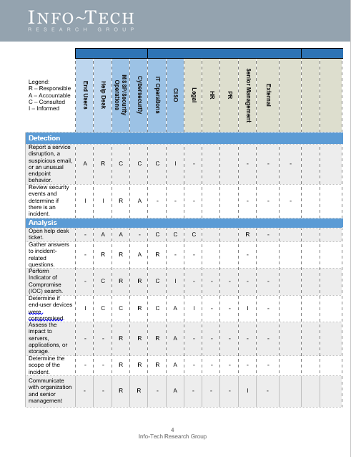
Assign roles and responsibilities for the threat management process (RACI)
1.9
1.9
Communications RACI Tool
Complete the Security Incident Communications Management RACI Chart inside the Information Security Incident Management Plan.
How to customize
Customize the header fields with applicable stakeholders.
Identify stakeholders that are:
Responsible: The person(s) who does the work to accomplish the activity; they have been tasked with completing the activity and/or getting a decision made.
Accountable: The person(s) who is accountable for the completion of the activity. Ideally, this is a single person and is often an executive or program sponsor.
Consulted: The person(s) who provides information. This is usually several people, typically called subject-matter experts (SMEs).
Informed: The person(s) who is updated on progress. These are resources that are affected by the outcome of the activities and need to be kept up to date.

Slide 30
Begin considering your message
1.10
You have to be 100% transparent with what’s happened. That doesn’t mean you need to drill down into the details that create any legal liability. But the employees should know everything, including the fact that you're not giving them all the details because of legal liability. That’s a fair thing; employees can understand that. 100% transparency gives your employees a sense of trust and confidence.
– Tracy Williams, President & CEO of Olmstead Williams Communications
Understand what to say and who to tell
Strike a balance
Consider the audience
Transparency is the best policy.
When things go wrong, it’s common to want to hide details – this is a mistake.
Be as honest as you can with all stakeholders, especially employees – they can be your best ally in a crisis.
If you must withhold details, admit, if possible, that you’re doing so and why.
Transparency must be balanced with a need-to-know policy.
Certain information may need to be withheld for legal or security reasons.
Use your organization’s threat escalation protocol to determine which stakeholders need to be informed – not all issues need to be made public.
Be sure that this protocol aligns with the organizations risk-tolerance profile.
A security incident leads to doubt and a loss of trust, and hiding details only adds to these feelings.
Be honest and be reassuring: stakeholders will be looking to you for leadership.
When addressing internal or external stakeholders, consider what you would want to hear.
Reminding them that you’re handling the issue and that you will support them through any difficulties helps to restore trust.

Slide 31
Seek to STAAR in your incident response communications
Effective communications are composed of the following elements:
Speed
Be the first to break the story. If the media beats you to it, it’ll seem like you’re hiding.
Transparency
Speed
Communicate open and honestly, even about the fact you can’t be open and honest.
Accuracy
Regularity
Transparency
Release information only when you are certain it is correct. Changing your story later on never looks good.
Accountability
Regularity
Take responsibility for the incident to help repair stakeholder trust. This isn’t necessarily admitting guilt, but do acknowledge your role in what happened.
Accountability
Accuracy
Update stakeholders regularly and set a date for the next update. Keep these commitments, even if you only report that there is no new information.

Slide 32

Avoid the mistakes Equifax made
CASE STUDY
Industry
Source
Finance
Packet Labs; ZDNet; CNBC
Situation
Response
Result
July 29, 2017 – Equifax, a credit monitoring company, discovered a massive data breach, exposing personal information, including credit card and social insurance numbers, on up to 143 million Americans.
Equifax may have been aware of the security vulnerability the hackers used to break in.
A patch was available to correct the vulnerability, but Equifax did not install it.
Both the patch and the vulnerability were publically reported to users of the affected software.
Equifax waited two months to disclose the breach, despite its scale and severity.
The company’s eventual notification was vague as to the affected data.
Equifax published a website to assist clients, but it was vulnerable to hacking – a big deal since users had to re-enter personal information to use it.
CBS News advised against calling Equifax to bypass the website process, as there was no way to guarantee that customer service reps weren’t using the site to help callers.
Equifax has been criticized by many customers for lacking transparency and for the poor support offered by the flawed website.
Equifax has been hit with many lawsuits, and their reputation has been seriously damaged.
By early September 2017, Equifax’s share price was down 6%.
Two Equifax executives have been charged with insider trading for deals made after learning of the data breach, but before it was publically disclosed.

Slide 33
Appreciate the techniques of Twitter and Under Armour
CASE STUDY
Industry
Source
Social Media; Retail
Twitter; The Verge; Under Armour; CNBC
Situation
Response
Result
May 3, 2018 – Twitter announced that it had detected a bug that caused users’ passwords to be stored without encryption.
Twitter had 330 million users who needed to be notified.
Twitter’s CTO tweeted a link to a blog post informing users of the situation and advising them to change their password.
This information also displayed when users activated the app.
A link was provided to make the process simple and quick.
Twitter had no reason to suspect an actual breach had occurred but wanted to keep users safe.
This proactive and transparent response shielded the company from reputational damage (and possibly a crisis).
March 25, 2018 – Under Armour became aware of a large data breach affecting users of its MyFitnessPal app.
Breach resulted in loss of usernames, email addresses, and hashed passwords.
Four days after learning of the breach, Under Armour notified affected users via email and the app’s instant messenger.
Then the company issued a press release explaining the situation and linking to a FAQ-style website.
Under Armour made the right communications moves to mitigate reputational damage – speed, transparency, etc.
Did not fully escape negative consequences: share price declined (but expected to recover), and lawsuits pending.

Slide 34
2
Develop Your Communications Plan
Master Your Security Incident Response Communications Program

Slide 35
Phase 2: Develop Your Communications Plan
PHASE 1
PHASE 2
1.1
1.10
2.1
2.10
Learn the Basics of Incident Response Communications
Begin Considering Your Message
Create an Internal Communications Plan
Consider Sharing Information With Your Peers
This step will walk you through the following activities: | This step involves the following participants:
Create an internal communications plan. Develop an external communications strategy. Draft the SIRT Policy. Run tabletop exercises. Track metrics. | IT/Cybersecurity leader Legal representative Public relations/communications specialist HR representative
Outcomes of this step
Internal communications plan. Interdepartmental communications template. External communications strategy. SIRT Policy. Sample tabletop exercises. Communications metrics tracking tool.

Slide 36
Phase 2 outline
Call 1-888-670-8889 or email GuidedImplementations@InfoTech.com for more information.
Complete these steps on your own, or call us to complete a guided implementation. A guided implementation is a series of 2-3 advisory calls that help you execute each phase of a project. They are included in most advisory memberships.
Guided Implementation 2: Master Your Security Incident Response Communication Program Proposed Time to Completion: 6-8 weeks
Step 2.1: Create an Internal Communications Plan | Step 2.2-2.10: Develop an External Communications Strategy
Start with an analyst kick-off call: Explore the elements of internal communications and their relationship to external communications. Review the most likely threats for your organization and plan to respond to them. Discuss challenges with internal communications and how to solve them. | Review findings with analyst: Discuss the external communications process, the value of a communications sequence, and how to manage fallout. Understand the role of social media in incident response. Outline how to implement tabletop exercises as part of training. Review elements of a strong SIRT Policy. Learn how to conduct an effective post-mortem review of the incident and how to track metrics.
Then complete these activities… Create an internal communications plan. Decide on an internal communication method. | Then complete these activities… Develop external communications strategy and SIRT Policy. Run tabletop exercises. Track incident response communications metrics.
With these tools & templates: Security Incident Response Interdepartmental Communications Template | With these tools & templates: Security Incident Communications Policy Template Security Incident Communications Guidelines and Templates Tabletop Exercises Package Security Incident Metrics Tool
Phase 1 Results & Insights: Develop both an internal and external communications plan suitable for your organization, based on its culture, politics, and risk tolerance. SIRT Policy. Communications training via simulated incident scenarios and the value of reviewing how the crisis was handled.

Slide 37
Create an internal communications plan
2.1
1. Introduce the SIRT (to each other)
The first step towards developing a good internal communications plan is to have SIRT members get used to interacting with each other so that members understand what issues are seen as important by each department the members come from. Consider using games that focus on teamwork and communication to help them get used to each others’ perspectives (e.g. office scavenger hunt).
2. Survey possible threats (inside and outside)
Using the template provided (step 1.8), develop a threat-escalation chart and assess who needs to be notified for each severity level. These decisions will be unique to each organization, but remember to strike a balance between transparency and need-to-know – especially when it comes to employees. It may be ideal to report all incidents to employees as way to teach them that the organization is not impenetrable and that they have a role to play in the organization’s security, but you shouldn’t overlook the possibility of an insider threat who you may be tipping off by openly communicating.
3. Establish a communication method (and a backup)
Communication is a major responsibility of the SIRT, so it is important that each member can easily contact the others, as well as stakeholders. Standard office communication may work well now, but if an attack knocks out the phone and email systems, you’ll need a backup. A backup communications method doesn’t need to be fancy; it just needs to efficient and reliable – a third-party email client, IM service, or cellular phones are all possible options. However, avoid using social media as a backup: it only takes one wrong click for the whole conversation to become public news.

Slide 38
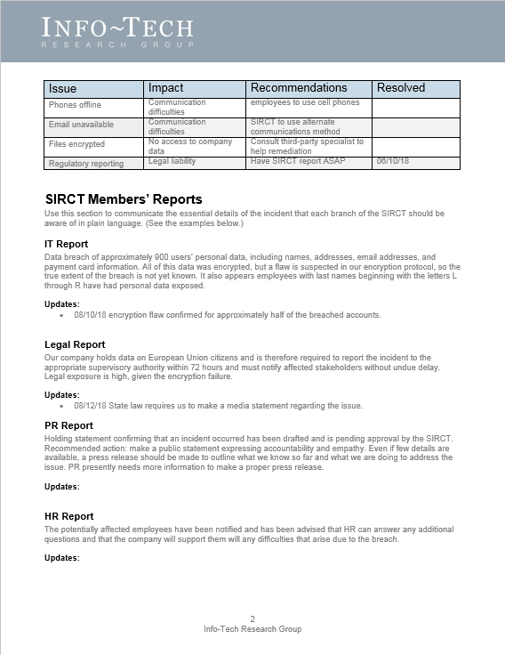
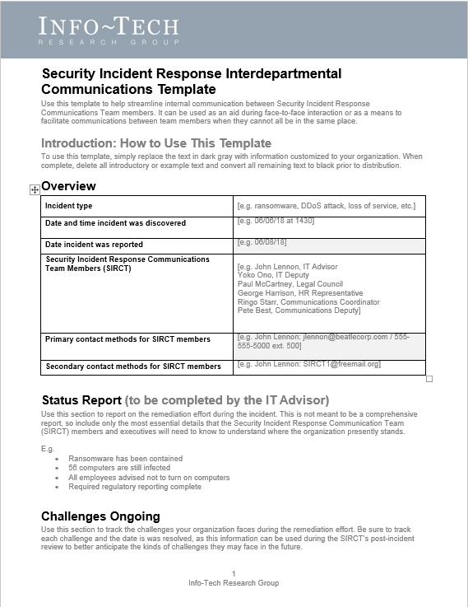
Customize the Security Incident Response Interdepartmental Communications Template
2.1
Security Incident Response Interdepartmental Communications Template
When it comes to communicating the specifics of an incident to all the involved personnel, it’s hard to beat a face-to-face meeting.
However, sometimes this just isn’t possible. Modern organizations are structured in ways that often prevent people from meeting in the same room as often as may be desired.
This doesn’t mean that communication has to stop until the SIRT can meet in person. In fact, there is no one-size-fits-all approach to incident response communications, and some organizations might be comfortable to coordinate these efforts remotely. It really depends on the organization in question and the ways they’re comfortable doing business.
However, even when all SIRT members are in the same place, communication can still be challenging, so it’s a good idea to have a communications record to fall back on, so that each team member can easily recover the information they need when they need it.
Regular communication between SIRT members is important. Use this template to communicate updates to other team members as soon as new information becomes available.
Remember to keep a copy of these exchanges for the post-incident review. They can be a valuable window into how to further improve communications between team members.
Customize this Communications Template to suit your organization’s needs and use it as a way to exchange and record information essential to the communications and remediation effort.

Slide 39
Develop an external communications strategy
2.2
Once the internal communications plan has been set, the SIRT will be ready to start strategizing external communications. There are six key things to remember for building an effective strategy:
1
Decide on a communications approval process
Your priorities for communicating in the immediate aftermath of a cyber incident need to be geared towards a long-term communications engagement . . . You have to set things up in such a way . . . so that when you get more information days, weeks, months down the road, you’re able to update your narrative, as opposed to chang[ing] your narrative.
– Loren Dealy Mahler, President, Dealy Mahler Strategies
External communications report on sensitive issues, so it is necessary to have a process in place to ensure that releasing certain information won’t make matters worse. Without a process in place, valuable time will be lost.
2
Evaluate communication mediums
You may need need to get your message out to a large number of people. There are a variety of options for doing this, but the medium you choose should fit the situation and the tone you’re trying to convey: social media works well to distribute a message quickly, but it is not likely the best place to notify people of a data breach.
3
Set an appropriate pace
Incident response communications are stressful, but don’t try to simply get them over with. It won’t be possible to communicate everything in a single message, so plan on releasing information piece by piece. Only share what you know for certain. If you change your story midway through the remediation, you may seem suspicious, or worse, incompetent – both of which will only further hurt public trust and the organization’s reputation.

Slide 40
Develop an external communications strategy continued
2.2
4
Prepare for media interactions
In some cases the media may be interested in interviewing members of your organization. Be sure to assign a spokesperson to interact with the media. It is also a good idea to accommodate media requests as much as possible. If you don’t, they may seek the information from other sources including lower-level employees, which is why it’s important to keep these employees informed about what they can and cannot say if asked for an interview.
Communicating is risky but necessary and very valuable if done correctly.
– Edward Gray, Lecturer, Ivey Business School at Western University
5
Focus on the right details
In the wake of a security incident, focus on rebuilding public trust. Avoid getting hung up on the specific details of who launched the attack and why. These details are important, but they are secondary to the incident’s impact on stakeholders, so keep this type of information brief and report it at the appropriate stage of the communications sequence. (More on this to come.)
6
Assess risk tolerance
Making decisions about what to disclose after an incident can be challenging. However, it is usually easier to repair reputational damage by adopting a position of honesty and accountability, as these are what stakeholders tend to value most after an incident.
Ultimately, what details you share and when are a matter of risk tolerance: communicating openly and not communicating at all both carry certain risks. To make the best choice, organizations need to take stock of their internal politics, culture, and the way they do business to make a decision that is consistent with these values.

Slide 41
Understand the usual sequence of external communications
The following is a typical sequence of basic external communications that organizations commonly release after an incident. Each phase of this sequence is used to expand on the previous one as new information becomes available.
Holding Statement
Holding statement: short statement issued to the public that confirms that an incident took place on a given day and time (if known) – used as a way to break your own bad news.
Because details are usually few immediately after an incident, these statements don’t typically contain many details, but they may announce when more information will be released.
Press Release
Press release: gives overview of the incident once enough details have been confirmed – fills in the gaps left by the holding statement, specifying what kind of incident occurred, what the effect of it was, who was affected, and what is being done to remediate the issue.
Several press releases may need to be issued to update stakeholders on the progress of the remediation effort.
Dark Site
Dark site: pre-built webpage that is kept offline until it is needed, then filled in with the relevant details about the incident – used to communicate directly with stakeholders affected by the breach; typically contains more specific information than a press release.
Commonly formatted like a FAQ page and explains what affected stakeholders need to know, what they need to do, and who they can contact for assistance.
Using this sequence helps to pace external communications to help ensure that only the confirmed details are released. But because each incident is different, the time between each step may vary from case to case. It is also possible that a press release and a dark site may be released at the same time if there is enough information available.

Slide 42
Use remediation stages to guide your communications schedule
There is no formula that indicates exactly the right moment to deliver news about a security incident. However, remediation stages make a convent roadmap – each time a new phase is entered, you will likely need to publish an update of some kind, though exactly what each message contains will vary from incident to incident.
Use the below as an example to plan your organization’s communications schedule. For more information on these remediation stages, consult Info-Tech’s Develop and Implement a Security Incident Management Program.
Detection
Analysis
Containment
Eradication
Recovery
Post-Incident Activities
Communication 1
Confirms that the incident occurred.
E.g. Holding statement
Communication 2
Outlines the incident type, but not specific details.
E.g. Press Release
Communication 3
Answers specific questions about the incident.
E.g. Dark site
Communication 4
Informs stakeholders on remediation effort’s progress.
E.g. Dark site update
Communication 5
Announces organization’s return to normal security.
E.g. Press release

Slide 43
Manage the fallout from the incident
2.3
As seen in the Under Armour data breach case study, some fallout after a security incident is unavoidable, and it can be tricky to manage.
Only 51% of respondents to Ponemon’s “Is Your Company Ready for a Big Data Breach?” study in 2018 indicated that they were confident in their breach response plans, with a majority listing the following reasons why they had doubts:
60%
64%
60%
75%
Not prepared to respond to data breach involving confidential information and intellectual property.
Inability to prevent negative public opinion, blog posts, and media reports.
Inability to prevent the loss of customers’ and business partners’ trust and confidence.
Inability to minimize the financial and reputational consequences of a material data breach.
According to Ponemon’s “2017 Cost of Data Breach Study” the average time to identify a data breach is 191 days.
It is important to recognize that dealing with a security incident effectively has a lot to do with having a strong security culture overall. The faster an incident is detected and dealt with, the lower the damage tends to be. This is why Twitter’s response was so effective.

Slide 44
Manage the fallout from the incident continued
2.3
Consumers are raising their expectations regarding data security.
73%
Report being more aware of data breaches than they were five years ago.
62%
Would blame the company that lost their data before the hacker who stole it.
82%
Of U.K. respondents would boycott a company that repeatedly mishandled and demonstrated a lack of respect for consumers’ data.
50%
Would be more likely to shop with a company that proves it takes data protection seriously.
There’s no such thing as successful incident response communications; strive instead for effective communications. There will always be some fallout after a security incident, but it can be effectively mitigated by being honest, transparent, and accountable.
Source: RSA, "Data Privacy and Security Report 2017.”

Slide 45
Manage the fallout from the incident continued
2.3
The way you talk about the incident can help to limit negative public perceptions.
What you say matters
Consider your words
Words are hard to take back, so be careful with the language you use when communicating an incident to stakeholders.
E.g. avoid referring to an incident as a breach until you are certain that an attacker breached your security and stole data.
Even when things go wrong, you can still sound like you know what you’re doing by speaking intelligently about the incident. The more precise you can be the better.
E.g. referring to your security incident as a “hack” doesn’t really tell stakeholders what happened. It may also imply that you don’t know either, which might suggest that your organization lacks essential cybersecurity knowledge and doesn’t know how to protect sensitive data.
Avoid spin
Honesty and transparency are important after a security incident, which means it is not a good idea to try to spin the incident (i.e. attempt to make it seem like something other than it really was).
This means putting your organization in a vulnerable position, but this is the first step towards rebuilding trust.
Communicating intelligently and precisely is not the same thing as using industry-specific language. Stakeholders need to understand what you’re trying to tell them, so strive to find a balance between being technical and being simplistic.
.
You won’t save face by withholding embarrassing details. Lying only makes a bad situation worse, but coming clean and acknowledging shortcomings (and how you’ve fixed them) can go a long way towards restoring stakeholders’ trust.

Slide 46
Consider customer compensation carefully
2.4
When clients or customers have been harmed as a result of a security incident, compensation may seem like a no-brainer. However, it is important to make sure that the gift actually addresses the harm done.
Health Care
CSO Online
CASE STUDY
Industry
Source
Allscripts – Ransomware
January 18, 2018 – Allscripts, a SaaS company providing electronic health records, was attacked with ransomware.
The attack left approximately 1,500 health care practices without service and they were unable to respond to patient needs, as prescription services and patient records were both unavailable for eight days.
The loss of service led to lost revenue for Allscript’s affected clients.
Allscripts attempted to smooth things over by giving affected clients a 33% credit on their monthly bill. But not all clients were satisfied by the offer.
"We all lost way more money with the system being down for 8 days then [sic] 33% of our monthly bill,” one client commented.
It was “a slap in the face,” said another.
Take away: because the gift did not meet expectations, it was seen as another sign of incompetence.
The Ponemon “2017 Cost of Data Breach Study” respondents reported that they would like the following after an incident:
Free identity theft protection and credit monitoring.
Discounts on products or services.
Access to a call center to respond to their concerns.
Sincere and personal apology (not a generic notification).
Gift cards.
72%
43%
37%
33%
42%

Slide 47

Appreciate the role of social media
2.5
Social media can be a very effective means of getting your message out to a wide audience, making it a useful tool for public relations efforts. However, it is not usually the best choice for informing with stakeholders about a security incident.
Social media is public in nature, yet security incidents deal with private personal information – the two don’t really mix. Nevertheless, social media still needs to be addressed during external communications planning.
Your organization may not want to use social media to broadcast its message, but that doesn’t mean others won’t use it as a platform to voice their feelings about the incident.
You’ll likely still have to post some sort of response on social media to manage the fallout from the incident.
This means that someone from your organization needs to be in charge of monitoring social media, which will help to gauge the public’s response to the incident: social media can let you know what you’re doing right and wrong.
The introduction of social media into the overall crisis space, beyond just the cyber realm, is a complete game changer, and it’s totally changed the way everyone has to respond to everything all the time . . . You have to say something; you can’t just stay quiet because people will say it for you.
– Loren Dealy Mahler, President, Dealy Mahler Strategies
When deciding how or if to use social media, consider your organization’s present relationship with it. If you already have an active social media presence, and your clients are used to receiving information that way, it may be an appropriate choice, but avoid using it simply because it’s trendy.

Slide 48
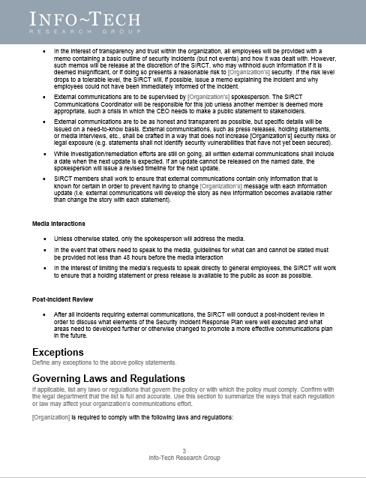
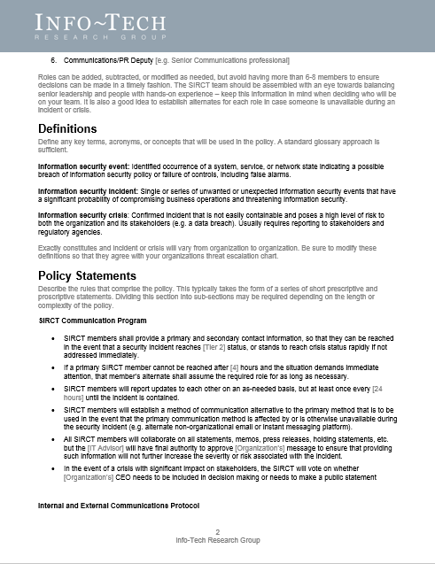
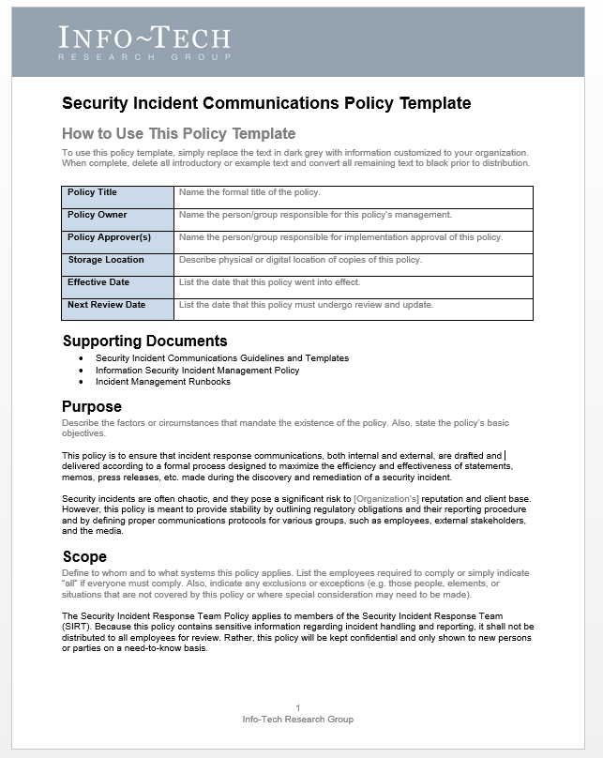
Draft the Security Incident Communications Policy Template
2.6
2.6
Security Incident Communications Policy Template
A strong communications policy outlines who is on the SIRT and defines the protocols they will need to follow, such as:
How long to wait before contacting an alternate.
Minimum frequency of updates.
What alternative communication method will be used if primary is offline.
Expectations for internal and external communications.
Customize the Security Incident Communications Policy Template to meet the needs of your organization by defining expectations and protocols for various aspects of incident response communications.
Drafting a policy helps to speed up and simplify your response process during an incident, which will help to save valuable time and offer some stability during a time of crisis. If these protocols are set in place beforehand, you’ll have to make fewer decisions during a stressful time.

Slide 49
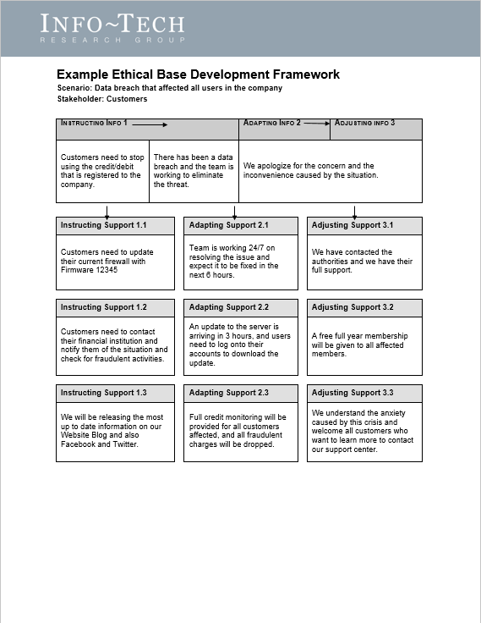
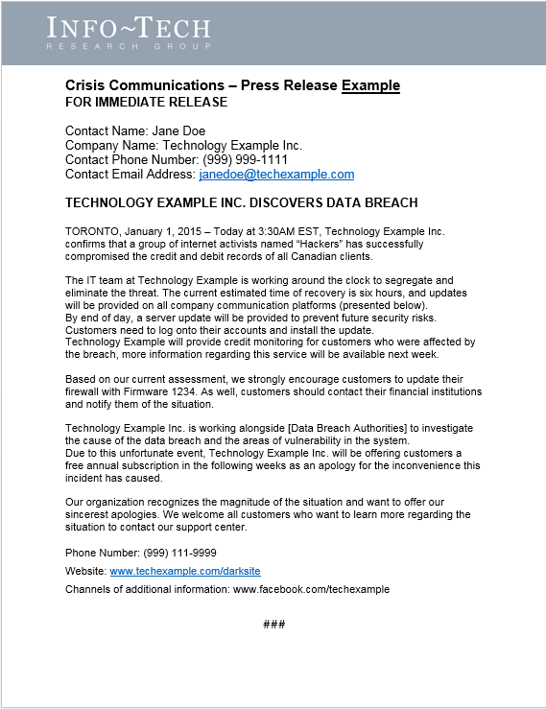
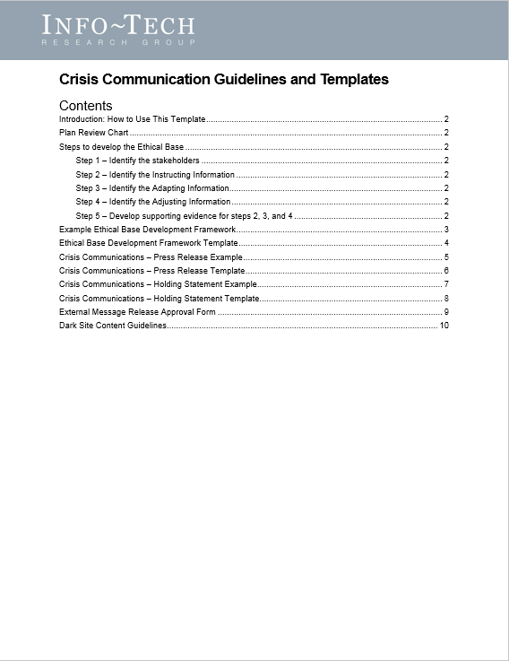
Customize the Security Incident Communications Guidelines and Templates
2.7
2.7
Security Incident Communications Guidelines and Templates
This package contains documents to help your organization with:
Outlining protocols for making effective external communications.
Drafting holding statements and press releases.
Creating an informative and useful dark site.
Implementing an external communications approval process.
The Security Incident Communications Guidelines and Templates contains both templates and examples, which will help you learn what information to include for each step of the communication sequence.
Customize these templates to suit your organization’s needs and use it as a way to begin planning your incident response communications.
Crafting holding statements, press releases, and dark sites takes time and effort. Be sure to have outlines for all of these essential communications before you need them. That way, when a crisis strikes all you’ll need to do is fill in the blanks and make small adjustments to the text.

Slide 50
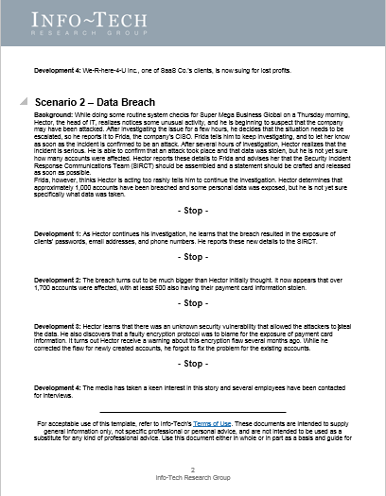
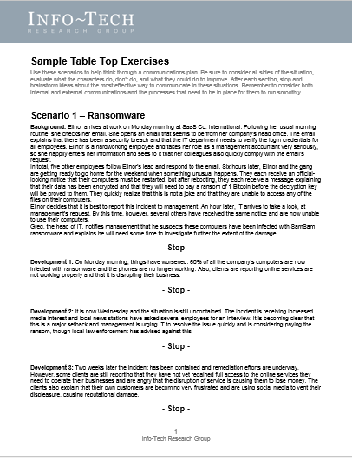
Run tabletop exercises to test the communications protocols
2.8
2.8
Tabletop Exercises Package
Foster relationships between SIRT members by letting them test the communication protocols they’ve laid out.
Tabletop exercises are one of the best ways to practice incident response. They are commonly used by IT professionals to practice working through a crisis situation from a technical standpoint. But they can also be used to streamline your communications effort.
Incident response has a lot of moving parts, so it is important to see them working in a controlled environment before needing to use them in the real world.
Doing tabletop exercises also helps to highlight gaps or oversights in your incident response communications planning. Thus, it is a good idea to run them a few times during the planning phase to make sure your plan is in good shape.
Once you have established a communications plan, it’s important to keep your team’s skills sharp. At a minimum, run a tabletop exercise once a year to make sure the SIRT is ready for the real event – especially if there are newly added members.
Try the exercises included in the Tabletop Exercises Package to get started, but don’t be afraid to create your own tabletop exercise to simulate the most likely threats for your industry.

Slide 51
Conduct a post-mortem review of the incident
2.9
Every incident offers new lessons, so make sure they don’t go to waste.
Tips for an effective post-mortem
Keep it brief – the post-mortem shouldn’t become a new source of stress. An afternoon should be more than enough time for a review.
Be supportive – chances are you won’t make it through a security crisis without a few scratches, but now is not the time lay blame or point fingers. The SIRT’s success depends on good relationships, so be sure to complement each other’s strengths.
Use constructive criticism – acknowledge where improvement could be made, but keep criticism constructive. Ultimately, every member on the team is responsible for its successes and failures.
Take notes – the point of the post-mortem is to learn, so make sure the important data is tracked so the SIRT can measure the response from one incident to the next.
Once a security incident is finally over, organizations usually want to get back to business-as-usual. However, it’s important to review the successes, mistakes, and lessons learned over the course of the incident remediation.
By holding a post-mortem review of the incident, the SIRT will have an opportunity to discuss what parts of the communications efforts worked well and what parts could be improved.
But to be effective, the post-mortem review needs to be scheduled as soon as possible after the incident or crisis has been wrapped up. This is so that SIRT members have clear memories of the events and how they handled each phase of the communications engagement.
The post-mortem review can also be a good way to boost the SIRT’s morale. Having the opportunity to discuss what members struggled with and what they did well can help them relax after the incident. This also can improve relationships between members, thereby enhancing their ability to communicate with each other.

Slide 52
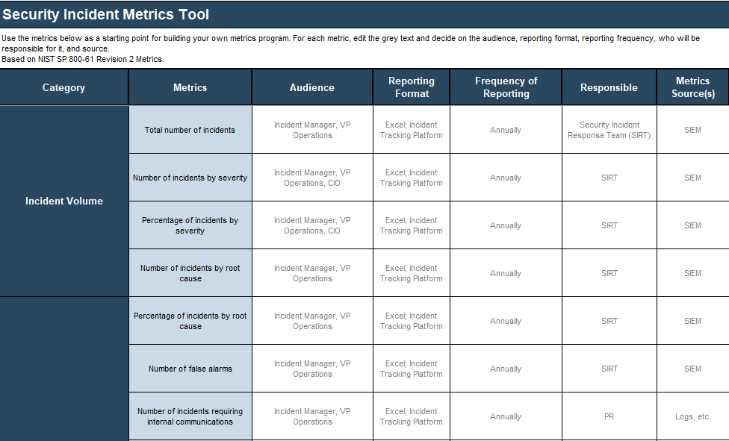
Track metrics for your incident response communications with the Security Incident Metrics Tool
2.9
Security Incident Metrics Tool
Part of your communications plan should be to track metrics related to the volume of communication types and the time spent preparing them for release.
By tracking this data, you’ll be able to see where efficiency could be improved, the costs associated with communications, and how the SIRT feels about their performance from incident to incident.
Customize this tool to reflect the metrics your organization values and who is responsible for tracking and reporting them.

Slide 53

Establish baseline metrics
Baseline metrics will improve through:
Increased communications efficiency: response time and approval processes will speed up after communications planning helps to streamline decision-making processes.
Increased awareness of the challenges associated with each incident type: effectiveness of the response will improve as the communications team becomes more familiar with what needs to be done and how to do it.
Defined threat escalation protocol: knowing who needs to be contacted and when takes a lot of the guesswork out of incident response.
Metric Description | Current Metric | Future Goal
Number of security events per year | 175 | 30
Number of security incidents per year | 61 | 20
Average time spent on communications approval (in days) | 3 | 1
Average time to issue a holding statement (in days) | 10 | 3
Average severity of fallout on social media (out of 10) | 7.5 | 3
Other metric
Other metric
Other metric
Other metric
Other metric
Other metric
Sample

Slide 54
Consider sharing information with your peers
2.10
There’s safety in numbers.
In some industries, such as finance, it’s common to share incident information with peers who are also in the industry.
The idea here is that every organization within that industry faces the same kinds of threats: if everyone shares their incident experiences, it increases the security of the industry as a whole by helping others to prepare for similar threats.
If you have contacts at other organizations within your industry, consider reaching out to them about sharing security incident data. Sometimes you can gain valuable insights into how to improve your own security culture by talking to others about theirs.
Ponemon’s 2018 “Is Your Company Ready for a Big Data Breach?” study found that:
77%
of organizations believe sharing data breach information helps to foster collaboration among peers and industry groups.
53%
suggest that sharing breach information improves security posture for their organization.
27%
argue that sharing information enhances timeliness of incident response.
24%
Claim that sharing information improves the effectiveness of their incident response plan.

Slide 55
Insight breakdown
There’s no such thing as successful incident response communications.
There will always be some fallout after a security incident, so strive instead for effective incident response communications: fallout can be managed through honesty, transparency, and accountability.
There are two types of incident response communications: internal and external – your message may have to be adapted for each stakeholder group.
Effective external communications begin with effective internal communications.
SIRT members come from departments that don’t usually work closely with each other. This means they often have different ways of thinking and speaking about issues.
Be sure they are used to communicating with each other before a crisis occurs: this is the first step towards crafting a message to inform other stakeholder groups of the details they need to know.
You won’t save face by withholding embarrassing details.
Lying only makes a bad situation worse, but coming clean and acknowledging shortcomings (and how you’ve fixed them) can go a long way towards restoring stakeholders’ trust.
If you can’t share all of the details with stakeholders, admit that you’re not giving them all the details and why (e.g. legal or security risks).

Slide 56



Summary of accomplishment
Knowledge Gained
Processes Optimized
The role of communications in security incident response.
The two types of communications (i.e. internal and external) and the forms they commonly take.
How to prepare for incident response communications.
The link between effective internal and external communications.
Consideration of likely security threats.
Value of a STAAR approach to communications.
How to create a communications plan.
How to manage incident fallout.
Considerations regarding the use of compensation.
The role of social media.
How to run an effective post-mortem.
Communications approval process.
Definition of communications team’s roles and responsibilities.
Establishing the SIRT.
Formalizing documents and protocols.
Tracking communications metrics.
Streamlining relationship between internal and external communications.
Meeting reporting obligations.
Deliverables Completed
Threat Escalation Chart
Communications RACI Tool
Security Incident Response Interdepartmental Communications Template
Security Incident Communications Policy Template
Security Incident Communications Guidelines and Templates
Tabletop Exercises Package
Security Incident Metrics Tool

Slide 57


Research contributors and experts
Headshot
Loren Dealy Mahler, President
Dealy Mahler Strategies LLC
Glendalynn Dixon, Consultant, Facilitator, Advisor
Technology Industry

Slide 58


Research contributors and experts
Edward Gray, Lecturer
Ivey Business School at Western University
Céline Gravelines, Senior Research Manager
Info-Tech Research Group

Slide 59


Research contributors and experts
Headshot
Keith Marnoch, Director, Media & Community Relations
Western University
TJ Minichillo, Global Head Cyber Intelligence & Analytics
Energy Industry

Slide 60


Research contributors and experts
Headshot
Tracy Olmstead Williams, President & CEO
Olmstead Williams Communications
Frank Sargent, Director, Executive Advisor, Security, Risk & Compliance
Info-Tech Research Group

Slide 61


Research contributors and experts
Headshot
Sean Thurston, Senior Director, Security, Risk & Compliance
Info-Tech Research Group
Frank Trovato, Research Director
Info-Tech Research Group

Slide 62

Research contributors and experts
Rita Zurbrigg, Senior Consulting Analyst Info-Tech Research Group

Slide 63


Related Info-Tech research
Develop and Implement a Security Incident Management Program
Create a scalable incident response program without breaking the bank.
Implement Crisis Management Best Practices
Don’t be another example of what not to do. Implement an effective crisis response plan to minimize the impact on business continuity, reputation, and profitability.

Slide 64
Bibliography
Agrawal, Parag. "Keeping Your Account Secure." Twitter, 3 May 2018. Web.
Aielle, Chloe. "Under Armour Says Data Breach Affected 150 Million MyFitnessPal Accounts." CNBC, 29 March 2018. Web.
Cisco. “2017 Security Benchmark Study.” Annual Cybersecurity Report: Chief Security Officers Reveal True Cost of Breaches and the Actions Organizations Are Taking. Cisco, 2017. Web.
DeNisco Rayome, Alison. “DDoS Attacks Increased 91% in 2017 Thanks to IoT.” Tech Republic, 20 Nov. 2017. Web.
Egan, Gretel. “2018 State of the Phish: Phishing Data, Insights, and Advice.” Wombat Security, 18 Jan. 2018. Web.
Gartenberg, Chaim. "Twitter Advising All 330 Million Users to Change Passwords After Bug Exposed Them in Plain Text." The Verge, 3 May 2018. Web.
GDPR Article 4(2), 6. “Article 4 EU GDPR ‘Definitions’.” Privazy Plan, n.d. Web.
Moyer, Liz. "Another Ex-Equifax Employee Is Being Charged With Insider Trading Related to Data Breach." CNBC, 28 June 2018. Web.
Packet Labs. "Equifax Data Breach." Packet Labs, 27 Sept. 2017. Web.
Ponemon Institute, "2017 Cost of Data Breach Study.” Ponemon Institute, June 2017. Web.
Ponemon Institute. “Is Your Company Ready for a Big Data Breach?” Experian, 21 Feb. 2018. Web.
Ragan, Steve. "Customers Describe the Impact of the Allscripts Ransomware Attack." CSO, 17 April 2018. Web.
RSA. "Data Privacy and Security Report 2017.” RSA, 25 May 2018. Web.

Slide 65
Bibliography
Under Armour. "Under Armour Notifies MyFitnessPal Users of Data Security Issue.” Cision, 29 March 2018. Web.
Under Armour. "MyFitnessPal Account Security Issue: Frequently Asked Questions.” MyFitnessPal, n.d. Web.
Verizon. “2017 Data Breach Investigations Report.” Verizon, n.d. Web.
Whittaker, Zack. "Equifax's Credit Monitoring Site Is Also Vulnerable to Hacking." ZDNet, 12 Sept. 2017. Web.

