Slide 1
Difference-in-Differences
Two-way fixed effects, the 2 × 2, and the parallel-trends assumption
Week 8 · QMSS 75000 / SOC 81900 · October 22, 2026
Edwin Grimsley, Ph.D.
Notes:
Tonight: start from last week's fixed effects, build difference-in-differences as two-way fixed effects with two groups and two periods, then spend most of the time on the one assumption everything rests on: parallel trends. Readings: The Effect ch. 18; Card & Krueger (1994); Kessler & Roth (2014).

Slide 2
A fixed effect is just a separate intercept for each group
WHERE WE LEFT OFF · FIXED EFFECTS, SLOWLY
Adding store fixed effects = giving every store its own dummy variable.
Anything about a store that never changes gets soaked up by its dummy: its size, its location, its manager's style. Measured or not.
Adding year fixed effects = giving every year its own dummy variable.
Anything that hits every store the same way that year gets soaked up: a recession, the season, a new survey question.
Removes confounding from… | No FE | Unit FE (one-way) | Two-way FE
Stable differences between units (NJ stores are smaller) | ✗ | ✓ | ✓
Shocks that hit everyone in a period (a bad year) | ✗ | ✗ | ✓
Something that changes only for treated units, at the same time as treatment | ✗ | ✗ | ✗
"One-way" = one set of dummies. "Two-way" = two sets: unit AND time.
The last row is what's left over. Two-way fixed effects can't remove it, so we have to assume it away: that's parallel trends.
In R (fixest): one-way feols(y ~ D | store) · two-way feols(y ~ D | store + year)
Notes:
Start here because last week the one-way vs. two-way distinction didn't land. A fixed effect is nothing fancier than a dummy for each group. 'One-way' means one set of dummies, usually one per unit. 'Two-way' means two sets: one per unit and one per time period. The table is the whole story: each set of dummies removes one kind of confounding. The bottom row, a change specific to the treated group at the moment of treatment, is never removed. Everything else in tonight's lecture is about that row.

Slide 3
One-way: compare each state with itself
WORKED EXAMPLE · CARD & KRUEGER'S FOUR NUMBERS
Workers per store | Feb 1992 | Nov 1992 | Change
New Jersey (law) | 20.44 | 21.03 | +0.59
Pennsylvania | 23.33 | 21.17 | −2.17
The problem
One-way FE credits the law with all of New Jersey's change from February to November.
But Pennsylvania, with no new law, lost 2.17 workers per store over the same months. Something hit fast-food jobs everywhere: the season, the economy.
One-way FE has no way to see that. It's a before/after comparison with stable differences removed.
With state fixed effects, the 2.9-worker gap between the states (23.33 vs. 20.44) drops out. Good: that gap was there before the law.
What's left for New Jersey is its own change: +0.59.
One-way FE here = compare New Jersey in November with New Jersey in February.
Notes:
Use the four numbers students will compute in the lab. With state fixed effects, the level difference between NJ and PA is gone, which is what we want. But all that is left for NJ is its own before/after change, +0.59. One-way fixed effects silently assumes nothing else changed between February and November. Pennsylvania tells us that's false: stores there lost two workers each with no law.

Slide 4
Two-way: also subtract what happened to everyone that year
WORKED EXAMPLE · ADD THE YEAR DUMMIES
Workers per store | Feb 1992 | Nov 1992 | Change
New Jersey (law) | 20.44 | 21.03 | +0.59
Pennsylvania | 23.33 | 21.17 | −2.17
Two-way estimate |  |  | +2.75
The punchline
State dummies remove the stable gap between states.
Year dummies remove the shock that hit both states.
Two-way fixed effects with a treatment dummy IS difference-in-differences.
It works only if Pennsylvania's −2.17 is what New Jersey would have done without the law.
The November year effect is learned from the state without the law: Pennsylvania's −2.17.
Two-way FE removes it from New Jersey's change: +0.59 − (−2.17) = +2.75.
feols(fte ~ nj:post | store + wave) in Lab 7 gives 2.75: same number.
Notes:
Now add year dummies. Because only NJ is treated, the November effect is identified from Pennsylvania: it says November is 2.17 lower than February for a store without the law. Take that out of NJ's change and you get 2.75. That is the difference-in-differences. So when people say 'two-way fixed effects' in a policy paper, in the simplest case they mean exactly this. And the last line is the bridge to the rest of the lecture: the whole thing rests on PA's change being the right stand-in for NJ's.

Slide 5
Two comparisons, each removing one problem
THE EFFECT 18.1.1
1
2
3
Within each group, before vs. after
Across groups, compare those changes
What's left is the effect
Compare a group with itself. Removes everything fixed about that group, like Week 7's unit fixed effects.
The untreated group's change shows what 'whatever else happened' looks like.
DiD = (change in treated) − (change in untreated)
But: the change also includes whatever else happened over time.
Subtract it from the treated group's change.
Valid only if the untreated group's change is the right stand-in. That is parallel trends.
Huntington-Klein, The Effect, ch. 18.1: "across-within" variation.
Notes:
Huntington-Klein's phrase is across-within variation. The within part is the before-after comparison for one group. The across part compares those before-after changes between groups. Each difference removes one kind of confounding: the first removes stable group differences, the second removes common time shocks.

Slide 6
John Snow, 1854: the first difference-in-differences
THE EFFECT 18.1.2: DIRTY WATER
Cholera death rate | 1849 | 1854 | Change
Lambeth customers (switched to clean water) | 130.1 | 84.9 | −45.2
Other companies (still dirty water) | 134.9 | 146.6 | +11.7
Difference-in-differences |  |  | −56.9
What happened
Between the two epidemics, the Lambeth company moved its water intake upstream, above London's sewage.
Deaths fell among Lambeth's customers and rose elsewhere. Snow credits clean water with the gap between the two changes, not with the whole drop.
The assumption: without the switch, Lambeth would have risen like everyone else.
Lambeth's own drop (−45.2) understates the effect, because 1854 was a worse year for everyone (+11.7).
Data: snow (causaldata package), from Snow's comparison of London water companies; the example in The Effect, ch. 18.1.2.
Notes:
Snow compared households served by different water companies in the 1849 and 1854 epidemics. Lambeth moved its intake upstream in between. A simple before/after for Lambeth says deaths fell 45. But other households saw deaths rise 12, so the epidemic year itself was worse. The DiD is −57. Ask: what has to be true for +11.7 to be what Lambeth would have experienced?

Slide 7
The 2 × 2 table and the regression that reproduces it
FOUR NUMBERS, TWO DIFFERENCES
 | Before | After
Untreated | b0 | b0 + b2
Treated | b0 + b1 | b0 + b1 + b2 + b3
Read each coefficient
b0 untreated group, before
b1 gap between groups before: allowed to be anything
b2 untreated group's change: the stand-in for 'what else happened'
b3 the difference-in-differences
With many groups and periods, Treated and After become group and time fixed effects: two-way fixed effects (The Effect 18.2.1).
Y = b0 + b1·Treated + b2·After + b3·(Treated × After) + e
(Treated after − Treated before) − (Untreated after − Untreated before) = (b2 + b3) − b2 = b3
In R: feols(y ~ treated * after, data, cluster = ~ group), or feols(y ~ treated:after | group + period, ...).
Notes:
Fill in the cells from the regression. b1 is the pre-period gap, which can be anything: DiD does not need the groups to look alike before. b2 is the untreated group's change, which is our estimate of what would have happened to the treated group anyway. b3 is the extra change in the treated group. Generalize: replace Treated with group dummies and After with period dummies and you have two-way fixed effects.

Slide 8
Difference-in-differences in the wild
THE EFFECT, CH. 18 AND BEYOND
Snow (1855)
Card (1990)
Card & Krueger (1994)
Cholera in London
The Mariel boatlift
The minimum wage
Lambeth's customers vs. other water companies, before and after Lambeth moved its intake upstream.
125,000 Cubans arrived in Miami in 1980. Wages and jobs in Miami vs. similar cities (the book suggests Atlanta or Tampa), before and after.
New Jersey fast-food jobs vs. Pennsylvania, before and after NJ's 1992 increase. Tonight's lab.
Kessler & Roth (2014)
Legewie & Fagan (2019)
Organ donation
Aggressive policing
California vs. 26 states, before and after California's 2011 switch to active choice. The book's main example; tonight's lab.
Students' test scores in NYC police "impact zones" vs. zones designated in other years. Staggered rollout. Next week.
Same recipe every time: a treated group, an untreated group, before and after. The Effect 18.1; Card (1990), ILR Review 43(2).
Notes:
Give students a sense of range. Same structure every time: one group gets a policy or shock, another doesn't, and we compare changes. Huntington-Klein uses Snow, Kessler and Roth, and Card's Mariel boatlift study, where he discusses which cities would make a good comparison for Miami. Ask: for the boatlift, what makes a city a good comparison? (Similar labor market trends before 1980, not itself hit by a migration shock.)

Slide 9
Did New Jersey's 1992 minimum wage increase cost jobs?
LAB 7 · CARD & KRUEGER (1994)
The 2 × 2
New Jersey: +0.59
Pennsylvania: −2.17
DiD: +2.75 workers per store
(SE 1.31, p = .04)
Standard theory predicted job losses. Card and Krueger found none.
NJ stores were smaller to begin with. That's fine: the design compares changes, not levels.
Card & Krueger (1994), AER 84(4); 410 fast-food restaurants, original survey data. Our numbers match their Table 3.
Notes:
Tonight's lab. 410 restaurants, surveyed in February and November 1992. New Jersey employment rose slightly; Pennsylvania's fell. The DiD is +2.75 full-time-equivalent workers per store. Point out the level gap before: PA stores were bigger. The DiD does not care about that; b1 absorbs it.

Slide 10
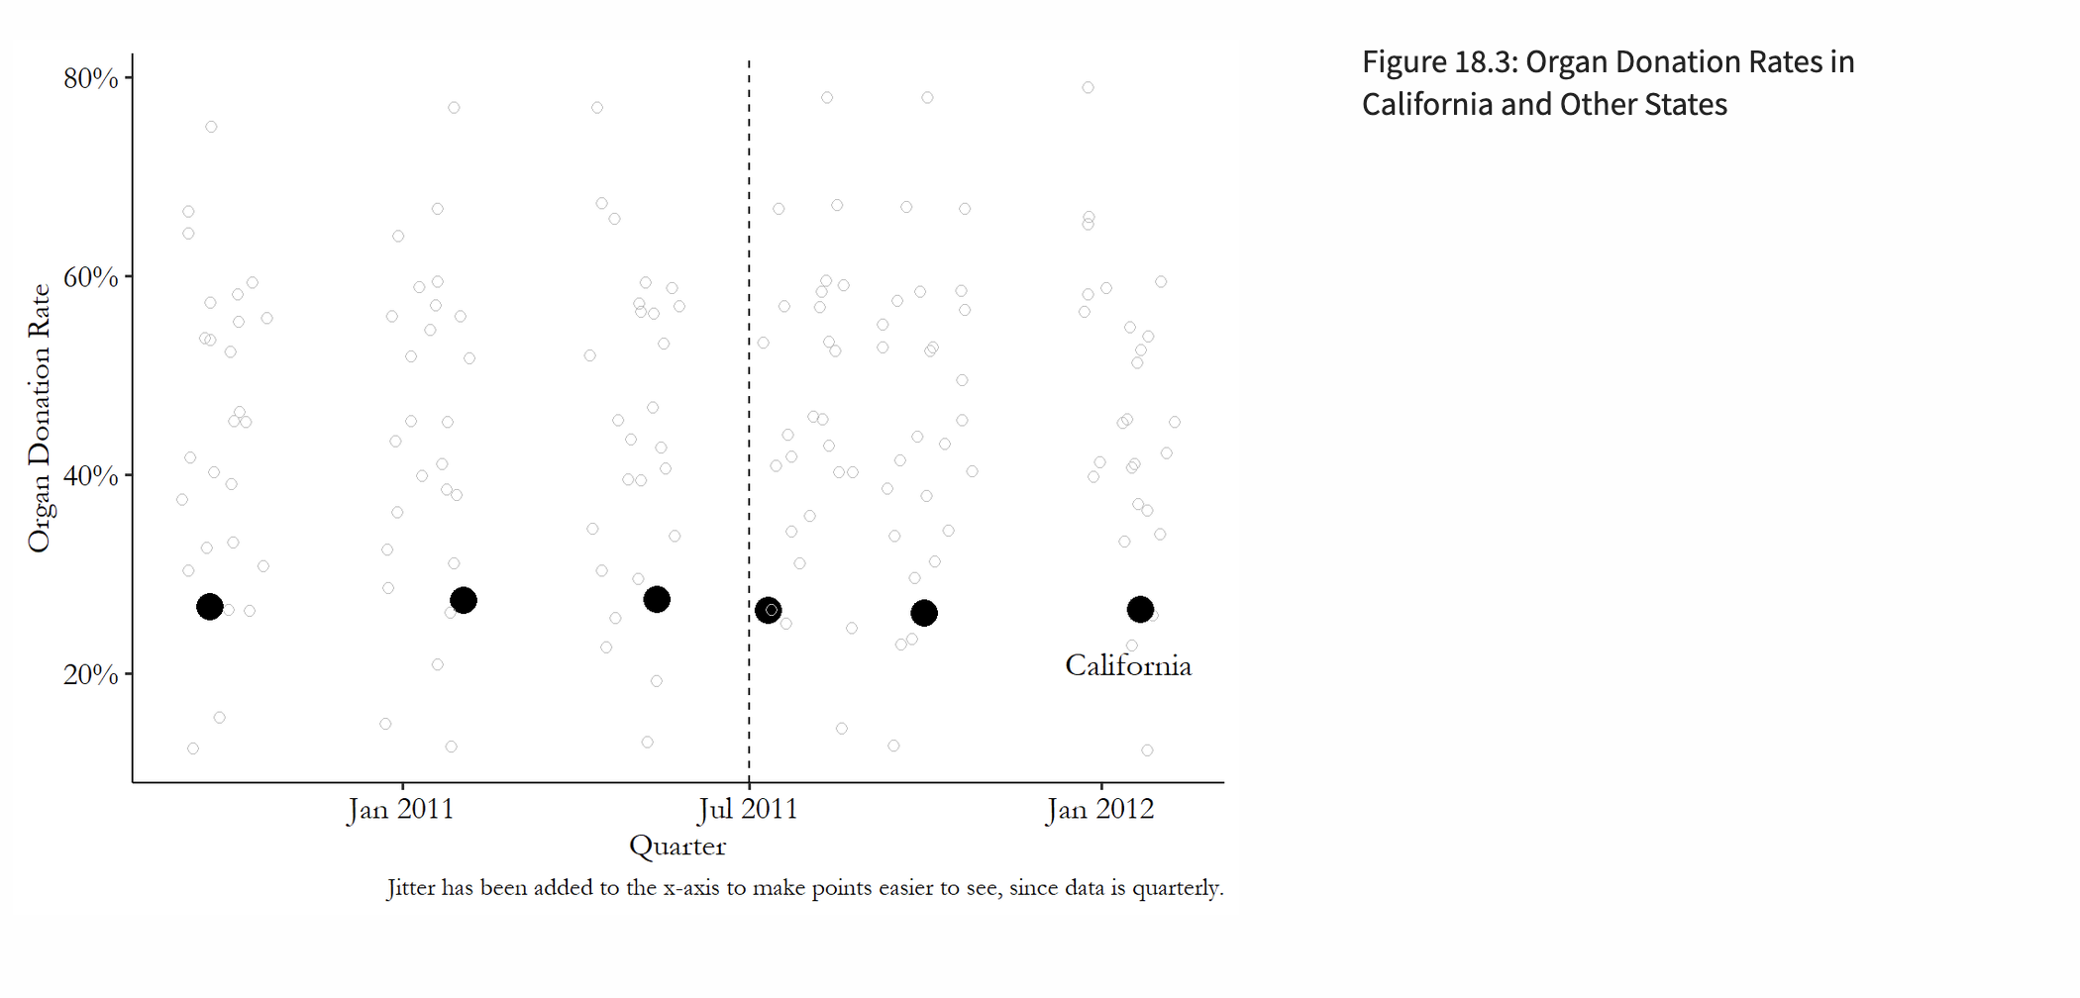

Slide 11
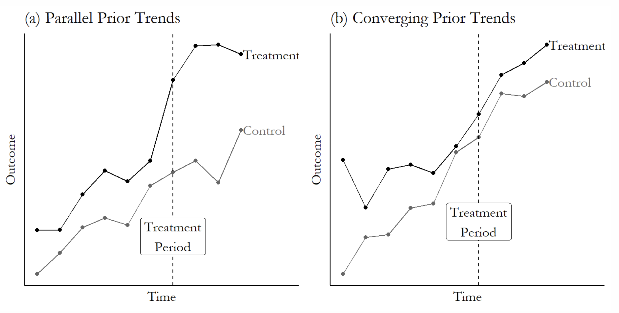

Slide 12
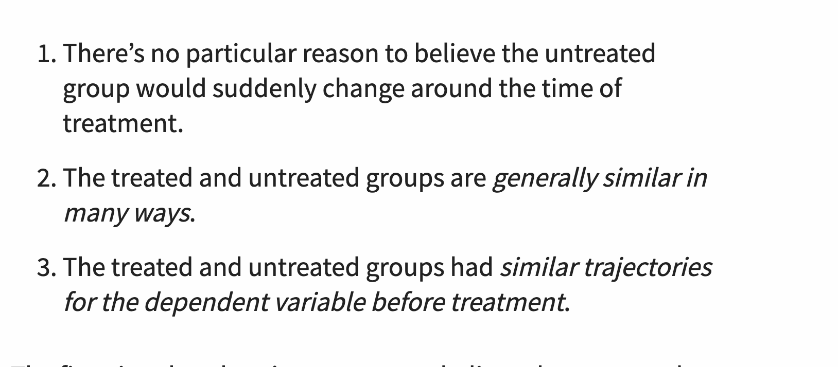
The Effect on Parallel Trends

Slide 13
What parallel trends requires, and what it doesn't
GETTING THE ASSUMPTION RIGHT
Doesn't require equal levels
Does require equal changes
NJ stores were smaller than PA's, and California's donor rate is far below other states'. Level gaps are differenced away.
Without treatment, both groups would have moved by the same amount over the same window.
Is about the after period
Depends on the scale
Matching trends before treatment is evidence, not proof. A shock that coincides with treatment breaks it.
Parallel in levels and parallel in percentages can't both hold if levels differ. Choosing logs vs. levels is a substantive choice.
The Effect 18.1.4 and 18.2.3.
Notes:
Four points students mix up. Different levels are fine. Equal counterfactual changes are required. The assumption concerns the post period, so pre-period evidence only makes it more plausible. And it is scale-dependent: if NJ and PA start at different levels, parallel in counts implies non-parallel in percentages. Last week's homework (the city comparison in Bertrand and Mullainathan) made the same point about scale.

Slide 14
Choosing the untreated group
THE EFFECT 18.1.4
A good comparison group…
Card & Krueger's second comparison
faces the same shocks as the treated group (same region, same industry, same season)
is not itself affected by the treatment (no spillovers: did NJ workers commute to PA?)
had similar trends before treatment, when you can check
isn't hit by its own shock at the same time (in the sourdough homework, think about which search terms COVID also changed)
Stores already paying $5.00+ were barely affected. Two comparison groups with different weaknesses agree, so a shared bias is less likely.
Lab 7, optional section. Card & Krueger (1994), Table 3.
Notes:
The comparison group is a design choice, not something the data hand you. Pennsylvania shares the regional economy but is a different state. High-wage NJ stores share New Jersey but are different kinds of stores. If both comparisons give similar answers, it is harder to tell a story where both are biased the same way.

Slide 15
Supporting parallel trends: what you can actually check
THE EFFECT 18.2.3
1
Plot it
Graph both groups' outcomes over several periods before treatment. Do they move together?
2
Test prior trends
In the pre-period only, regress Y on time × treated. A clear slope difference is a warning.
3
Placebo date
Pretend treatment happened earlier, using only pre-period data. The "effect" should be about zero.
4
Placebo group or outcome
Run the same DiD on groups or outcomes the policy couldn't have touched. Example: two untreated Pennsylvania regions.
None of these proves the assumption: they test the before period. Card and Krueger had one period before the law, so they could do almost none of this.
Notes:
These are the four checks students should reach for, and they all appear in tonight's lab or homework. Stress the limit: every check is about the pre-period or about units that should not respond. They raise or lower our confidence; they cannot verify the counterfactual.

Slide 16
A study where you can see the trends before treatment
THE EFFECT 18.1–18.2 · KESSLER & ROTH (2014)
The policy
In July 2011 California's license form switched to active choice: applicants must answer yes or no to registering as a donor.
Three quarters before, three after
Before Q3 2011 the lines are roughly parallel; after, California falls while the others rise.
DiD: −2.2 points (SE 0.6)
Data: organ_donations (causaldata package), from Kessler & Roth (2014); the worked example in The Effect, ch. 18. Lab 7, Part 3.
Notes:
Unlike Card and Krueger, we have several quarters before the policy. California's level is much lower, but what matters is that before July 2011 the lines move together. Afterward California's rate falls about 2 points relative to the comparison states: active choice lowered registration.

Slide 17
Event study: one difference-in-differences per period
FROM ONE NUMBER TO AN EVENT STUDY
How to read it
Each bar is a 2 × 2 comparing that quarter with Q2 2011.
Before (leads): −0.3 and +0.6 points. Small, so no sign of diverging trends.
After (lags): about −2 points, and it stays there. The effect is immediate and lasting.
Next week: event studies with staggered timing (Legewie & Fagan).
feols(Rate ~ i(quarter, california, ref = "Q22011") | State + Quarter, cluster = ~ State). The Effect 18.2.3–18.2.4.
Notes:
The event study replaces one After dummy with a separate dummy for each period, all relative to the last pre-period. The pre-period bars are the parallel-trends check; the post-period bars show how the effect evolves. One honest wrinkle: the Q1 2011 lead is 'significant' with clustered SEs from only 27 states, but it is a quarter of a point next to a 2-point effect. Judge pre-trends by size, not stars.

Slide 18
Controls and standard errors in difference-in-differences
THE EFFECT 18.2.5 AND INFERENCE
Controls
Standard errors
Fixed effects already handle stable group traits and common shocks. Most controls add little.
Never control for something the treatment could change (Week 2: bad controls). In Card and Krueger, that's a store's wage after the law.
A control earns its place if it changes differently across groups over time and isn't caused by the treatment.
Cluster at the level treatment is assigned: store or state, not observation.
Repeated observations of the same unit are correlated, so ordinary SEs are too small.
Clustering needs many clusters. With one treated state, or three search terms, clustered SEs aren't reliable (Homework 5, Q10).
The Effect 18.2.5; Bertrand, Duflo & Mullainathan (2004) on serial correlation in DiD standard errors.
Notes:
Two practical points. Controls: the fixed effects do most of the work, and post-treatment controls are actively harmful. Inference: cluster at the level of treatment assignment; with very few clusters, even clustered SEs mislead. California is one treated state, which is why Kessler and Roth's design is stronger on bias than on precision.

Slide 19
When treatment rolls out at different times
THE EFFECT 18.2.6: ROLLOUT DESIGNS
Broadband arrives | 2000 | 2001 | 2002 | 2003 | 2004
King County (2001) | – | ✓ | ✓ | ✓ | ✓
Pierce County (2002) | – | – | ✓ | ✓ | ✓
Snohomish County (2003) | – | – | – | ✓ | ✓
What two-way FE quietly does
OK: Pierce in 2002 vs. Snohomish (not yet treated).
Problem: Snohomish in 2003 vs. King and Pierce, which are already treated.
If broadband's effect keeps growing, King and Pierce are still changing because of treatment, so they're not a clean "untreated" trend. The estimate can be badly off, even negative when every county benefits.
The book's example: outcome = new businesses formed. Each county's own before/after is a fine DiD. The trouble starts when you pool them in one two-way fixed-effects regression.
Huntington-Klein calls this "the secret shame of econometrics" (The Effect 18.2.6). Goodman-Bacon (2021).
Notes:
Use the book's broadband example. Each county on its own gives a fine before/after comparison. But a single two-way fixed-effects regression averages all possible 2 × 2 comparisons, including ones where an already-treated county plays the control. If effects change over time, those comparisons are contaminated: the already-treated county's outcome is still moving because of its own treatment. Goodman-Bacon showed the TWFE estimate is a weighted average of all these comparisons, and some weights can push the estimate the wrong way.

Slide 20
Fixes for staggered timing, and next week
THE EFFECT 18.3.1: DOING IT RIGHT
1
Diagnose
Goodman-Bacon decomposition: how much of the estimate comes from already-treated controls?
Next week · Week 9
Legewie & Fagan (2019)
NYC designated police "impact zones" in phases from 2004 to 2012: a staggered rollout. Did living in one lower Black boys' test scores?
We'll run their event study and ask which comparisons it relies on.
R: bacondecomp
2
Compare cohorts only to clean controls
Callaway & Sant'Anna: a separate DiD for each adoption cohort and year, using never- or not-yet-treated units, then average.
R: did
3
Model the dynamics
Sun & Abraham; Wooldridge's extended two-way FE: interact treatment timing with cohort.
R: fixest::sunab, etwfe
4
Impute the counterfactual
Borusyak, Jaravel & Spiess: predict each treated unit's untreated outcome from untreated data, then compare.
R: didimputation
Callaway & Sant'Anna (2021); Sun & Abraham (2021); Wooldridge (2021); Borusyak, Jaravel & Spiess (2024). See also Roth et al. (2023).
Notes:
Students don't need to master these estimators tonight. The point: the design (staggered adoption) is fine; the default regression is the problem. The modern fixes all do the same thing in different ways: make sure each treated cohort is compared only with units that are not (yet) treated. We'll see this next week with Legewie and Fagan's staggered impact-zone designations.

Slide 21
Takeaways and tonight's work
1
DiD is two-way fixed effects with a treatment
Unit fixed effects remove stable differences; time fixed effects remove common shocks.
2
Everything rests on parallel trends
The untreated group's change has to be the right stand-in for the treated group's counterfactual.
3
You can support it, never prove it
Plot pre-trends, test them, run placebos, try a second comparison group.
4
Tonight: Lab 7 · Due Oct 29: Homework 5
Lab: three outputs (the 2 × 2, the regression table, the event study). Homework: sourdough and COVID lockdowns.
Notes:
Close by sending them into the lab. Lab 7 has three outputs to submit: the 2 × 2 table, the regression table and the organ-donation event study. Homework 5 is due October 29. Next week's reading: Legewie and Fagan (2019).

