Slide 1
When a rule draws the line: regression discontinuity
Week 10 · Causal Analysis, CUNY Graduate Center (QMSS)
Notes:
Two weeks of DiD compared groups over time. Today: when treatment is assigned by a cutoff on a score, the people just on either side of the line make the comparison.

Slide 2
Where RD fits among the designs we've used
 | RCT | Matching / FE | DiD | RD
Who gets treated | A coin flip | Anyone; we observe why | Some units, at some time | A rule: score above a cutoff
Comparison | Treatment vs. control | Treated vs. similar untreated | Change in treated vs. change in comparison | Just above vs. just below the cutoff
Key assumption | Randomization worked | No unmeasured confounders | Parallel trends | Continuity: only treatment jumps at the cutoff
What you learn | Average effect | Average effect, if adjusted well | Effect for the treated | Effect at the cutoff only
Main check | Balance table | Balance, sensitivity | Event-study leads | No jumps in density, covariates, placebos
RD is the closest thing to an experiment without one: near the cutoff, which side you land on is close to chance.
Notes:
Every design so far builds a stand-in for the missing counterfactual. RCTs get it from a coin flip; matching and fixed effects from measured covariates or within-unit change; DiD from another group's trend. RD gets it from a rule. The price is locality: the effect is for units near the cutoff.

Slide 3
Rules with cutoffs are everywhere
Age
Votes
Test scores
Legal drinking at 21; adult court at 18; Medicare at 65
Winning a two-candidate race: a margin above zero
Exam schools, remedial classes, scholarships
Income or need
Points and scores
Dates and places
Program eligibility thresholds
Sentencing guidelines, risk assessments, pretrial release
A policy takes effect in a given month; borders and district lines
Notes:
Ask the class for cutoffs in their own fields. Geography (borders) is a spatial version of the same idea: the boundary designs we'll come back to.

Slide 4
Turning 21: deaths jump the month drinking becomes legal
+7.7
deaths per 100,000 at 21, about 8% above the rate just before
Driven by car crashes (+4.5) and suicides (+1.8).
Deaths from disease barely move: a placebo outcome.
Carpenter & Dobkin (2009); Mastering 'Metrics, ch. 4
Notes:
Real data: national death rates by month of age, 19 to 23. Treatment (legal drinking) switches from 0 to 1 exactly at 21: a sharp RD. Lab Part 1 reproduces these numbers.

Slide 5
The assumption: without treatment, no jump
Continuity
Potential outcomes change smoothly through the cutoff. Only treatment jumps.
Why that's credible
People at 20 years 11 months and 21 years 1 month are alike in almost every way, as if assigned by coin flip.
The price
The effect is for people at the cutoff. It says little about 18- or 30-year-olds.
Notes:
Stylized numbers. Compare with last week's parallel-trends slide: there the dashed line was the treated group's untreated path over time; here it's the outcome just past the cutoff without treatment. Threat for MLDA: anything else that changes at 21 (casino entry in some states, renting cars is 25, so not that).

Slide 6
Estimating the jump: fit lines near the cutoff
1
2
3
Choose a bandwidth
Fit each side
Take the gap
How far from the cutoff to look. Closer means less bias, fewer observations.
A local linear regression on each side, weighting points nearest the cutoff most.
The difference between the two fitted lines at the cutoff is the estimate.
est <- rdrobust(y = senate$vote,
x = senate$margin, c = 0)
rdplot(senate$vote, senate$margin, c = 0)
Avoid high-order global polynomials
They let points far from the cutoff drive the answer (Gelman & Imbens 2019). rdrobust picks the bandwidth and reports bias-corrected, robust CIs (Calonico, Cattaneo & Titiunik 2014).
Notes:
Bias-variance trade-off: a narrow bandwidth compares more similar units but with fewer of them. The robust confidence interval accounts for the bias from fitting straight lines to curves.

Slide 7
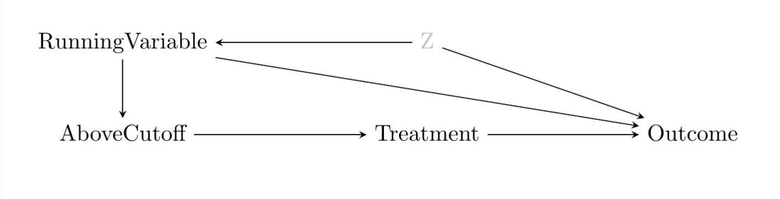
RD Graph

Slide 8
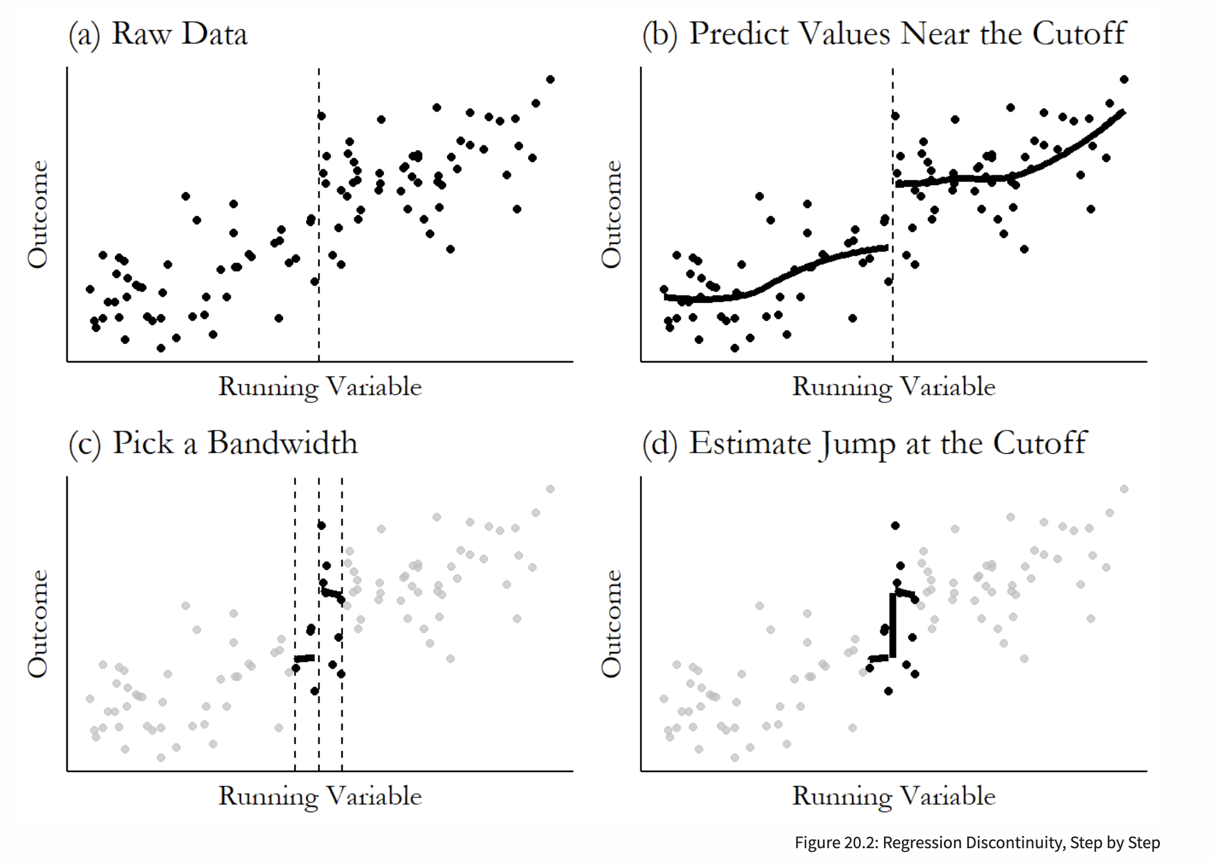
Tip for Regression Discontinuty

Slide 9
Sharp or fuzzy: does the rule decide, or just nudge?
Sharp RD
Fuzzy RD
Treatment goes from 0 to 1 exactly at the cutoff.
Everyone above is treated; no one below is.
Examples: winning an election at 50%; legal access to alcohol at 21.
The chance of treatment jumps, but not from 0 to 1.
Some below take it up; some above don't (drinking before 21).
Estimate = jump in outcome ÷ jump in treatment: instrumental variables at a cutoff.
We return to this with IV on November 19.
Same estimand logic either way: the comparison is only valid right at the cutoff.
Notes:
The MLDA estimate is the effect of legal access, a sharp intent-to-treat. The effect of drinking itself would be fuzzy: deaths jump divided by the jump in drinking at 21.

Slide 10
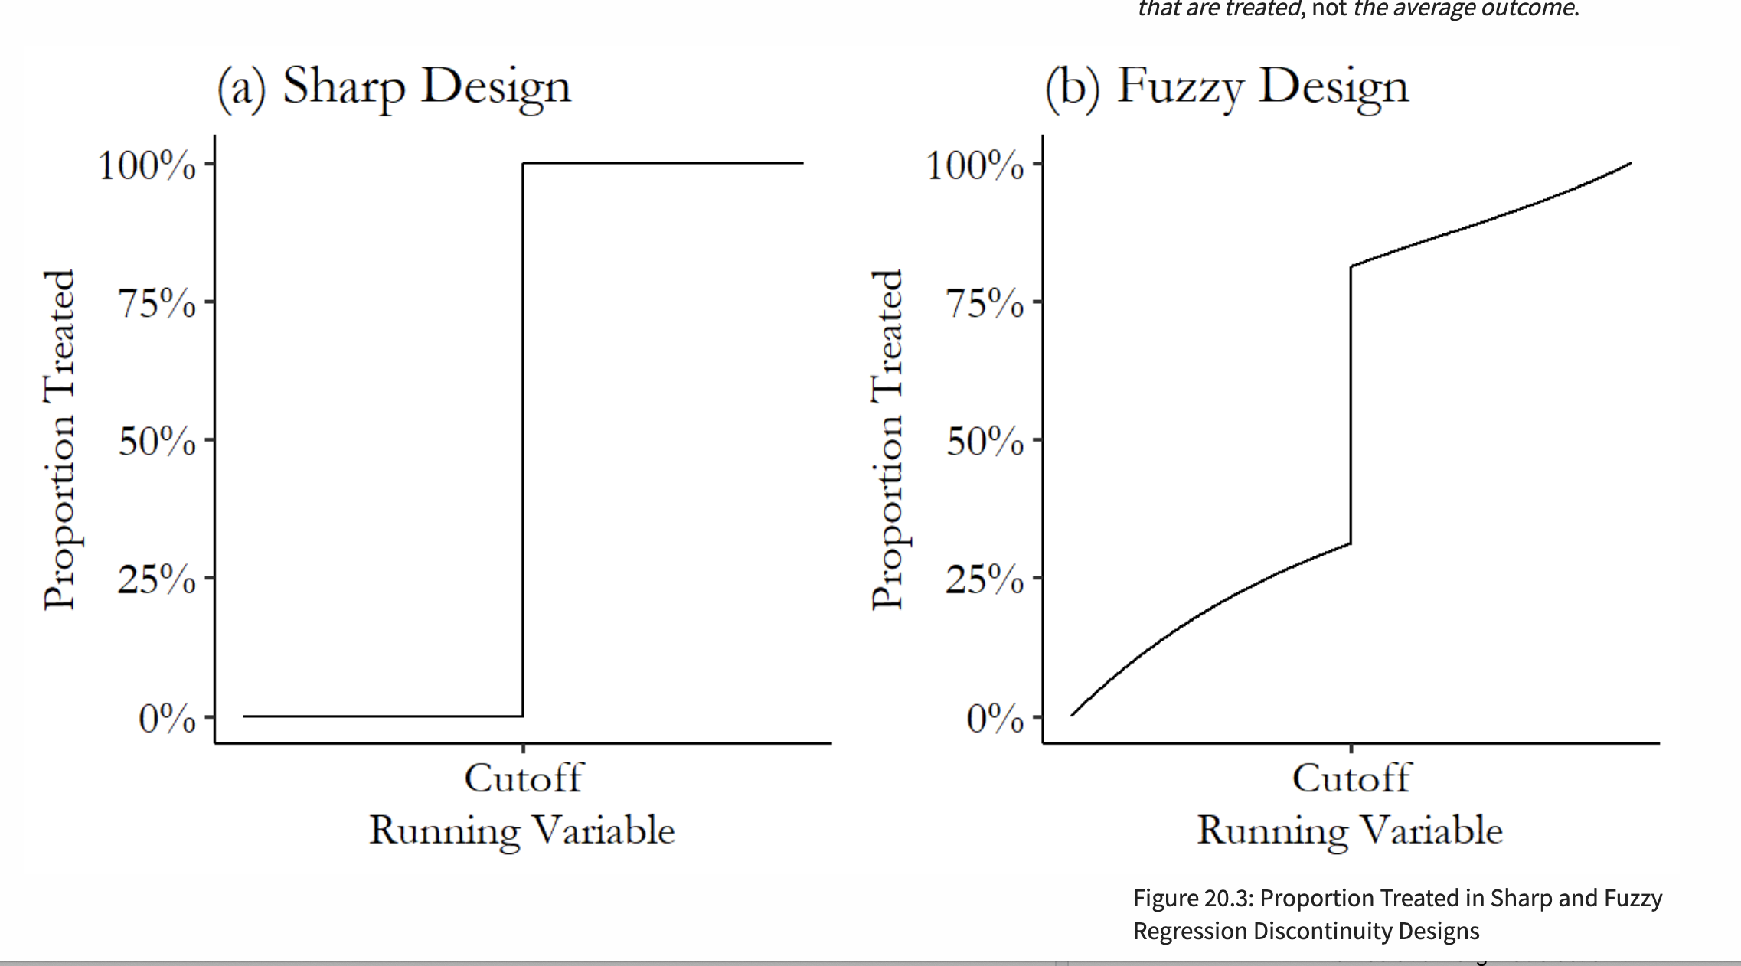
Sharp Design vs Fuzzy Design

Slide 11
What are we actually testing?
The effect
No sorting
Balance
Placebos
Does the outcome jump at the cutoff?
Does the number of units jump at the cutoff?
Do characteristics fixed before treatment jump?
Does anything jump at fake cutoffs, or in outcomes treatment can't affect?
We hope: yes
We hope: no
We hope: no
We hope: no
Every test asks the same question: is there a jump at the cutoff? Only the first should find one.
Notes:
The null hypothesis in each check is 'no discontinuity.' For the outcome we want to reject it; for density, covariates and placebos we want not to. Remind students that failing to reject is not proof (last week's pre-trend discussion).

Slide 12
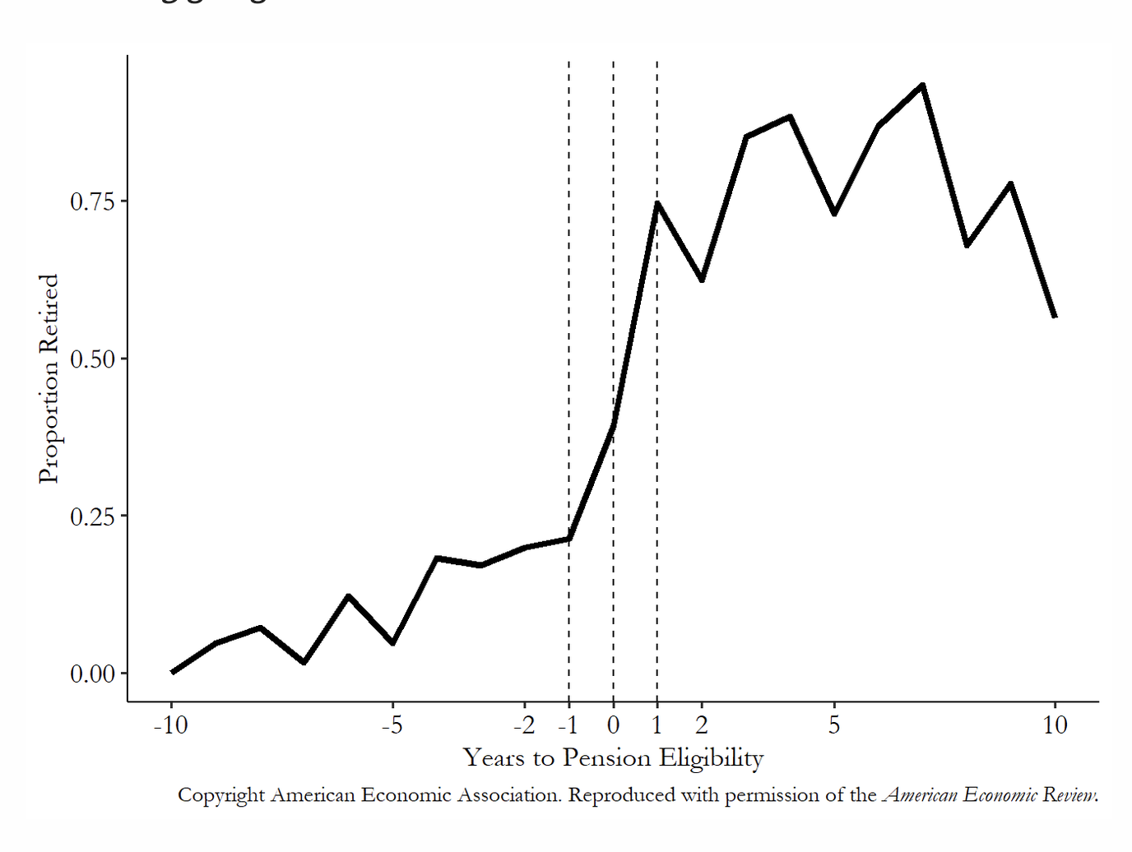

Slide 13
Changing the specification: what should move?
What you change | What a credible result does
Bandwidth | Narrower: less bias, more noise. A credible effect is stable across reasonable widths.
Polynomial | Local linear is the default. Quadratic is a check; high-order global fits are not.
Adding covariates | Shouldn't change the estimate much, only tighten the CI. A big shift means imbalance.
Kernel | How much to weight points near the cutoff. Rarely matters.
Donut | Drop units right at the cutoff. Tests whether a few just-over cases drive the result.
Choose the main specification before looking, then show the reader everything around it.
Notes:
Both labs ask students to vary these. The point is not to find the specification with the smallest p-value but to show the answer doesn't hinge on one choice.

Slide 14
Three checks, and what each would catch
1
Density
2
Balance
3
Placebos
Could units push themselves just over the line? Count units on each side of the cutoff (rddensity).
Run the same RD on characteristics fixed before treatment.
Fake cutoffs where nothing changes; outcomes the treatment can't affect.
Catches: sorting, manipulation
Catches: units on each side differing in other ways
Catches: jumps that aren't the treatment
Notes:
No results here: the labs find them. In close U.S. House races, Caughey and Sekhon (2011) found incumbents win more of the closest races, so sorting is a real risk in some settings.

Slide 15
When the cutoff is a date: RD in time
Running variable
Calendar time: months before and after the policy took effect.
Cutoff
The policy month. Treated if the month is on or after it.
Why no density test
Every month occurs exactly once. Months can't sort themselves across the cutoff, so there is nothing to test.
Illustrative numbers, not real data.
Notes:
Sorting worries are replaced by timing worries: departments may change behavior before the official date (anticipation) or after (training lag), and anything else that changed the same month (a new chief, a consent decree, a protest wave) is a competing explanation.

Slide 16
What changes from the classic RD
 | Classic RD | RD in time
Running variable | Age, vote margin, poverty rate | Months relative to the policy date
Outcomes | One outcome per unit | Log counts, rates per arrest or resident, Black share of incidents
Cutoff | Known exactly | Adoption, effective and training dates can differ: which one?
Bandwidth | Many units near the cutoff | Only so many months; nearby months are correlated
Seasonality | Not an issue | Force rises and falls through the year: compare like months
Implementation lag | Treatment is immediate | Officers learn new rules over time: a donut or a delayed cutoff
Notes:
Hausman and Rapson (2018) on RD in time: few observations near the cutoff, serial correlation, and anything else that changes on the same date. Logs make effects comparable across cities of different sizes; rates require a good denominator; the Black share speaks to disparity directly.

Slide 17
What we're testing: did use-of-force policies reduce force?
Black subjects
White subjects
Did force against Black subjects fall after the policy month?
Did force against White subjects fall, and by as much?
Serious force
Minor force
Firearms, Tasers and other less-lethal weapons, chemical agents: what the policies target most directly.
Weaponless physical force such as grabs and takedowns: may not change, or may rise if officers step down the continuum.
The racial gap is an outcome too: if force falls for everyone equally, disparities don't change.
Notes:
Four questions in one design. Separate estimates by race and by severity; then ask whether the Black share of force incidents changes at the cutoff. A drop in minor force could reflect reporting changes rather than behavior.

Slide 18
Lab 9, Part A: classic RD
Drinking age
Close Senate elections
Running variable: age in months
Cutoff: 21
Outcome: deaths per 100,000, by cause
Running variable: Democratic margin
Cutoff: 0
Outcome: Democratic vote share next election
Plot it → estimate the jump → vary the bandwidth and polynomial → run the three checks
week10-lab9.R · install.packages(c("rdrobust", "rddensity", "ggplot2"))
Notes:
No results on this slide on purpose: students find them. The debrief slides at the end of the deck have the answers.

Slide 19
Lab 9, Part B: use-of-force policies as RD in time
1
Set the cutoff
Pick the policy month for each city, and decide what to do if dates are uncertain.
2
Build the outcomes
Monthly log counts and rates, by subject race and by serious vs. minor force; the Black share.
3
Estimate
Local linear fits on each side of the policy month, pooled and city by city; then by subject race and severity.
4
Stress-test
Bandwidth, placebo dates, a donut, calendar-month controls for seasonality, and shifted cutoffs where dates are uncertain.
Chicago, Minneapolis, Indianapolis, Austin, Cincinnati · week10-lab9b-use-of-force.R · uof_city_month.csv
Notes:
Setup only, no results. Seasonality: compare January to January, not January to July. Implementation lag: training rollouts can take months, so try the effective date, the training-complete date, or a donut that drops the months in between.

