Slide 1
Test Slide !
Is this visible?
1
2
3
4
5
6
7
8

Slide 2

Argus UI

Slide 3
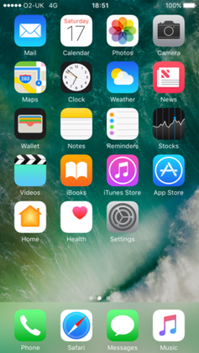
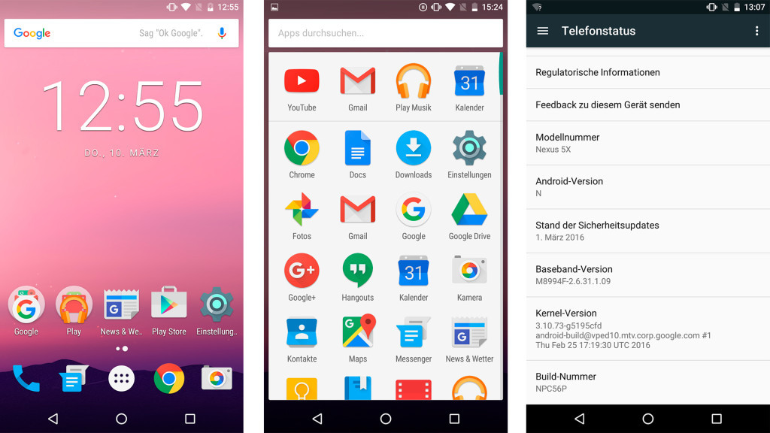
Mobile Interfaces
Most mainstream smart-phone UIs are heavily graphical.
Very user friendly for those with site. Not so much for others.

Slide 4
What is Argus
Argus is
A custom user interface designed for the visually impaired.
Anyone with basic language skills can use.
Big bold buttons which is easy to navigate around.
Voice feedback for each button pressed.
All apps remain accessible.

Slide 5
A home screen which helps navigate to other areas of the smartphone.
Currently implemented:
On first use, a narrative tutorial
A custom dialer.
A gesture window to open apps using gesture.
Functioning OCR camera.
A Basic Contacts page
The Alpha build is glitchy.

Slide 6
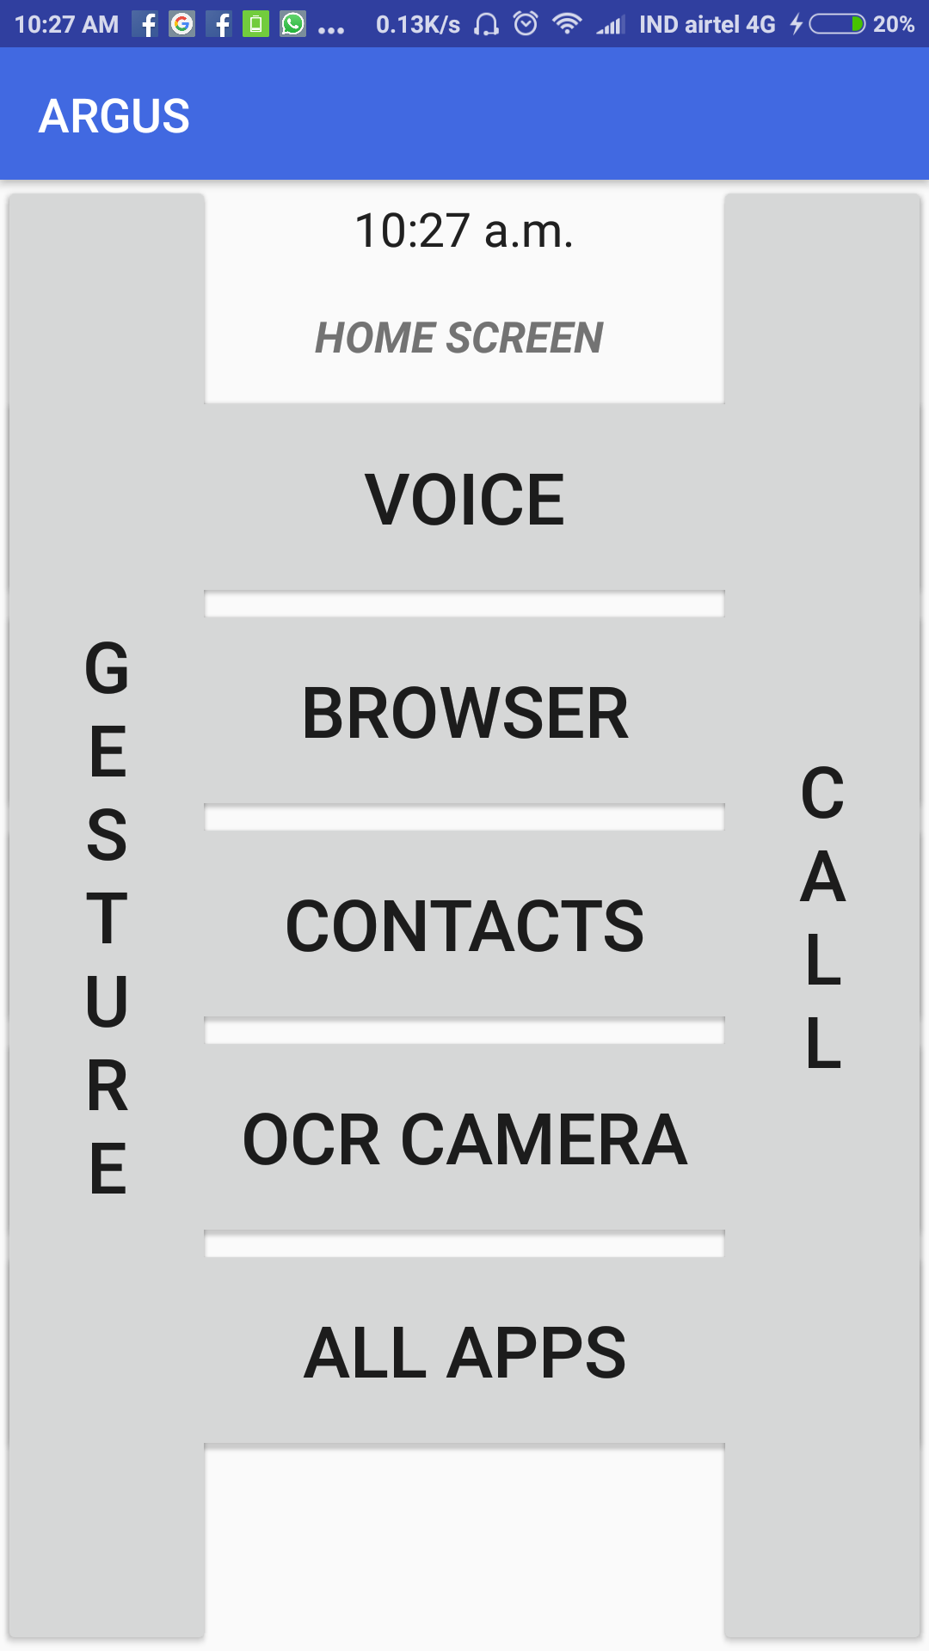
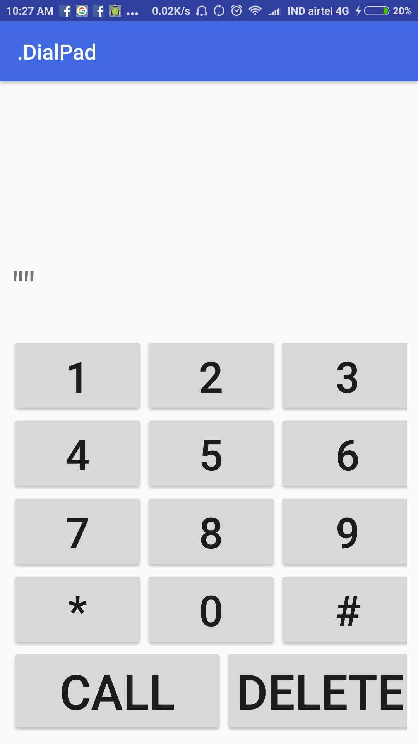

Slide 7
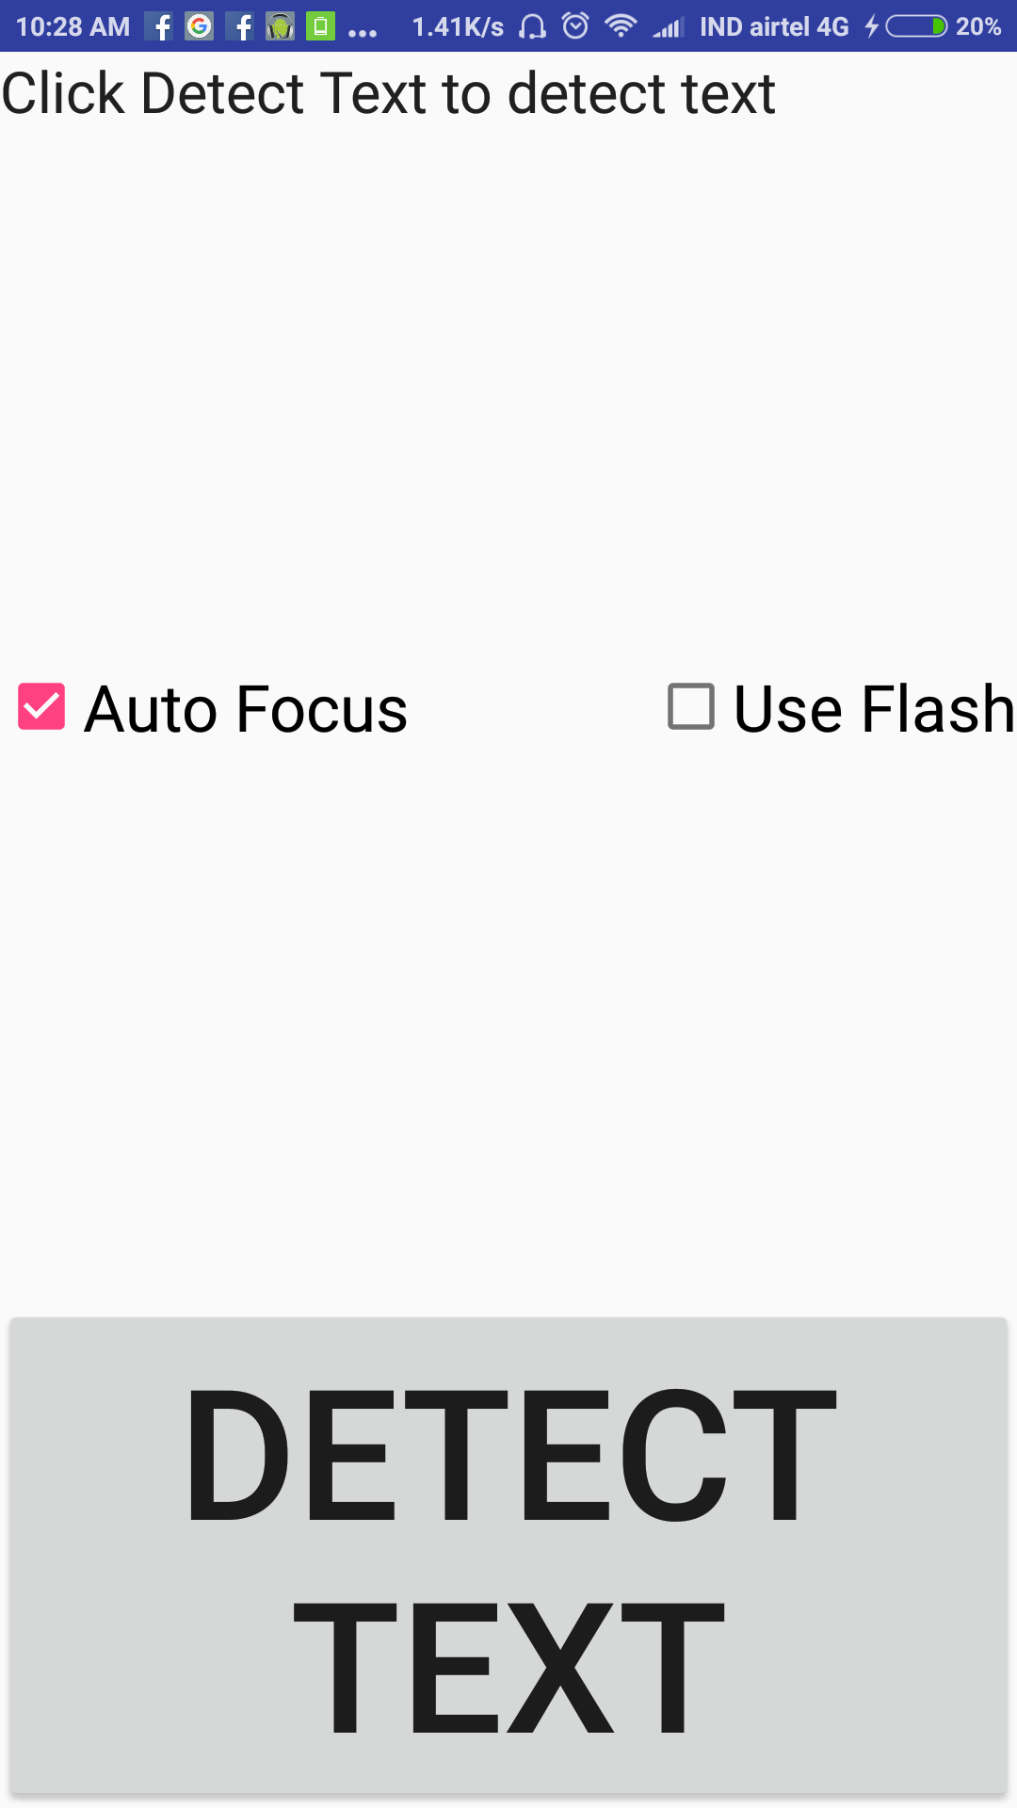
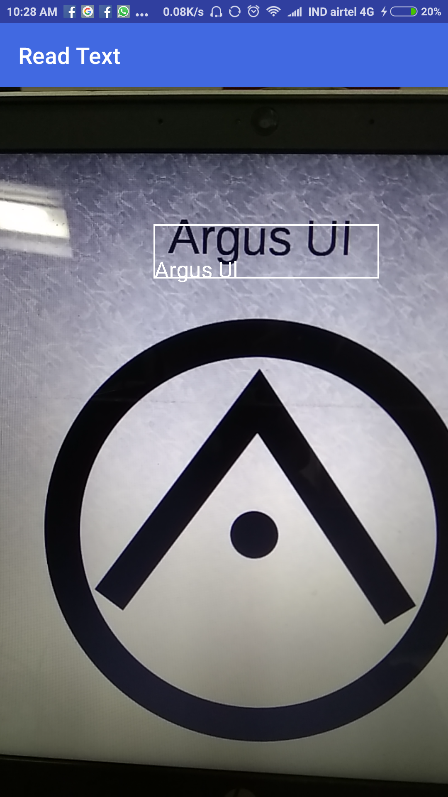

Slide 8
Improvements to be made
Moving from a launcher app model to a shell interface.
Making many more custom interfaces for common apps:
Integrated text to speech browser
A custom Media player
A fully functional contacts page
Integration with navigational interfaces(Tango) and other smart assistive technologies like smartcane.
Upgrade the OCR camera with full Google Vision API.

Slide 9
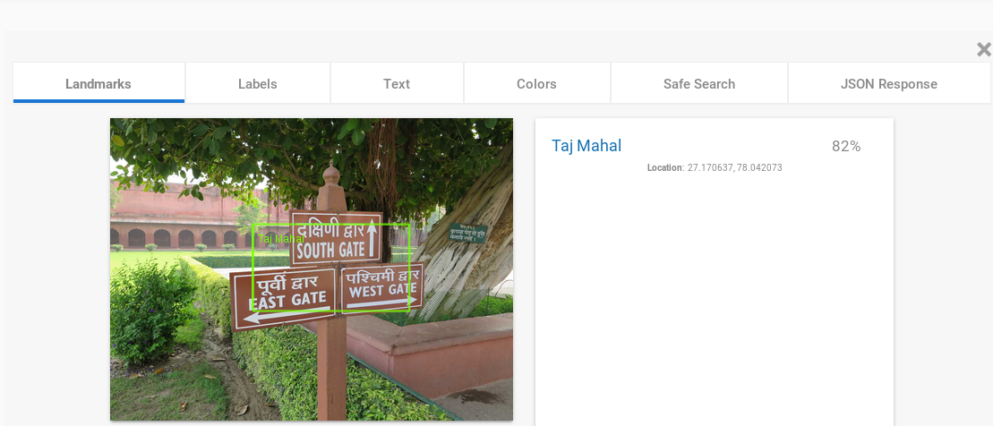
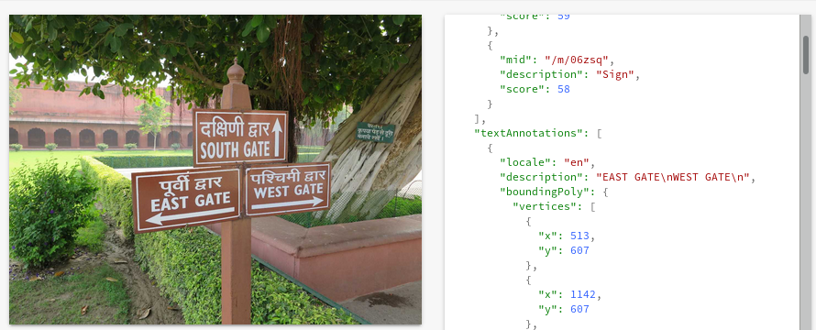

Slide 10
Differences from talkback
Talkback tries to explain the graphical interface via verbal description.
Argus provides an interface especially made for the visually impaired.
Talkback has a steep learning curve. Only the technically sound can use it effectively.
Argus tries to be as simple and easy to use as possible.

Slide 11
Open Source
The power of open source is power of the people.
Many drops make an ocean.
Open Source is evolution! Not intelligent Design.
Virtually no cost. Free and Open.

Slide 12
Spread Model
Smart-phones are everywhere.
Android is open and currently the majority share in smart-phone industry.
Just download the apk and you’re good to go.
Simplicity is key to success

Slide 13
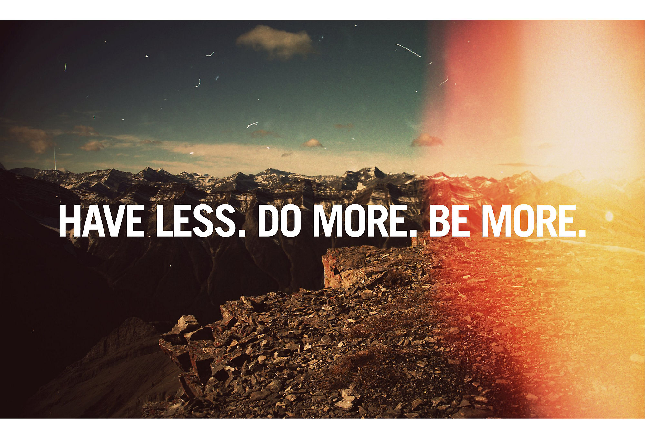

Slide 14
Thank You!

