Slide 1
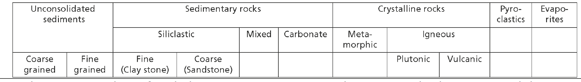
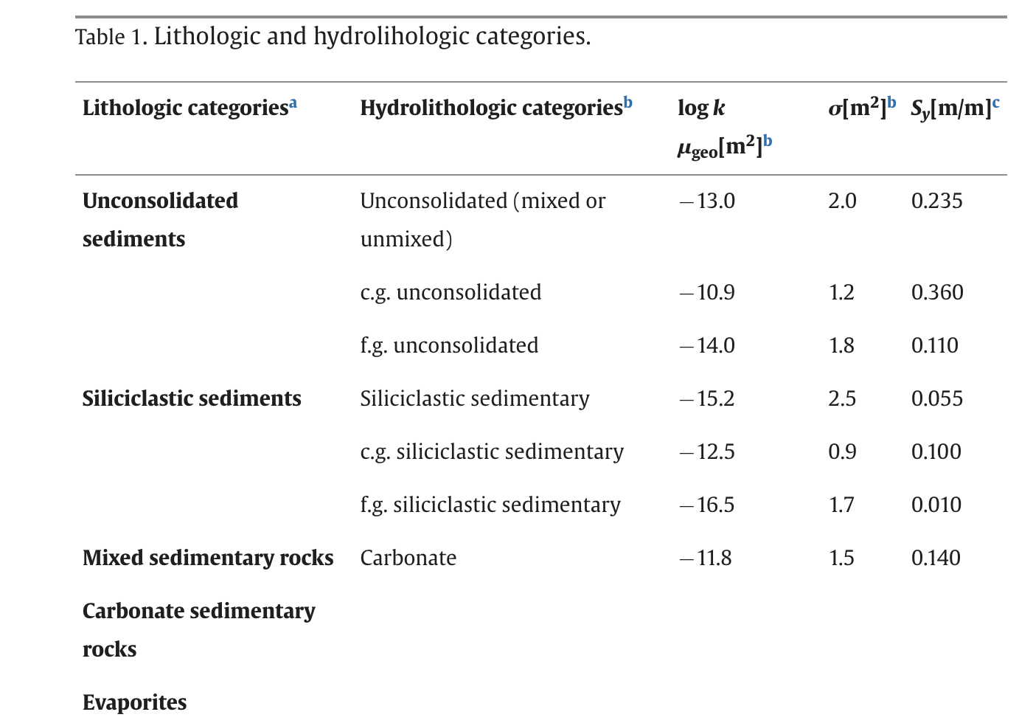
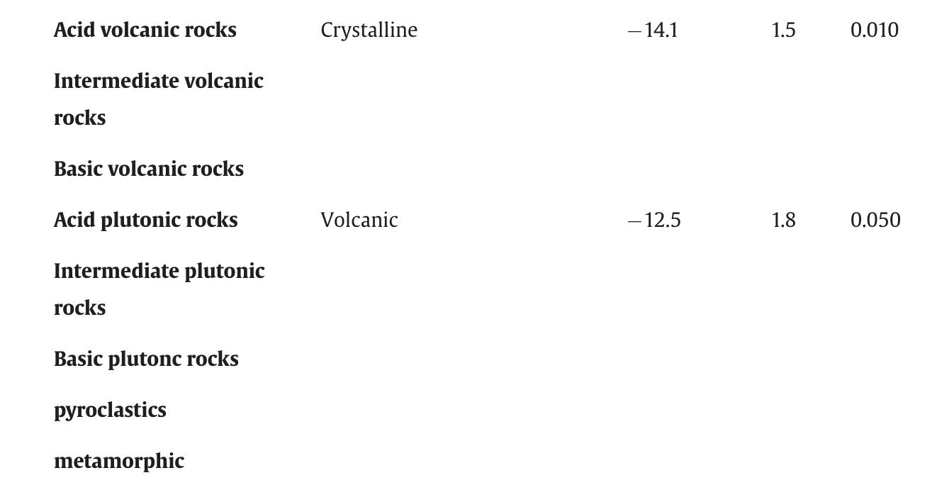
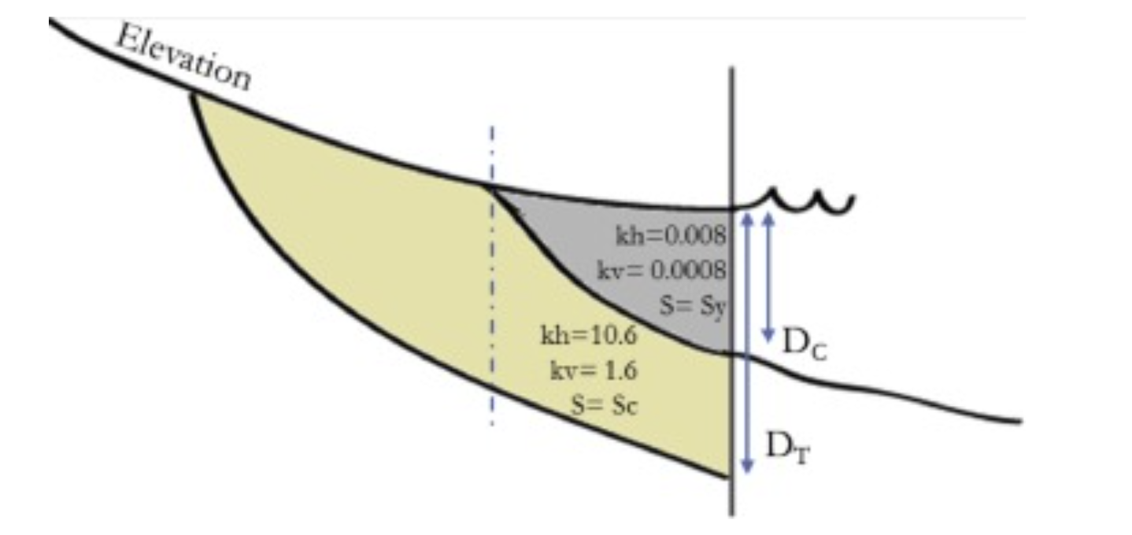
Pref. anis.
anis. = 1
Pref. anis.
anis. = 1
Steady state: 6: 3 pref. K, 2 pref anis; 1 C_entrance: 3 x 3 x 3 x 2 x 3 = 162
Transient: 2 pref specific yield storage coefficient: 3 x 3 = 9

Slide 2
Prefactor Steady State
Ks
Fine + coarse unconsolidated 3: 0.1 - 1.0 - 10
Fine + coarse 3: 0.1 - 1.0 - 10
Carbonate: 3: 0.1 - 1.0 - 10
Anisotropy 2: 0.1 - 1.0
Entrance resistance 3: 0.1 - 1.0 - 10
Prefactor Transient (perhaps only where we have measurements):
- Europe, CONUS, India, Australia
Storage coefficient 3 x 3 = 3 runs
Specific yield: unconfined aquiger + confining layer 2: 0.5 – 1.0 -1.5
Storage coefficient: all confined aquifers: 0.1 - 1.0 - 10

