Slide 1
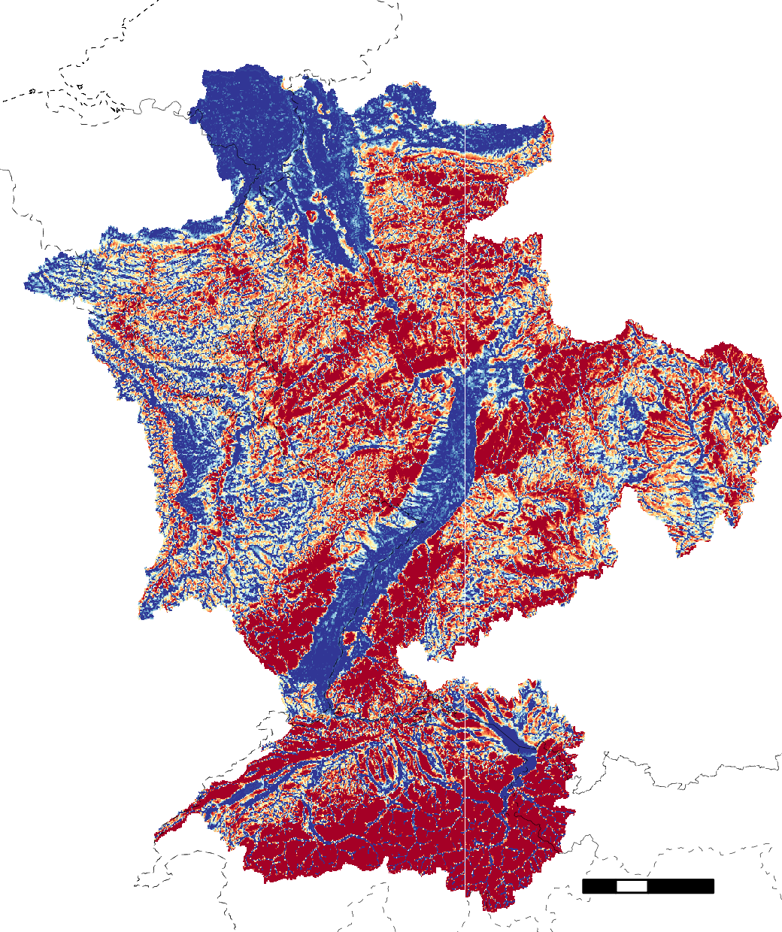
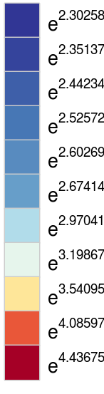
NETHERLANDS
BELGIUM
GERMANY
FRANCE
groundwater depth (m)
≤ 0.5
1
2
3
4
5
10
15
25
50
≥ 75
GERMANY
FRANCE
AUSTRIA
SWITZERLAND
0
100km

