Slide 1
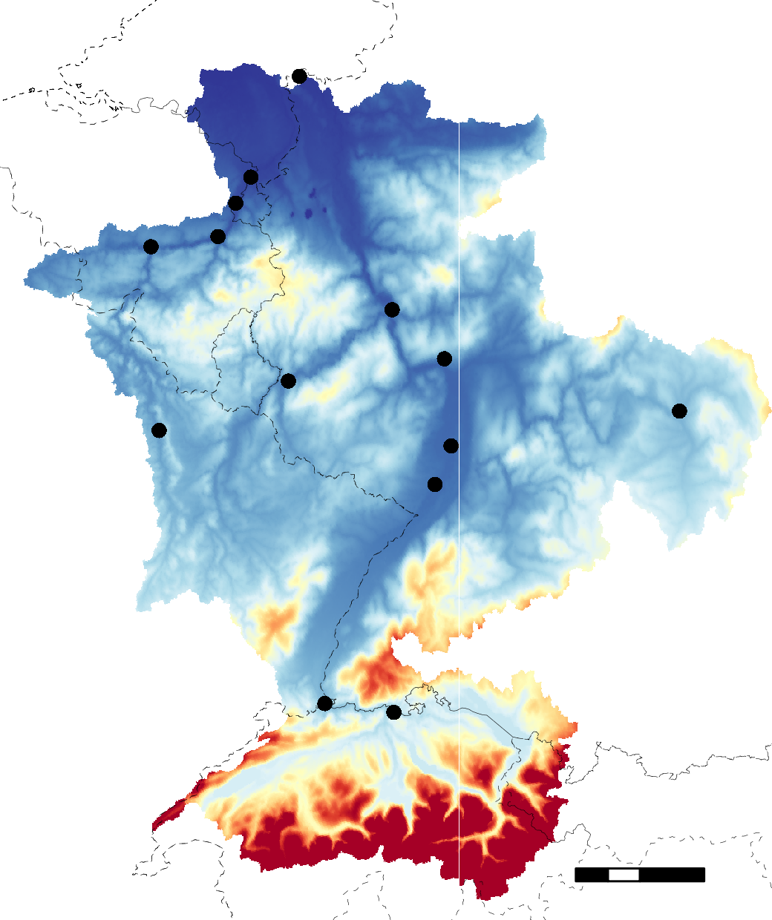
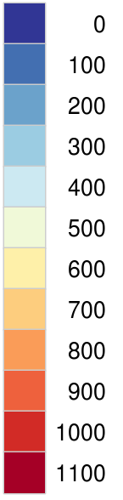
NETHERLANDS
Lobith (a)
BELGIUM
f
Borgharen (b)
Liege
Namur
GERMANY
Koblenz
Wiesbaden
FRANCE
LUX
d
c
e
groundwater head (+m)
Mannheim
≤ 0
100
200
300
400
500
600
700
800
900
1000
≥ 1100
g
GERMANY
FRANCE
Basel
Rekingen
AUSTRIA
SWITZERLAND
0
100km

