Slide 1
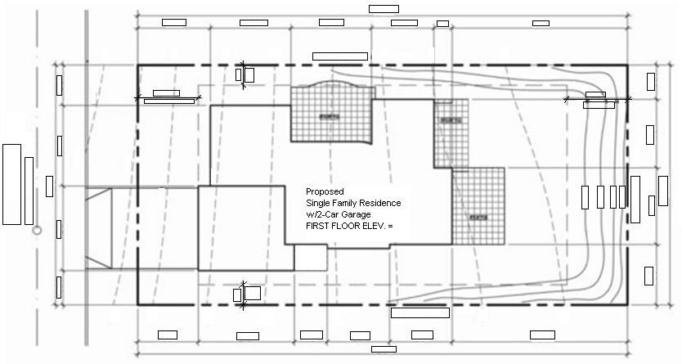
MDC BCN 1272 BUILDING CONSTRUCTION PLAN INTERPRETATION
Competency 4 EXERCISE 4
1
A
B
1. Name the plan
2. Rotate the North symbol to it proper orientation.
3. Note the property metes and bounds.
4. Calculate the Lot Area___________________________Write in the proper box the dimensions used.
5. Indicate the Lot highest_________ and the lowest ________ elevation.
6. Note the First Floor Elevation___________.
7. From the North West property corner locate point A (X,Y)______________ ,and point B_______________ (X,Y)
Write in the proper box the dimensions used.
8. The main entrance of the residence is facing what orientation________________.
9.Indicate the maximum slope of the car garage entrance pavement
10. Within the property quantify the existing trees____, and quantify the trees______ to be removed______

Slide 2
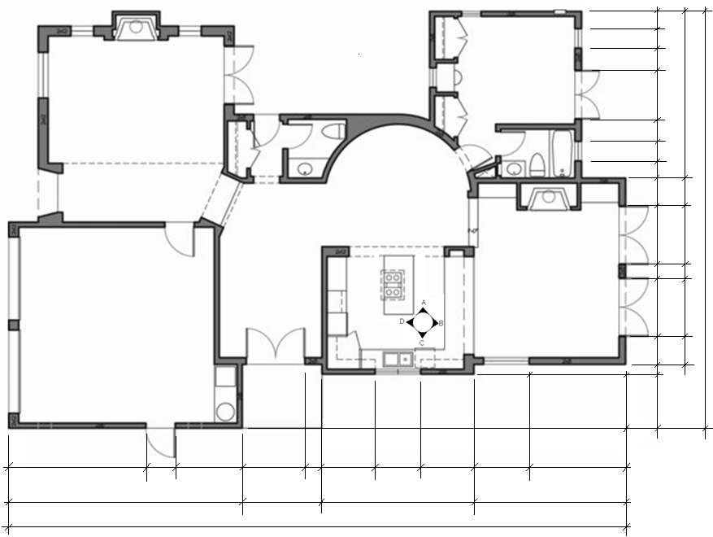
MDC BCN 1272 BUILDING CONSTRUCTION PLAN INTERPRETATION
Competency 4 EXERCISE 4
2
Complete the list of question on p 2.1 and illustrate the answer in the view.

Slide 3
MDC BCN 1272 BUILDING CONSTRUCTION PLAN INTERPRETATION
Competency 4 EXERCISE 4
2.1
1. Name the view, indicate the scale.
2. Rotate the North symbol to it proper orientation.
3. Print view and provide the dimension on the box provided using SCALE: 1/8”=1’-0”
4. Name the residence rooms in the view.
5. The entire Floor plan has how many entrances from the exterior?__________
6. The overall-length of the house is___________, and the overall width_______________.
7. Mark and identify the section(s) and located them in the floor plan
8. Quantify all the doors :___________
9. Quantify all the doors :___________
10. The Powder room has______________ (types of fixtures)
11. The Bath has a________________________________ (type of fixtures)
12. Name the appliances in the kitchen _______________________________________________
13. A coat closet is located right next to which room____________.
14. What is the distance (center) of window type 9 from the West wall_________.
15. Locate the interior elevation call out at the kitchen and identify the corresponding views on sheet 5.
16. Name the appliances installed in the in the garage and named them with its abbreviation and full name.
17. The finish floor elevation of the garage is_________ What is the height difference to the Living Room______ ,and the Dining Room______.
18. The hidden lines at the kitchen entrance and thru the family room illustrate what architectural form________.

Slide 4
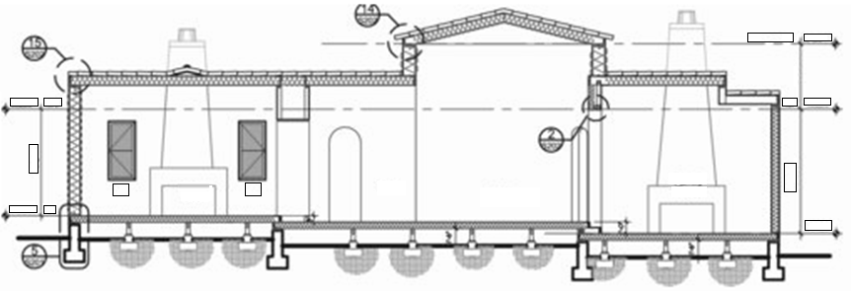
MDC BCN 1272 BUILDING CONSTRUCTION PLAN INTERPRETATION
Competency 4 EXERCISE 4
3
1. Name the view and identify it accordingly with the plan
2. Indicate the finish floor and it’s elevation.
3. Indicate both T.O.P. and their elevation.
4. Name the rooms
5. Indentify the window with the corresponding tag.
6. How many wall footings are shown?______
7. Identify the eave detail__________.
8. A minimum distance of______ need to be provided between the finish grade and the floor.?______
9. Type_____ gypsum shall be used in the garage walls and ceiling.

Slide 5
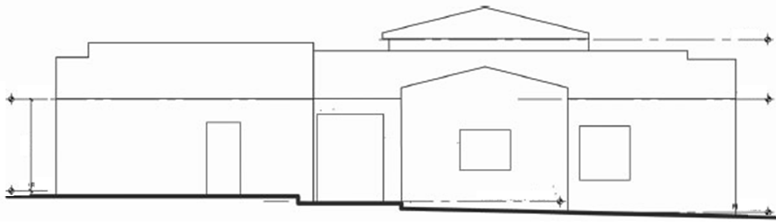
MDC BCN 1272 BUILDING CONSTRUCTION PLAN INTERPRETATION
Competency 4 EXERCISE 4
4
Complete the list of question
1. Name the architectural view
2. Indentify the scale
3. Identify each opening with the proper ID bubble.
4. From www.miamidade.gov building department website
http://www.miamidade.gov/building/pc-search_app.asp
provide the N.O.A. for similar openings type.
a. N.O.A. stands for _____________________________
b. Opening #_____, N.O.A.________________________
c. Opening #_____, N.O.A.________________________
d. Opening #_____, N.O.A.________________________
e. Opening #_____, N.O.A.________________________
5. Indicate the interior finish floor elevations
6. Indicate both T.O.P. and their elevation.
7. Indicate the roof slopes.

Slide 6

MDC BCN 1272 BUILDING CONSTRUCTION PLAN INTERPRETATION
Competency 4 EXERCISE 4
5
Identify the Kitchen interior elevations base on the floor plan on sheet #2

