Slide 2
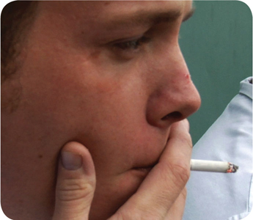
How Food Handlers Can Contaminate Food
Food handlers can contaminate food when they:
Have a foodborne illness
Have wounds that contain a pathogen
Sneeze or cough
Have contact with a person who is sick
Touch anything that may contaminate their hands and do not wash them
Have symptoms such as diarrhea, vomiting, or jaundice—a yellowing of the eyes or skin
3-2
Notes:
Instructor Notes
With some illnesses, a person may infect others before showing any symptoms. For example, a person could spread hepatitis A for weeks before having any symptoms.
With other illnesses, a person may infect others for days or even months after symptoms are gone. Norovirus can be spread for days after symptoms have ended.
Some people carry pathogens and infect others without ever getting sick themselves. These people are called carriers. The bacteria Staphylococcus aureus is carried in the nose of 30 to 50 percent of healthy adults. About 20 to 35 percent of healthy adults carry it on their skin. Food handlers transfer this type of bacteria to food when they touch the infected areas of their bodies and then touch food without washing their hands.

Slide 3
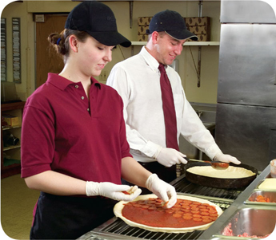
Managing a Personal Hygiene Program
Managers must focus on the following:
Creating personal hygiene policies
Training food handlers on personal hygiene policies and retraining them regularly
Modeling correct behavior at all times
Supervising food safety practices
Revising personal hygiene policies when laws or science change
3-3
Notes:
Instructor Notes
Don’t underestimate your role in a personal hygiene program. You have many responsibilities to help make the program work. Some of these are highlighted in the slide.

Slide 4
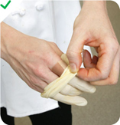
Infected Wounds or Cuts
Infected wounds or cuts:
Contain pus
Must be covered to prevent pathogens from contaminating food and food-contact surfaces
How a wound is covered depends on where it is located:
Cover wounds on the hand or wrist with an impermeable cover, (i.e. bandage or finger cot) and then a single-use glove
Cover wounds on the arm with an impermeable cover, such as a bandage
Cover wounds on other parts of the body with a dry, tight-fitting bandage
3-4

Slide 5
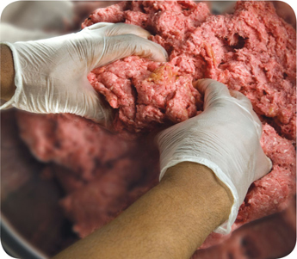
Single-Use Gloves
Single-use gloves:
Should be used when handling ready-to-eat food
Except when washing produce
Except when handling ready-to-eat ingredients for dishes cooked to the correct temperature
Must NEVER be used in place of handwashing
Must NEVER be washed and reused
Must fit correctly
3-5
Notes:
Instructor Notes
Single-use gloves can help keep food safe by creating a barrier between hands and food. Gloves should be worn when handling ready-to-eat food. The exceptions include when washing produce, or when handling ready-to-eat ingredients for a dish that will be cooked to the correct internal temperature.
Hands must be washed before putting on gloves and when changing to a new pair.
Make sure you provide different glove sizes. Gloves that are too big will not stay on. Those that are too small will tear or rip easily.
Some food handlers and customers may be sensitive to latex. Consider providing gloves made from other materials.

Slide 6
Single-Use Gloves
How to use gloves:
Wash hands before putting gloves on when starting a new task
Select the correct glove size
Hold gloves by the edge when putting them on
Once gloves are on, check for rips or tears
NEVER blow into gloves
NEVER roll gloves to make them easier to put on
3-6
Notes:
Instructor Notes
Wash your hands before putting gloves on when starting a new task. You do not need to rewash your hands each time you change gloves as long as you are performing the same task, and your hands have not become contaminated.
Avoid contaminating gloves when putting them on.

Slide 7
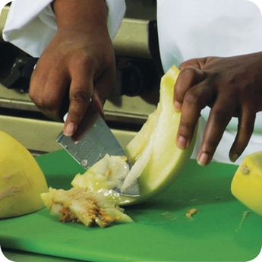
Bare-Hand Contact with Ready-to-Eat Food
Bare-hand contact with ready-to-eat food must be avoided unless:
The food is an ingredient in a dish that does not contain raw meat, seafood, or poultry
The dish will be cooked to at least 145˚F (63˚C)
The food is an ingredient in a dish containing raw meat, seafood, or poultry
The dish will be cooked to the required minimum internal temperature of the raw item(s)
NEVER handle ready-to-eat food with bare hands when you primarily serve a high-risk population
3-7
Notes:
Instructor Notes
Food can become contaminated when it has been handled with bare hands. This is especially true when hands have not been washed correctly or have infected cuts or wounds. For this reason, do not handle ready-to-eat food with bare hands.
There are times when it may be acceptable to handle ready-to-eat food with bare hands. This is true in the situations identified in the slide.
Never handle ready-to-eat food with bare hands if you primarily serve a high-risk population.
Some regulatory authorities allow bare-hand contact with ready-to- eat food. If your jurisdiction allows this, you must have specific policies in place about staff health. You must also train staff in handwashing and personal hygiene practices.

Slide 8
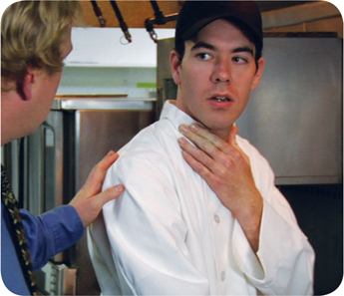
Handling Staff Illnesses
If:
The food handler has a sore throat with a fever
Then:
Restrict the food handler from working with or around food
Exclude the food handler from the operation if you primarily serve a high-risk population
A written release from a medical practitioner is required before returning to work
3-8
Notes:
Instructor Notes
You must encourage your staff to report any health problems before they come to work. This includes newly hired staff who haven’t started working yet.
Staff should also let you know immediately if they get sick while working. Your regulatory authority may ask you to prove you have made staff aware of this policy.
When food handlers are sick, you may need to restrict them from working with or around food. Sometimes, you may need to exclude them from working in the operation.

Slide 9

Handling Staff Illnesses
If:
The food handler has at least one of these symptoms
Vomiting
Diarrhea
Then:
Exclude the food handler from the operation
Before returning to work, food handlers who vomited or had diarrhea must meet one of these requirements
Have had no symptoms for at least 24 hours
Have a written release from a medical practitioner
3-9

Slide 10
Handling Staff Illnesses
If:
The food handler has jaundice
Then:
Report the food handler to the regulatory authority
Exclude food handlers from the operation if they have had jaundice for 7 days or less
Food handlers must have a written release from a medical practitioner and approval from the regulatory authority before returning to work
3-10

Slide 11
Handling Staff Illnesses
If:
The food handler is vomiting or has diarrhea and has been diagnosed with an illness caused by one of these pathogens
Norovirus
Shigella spp.
Nontyphoidal Salmonella
Shiga toxin-producing E. coli
Then:
Exclude the food handler from the operation
Work with the food handler’s medical practitioner and/or the local regulatory authority to decide when the person can go back to work
3-11
Notes:
Instructor Notes
Some food handlers diagnosed with these foodborne illnesses may not experience the usual signs or their symptoms may be over. Work with the local regulatory authority to determine whether the food handler must be excluded from the operation or restricted from working with or around food, and when the exclusion or restriction can be removed.
Remember these are only guidelines, working with your regulatory authority will help you determine the best course of action.

Slide 12
Handling Staff Illnesses
If:
The food handler has been diagnosed with an illness caused by one of these pathogens.
Hepatitis A
Salmonella Typhi
Then:
Exclude the food handler from the operation
Work with the food handler’s medical practitioner and/or the local regulatory authority to decide when the person can go back to work
3-12
Notes:
Instructor Notes
Whether or not a food handler has symptoms, those diagnosed with a disease caused by these pathogens must be excluded from the operation. Work with the local regulatory authority to determine when the exclusion can be removed.
Remember these are only guidelines, working with your regulatory authority will help you determine the best course of action.

