Slide 2
Challenges to Food Safety
A foodborne illness is a disease transmitted to people through food.
An illness is considered an outbreak when:
Two or more people have the same symptoms after eating the same food
An investigation is conducted by state and local regulatory authorities
The outbreak is confirmed by laboratory analysis
1-2

Slide 3
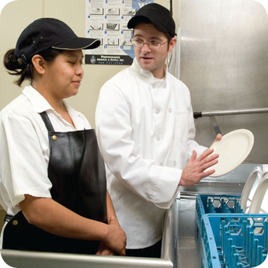
Challenges to Food Safety
Challenges include:
Time and money
Language and culture
Literacy and education
Pathogens
Unapproved suppliers
High-risk customers
Staff turnover
1-3
Notes:
Instructor Notes
Pressure to work quickly can make it hard to take the time to follow food safety practices.
Your staff may speak a different language than you do, which can make it difficult to communicate. Cultural differences can also influence how food handlers view food safety.
Staff often have different levels of education, making it more challenging to teach them food safety.
Illness-causing microorganisms are more frequently found on food that once was considered safe.
Food that is received from suppliers that are not practicing food safety can cause a foodborne-illness outbreak.
The number of customers at high risk for getting a foodborne illness is increasing. An example of this is the growing elderly population.
Training new staff leaves less time for food safety training.
The ServSafe program will provide the tools needed to overcome the challenges in managing a good food safety program.

Slide 4
How Food Becomes Unsafe
Five risk factors for foodborne illness:
Purchasing food from unsafe sources
Failing to cook food correctly
Holding food at incorrect temperatures
Using contaminated equipment
Practicing poor personal hygiene
1-4
Notes:
Instructor Notes
If food is not handled correctly, it can become unsafe. These are the five most common food-handling mistakes, or risk factors, that can cause foodborne illness.

Slide 5
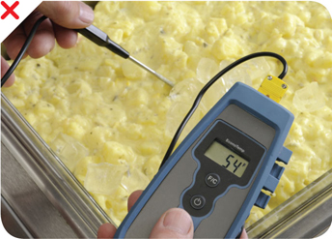
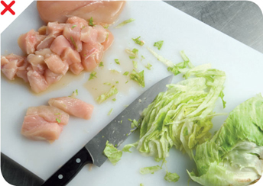
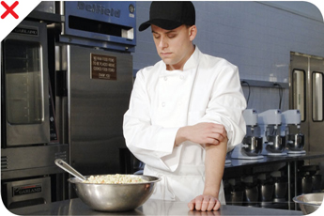
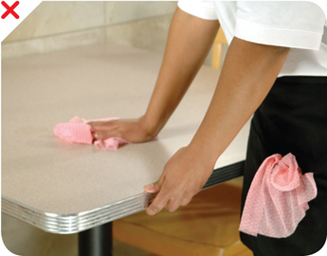
How Food Becomes Unsafe
Time-temperature abuse
Cross-contamination
Poor personal hygiene
Poor cleaning and sanitizing
1-5
Notes:
Instructor Notes
Except for purchasing food from unsafe sources, each risk factor for foodborne illness is related to four main factors: time-temperature abuse, cross-contamination, poor personal hygiene, and poor cleaning and sanitizing.

Slide 6
How Food Becomes Unsafe
Poor cleaning and sanitizing:
Equipment and utensils are not washed, rinsed, and sanitized between uses
Food contact surfaces are wiped clean instead of being washed, rinsed, and sanitized
Wiping cloths are not stored in a sanitizer solution between uses
Sanitizer solution was not prepared correctly
1-6

Slide 7
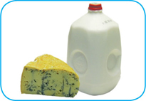
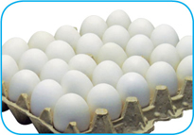

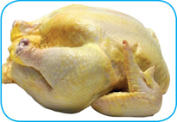

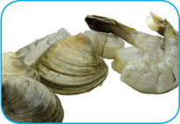
Food Most Likely to Become Unsafe
TCS food:
1-7
Notes:
Instructor Notes
The list of TCS food includes the following:
Milk and dairy products
Shell eggs (except those treated to eliminate nontyphoidal Salmonella)
Meat: beef, pork, and lamb
Poultry
Fish
Shellfish and crustaceans

Slide 8
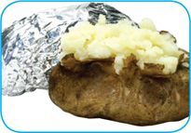
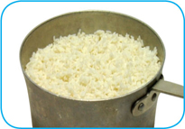

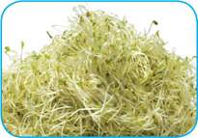
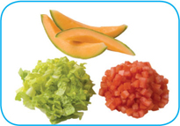

Food Most Likely to Become Unsafe
TCS food:
1-8
Notes:
Instructor Notes
The list of TCS food includes the following:
Baked potatoes
Heat-treated plant food, such as cooked rice, beans, and vegetables
Tofu or other soy protein; synthetic ingredients, such as textured soy protein in meat alternatives
Sprouts and sprout seeds
Sliced melons; cut tomatoes; cut leafy greens
Untreated garlic-and-oil mixtures

Slide 9
Ready-to-Eat Food
Ready-to-eat food is food that can be eaten without further:
Preparation
Washing
Cooking
Ready-to-eat food includes:
Cooked food
Washed fruit and vegetables
Deli meat
Bakery items
Sugar, spices, and seasonings
1-9
Notes:
Instructor Notes
Like TCS food, ready-to-eat food also needs careful handling to prevent contamination.

Slide 10


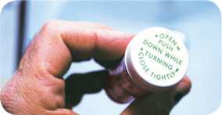
Populations at High Risk for Foodborne Illnesses
These people have a higher risk of getting a foodborne illness:
Elderly people
Preschool-age children
People with compromised immune systems
1-10
Notes:
Instructor Notes
Elderly people are at high risk because their immune systems have weakened with age.
Very young children are at high risk because they have not built up strong immune systems.
People with compromised immune systems include:
People with cancer or on chemotherapy
People with HIV/AIDS
Transplant recipients
People taking certain medications

Slide 11
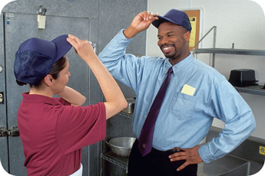
Keeping Food Safe
Focus on these measures:
Controlling time and temperature
Preventing cross-contamination
Practicing personal hygiene
Purchasing from approved, reputable suppliers
Cleaning and sanitizing
1-11
Notes:
Instructor Notes
Set up standard operating procedures that focus on these areas. The ServSafe program will show you how to design these procedures.

Slide 12
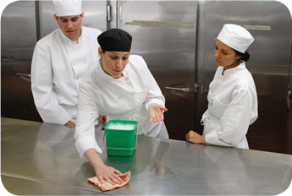
Keeping Food Safe
Training and monitoring:
Train staff to follow food safety procedures
Provide initial and ongoing training
Provide all staff with general food safety knowledge
Provide job specific food safety training
Retrain staff regularly
Monitor staff to make sure they are following procedures
Document training
1-12
Notes:
Instructor Notes
Managers must set up standard operating procedures that focus on the measures listed on the slide. Then they must train their staff on these procedures and monitor them to make sure the procedures are followed.

Slide 13
Keeping Food Safe
Government agencies:
The Food and Drug Administration (FDA)
U.S. Department of Agriculture (USDA)
Centers for Disease Control and Prevention (CDC)
U.S. Public Health Service (PHS)
State and local regulatory authorities
1-13
Notes:
Instructor Notes
The Food and Drug Administration (FDA) inspects all food except meat, poultry, and eggs. The agency also regulates food transported across state lines. In addition, the agency issues the FDA Food Code, which provides recommendations for food safety regulations.
The U.S. Department of Agriculture (USDA) regulates and inspects meat, poultry, and eggs. It also regulates food that crosses state boundaries or involves more than one state.
Agencies such as the Centers for Disease Control and Prevention (CDC) and the U. S. Public Health Service (PHS) conduct research into the causes of foodborne-illness outbreaks.
State and local regulatory authorities write or adopt code that regulates retail and foodservice operations.

