Slide 2
Food Safety Management Systems
Food safety management system:
Group of practices and procedures intended to prevent foodborne illness
Actively controls risks and hazards throughout the flow of food
8-2

Slide 3
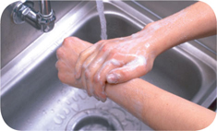

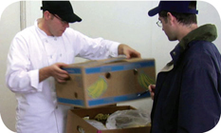

Food Safety Programs
These are the foundation of a food safety management system:
Personal hygiene program
Food safety training program
Supplier selection and specification program
Quality control and assurance program
8-3
Notes:
Instructor Notes
Having food safety programs already in place gives you the foundation for your system. The principles presented in the ServSafe program are the basis of these programs.

Slide 4
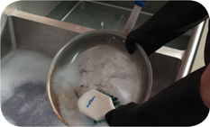
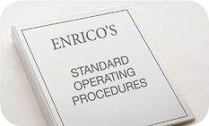
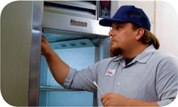
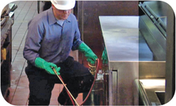
Food Safety Programs
These are the foundation of a food safety management system:
Cleaning and sanitation program
Standard operating procedures (SOPs)
Facility design and equipment maintenance program
Pest control program
8-4
Notes:
Instructor Notes
Having food safety programs already in place gives you the foundation for your system. The principles presented in the ServSafe program are the basis of these programs.

Slide 5
Active Managerial Control
Focuses on controlling the five most common risk factors for foodborne illness:
Purchasing food from unsafe sources
Failing to cook food adequately
Holding food at incorrect temperatures
Using contaminated equipment
Practicing poor personal hygiene
8-5

Slide 6
Active Managerial Control
There are many ways to achieve active managerial control in the operation:
Training programs
Manager supervision
Incorporation of standard operating procedures (SOPs)
HACCP
These are critical to the success of active managerial control:
Monitoring critical activities in the operation
Taking the necessary corrective action when required
Verifying that the actions taken control the risks factors
8-6
Notes:
Instructor Notes
There are many ways to achieve active managerial control in the operation. According to the Food and Drug Administration (FDA), you can use simple tools such as training programs, manager supervision, and the incorporation of SOPs. Active Managerial Control can also be achieved through more complex solutions such as a HACCP Program.
Monitoring is critical to the success of active managerial control. Food will be safe if managers monitor critical activities in the operation.
Managers must also take the necessary corrective action when required. They must also verify that the actions taken to control the risk factors for foodborne illness are actually working.

Slide 7
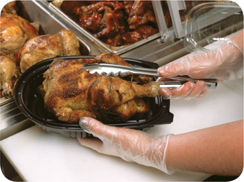
Active Managerial Control
The FDA provides recommendations for controlling the common risk factors for foodborne illness:
Demonstration of knowledge
Staff health controls
Controlling hands as a vehicle of contamination
Time and temperature parameters for controlling pathogens
Consumer advisories
8-7
Notes:
Instructor Notes
Demonstration of knowledge: As a manager, you must be able to show that you know what to do to keep food safe. Becoming certified in food safety is one way to show this.
Staff health controls: Procedures must be put in place to make sure staff are practicing personal hygiene. For example, staff must know that they must report illnesses and illness symptoms to management.
Controlling hands as a vehicle of contamination: Controls must be put in place to prevent bare-hand contact with ready-to-eat food. This might include requiring the use of tongs to handle ready-to-eat food.
Time and temperature parameters for controlling pathogens: Procedures must be put in place to limit the time food spends in the temperature danger zone. Requiring food handlers to check the temperature of food being hot-held every two hours is an example.
Consumer advisories: Notices must be provided to customers if you serve raw or undercooked menu items. These notices must include a statement about the risks of eating these foods.

Slide 8
HACCP
The HACCP approach:
HACCP is based on identifying significant biological, chemical, or physical hazards at specific points within a product’s flow through an operation
Once identified, hazards can be prevented, eliminated, or reduced to safe levels
8-8
Notes:
Instructor Notes
There are many systems you can implement to achieve active managerial control of foodborne illness risk factors. Hazard Analysis Critical Control Point (HACCP) is one such system. HACCP (pronounced HASS-ip) is based on identifying significant biological, chemical, or physical hazards at specific points within a product’s flow. Once identified, the hazards can be prevented, eliminated, or reduced to safe levels.

Slide 9
HACCP
To be effective, a HACCP system must be based on a written plan:
It must be specific to each facility’s menu, customers, equipment, processes, and operations
A plan that works for one operation may not work for another
8-9
Notes:
Instructor Notes
Each HACCP plan is unique, a plan that works for one operation may not work for another.

Slide 10
The 7 HACCP Principles
The seven HACCP principles:
Conduct a hazard analysis
Determine critical control points (CCPs)
Establish critical limits
Establish monitoring procedures
Identify corrective actions
Verify that the system works
Establish procedures for record keeping and documentation
8-10
Notes:
Instructor Notes
In general terms, the HACCP principles can be broken into three groups:
Principles 1 and 2 help you identify and evaluate your hazards.
Principles 3, 4, and 5 help you establish ways for controlling those hazards.
Principles 6 and 7 help you maintain the HACCP plan and system and verify its effectiveness.

Slide 11
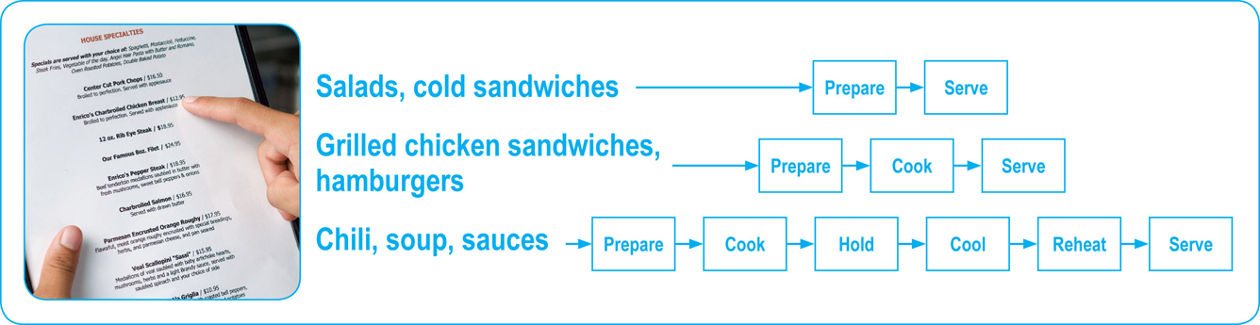
The 7 HACCP Principles
Principle 1: Conduct a hazard analysis
Identify potential hazards in the food served by looking at how it is processed
Identify TCS food items and determine where hazards are likely to occur for each one; look for biological, chemical, and physical contaminants
8-11
Notes:
Instructor Notes
Here is a real-world example showing the efforts of Enrico’s, an Italian restaurant, as it implements a HACCP program:
The management team at Enrico’s decided to implement a HACCP program. They began by analyzing their hazards.
The team noted that many of their dishes are received, stored, prepared, cooked, and served the same day. The most popular of these items was the spicy charbroiled chicken breast.
The team determined that bacteria were the most likely hazard to food prepared this way.

Slide 12
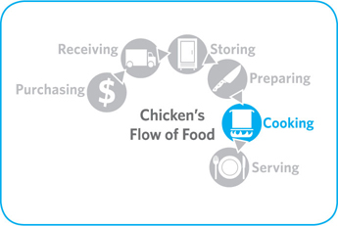
The 7 HACCP Principles
Principle 2: Determine critical control points (CCPs)
Find points in the process where identified hazards can be prevented, eliminated, or reduced to safe levels—these are the CCPs
Depending on the process, there may be more than one CCP
8-12
Notes:
Instructor Notes
Here is a real-world example showing the efforts of Enrico’s, an Italian restaurant, as it implements a HACCP program:
Enrico’s management identified cooking as the CCP for food prepared and cooked for immediate service. This included the chicken breasts.
These food items must be handled correctly throughout the flow of food. However, correct cooking is the only step that will eliminate or reduce bacteria to safe levels.
Because the chicken breasts were prepared for immediate service, cooking was the only CCP identified.

Slide 13
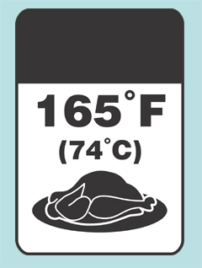
The 7 HACCP Principles
Principle 3: Establish critical limits
For each CCP, establish minimum or maximum limits
These limits must be met to
Prevent or eliminate the hazard
Reduce it to a safe level
Critical
Limit
8-13
Notes:
Instructor Notes
Here is a real-world example showing the efforts of Enrico’s, an Italian restaurant, as it implements a HACCP program:
With cooking identified as the CCP for Enrico’s chicken breasts, a critical limit was needed. Management determined that the critical limit would be cooking the chicken to a minimum internal temperature of 165°F (74°C) for 15 seconds.
They decided that the critical limit could be met by cooking chicken breasts in the broiler for 16 minutes.

Slide 14
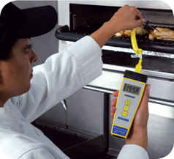
The 7 HACCP Principles
Principle 4: Establish monitoring procedures
Determine the best way to check critical limits
Make sure they are consistently met
Identify who will monitor them and how often
8-14
Notes:
Instructor Notes
Here is a real-world example showing the efforts of Enrico’s, an Italian restaurant, as it implements a HACCP program:
At Enrico’s, each charbroiled chicken breast is cooked to order. The team decided to check the critical limit by inserting a clean and sanitized thermocouple probe into the thickest part of each chicken breast.
The grill cook must check the temperature of each chicken breast after cooking. Each chicken breast must reach the minimum internal temperature of 165°F (74°C) for 15 seconds.

Slide 15
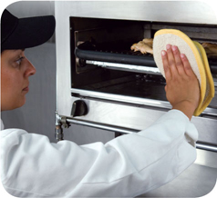
The 7 HACCP Principles
Principle 5: Identify corrective actions
Identify steps that must be taken when a critical limit is not met
Determine these steps in advance
8-15
Notes:
Instructor Notes
Here is a real-world example showing the efforts of Enrico’s, an Italian restaurant, as it implements a HACCP program:
If the chicken breast has not reached its critical limit within the 16-minute cook time, the grill cook at Enrico’s must keep cooking the chicken breast until it has reached it.
This and all other corrective actions are noted in the temperature log.

Slide 16
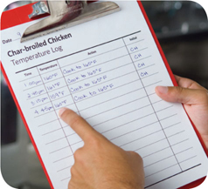
The 7 HACCP Principles
Principle 6: Verify that the system works
Determine if the plan is working as intended
Evaluate the plan on a regular basis using
Monitoring charts
Records
Hazard analysis
Determine if your plan prevents, reduces, or eliminates identified hazards
8-16
Notes:
Instructor Notes
Here is a real-world example showing the efforts of Enrico’s, an Italian restaurant, as it implements a HACCP program:
Enrico’s management team performs HACCP checks once per shift. They make sure that critical limits were met and appropriate corrective actions were taken when needed.
They also check the temperature logs on a weekly basis to identify patterns. This helps to determine if processes or procedures need to be changed. For example, over several weeks they noticed problems toward the end of each week. The chicken breasts often failed to meet the critical limit. The appropriate corrective action was being taken.
Management discovered that Enrico’s received chicken shipments from a different supplier on Thursdays. This supplier provided a six-ounce chicken breast. Enrico’s chicken specifications listed a four-ounce chicken breast. Management worked with the supplier to ensure they received four-ounce breasts. The receiving procedures were changed to include a weight check.

Slide 17

The 7 HACCP Principles
Principle 7: Establish procedures for record keeping and documentation
Keep records for these actions:
Monitoring activities
Corrective actions
Validating equipment (checking for good working condition)
Working with suppliers (invoices, specifications, etc.)
8-17
Notes:
Instructor Notes
Maintain your HACCP plan and keep all documentation created when developing it.
Here is a real-world example showing the efforts of Enrico’s, an Italian restaurant, as it implements a HACCP program:
Enrico’s management team determined that time-temperature logs should be kept for three months. Receiving invoices would be kept for 60 days. The team used this documentation to support and revise their HACCP plan.

Slide 18
HACCP
These specialized processing methods require a variance and may require a HACCP plan:
Smoking food as a method to preserve it (but not to enhance flavor)
Using food additives or components such as vinegar to preserve or alter food so it no longer requires time and temperature control for safety
Curing food
Custom-processing animals
8-18
Notes:
Instructor Notes
Some food processes are highly specialized and can be a serious health risk if specific procedures are not followed. Typically these processes are carried out at processing plants.
A variance from the regulatory authority will be required before processing food this way. A variance is a document that allows a requirement to be waived or changed.
A HACCP plan may also be required if the processing method carries a higher risk of causing a foodborne illness. There may also be dangers unique to these processes that are best addressed by HACCP.

Slide 19
HACCP
These specialized processing methods require a variance and may require a HACCP plan:
Packaging food using ROP methods including
MAP
Vacuum-packed
Sous vide
Treating (e.g. pasteurizing) juice on-site and packaging it for later sale
Sprouting seeds or beans
8-19
Notes:
Instructor Notes
Always check with your local regulatory authority to see if a variance is also required when prepping food in these ways.
A HACCP plan is required when packaging food using reduced-oxygen packaging (ROP) methods. This includes MAP, vacuum-packed, and sous vide food. Clostridium botulinum and Listeria monocytogenes are risks to food packaged in these ways.

