Slide 2
How Contamination Happens
Contaminants come from a variety of places:
Animals we use for food
Air, contaminated water, and dirt
People
Deliberately
Accidentally
2-2
Notes:
Instructor Notes
Contamination comes from a variety of places.
Contaminants can cause foodborne illness or result in physical injury.
Contaminants are found in the animals we use for food, the air, water, dirt; and they occur naturally in food, such as bones in fish.
Food can be contaminated on purpose.
Most food is contaminated accidently.
Examples of accidental contamination include: food handlers who don’t wash their hands after using the restroom, and then contaminate food and surfaces with feces from their fingers; and food handlers who pass contaminants through illness.

Slide 3
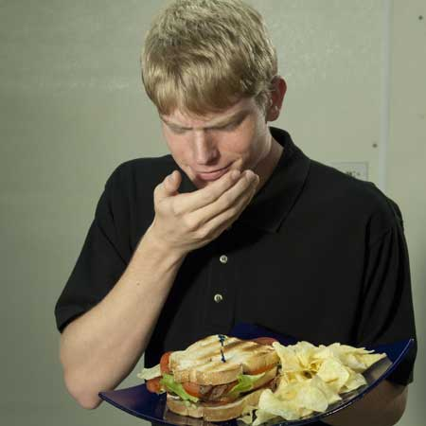
How Contamination Happens
People can contaminate food when:
They do not wash their hands after using the restroom
They are in contact with a person who is sick
They sneeze or vomit onto food or food-contact surfaces
They touch dirty food-contact surfaces and equipment and then touch food
2-3
Notes:
Instructor Notes
Food handlers who don’t wash their hands after using the restroom may contaminate food and surfaces with feces from their fingers. Once the food that the food handler touched is eaten, a foodborne illness may result. This is called the fecal-oral route of contamination.

Slide 4
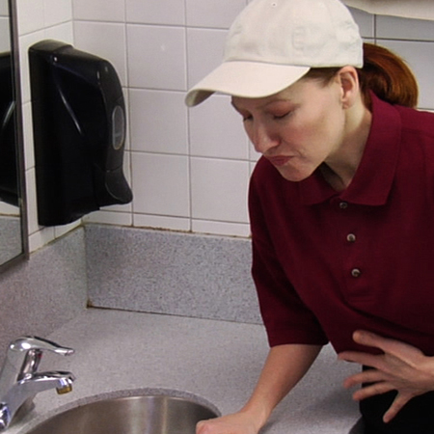
Biological Contamination
Common symptoms of foodborne illness:
Diarrhea
Vomiting
Fever
Nausea
Abdominal cramps
Jaundice (yellowing of skin and eyes)
Onset times:
Depend on the type of foodborne illness
Can range from 30 minutes to six weeks
2-4
Notes:
Instructor Notes
The symptoms of a foodborne illness vary depending on which illness a person has. But most victims of foodborne illness share some common symptoms.
Not every person who is sick from a foodborne illness will have all of these symptoms. Nor are the symptoms of a foodborne illness limited to this list.
How quickly foodborne-illness symptoms appear in a person is known as the onset time of the illness. Onset times depend on the type of foodborne illness a person has. They can range from 30 minutes to as long as six weeks. How severe the illness is can also vary, from mild diarrhea to death.

Slide 5
The “Big Six” Pathogens
Food handlers diagnosed with illnesses from the “Big Six” pathogens cannot work in a foodservice operation while they are sick.
Shigella spp.
Salmonella Typhi
Nontyphoidal Salmonella (NTS)
Shiga toxin-producing Escherichia coli (STEC), also known as E. coli
Hepatitis A
Norovirus
2-5
Notes:
Instructor Notes
According to the Food and Drug Administration (FDA), there are over 40 different kinds of bacteria, viruses, parasites, and molds that can occur in food and cause a foodborne illness. Of these, six have been singled out by the FDA. These have been dubbed the “Big Six” because they are highly contagious and can cause severe illness. They include:
Shigella spp.
Salmonella Typhi
Nontyphoidal Salmonella (NTS)
Shiga toxin-producing Escherichia coli (STEC), also known as E. coli
Hepatitis A
Norovirus
These pathogens are often found in very high numbers in an infected person’s feces and can be transferred to food easily. A person does not have to eat much of the pathogen in order to get sick, and that illness is often severe. For this reason, food handlers diagnosed with illnesses from these pathogens cannot work in a foodservice operation while they are sick.

Slide 6
Major Bacteria That Cause Foodborne Illness
The FDA has identified four types of bacteria that cause severe illness and are highly contagious:
Salmonella Typhi
Nontyphoidal Salmonella
Shigella spp.
Shiga toxin-producing Escherichia coli
2-6
Notes:
Instructor Notes
Food handlers with illnesses from these bacteria can NEVER work in a foodservice operation while they are sick.
These four bacteria are included in the FDA’s “Big Six” pathogens.

Slide 7
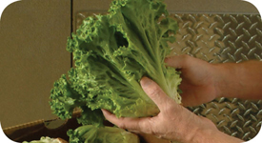
Major Bacteria That Cause Foodborne Illness
Bacteria: Salmonella Typhi (SAL-me-NEL-uh TI-fee)
Source: People
Food Linked with the Bacteria | Prevention Measures
Ready-to-eat food Beverages | Exclude food handlers diagnosed with an illness caused by Salmonella Typhi from the operation
 | Wash hands
 | Cook food to minimum internal temperatures
2-7
Notes:
Instructor Notes
Salmonella Typhi lives only in humans.
People with typhoid fever carry the bacteria in their bloodstream and intestinal tract.
Eating only a small amount of these bacteria can make a person sick.
The severity of symptoms depends on the health of the person and the amount of bacteria eaten. The bacteria are often in a person’s feces for weeks after symptoms have ended.

Slide 8
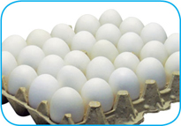
Major Bacteria That Cause Foodborne Illness
Bacteria: Nontyphoidal Salmonella (SAL-me-NEL-uh)
Source: Farm animals
Food Linked with the Bacteria | Prevention Measures
Poultry and eggs Meat Milk and Dairy products Produce, such as tomatoes, peppers, and cantaloupes | Cook poultry and eggs to minimum internal temperatures
 | Prevent cross-contamination between poultry and ready-to-eat food
 | Keep food handlers who are vomiting or have diarrhea and have been diagnosed with an illness from nontyphoidal Salmonella out of the operation
2-8
Notes:
Instructor Notes
Many farm animals carry nontyphoidal Salmonella naturally.
Eating only a small amount of these bacteria can make a person sick.
The severity of symptoms depends on the health of the person and the amount of bacteria eaten. The bacteria are often in a person’s feces for weeks after symptoms have ended.

Slide 9
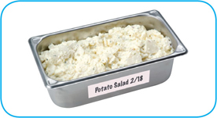
Major Bacteria That Cause Foodborne Illness
Bacteria: Shigella spp. (shi-GEL-uh)
Source: Humans
Food Linked with the Bacteria | Prevention Measures
Food easily contaminated by hands, such as salads containing TCS food (potato, tuna, shrimp, macaroni, chicken) | Exclude food handlers who have diarrhea and have been diagnosed with an illness caused by Shigella spp. from the operation Exclude food handlers who have diarrhea from the operation
Food that has made contact with contaminated water, such as produce | Wash hands
 | Control flies inside and outside the operation
2-9
Notes:
Instructor Notes
Shigella spp. is found in the feces of humans with the illness.
Most illnesses occur when people eat or drink contaminated food or water.
Flies can also transfer the bacteria from feces to food.
Eating only a small amount of these bacteria can make a person sick.
High levels of the bacteria are often in a person’s feces for weeks after symptoms have ended.

Slide 10
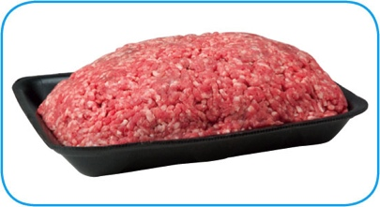
Major Bacteria That Cause Foodborne Illness
Bacteria: Shiga toxin-producing Escherichia coli (ess-chur-EE-kee-UH-KO-LI)
Source: Intestines of cattle; infected people
Food Linked with the Bacteria | Prevention Measures
Ground beef (raw and undercooked) Contaminated produce | Exclude food handlers who have diarrhea and have been diagnosed with a disease from the bacteria Cook food, especially ground beef, to minimum internal temperatures
 | Purchase produce from approved, reputable suppliers
 | Prevent cross-contamination between raw meat and ready-to-eat food
2-10
Notes:
Instructor Notes
Shiga toxin-producing E. coli can be found in the intestines of cattle.
It is also found in infected people.
The bacteria can contaminate meat during slaughtering.
Eating only a small amount of the bacteria can make a person sick.
Once eaten, it produces toxins in the intestines, which cause the illness.
The bacteria are often in a person’s feces for weeks after symptoms have ended.

Slide 11
Major Viruses that Cause Foodborne Illnesses
The FDA has identified two viruses that are highly contagious and can cause severe illness:
Hepatitis A
Norovirus
Food handlers diagnosed with an illness from hepatitis A or Norovirus must not work in an operation while they are sick.
2-11
Notes:
Instructor Notes
These two viruses are included in the FDA’s “Big Six” pathogens.

Slide 12
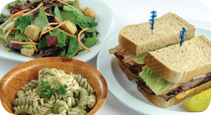
Major Viruses That Cause Foodborne Illness
Virus: Hepatitis A (HEP-a-TI-tiss)
Source: Infected people
Food Linked with the Virus | Prevention Measures
Ready-to-eat food Shellfish from contaminated water | Exclude food handlers who have been diagnosed with hepatitis A from the operation
 | Exclude food handlers who have jaundice for seven days or less from the operation
 | Wash hands
 | Avoid bare-hand contact with ready-to-eat food
 | Purchase shellfish from approved, reputable suppliers
2-12
Notes:
Instructor Notes
Hepatitis A is mainly found in the feces of people infected with it.
The virus can contaminate water and many types of food.
It is commonly linked with ready-to-eat food. However, it has also been linked with shellfish from contaminated water.
The virus is often transferred to food when infected food handlers touch food or equipment with fingers that have feces on them.
Eating only a small amount of the virus can make a person sick.
An infected person may not show symptoms for weeks but can be very infectious.
Cooking does not destroy hepatitis A.

Slide 13
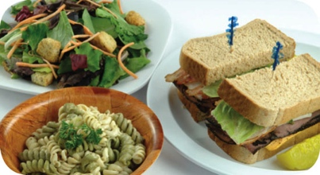
Major Viruses That Cause Foodborne Illness
Virus: Norovirus (NOR-o-VI-rus)
Source: Infected people
Food Linked with the Virus | Prevention Measures
Ready-to-eat food Shellfish from contaminated water | Exclude food handlers who are vomiting or have diarrhea and have been diagnosed with Norovirus from the operation
 | Wash hands
 | Avoid bare-hand contact with ready-to-eat food
 | Purchase shellfish from approved, reputable suppliers
2-13
Notes:
Instructor Notes
Like hepatitis A, Norovirus is commonly linked with ready-to-eat food.
It has also been linked with contaminated water.
Norovirus is often transferred to food when infected food handlers touch food or equipment with fingers that have feces on them.
Eating only a small amount of Norovirus can make a person sick. It is also very contagious.
People become contagious within a few hours after eating it.
The virus is often in a person’s feces for days after symptoms have ended.

Slide 14
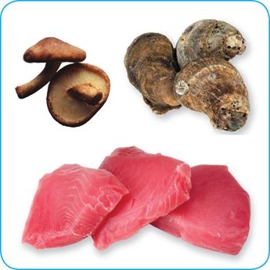
Biological Toxins
Origin:
Naturally occur in certain plants, mushrooms, and seafood
Seafood toxins:
Produced by pathogens found on certain fish
Tuna, bonito, mahimahi
Histamine produced when fish is time-temperature abused
Occur in certain fish that eat smaller fish that have consumed the toxin
Barracuda, snapper, grouper, amberjack
Ciguatera toxin is an example
2-14
Notes:
Instructor Notes
Some toxins are naturally associated with certain plants, mushrooms, and seafood. Toxins are a natural part of some fish.
Other toxins, such as histamine, are made by pathogens on the fish when it is time-temperature abused. This can occur in tuna, bonito, mackerel, and mahimahi.
Some fish become contaminated when they eat smaller fish that have eaten a toxin. One of these toxins is the ciguatera toxin. It can be found in barracuda, snapper, grouper, and amberjack. Shellfish, such as oysters, can be contaminated when they eat marine algae that have a toxin.

Slide 15
Biological Toxins
Illness:
Symptoms and onset times vary with illness
People will experience illness within minutes
General symptoms:
Diarrhea or vomiting
Neurological symptoms
Tingling in extremities
Reversal of hot and cold sensations
Flushing of the face and/or hives
Difficulty breathing
Heart palpitations
2-15
Notes:
Instructor Notes
Toxins cannot be destroyed by cooking or freezing. The most important way to prevent a foodborne illness is to purchase plants, mushrooms, and seafood from approved, reputable suppliers. It is also important to control time and temperature when handling raw fish.

Slide 16
Deliberate Contamination of Food
Groups who may attempt to contaminate food:
Terrorists or activists
Disgruntled current or former staff
Vendors
Competitors
FDA defense tool:
A.L.E.R.T.
2-16
Notes:
Instructor Notes
So far, you have learned about methods to prevent the accidental contamination of food. But you also must take steps to stop people who are actually trying to contaminate it. This may include the groups listed on the slide.
These people may try to tamper with your food using biological, chemical, or physical contaminants. They may even use radioactive materials. Attacks might occur anywhere in the food supply chain. But they are usually focused on a specific food item, process, or business.
The best way to protect food is to make it as difficult as possible for someone to tamper with it. For this reason, a food defense program should deal with the points in your operation where food is at risk.
The FDA has created a tool that can be used to develop a food defense program. It is based on the acronym A.L.E.R.T. It can be used to help you identify the points in your operation where food is at risk.

Slide 17
Deliberate Contamination of Food
Assure Make sure products received are from safe sources
Look Monitor the security of products in the facility
Employees Know who is in your facility
Reports Keep information related to food defense accessible
Threat Develop a plan for responding to suspicious activity or a threat to the operation
2-17
Notes:
Instructor Notes
Assure Make sure that products you receive are from safe sources. Supervise product deliveries. Use approved suppliers who practice food defense. Request that delivery vehicles are locked or sealed.
Look Monitor the security of products in the facility. Limit access to prep and storage areas. Locking storage areas is one way to do this. Create a system for handling damaged products. Store chemicals in a secure location. Train staff to spot food defense threats.
Employees Know who is in your facility. Limit access to prep and storage areas. Identify all visitors, and verify credentials. Conduct background checks on staff.
Reports Keep information related to food defense accessible: receiving logs, office files and documents, staff files, and random food defense self-inspections.
Threat Identify what you will do and who you will contact if there is suspicious activity or a threat at your operation. Hold any product you suspect to be contaminated. Contact your regulatory authority immediately. Maintain an emergency contact list.

Slide 18
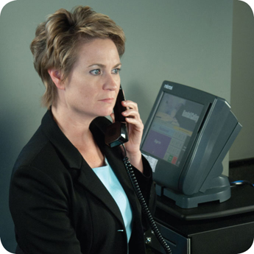
Responding to a Foodborne-Illness Outbreak
Gather information
Ask the person for general contact information
Ask the person to identify the food eaten
Ask for a description of symptoms
Ask when the person first got sick
Notify authorities
Contact the local regulatory authority if an outbreak is suspected
2-18
Notes:
Instructor Notes
Ask the person making the complaint for general contact information and to identify the food that was eaten. Also ask for a description of symptoms and when the person first got sick.
Contact the local regulatory authority if you suspect an outbreak.

Slide 19
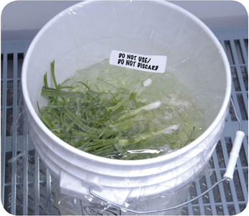
Responding to a Foodborne-Illness Outbreak
Segregate product
Set the suspected product aside if any remains
Include a label with “Do Not Use” and “Do Not Discard” on it
Document the information
Log information about suspected product
Include a product description, product date, lot number, sell-by date, and pack size
2-19
Notes:
Instructor Notes
Set the suspected product aside if any remains. Include a label with Do Not Use and Do Not Discard on it, as shown in the photo on the slide.
Log information about the suspected product. This might include a product description, production date, and lot number. The sell-by date and pack size should also be recorded.

Slide 20
Responding to a Foodborne-Illness Outbreak
Identify staff
Keep a list of food handlers scheduled at time of incident
Interview staff immediately
Cooperate with authorities
Provide appropriate documentation
Review procedures
Determine if standards are being met
Identify if standards are not working
2-20
Notes:
Instructor Notes
Maintain a list of food handlers scheduled at the time of the suspected contamination. These staff members may be subject to an interview and sampling by investigators. They should also be interviewed immediately by management about their health status.
Cooperate with regulatory authorities in the investigation. Provide appropriate documentation. You may be asked to provide temperature logs, HACCP documents, staff files, etc.
Review food-handling procedures to identify if standards are not being met or procedures are not working.

Slide 21
Preventing Allergic Reactions
To help prevent allergic reactions, service staff should:
Describe menu items to guests, and identify any allergens in the item.
Suggest menu items without the allergen.
Clearly identify the guest's order for kitchen and service staff.
Deliver food separately to prevent cross-contact.
2-21
Notes:
Instructor Notes
Your staff should be able to tell customers about menu items that contain potential allergens. At minimum, have one person available per shift to answer customers’ questions about menu items. When working with a customer to place an allergen special order, staff must be able to do the following.
Describe menu items to guests, and identify any allergens in the item. Identify any “secret” ingredients. For example, your operation may have a house specialty that includes an allergen.
Suggest menu items that do not contain the food that the customer is allergic to.
Identify the allergen special order. Clearly mark or otherwise indicate the order for the guest with the identified food allergy. This is done to inform the kitchen staff of the guest’s food allergy.
Confirm the allergen special order with the kitchen staff when picking up the food. Make sure no garnishes or other items containing the allergen touch the plate. Food should be hand-delivered to guests with allergies. Delivering food separately from the other food delivered to a table will help prevent contact with food allergens.

Slide 22
Avoiding Cross-Contact
When preparing food for a guest with a known allergy, kitchen staff should:
Check recipes and food labels for the allergen
Use cleaned and sanitized utensils
Wash hands and change gloves
Use separate fryers and cooking oils
Label packages properly
2-22
Notes:
Instructor Notes
When preparing an allergen special order, always check recipes and food labels for the allergen. Manufactured products that contain one or more of the Big Eight allergens are required to clearly identify them on the ingredient label. This makes it easy to see if a product is safe.
Used cleaned an sanitized utensils and equipment, including food-prep surfaces. Some operations use a separate set of cooking utensils just for allergen special orders. Make sure the allergen does not touch anything for customers with food allergies.
Wash hands and change gloves before preparing the order.
Use separate fryers and cooking oils when frying food for customers with food allergies. As an example, cooking shrimp in a fryer will make that oil dangerous for guest with a shellfish allergy. Any other food cooked in that oil could cause an allergic reaction in those guests.
When labeling food packaged on-site for retail sale, make sure the label includes any of the Big Eight allergens contained in the product.

