Slide 2
Purchasing
and
Receiving
5-2

Slide 3
Receiving and Inspecting
Key drop deliveries:
Supplier is given after-hours access to the operation to make deliveries
Deliveries must meet the following criteria
Be inspected upon arrival at the operation
Be from an approved source
Have been placed in the correct storage location to maintain the required temperature
Have been protected from contamination in storage
Is NOT contaminated
Is honestly presented
5-3
Notes:
Instructor Notes
Some foodservice operations receive food after-hours when they are closed for business. This is often referred to as a key drop delivery.
The supplier is given a key or other access to the operation to make the delivery. Products are then placed in coolers, freezers, and dry storage areas. The delivery must be inspected once you arrive at the operation and meet the criteria identified in the slide.

Slide 4
Receiving and Inspecting
Recalls:
Identify the recalled food items
Remove the item from inventory, and place it in a secure and appropriate location
Store the item separately from food, utensils, equipment, linens, and single-use items
Label the item in a way that will prevent it from being placed back in inventory
Inform staff not to use the product
Refer to the vendor’s notification or recall notice to determine what to do with the item
5-4
Notes:
Instructor Notes
Food items you have received may sometimes be recalled by the manufacturer. This may happen when food contamination is confirmed or suspected. It can also occur when items have been mislabeled or misbranded. Often food is recalled when food allergens have not been identified on the label. Most vendors will notify you of the recall. However, you should also monitor recall notifications made by the FDA and the USDA. Follow the guidelines in the slide when notified of a recall.
Identify the recalled food items by matching information from the recall notice to the item. This may include the manufacturer’s ID, the time the item was manufactured, and the item’s use-by date.
Remove the item from inventory, and place it in a secure and appropriate location. That may be a cooler or dry-storage area.
The recalled item must be stored separately from food, utensils, equipment, linens, and single-use items.
Label the item in a way that will prevent it from being placed back in inventory. Some operations do this by including a Do Not Use and Do Not Discard label on recalled food items. Inform staff not to use the product.
Refer to the vendor’s notification or recall notice for what to do with the item. For example, you might be instructed to throw it out or return it to the vendor.

Slide 5
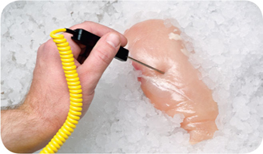
Receiving and Inspecting
Checking the temperature of meat, poultry, and fish:
Insert the thermometer stem or probe into the thickest part of the food (usually the center)
5-5

Slide 6
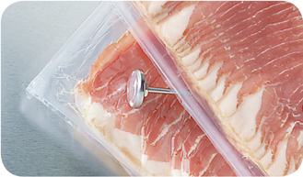
Receiving and Inspecting
Checking the temperature of ROP Food (MAP, vacuum-packed, and sous vide food):
Insert the thermometer stem or probe between two packages
As an alternative, fold packaging around the thermometer stem or probe
5-6
Notes:
Instructor Notes
ROP stands for reduced-oxygen packaging. It includes MAP, vacuum-packed, and sous vide food.
It may be possible to check the temperature of bulk food by folding the packaging around the thermometer stem or probe. You must be careful not to puncture the packaging when using this method.

Slide 7
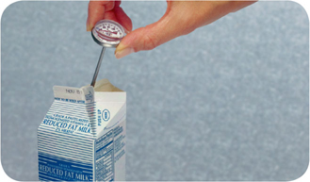
Receiving and Inspecting
Checking the temperature of other packaged food:
Open the package and insert the thermometer stem or probe into the food
5-7
Notes:
Instructor Notes
When checking the temperature of food by this method, make sure the sensing area of the thermometer stem or probe is fully immersed in the food. It must not touch the package.

Slide 8
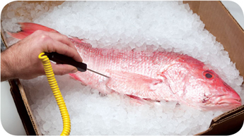
Receiving and Inspecting
Temperature criteria for deliveries:
Cold TCS food: Receive at 41˚F (5˚C) or lower, unless otherwise specified
Live shellfish: Receive oysters, mussels, clams, and scallops at an air temperature of 45˚F (7˚C) and an internal temperature no greater than 50˚F (10˚C)
Once received, the shellfish must be cooled to 41˚F (5˚C) or lower in four hours
Shucked shellfish: Receive at 45˚F (7˚C) or lower
Cool the shellfish to 41˚F (5˚C) or lower in four hours
5-8

Slide 9
Receiving and Inspecting
Required documents:
Farm raised fish
Must have documentation stating the fish was raised to FDA standards
Keep documents for 90 days from the sale of the fish
5-9

Slide 10
Storage
5-10

Slide 11
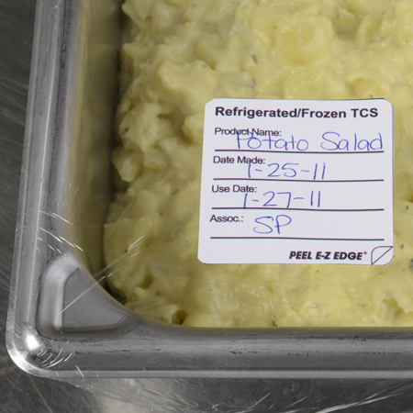
Storage
Labeling food for use on-site:
All items not in their original containers must be labeled
Food labels should include the common name of the food or a statement that clearly and accurately identifies it
It is not necessary to label food if it clearly will not be mistaken for another item
5-11
Notes:
Instructor Notes
Labeling food is important for many reasons. Illnesses have occurred when unlabeled chemicals were mistaken for food such as flour, sugar, and baking powder. Customers have also suffered allergic reactions when food was unknowingly prepped with a food allergen that was not labeled.
It is not necessary to label food if clearly it will not be mistaken for another item. The food must be easily identified by sight

Slide 12
Storage
Labeling food packaged on-site for retail sale:
Common name of the food or a statement clearly identifying it
Quantity of the food
If the item contains two or more ingredients, list the ingredients and sub ingredients in descending order by weight
List of artificial colors and flavors in the food including chemical preservatives
Name and place of business of the manufacturer, packer, or distributor
Source of each major food allergen contained in the food
5-12
Notes:
Instructor Notes
Food packaged in the operation that is being sold to customers for use at home must be labeled. The label must include the information on the slide.
Naming the source of each major food allergen contained in the food is not necessary if the source is already part of the common name of the ingredient.

Slide 13
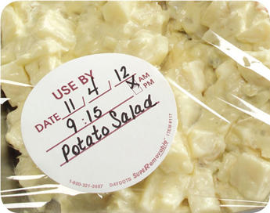
Storage
Date marking:
Ready-to-eat TCS food must be marked if held for longer than 24 hours
Date mark must indicate when the food must be sold, eaten, or thrown out
5-13
Notes:
Instructor Notes
Refrigeration slows the growth of most bacteria. Some types, such as Listeria monocytogenes, grow well at refrigeration temperatures. When food is refrigerated for long periods of time, these bacteria can grow enough to cause illness. For this reason, ready-to-eat TCS food must be marked if held for longer than 24 hours. It must indicate when the food must be sold, eaten, or thrown out.

Slide 14
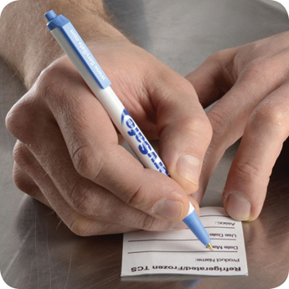
Storage
Date marking:
Ready-to-eat TCS food can be stored for only seven days if it is held at 41˚F (5˚C) or lower
The count begins on the day that the food was prepared or a commercial container was opened
For example, potato salad prepared and stored on October 1 would have a discard date of October 7 on the label
Some operations write the day or date the food was prepared on the label; others write the use-by day or date on the label
5-14

Slide 15
Storage
Date marking:
If:
A commercially processed food has a use-by date that is less than seven days from the date the container was opened
Then:
The container should be marked with this use-by date as long as the date is based on food safety
5-15
Notes:
Instructor Notes
Operations have a variety of systems for date marking. Some write the day or date the food was prepped on the label. Others write the use-by day or date on the label.

Slide 16
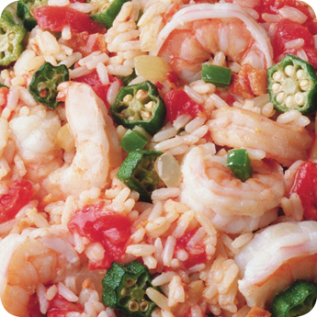
Storage
Date marking:
When combining food in a dish with different use-by dates, the discard date of the dish should be based on the earliest prepared food
Consider a shrimp and sausage jambalaya prepared on December 4
The shrimp has a use-by date of December 8
The sausage has a use-by date of December 10
The use-by date of the jambalaya is December 8
5-16

Slide 17
Storage
Temperatures:
Store TCS food at an internal temperature of 41˚F (5˚C) or lower or 135˚F (57˚C) or higher
Store frozen food at temperatures that keep it frozen
Make sure storage units have at least one air temperature measuring device; it must be accurate to +/- 3˚F or +/- 1.5˚C
Place the device in the warmest part of refrigerated units, and the coldest part of hot-holding units
5-17
Notes:
Instructor Notes
Pathogens can grow when food is not stored at the correct temperature. Follow the guidelines on the slide to keep food safe.

Slide 18
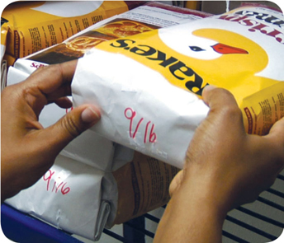
Storage
Rotate food to use the oldest inventory first:
One way to rotate products is to follow FIFO
Identify the food item’s use-by or expiration date
Store items with the earliest use-by or expiration dates in front of items with later dates
Once shelved, use those items stored in front first
Throw out food that has passed its manufacturer’s use-by or expiration date
5-18
Notes:
Instructor Notes
Food must be rotated in storage to maintain quality and limit the growth of pathogens. Food items must be rotated so that those with the earliest use-by or expiration dates are used before items with later dates.
Many operations use the first-in, first-out (FIFO) method to rotate their refrigerated, frozen, and dry food during storage. The slide explains one way to use the FIFO method.

Slide 19
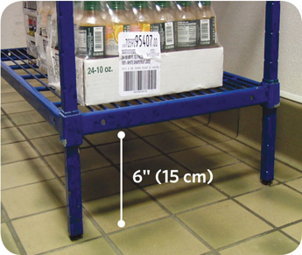
Storage
Preventing cross-contamination:
Store all items in designated storage areas
Store items away from walls and at least six inches (15 centimeters) off the floor
Store single-use items (e.g., sleeve of single-use cups, single-use gloves) in original packaging
5-19

Slide 20
Storage
Food should be stored in a clean, dry location away from dust and other contaminants:
To prevent contamination, NEVER store food in these areas
Locker rooms or dressing rooms
Restrooms or garbage rooms
Mechanical rooms
Under unshielded sewer lines or leaking water lines
Under stairwells
5-20

