Slide 2
General Preparation Practices
Food and color additives:
Only use additives approved by your local regulatory authority
NEVER use more additives than are allowed by law
NEVER use additives to alter the appearance of food
Do NOT sell produce treated with sulfites before it was received in the operation
NEVER add sulfites to produce that will be eaten raw
6-2

Slide 3
General Preparation Practices
Present food honestly:
Do NOT use the following to misrepresent the appearance of food
Food additives or color additives
Colored overwraps
Lights
Food not presented honestly must be thrown out
6-3
Notes:
Instructor Notes
Food must be offered to customers in a way that does not mislead or misinform them. Customers must be able to judge the true appearance, color, and quality of food.

Slide 4
General Preparation Practices
Corrective actions:
Food must be thrown out in the following situations
When it is handled by staff who have been restricted or excluded from the operation due to illness
When it is contaminated by hands or bodily fluids from the nose or mouth
When it has exceeded the time and temperature requirements designed to keep food safe
6-4
Notes:
Instructor Notes
• Food that has become unsafe must be thrown out unless it can be safely reconditioned. All food—especially ready-to-eat food—must be thrown out in the situations highlighted in the slide.
• Sometimes food can be restored to a safe condition. This is called reconditioning. For example, a hot food that has not been held at the correct temperature may be reheated if it has not been in the temperature danger zone for more than four hours.

Slide 5
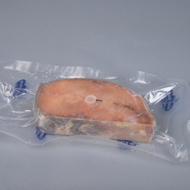
Thawing ROP Fish
Frozen fish received in ROP packaging must be thawed carefully.
If the label states that the product must remain frozen until use, then remove the fish from the packaging:
Before thawing under refrigeration.
Before or immediately after thawing under running water.
6-5
Notes:
Instructor Notes
Because of concerns about the potential for Botulism, frozen fish in ROP packaging has special handling practices.

Slide 6
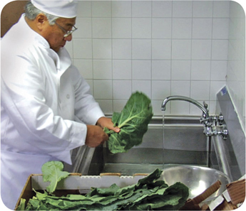
Prepping Specific Food
Produce:
Produce can be washed in water containing ozone to sanitize it
Check with your local regulatory authority
When soaking or storing produce in standing water or an ice-water slurry, do NOT mix
Different items
Multiple batches of the same item
6-6
Notes:
Instructor Notes
Certain chemicals may be used to wash fruits and vegetables. Also, produce can be treated by washing it in water containing ozone. This treatment helps control pathogens. Check your local regulatory requirements.

Slide 7
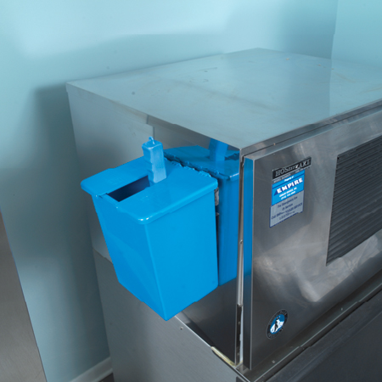
Prepping Specific Food
Ice:
NEVER use ice as an ingredient if it was used to keep food cold
Transfer ice using clean and sanitized containers and scoops
NEVER hold ice in containers that held chemicals or raw meat, seafood, or poultry
6-7
Notes:
Instructor Notes
Make ice from water that is safe to drink.
Never use ice as an ingredient if it was used to keep food cold. For example, if ice is used to cool food on a salad bar, it cannot then be used in drinks.

Slide 8
Prepping Specific Food
Ice:
Store ice scoops outside ice machines in a clean, protected location
NEVER use a glass to scoop ice or touch ice with hands
6-8

Slide 9
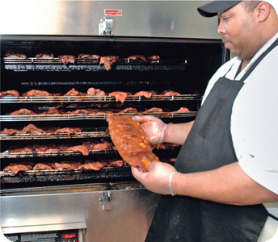
Preparation Practices That Have Special Requirements
You need a variance if prepping food in these ways:
Packaging fresh juice on-site for sale at a later time, unless the juice has a warning label
Smoking food to preserve it but not to enhance flavor
Using food additives or components to preserve or alter food so it no longer needs time and temperature control for safety
Curing food
6-9
Notes:
Instructor Notes
You will need a variance when prepping food in certain ways. A variance is a document issued by your regulatory authority that allows a regulatory requirement to be waived or changed.
When applying for a variance, your regulatory authority may require you to submit a HACCP plan. The plan must account for any food safety risks related to the way you plan to prep the food item.

Slide 10
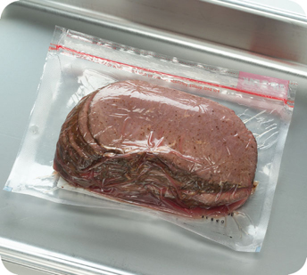
Preparation Practices
You need a variance if prepping food in these ways:
Packaging food using a reduced-oxygen packaging (ROP) method
Sprouting seeds or beans
Offering live shellfish from a display tank
Custom-processing animals for personal use (i.e. dressing a deer)
6-10
Notes:
Instructor Notes
Clostridium botulinum and Listeria monocytogenes are risks to food packaged using a reduced-oxygen packaging method. This includes MAP, vacuum-packed and sous vide foods.

Slide 11
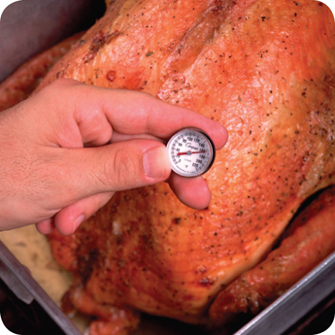
Cooking Requirements for Specific Food
Minimum internal cooking temperature:
165˚F (74˚C) for 15 seconds
Poultry—whole or ground chicken, turkey, or duck
Stuffing made with fish, meat, or poultry
Stuffed meat, seafood, poultry, or pasta
Dishes that include previously cooked, TCS ingredients
6-11

Slide 12
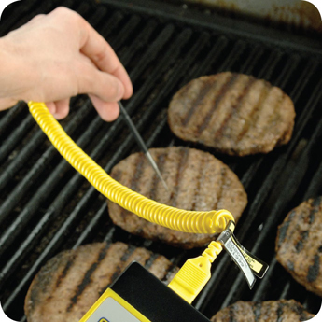
Cooking Requirements for Specific Food
Minimum internal cooking temperature:
155˚F (68˚C) for 15 seconds
Ground meat—beef, pork, and other meat
Injected meat—including brined ham and flavor-injected roasts
Mechanically tenderized meat
Ratites including ostrich and emu
Ground seafood—including chopped or minced seafood
Shell eggs that will be hot-held for service
6-12

Slide 13
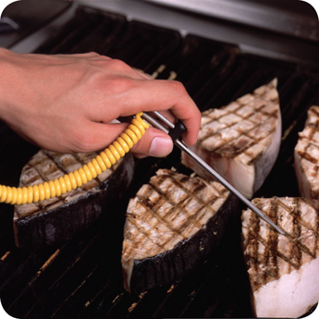
Cooking Requirements for Specific Food
Minimum internal cooking temperature:
145˚F (63˚C) for 15 seconds
Seafood—including fish, shellfish, and crustaceans
Steaks/chops of pork, beef, veal, and lamb
Commercially raised game
Shell eggs that will be served immediately
6-13

Slide 14
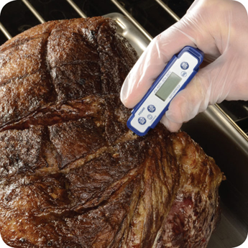
Cooking Requirements for Specific Food
Minimum internal cooking temperature:
145˚F (63˚F) for four minutes
Roasts of pork, beef, veal, and lamb
Alternate cooking times/temperatures
130˚F (54˚C) 112 minutes
131˚F (55˚C) 89 minutes
133˚F (56˚C) 56 minutes
135˚F (57˚C) 36 minutes
136˚F (58˚C) 28 minutes
138˚F (59˚C) 18 minutes
140˚F (60˚C) 12 minutes
142˚F (61˚C) 8 minutes
144˚F (62˚C) 5 minutes
6-14
Notes:
Instructor Notes
Roasts may be cooked to these alternate cooking times and temperatures depending on the type of roast and oven used:
130°F (54°C) 112 minutes
131°F (55°C) 89 minutes
133°F (56°C) 56 minutes
135°F (57°C) 36 minutes
136°F (58°C) 28 minutes
138°F (59°C) 18 minutes
140°F (60°C) 12 minutes
142°F (61°C) 8 minutes
144°F (62°C) 5 minutes

Slide 15
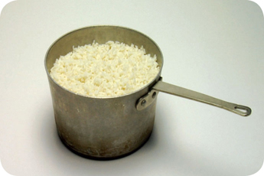
Cooking Requirements for Specific Food
Minimum internal cooking temperature:
135˚F (57˚C)
Fruit, vegetables, grains (rice, pasta), and legumes (beans, refried beans) that will be hot-held for service
6-15

Slide 16
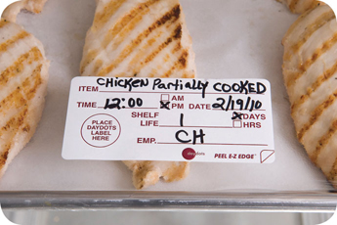
Partial Cooking During Preparation
If partially cooking meat, seafood, poultry, or eggs or dishes containing these items:
NEVER cook the food longer than 60 minutes during initial cooking
Cool the food immediately after initial cooking
Freeze or refrigerate the food after cooling
Heat the food to its required minimum internal temperature before selling or serving
Cool the food if it will not be served immediately or held for service
6-16
Notes:
Instructor Notes
Some operations partially cook food during prep and then finish cooking it just before service. You must follow the steps in the slide if you plan to partially cook meat, seafood, poultry, or eggs; or dishes containing these items.
Your local regulatory authority may require you to have written procedures that explain how the food cooked by this process will be prepped and stored. These procedures must be approved by the regulatory authority and describe the following:
How the requirements will be monitored and documented
Which corrective actions will be taken if requirements are not met
How these food items will be marked after initial cooking to indicate that they need further cooking
How these food items will be separated from ready-to-eat food during storage, once initial cooking is complete

Slide 17
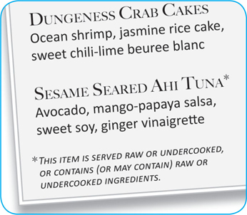
Consumer Advisories
If your menu includes raw or undercooked TCS items, you must:
Note it on the menu next to the items
Asterisk the item
Place a footnote at the menu bottom indicating the item is raw, undercooked, or contains raw or undercooked ingredients
Advise customers who order this food of the increased risk of foodborne illness
Post a notice in the menu
Provide this information using brochures, table tents, or signs
6-17
Notes:
Instructor Notes
If your menu includes TCS items that are raw or undercooked, you must note it on the menu next to these items. This can be done by placing an asterisk next to the item that points customers to a footnote at the bottom of the menu. The footnote must include a statement that indicates the item is raw or undercooked, or contains raw or undercooked ingredients.
You must advise customers who order food that is raw or undercooked of the increased risk of foodborne illness. You can do this by posting a notice in your menu. You can also provide this information using brochures, table tents, signs, or other written methods.

Slide 18
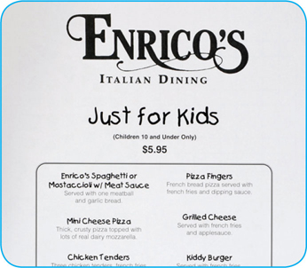
Consumer Advisories
The FDA advises against offering these items on a children’s menu if they are raw or undercooked:
Meat
Poultry
Seafood
Eggs
6-18
Notes:
Instructor Notes
The Food and Drug Administration (FDA) advises against offering raw or undercooked meat, poultry, seafood, or eggs on a children’s menu. This is especially true for undercooked ground beef, which may be contaminated with Shiga toxin-producing E. coli O157:H7.

Slide 19
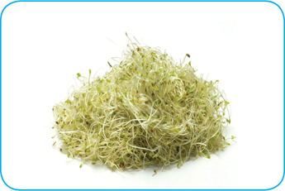
Operations That Mainly Serve High-Risk Populations
NEVER serve:
Raw seed sprouts
Raw or undercooked eggs, meat, or seafood
Over-easy eggs
Raw oysters on the half shell
Rare hamburgers
6-19

Slide 20
Storing Food for Further Cooling
When storing food for further cooling:
Loosely cover food containers before storing them
Food can be left uncovered if protected from contamination
Storing uncovered containers above other food, especially raw seafood, meat, and poultry, will help prevent cross-contamination
6-20
Notes:
Instructor Notes
Loosely cover food containers before storing them. Food can be left uncovered if stored in a way that prevents contaminants from getting into it. Storing uncovered containers above other food, especially raw seafood, meat, and poultry, will help prevent cross-contamination.

Slide 21
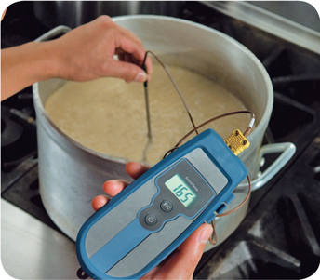
Reheating Food
Food reheated for immediate service:
Can be reheated to any temperature if it was cooked and cooled correctly
Food reheated for hot-holding:
Must be reheated to an internal temperature of 165˚F (74˚C) for 15 seconds within two hours
Reheat commercially processed and packaged ready-to-eat food to an internal temperature of at least 135˚F (57˚C)
6-21
Notes:
Instructor Notes
These guidelines apply to all heating methods, such as ovens or microwave ovens.

