Slide 2
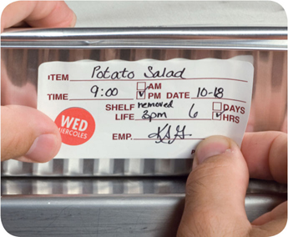
Holding Food Without Temperature Control
Cold food can be held without temperature control for up to six hours if:
It was held at 41˚F (5˚C) or lower before removing it from refrigeration
It does not exceed 70˚F (21˚C) during service
Throw out food that exceeds this temperature
It has a label specifying
Time it was removed from refrigeration
Time it must be thrown out
It is sold, served, or thrown out within six hours
7-2
Notes:
Instructor Notes
If your operation displays or holds TCS food without temperature control, it must do so under certain conditions. The conditions for holding cold food are different from those for holding hot food. Before using time as a method of control, check with your local regulatory authority for specific requirements.
For cold food, label the food with the time you removed it from refrigeration and the time you must throw it out. The discard time on the label must be six hours from the time you removed the food from refrigeration.
For example, if you remove potato salad from refrigeration at 3:00 p.m. to serve at a picnic, the discard time on the label should be 9:00 p.m. This equals six hours from the time you removed it from refrigeration.

Slide 3
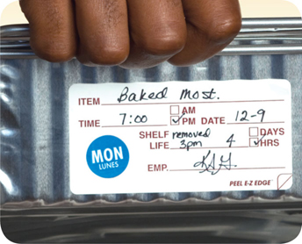
Holding Food Without Temperature Control
Hot food can be held without temperature control for up to four hours if:
It was held at 135˚F (57˚C) or higher before removing it from temperature control
It has a label specifying when the item must be thrown out
It is sold, served, or thrown out within four hours
7-3
Notes:
Instructor Notes
Before using time as a method of control, check with your local regulatory authority for specific requirements.
For hot food, the discard time on the label must be four hours from the time you removed the food from temperature control.

Slide 4
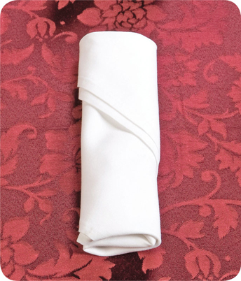
Preset Tableware
If you preset tableware:
Prevent it from being contaminated
Wrap or cover the items
Table settings do not need to be wrapped or covered if extra settings:
Are removed when guests are seated
Are cleaned and sanitized after guests have left
7-4
Notes:
Instructor Notes
Table settings do not need to be wrapped or covered if extra settings meet these requirements:
They are removed when guests are seated
If they remain on the table, they are cleaned and sanitized after guests have left

Slide 5
Refilling Returnable Take-Home Containers for Food
Some jurisdictions allow the refilling of take home food containers.
Take-home food containers must be:
Designed to be reused
Provided to the customer by the operation
Cleaned and sanitized correctly
7-5
Notes:
Instructor Notes
Some jurisdictions allow food handlers to refill take-home containers brought back by a customer with food and beverages. Take-home containers can be refilled if they meet these conditions.
They were designed to be reused
They were provided to the customer by the operation
They are cleaned and sanitized correctly

Slide 6
Refilling Returnable Take-Home Containers for Beverages
Some jurisdictions allow the refilling of take home beverage containers.
These can be refilled for the same customer with non-TCS food. The container must be:
Able to be effectively cleaned at home and at the operation
Rinsed with fresh, pressurized hot water before refilling
Refilled by staff in the operation or by the customer using a process that prevents contamination
7-6
Notes:
Instructor notes
Take-home beverage containers can be refilled as long as the beverage is not a TCS food and the container will be refilled for the same customer. The container must also meet these conditions.
It can be effectively cleaned at home and in the operation
It will be rinsed before refilling with fresh, hot water under pressure
It will be refilled by staff in the operation or by the customer using a process that prevents contamination

Slide 7
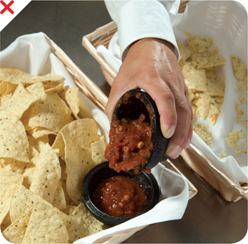
Re-serving Food
NEVER re-serve:
Food returned by one customer to another customer
Uncovered condiments
Uneaten bread
Plate garnishes
Generally, only unopened, prepackaged food in good condition can be re-served:
Condiment packets
Wrapped crackers or breadsticks
7-7
Notes:
Instructor Notes
You must protect condiments from contamination. Serve them in their original containers or in containers designed to prevent contamination. Offering condiments in individual packets or portions can also help keep them safe. Never re-serve uncovered condiments. Do not combine leftover condiments with fresh ones. Throw away opened portions or dishes of condiments after serving them to customers. Salsa, butter, mayonnaise, and ketchup are examples.
Change linens used in bread baskets after each customer.
In general, only unopened prepackaged food can be re-served. That includes condiment packets, wrapped crackers or breadsticks, and bottles of ketchup and mustard.

Slide 8
Labeling Bulk Food in Self-Service Areas
When labeling bulk food in self-service areas:
Make sure the label is in plain view of the customer
Include the manufacturer or processor label provided with the food
As an alternative, provide the information using a card, sign, or other labeling method
7-8

Slide 9
Labeling Bulk Food in Self-Service Areas
A label is not needed for bulk unpackaged food, such as bakery products, if:
The product makes no claim regarding health or nutrient content
No laws requiring labeling exist
The food is manufactured or prepared on the premises
The food is manufactured or prepared at another regulated food operation or processing plant owned by the same person
7-9
Notes:
Instructor Notes
Bulk unpackaged food, such as bakery products and unpackaged food portioned for customers, does not need to be labeled if it meets the conditions identified in the slide.

Slide 10
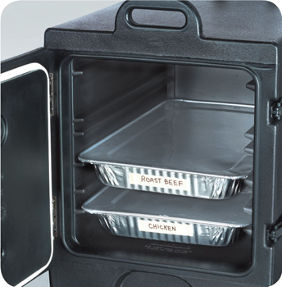
Off-Site Service
When delivering food off-site:
Use insulated, food-grade containers designed to stop food from mixing, leaking, or spilling
Clean the inside of delivery vehicles regularly
Check internal food temperatures
Label food with a use-by date and time, and reheating and service instructions
7-10
Notes:
Instructor Notes
Delays from the point of preparation to the point of service increase the risk that food will be exposed to contamination or time-temperature abuse.
At the service site, use appropriate containers or equipment to hold food at the correct temperature.
Check internal food temperatures. If containers or delivery vehicles are not holding food at the correct temperature, reevaluate the length of the delivery route or the efficiency of the equipment being used.

Slide 11
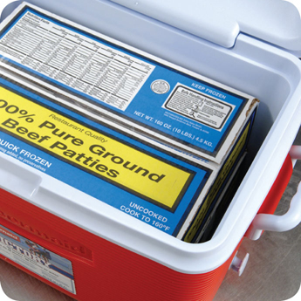
Off-Site Service
When delivering food off-site:
Make sure the service site has the correct utilities
Safe water for cooking, dishwashing, and handwashing
Garbage containers stored away from food-prep, storage, and serving areas
Store raw meat, poultry, and seafood, and ready-to-eat items separately
7-11

Slide 12
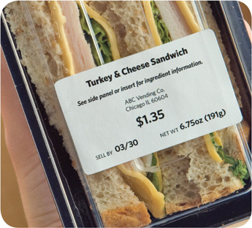
Vending Machines
To keep vended food safe:
Check product shelf life daily
Refrigerated food prepped on-site and not sold in seven days must be thrown out
Keep TCS food at the correct temperature
Dispense TCS food in its original container
Wash and wrap fresh fruit with edible peels before putting it in the machine
7-12
Notes:
Instructor Notes
Handle food prepped and packaged for vending machines with the same care as any other food served to customers. Vending operators should protect food from contamination and time-temperature abuse during transport, delivery, and service.
Check product shelf life daily. Products often have a code date, such as an expiration or a use-by date. If the date has expired, throw out the food immediately. Throw out refrigerated food prepped on-site if not sold within seven days of preparation.
Keep TCS food at the correct temperature. It should be held at 41°F (5°C) or lower, or at 135°F (57°C) or higher. These machines must have controls that prevent TCS food from being dispensed if the temperature stays in the danger zone for a specified amount of time. This food must be thrown out

