Slide 2
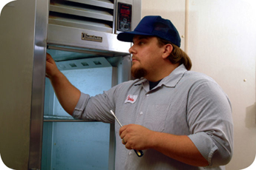
Installing and Maintaining Equipment
Once equipment has been installed:
It must be maintained regularly
Only qualified people should maintain it
Set up a maintenance schedule with your supplier or manufacturer
Check equipment regularly to make sure it is working correctly
9-2

Slide 3
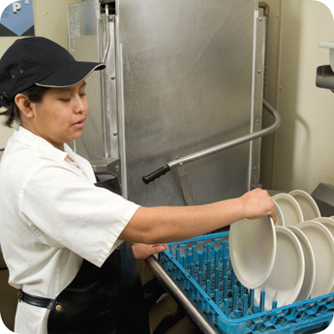
Dishwashing Machines
Dishwashers must be installed:
So they are reachable and conveniently located
In a way that keeps utensils, equipment, and other food-contact services from becoming contaminated
Following manufacturer’s instructions
9-3
Notes:
Instructor Notes
Always follow the manufacturer’s instructions when installing, operating, and maintaining dishwashers.

Slide 4
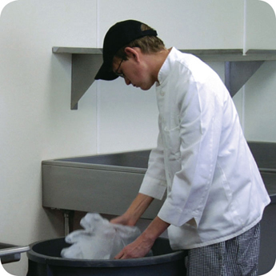
Garbage
Designated storage areas:
Store waste and recyclables separately from food and food-contact surfaces
Storage must not create a nuisance or a public health hazard
9-4
Notes:
Instructor Notes
Waste and recyclables must be stored separately from food and food-contact surfaces. The storage of these items must not create a nuisance or a public health hazard.

Slide 5
Emergencies That Affect the Facility
Imminent health hazard:
A significant threat or danger to health
Requires immediate correction or closure to prevent injury
Possible imminent health hazards:
Electrical power outages
Fire
Flood
Sewage backups
9-5
Notes:
Instructor Notes
Certain crises can affect the safety of the food you serve. Common crisis’ include electrical power outages, fire, flooding, and sewage backups. Local regulatory authorities consider these to be imminent health hazards. An imminent health hazard is a significant threat or danger to health that requires immediate correction or closure to prevent injury.
Temperature control: Power failures and refrigeration breakdowns can threaten your ability to control the temperature of TCS food, which can result in the growth of pathogens.
Physical security: Unauthorized people inside a facility are a risk to food safety. This is especially true when they can access storage and processing areas. Also, acts of nature can weaken a facility’s security.
Drinkable water supply: Threats to the drinkable water supply must also be considered. Broken water mains and breakdowns at water treatment facilities are a risk to the safety of food. Terrorist contamination of the water supply could also be a threat.

Slide 6
Emergencies That Affect the Facility
How to respond to a crisis affecting the facility:
Determine if there is a significant risk to the safety or security of your food
If the risk is significant
Stop service
Notify the local regulatory authority
Decide how to correct the problem
Establish time-temperature control
Clean and sanitize surfaces
Verify water is drinkable
Reestablish physical security of the facility
9-6

