Slide 2
Guidelines for the Effective Use of Sanitizers
Chlorine
Water temperature | ≥100°F (38°C) | ≥75°F (24°C)
Water pH | ≤10 | ≤8
Water hardness | As per manufacturer’s recommendations
Sanitizer concentration range | 50–99 ppm | 50–99 ppm
Sanitizer contact time | ≥7 sec | ≥7 sec
10-2

Slide 3
Guidelines for the Effective Use of Sanitizers
 | Iodine | Quats
Water temperature | 68°F (20°C) | 75°F (24°C)
Water pH | ≤5 or as per manufacturer’s recommendations | As per manufacturer’s recommendations
Water hardness | As per manufacturer’s recommendations | ≤500 ppm or as per manufacturer’s recommendations
Sanitizer concentration range | 12.5–25 ppm | As per manufacturer’s recommendations
Sanitizer contact time | ≥30 sec | ≥30 sec
10-3

Slide 4
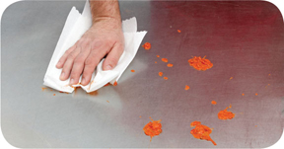
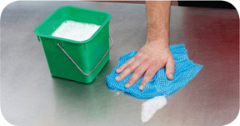
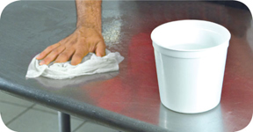
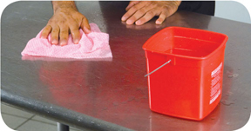
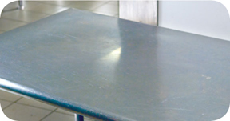
How and When to Clean and Sanitize
How to clean and sanitize:
Scrape or remove food bits from the surface
Wash the surface
Rinse the surface
Sanitize the surface
Allow the surface to air-dry
10-4
Notes:
Instructor Notes
All surfaces must be cleaned and rinsed. This includes walls, storage shelves, and garbage containers. However, any surface that touches food, such as knives, stockpots, cutting boards, or prep tables, must be cleaned and sanitized.
Scrape or remove food bits from the surface. Use the correct cleaning tool such as a nylon brush or pad, or a cloth towel.
Wash the surface. Prepare the cleaning solution with an approved detergent. Wash the surface with the correct cleaning tool such as a cloth towel.
Rinse the surface. Use clean water. Rinse the surface with the correct cleaning tool such as a cloth towel.
Sanitize the surface. Use the correct sanitizing solution. Prepare the concentration per manufacturer requirements. Use the correct tool, such as a cloth towel, to sanitize the surface. Make sure the entire surface has come in contact with the sanitizing solution.
Allow the surface to air-dry.

Slide 5
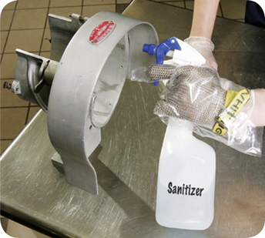
How and When to Clean and Sanitize
Cleaning and sanitizing stationary equipment:
Unplug the equipment
Take the removable parts off the equipment
Wash, rinse, and sanitize them by hand or run the parts through a dishwasher if allowed
Scrape or remove food from the equipment surfaces
Wash the equipment surfaces
10-5
Notes:
Instructor Notes
Equipment manufacturers will usually provide instructions for cleaning and sanitizing stationary equipment, such as a slicer.
Unplug the equipment.
Take the removable parts off the equipment. Wash, rinse, and sanitize them by hand. You can also run the parts through a dishwasher if allowed.
Scrape or remove food from the equipment surfaces.
Wash the equipment surfaces. Use a cleaning solution prepared with an approved detergent. Wash the equipment with the correct cleaning tool such as a nylon brush or pad, or a cloth towel.

Slide 6
How and When to Clean and Sanitize
Cleaning and sanitizing stationary equipment:
Rinse the equipment surfaces with clean water
Sanitize the equipment surfaces
Make sure the sanitizer comes in contact with each surface
Allow all surfaces to air-dry
Put the unit back together
10-6
Notes:
Instructor Notes
Rinse the equipment surfaces with clean water. Use a cloth towel or other correct tool.
Sanitize the equipment surfaces. The food handler in the photo is sanitizing the surfaces of a slicer. Make sure the sanitizer comes in contact with each surface. The concentration of the sanitizer must meet requirements.
Allow all surfaces to air-dry.
Put the unit back together.

Slide 7
How and When to Clean and Sanitize
Clean-in-place equipment:
Equipment holding and dispensing TCS food must be cleaned and sanitized every day unless otherwise indicated by the manufacturer
Check local regulatory requirements
10-7
Notes:
Instructor Notes
Some pieces of equipment, such as soft-serve yogurt machines, are designed to have cleaning and sanitizing solutions pumped through them. Since many of them hold and dispense TCS food, they must be cleaned and sanitized every day unless otherwise indicated by the manufacturer. You should also check your local regulatory requirements.

Slide 8
Monitoring High Temperature Dishwashing Machines
When using high-temperature dishwashing machines, provide staff with tools to check the temperature of the items being sanitized.
Options include:
Maximum registering thermometers
Temperature sensitive tape
10-8
Notes:
Instructor Notes:
Operations using high-temperature dishwashing machines must provide staff with an easy and quick way to measure the surface temperatures of items being sanitized.
The method used must provide an irreversible record of the highest temperature reached during the sanitizing rinse. This ensures that the dishwasher can reach correct sanitizing temperatures during operation.
Maximum registering thermometers or heat sensitive tape are good tools for checking temperatures.

Slide 9
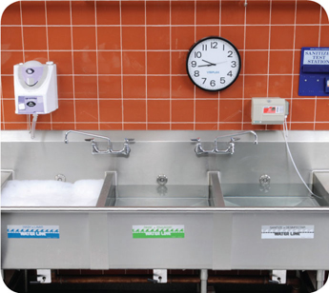
Manual Dishwashing
Setting up a three-compartment sink:
Clean and sanitize each sink and drain board
Fill the first sink with detergent and water at least 110˚F (43˚C)
Fill the second sink with clean water
Fill the third sink with water and sanitizer to the correct concentration
Provide a clock with a second hand to let food handlers know how long items have been in the sanitizer
10-9

Slide 10
Cleaning and Sanitizing in the Operation
Cleaning up after people who get sick:
Diarrhea and vomit in the operation must be cleaned up correctly
It can carry Norovirus, which is highly contagious
Correct cleanup can prevent food from becoming contaminated and keep others from getting sick
Check with your local regulatory authority regarding requirements for cleaning up vomit and diarrhea. A written cleanup plan may be required.
10-10
Notes:
Instructor Notes
If a person has diarrhea or vomits in the operation, these spills must be cleaned up the correct way. Vomit and diarrhea can carry Norovirus, which is highly contagious. Correct cleanup can prevent food from becoming contaminated. It will also keep others from getting sick. The way you clean up these substances is different from the way you clean other items in the operation.

Slide 11
Cleaning and Sanitizing in the Operation
Consider the following when developing a plan for cleaning up vomit and diarrhea:
How you will contain liquid and airborne substances, and remove them from the operation
How you will clean, sanitize, and disinfect surfaces
When to throw away food that may have been contaminated
What equipment is needed to clean up these substances, and how it will be cleaned and disinfected after use
When a food handler must wear personal protective equipment
10-11
Notes:
Instructor Notes
There are several things to think about when developing a plan for cleaning up vomit and diarrhea.
How you will contain liquid and airborne substances, and remove them from the operation
How you will clean, sanitize, and disinfect surfaces
When to throw away food that may have been contaminated
What equipment is needed to clean up these substances, and how it will be cleaned and disinfected after use
When a food handler must wear personal protective equipment
How staff will be notified of the correct procedures for
containing, cleaning, and disinfecting these substances
How to segregate contaminated areas from other areas
When staff must be restricted from working with or around food or excluded from working in the operation
How sick customers will be quickly removed from the operation
How the cleaning plan will be implemented

Slide 12
Cleaning and Sanitizing in the Operation
Develop a plan for cleaning up vomit and diarrhea:
How staff will be notified of the correct procedures for containing, cleaning, and disinfecting these substances
How to segregate contaminated areas from other areas
When staff must be restricted from working with or around food or excluded from working in the operation
How sick customers will be quickly removed from the operation
How the cleaning plan will be implemented
10-12
Notes:
Instructor Notes
If a person has diarrhea or vomits in the operation, these spills must be cleaned up the correct way. Vomit and diarrhea can carry Norovirus, which is highly contagious. Correct cleanup can prevent food from becoming contaminated. It will also keep others from getting sick. The way you clean up these substances is different from the way you clean other items in the operation. There are several things to think about when developing a plan for cleaning up vomit and diarrhea.
How you will contain liquid and airborne substances, and remove them from the operation
How you will clean, sanitize, and disinfect surfaces
When to throw away food that may have been contaminated
What equipment is needed to clean up these substances, and how it will be cleaned and disinfected after use
When a food handler must wear personal protective equipment
How staff will be notified of the correct procedures for containing, cleaning, and disinfecting these substances
How to segregate contaminated areas from other areas
When staff must be restricted from working with or around food or excluded from working in the operation
How sick customers will be quickly removed from the operation
How the cleaning plan will be implemented

Slide 13
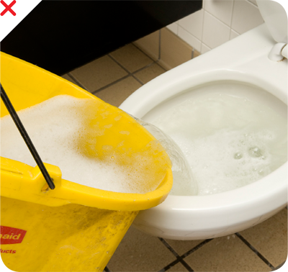
Cleaning and Sanitizing in the Operation
NEVER:
Dump mop water or other liquid waste into toilets or urinals
Clean tools in sinks used for
Handwashing
Food prep
Dishwashing
10-13
Notes:
Instructor Notes
When storing cleaning tools, consider the following:
Air-dry towels overnight
Hang mops, brooms, and brushes on hooks to air-dry
Clean, and rinse buckets. Let them air-dry, and store them with other tools

