Slide 1


Introduction : The Gaia Operating System
Module 1: The Gaia Operating System Instructor: Kim Winfield

Slide 2
Objectives
Navigate the file structure of the Gaia Operating System
Apply competency with the installation of the Gaia Operating System
Use the command line interface for installation and configuration of the Gaia Operating System
Execute command of the Web UI for the Gaia Operating System
Perform a backup of the Gaia Operating System from the Command Line Interface (CLI) and the Web User Interface (WebUI)

Slide 3
Navigating the Gaia Operating System File Structure
The Command Shells
CLISH – This is the default shell for users. The path for the shell is /etc/cli.sh
Bin/Bash – This shell gives the user permissions to navigate the file structure and make changes to files by editing, copying, deleting, etc. The path for the shell is /bin/bash

Slide 4

clish
The default shell for administrators and users of the Gaia Operating System is clish.
The prompt will have the machines hostname followed by a >
This shell will allow the administrator to make changes to the configuration of the Operating System and should be used anytime those changes need to be made.

Slide 5

bin/bash or Expert
The prompt for this shell will show as displayed below
The prompt will have Expert inserted prior to the name of the server and the #.
This shell allows the user to modify files, navigate the directory structure and make changes to the files.
Very few users should have access to this shell.

Slide 6
Installation of the Gaia Operating System
Installation via DVD or ISO file
Pre-installed O/S on Appliances
Installation via USB device
Network installation via a pixie boot
Unattended USB Installation of Gaia O/S

Slide 7
Installation via DVD or ISO file
Start the installation with the install media mounted in the DVD drive of the server
Choose to install Gaia on the system and press enter
Select keyboard language
Configure Hard Disk Partition sizes
Enter and confirm password
Lab 1.1 Installs the Gaia O/S on the Management Server. Review the document for Lab 1.1 and if possible

Slide 8
Pre-installed O/S on Appliances
Open a terminal emulation program, while connected to the serial port on the appliance
Restart the appliance
When prompted, enter the boot menu
Select Reset to factory defaults – Security Management Server or Security Gateway
Type yes and press Enter
Configure Management IP Address
Run the First Time Configuration Wizard

Slide 9
Installation via USB device
If using a removable USB device, use the following knowledge base article
http://supportcontent.checkpoint.com/solutions?id=sk65205
Connect computer to the console port with a db9 serial cable
Connect the installation media to the USB port
Redirect the boot sequence to the installation media

Slide 10
Unattended USB Installation of Gaia O/S
Gaia can be installed on an appliance using and ISO and a removable USB drive
http://supportcontent.checkpoint.com/solutions?id=sk65205
Prepare the installation media(USB) with these pre-configured settings for specified network interfaces
IP address
Network mask
Default gateway

Slide 11
Gaia Operating System Command Line (CLI) Installation and Modification
config_system
Command must have a parameters and value pair seperated by &
"hostname=myhost&domainname=somedomain.com&timezone='America/Indiana/Indianapolis‘
config_system –f
To run the first time configuration wizard form a specified configuration file, that includes a series of configuration command strings
config_system –l
To list the configurable parameters

Slide 12
Gaia Operating System Web User Interface Installation and Modification
Initial Configuration
Open a browser to the WebUI of the machine you wish to configure: https://Mangement_Server_or_Security_GW ipaddress
First Time Configuration Wizard
Modifying Parameters
Open a browser to the WebUI of the machine you wish to modify: https://Mangement_Server_or_Security_GW ipaddress

Slide 13
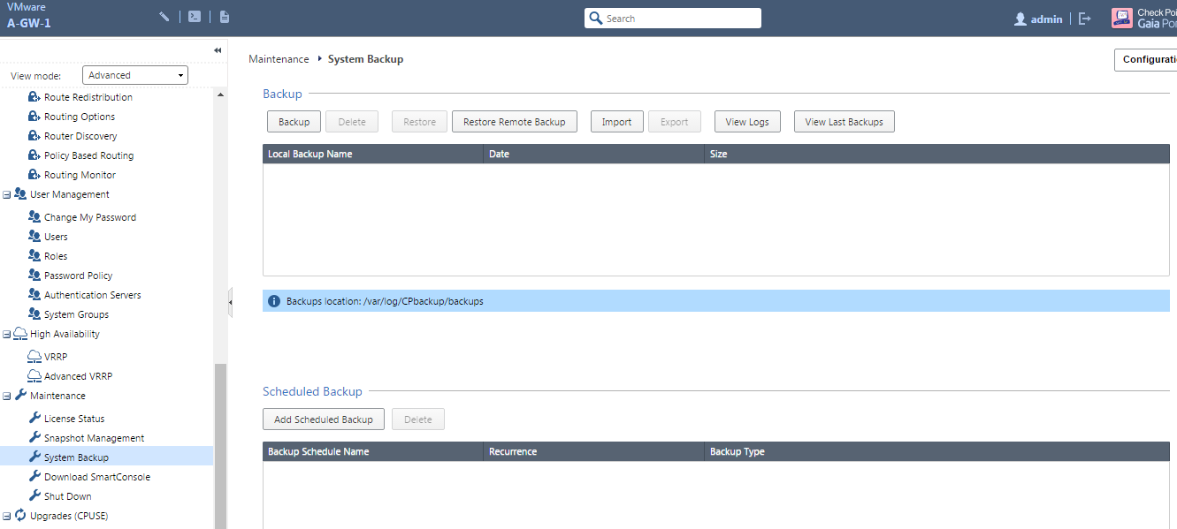
Gaia Operating System Backup via Web UI and CLI
WebUI Backup
Command Line
Add backup (options)
local – backup saved on the local machine
ip- ip address of the the remote server to store the backup
username – username required to login to remote frp or scp server
password plain – password required to login to remote ftp or scp server

Slide 14
Summary
Navigated the file structure of the Gaia Operating System
Applied competency with the installation and configuration of the Gaia Operating System
Used the Command Line Interface for installing and configuring the Gaia Operating System
Executed command of the Web User Interface for the Gaia Operating System
Performed a backup of the Gaia Operating System from the Command Line Interface and the Web User Interface

Slide 15
Bibliography
Command Line Interface Reference Guide Check Point Software Ltd. California, USA
Gaia Administration Guide Check Point Software Ltd. California, USA
Gaia Installation and Upgrade Guide Check Software Ltd. California, USA

