Slide 1


Module 10 Mobile Access
Module 10: Mobile Access Instructor: Kim Winfield

Slide 2
Objectives
Administer and implement a Mobile Access solution for SSL VPN
Apply Secure Workspace to secure, a remote users desktops
Create access to internal web applications using the Mobile Access Blade

Slide 3
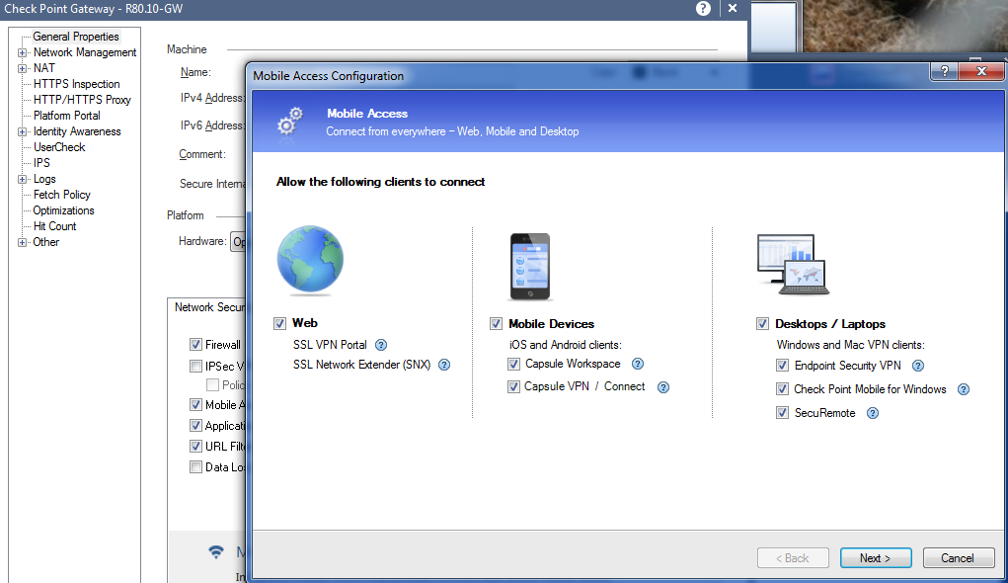
Mobile Access an SSL VPN Solution
Mobile Access Blade Wizard
Web
Mobile Devices
Desktops
Laptops

Slide 4
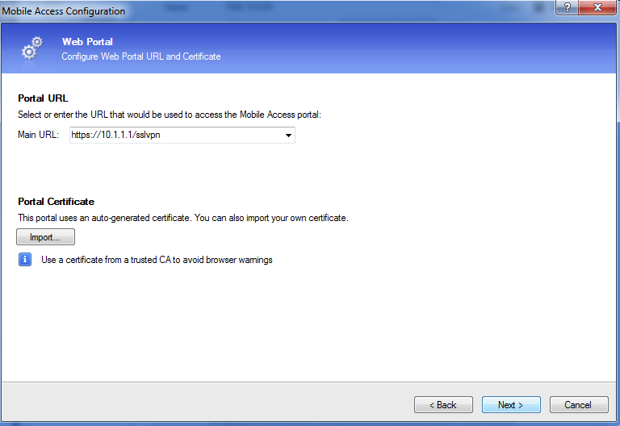
Mobile Access Web Portal
Portal URL
Portal Certificate

Slide 5
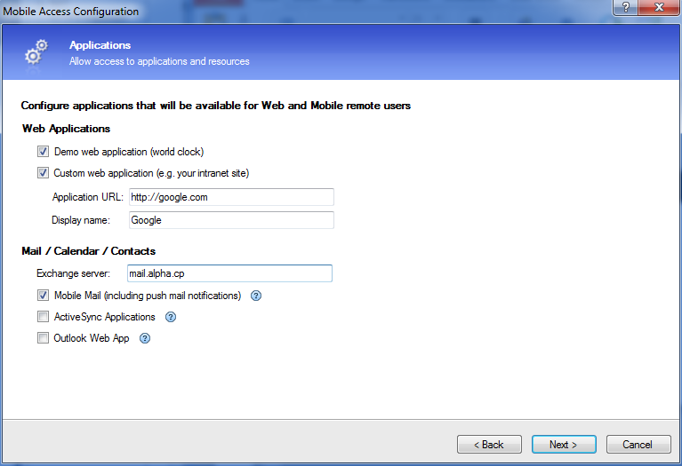
Mobile Access Application
Application Wizard
E-Mail Configuration
Integration with Active Directory
Users Per Application

Slide 6
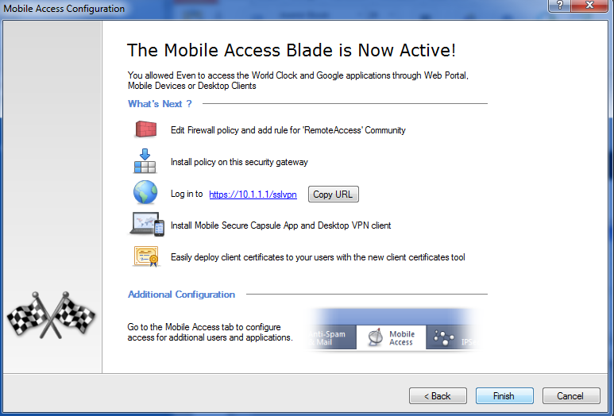
Mobile Access Wizard Completion
Edit Firewall Policy
Install Policy
Login Information for Users
User Application
Client Certificate if desired

Slide 7
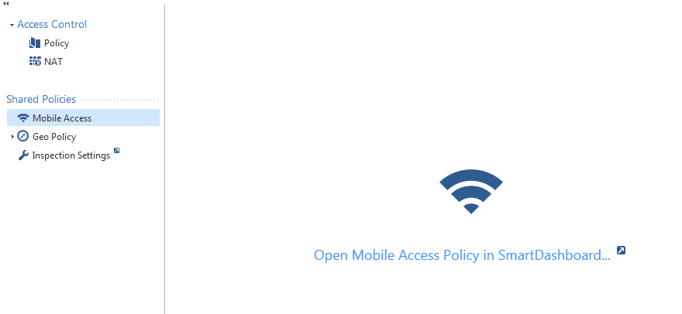
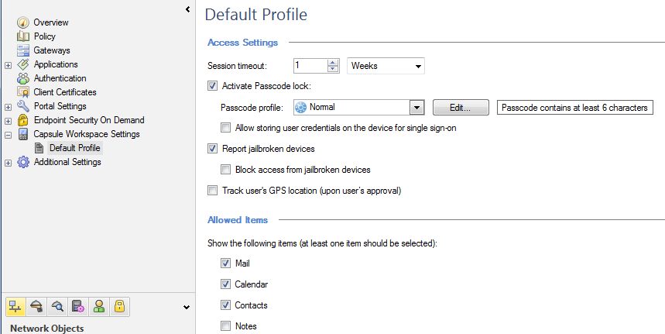
Capsule Workspace
Open Legacy SmartDashboard
Create Capsule Workspace Policy

Slide 8
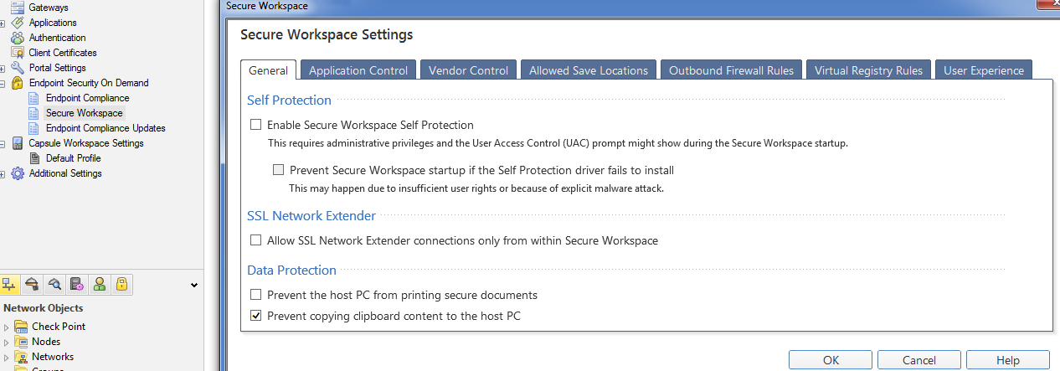
Endpoint Security on Demand
Secure Workspace
Application Control
Vendor Control
Allowed Saved Locations
Outbound Firewall Rules
Virtual Registry Rules
User Experience

Slide 9
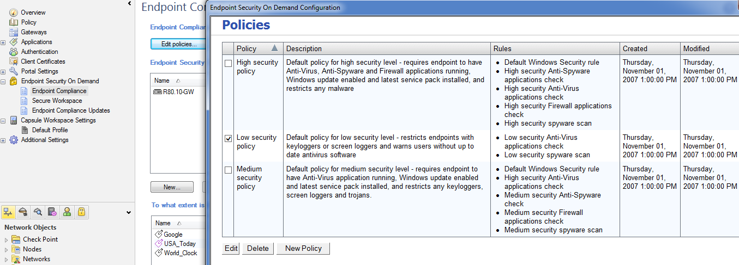
Endpoint Compliance
Policy
Policy Enforcement per Applicaion

Slide 10
Access to Internal Applications
Policy Based
Users and User Groups
Applications (Internal or Internet Based)

Slide 11
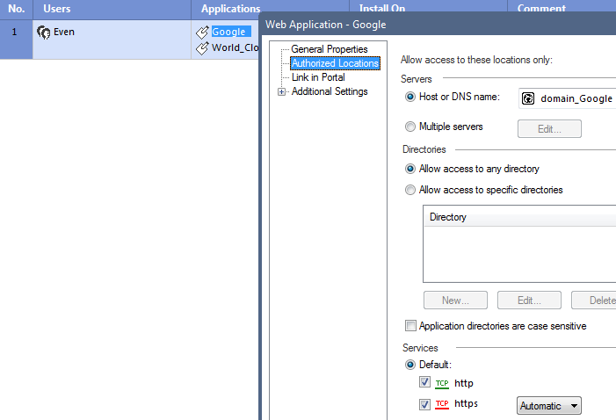
Access to Internal Applications
Access is based on Application
IP Address
Domain Name
Multiple Servers
Directories on those Servers
Specific Services

Slide 12
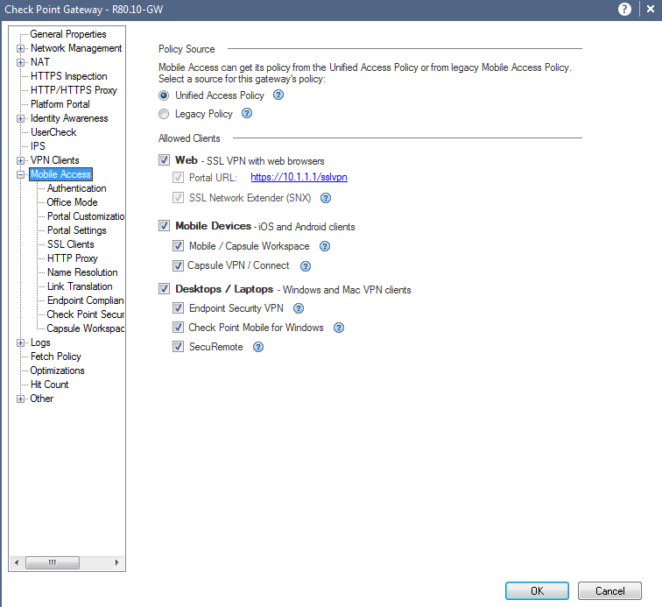
SmartConsole Mobile Access
Mobile Access
Policy Source
Allowed Clients
Authentication
Office Mode
Portal Customization
Portal Settings
SSL Clients
HTTP Proxy
Name Resolution
Link Translation
Endpoint Compliance
Check Point Secure Workspace
Capsule Workspace

Slide 13
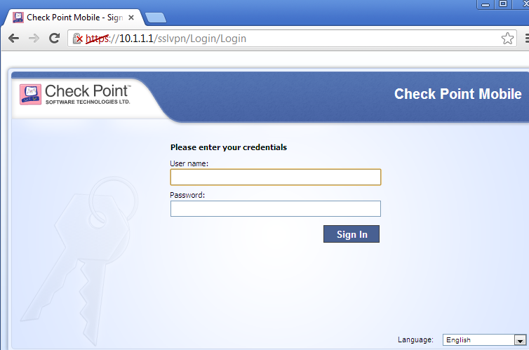
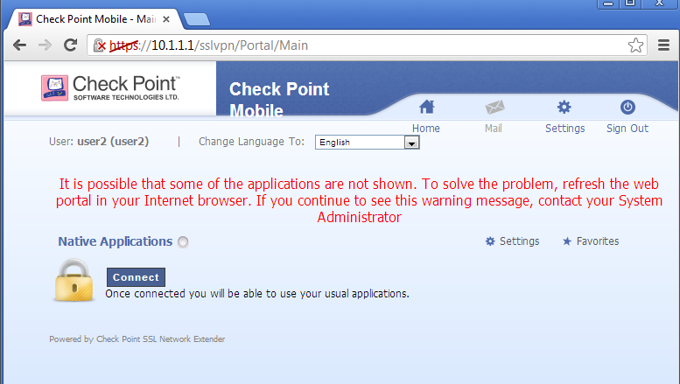
Access to Internal Applications Client Side
User Login
User Portal
All Web Applications will appear in this sections of the web page

Slide 14
Summary
Administered and implemented a Mobile Access solution for SSL VPN
Applied SecureWorkspace to secure, a remote users desktop or laptop
Created access to internal web applications using the Mobile Access Blade

Slide 15
Bibliography
Check Point R80.10 Mobile Access Admin Guide California: USA

