Slide 1


Module 11 IPsec VPN
Module 11. IPSec VPN Instructor: Kim Winfield

Slide 2
Objectives
Describe an IKE/IPSec key exchange for site to site VPN connectivity
VPN Community Functionality
Configuration Steps for Site to Site and Client to Site VPN

Slide 3
IPsec
Ipsec is not one protocol but a suite of protocols
IPsec crates a boundary between unprotected and protected interfaces
Security Protocols
Security Associations
Key Management (IKE)
Cryptographisd Algorithms

Slide 4
Ipsec Security Protocols and Cryptographic Algorithms
Authentication Header (AH)
Encapsulating Security Payload (ESP)
IPsec implementations MUST support ESP and MAY support AH
IKE
IKEv2

Slide 5
Ipsec Security Associations
IKE SA
IP

Slide 6
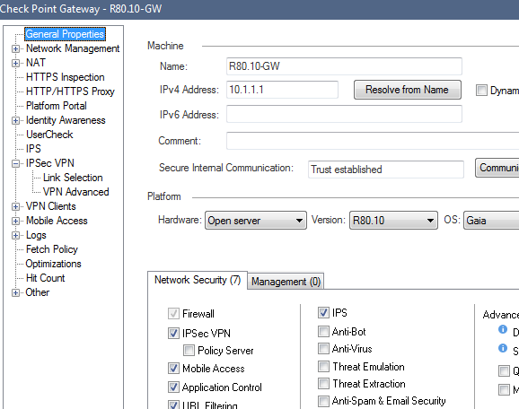
Check Point VPN
Site to Site and Remote Access for Users
Simplified and Traditional Mode VPN’s
VPN Communities

Slide 7
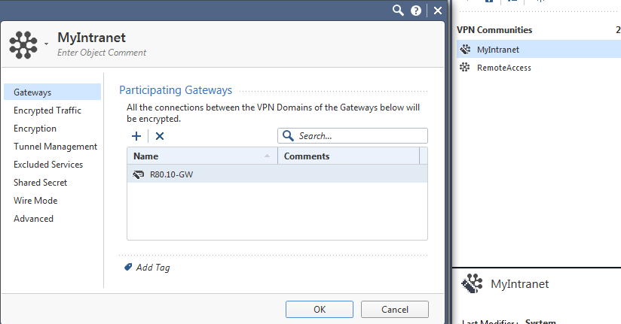
Meshed Communities
Multiple Gateways all connected to each other
Number of Tunnels of Gateways is N-1
Ex. 4 Gateways in the Community each gateway would potentially have 3 tunnels
Excluded Services

Slide 8
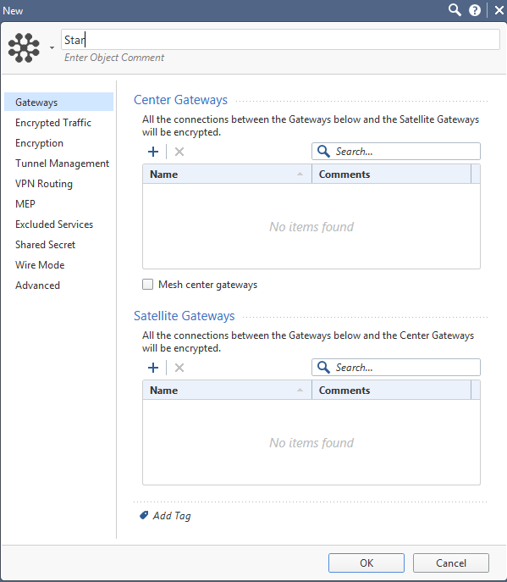
Star Community
Center Gateway
Satellite Gateway
VPN Routing

Slide 9
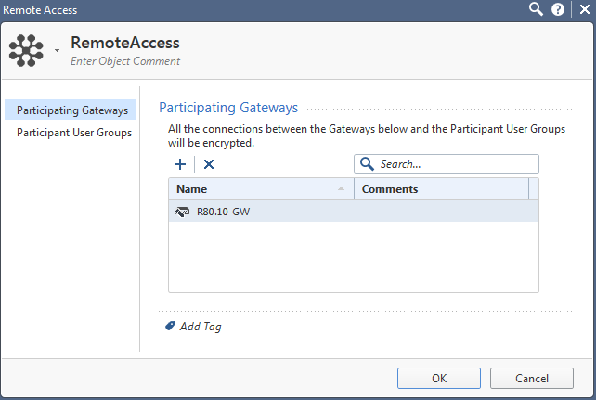
Remote Access Community
Participating Gateways
Participating User Groups

Slide 10
Configuring a Site to Site VPN
Use Meshed or Star Community
Add Gateways with their encryption domain defined
Specify encryption properties in the community
Create rules in the rulebase

Slide 11
Configuring a Remote Access VPN (Client to Site VPN)
Add the security gateway to the Remote Access VPN Community
Add user groups to the community
Create rules on the gateway allowing the user group in the community access to resources inside the encryption domain

Slide 12
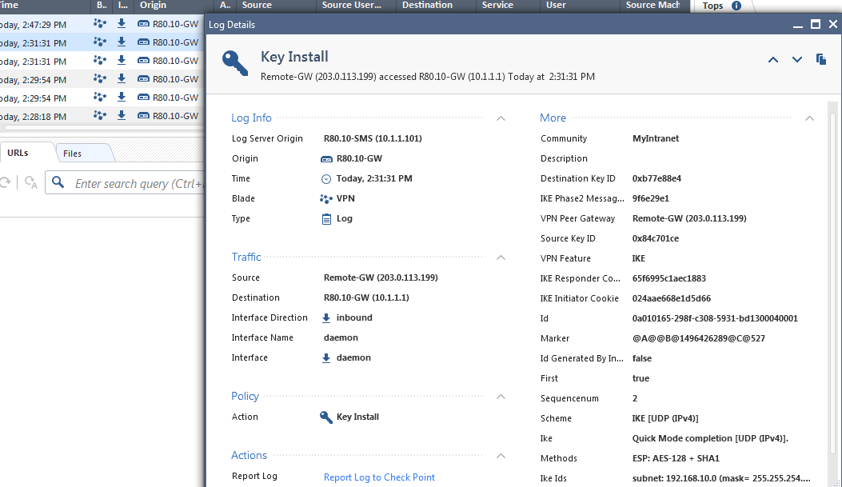
The Encrypted Tunnel (SmartLog)
Phase 1 key exchange in the logs
Phase 2 key exchange in the logs
https://youtu.be/fNJCMjlYg7g

Slide 13
Summary
Described an IKE/IPSec key exchange for site to site VPN connectivity
Explained VPN Community Functionality
Configured a Site to Site, and Client to Site, VPN

Slide 14
Bibliography
Check Point R80.10 Site to Site VPN Admin Guide California: USA
Check Point R80.10 Remote Access VPN Admin Guide California: USA

