Slide 1


Module 12 System Monitoring
Module 1: System Monitoring Instructor: Kim Winfield

Slide 2
Objectives
Use Smart Event and event correlation
Apply Smartview Monitor and real time monitoring
Use CPView to monitor the Security Gateway real time performance and historical performance

Slide 3
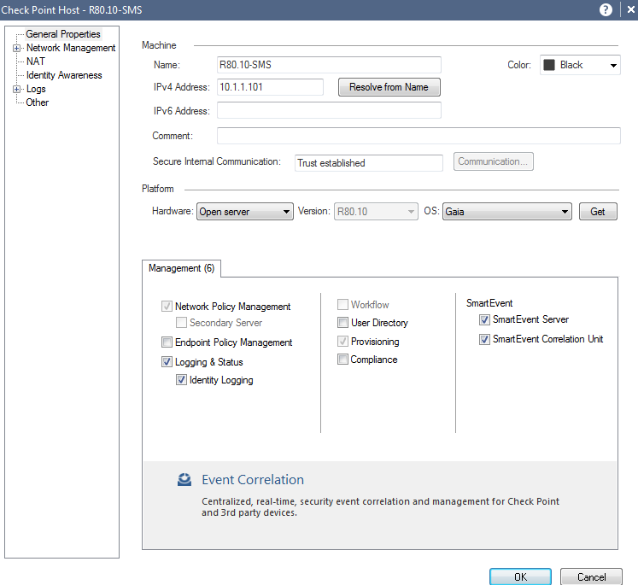
SmartEvent
Event Analysis
Log Entries are used to create events
Creating Custom Events

Slide 4
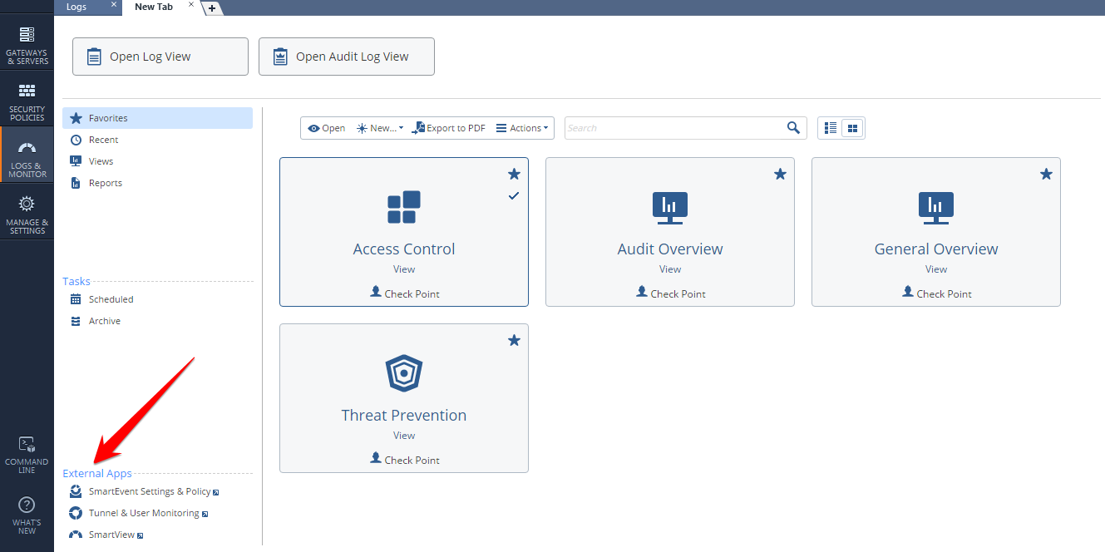
SmartEvent
Log Views and Reports
Scheduled Tasks
Archive
External Apps
Smart Event Settings
Tunnel &User Monitoring
Smarview

Slide 5
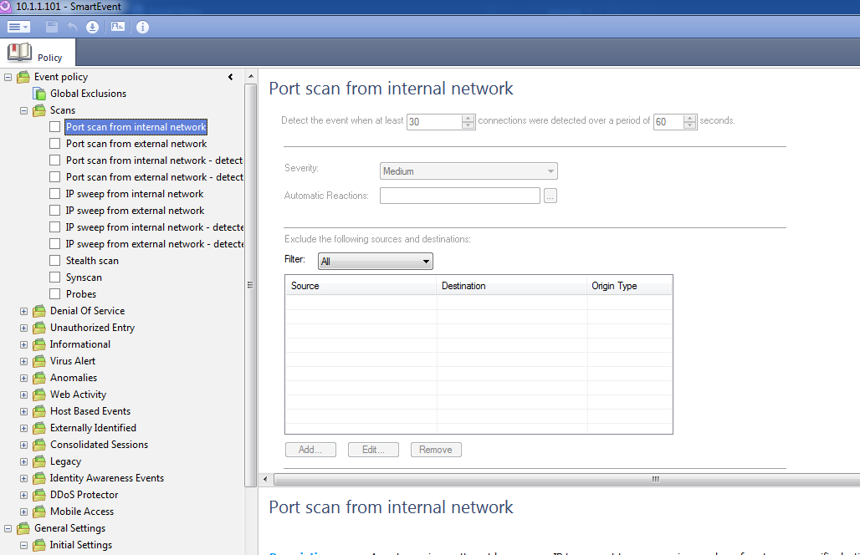
SmartEvent Policy
Event Policy
Global Exclusions
Network Based Events
Malware and Anit-Virus Events
Identity Awareness Events
Mobile Access Events
General Settings
Initial Settings
Objects

Slide 6
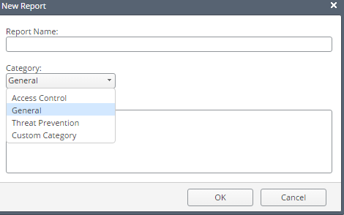
SmartEvent Reports
Pre-defined Reports
User Defined View
User Defined Report

Slide 7
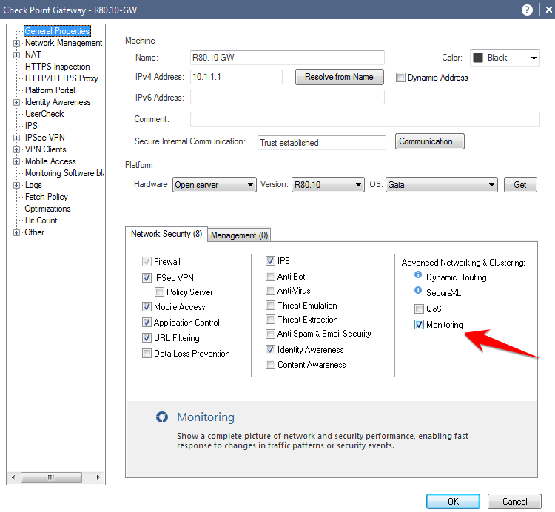
SmartView Monitor
Monitoring System Health
Monitoring Traffic
Enabled on Security Gateway

Slide 8
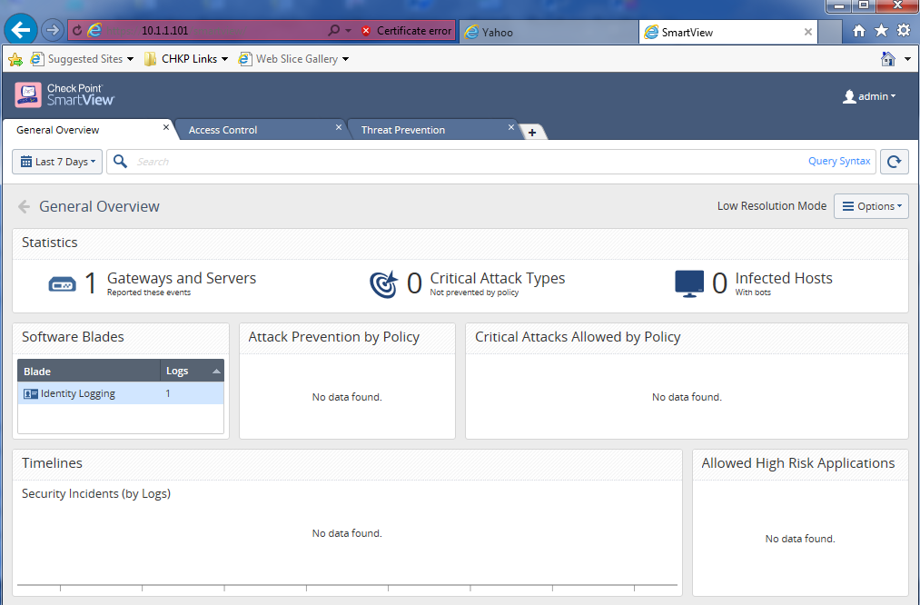
SmartView Monitor
Web Based Application
Enable Monitoring on the Gateways
General Overview
Statistics
Software Blades
Access Control
Allowed Traffic
Blocked Traffic
Threat Prevention
Statistics
Top Protections
Hosts Infected with Bots

Slide 9
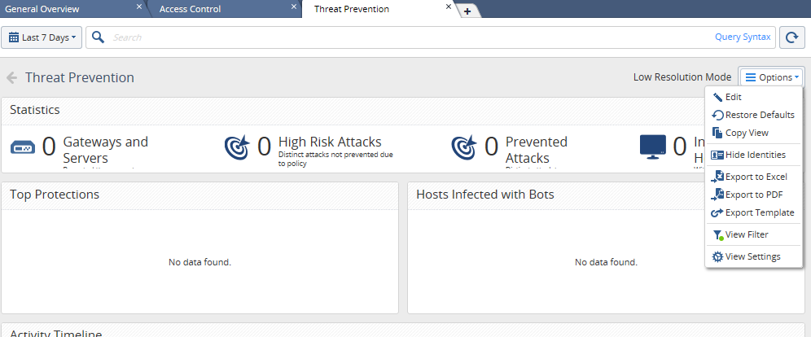
SmartView Monitor
Options
Hide Identities of Users
Export
Excel
PDF
Export Template
View Settings

Slide 10
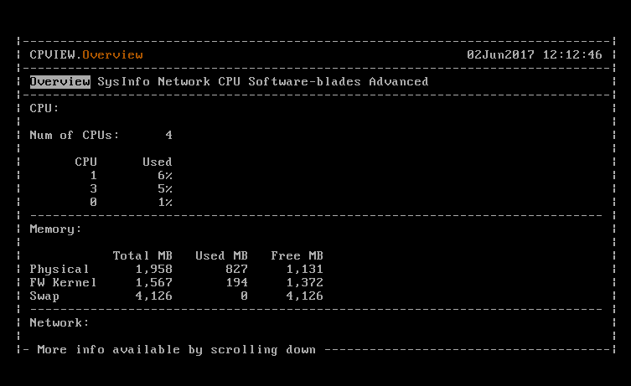
CPView
Shell Menu
Overview
System Information
Network
CPU
Software Blades
Advanced

Slide 11
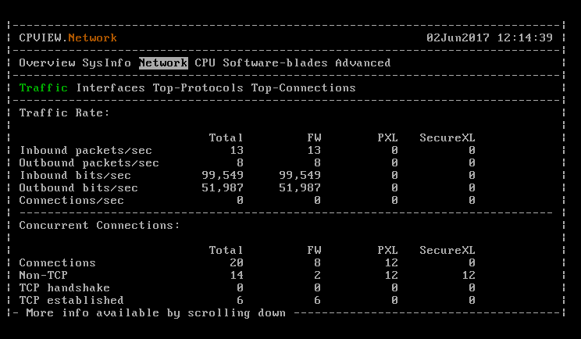
CPView
Real Time Statistics
No Overhead on CPU on most counters
Sub Menus and Counters

Slide 12
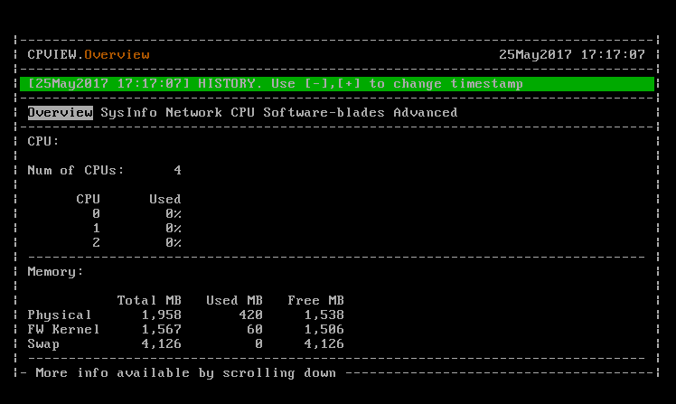
CPView History
Historical Data
Per Minute performance statistics
Option to view specific date
Option to view specific time

Slide 13
Summary
Used Smart Event and event correlation
Applied Smartview Monitor and real time monitoring
Used CPView to monitor the Security Gateway real time performance and historical performance

Slide 14
Bibliography
Check Point R80.10 Logging and Monitoring Admin Guide California: USA
Check Point R80.10 CPView Guide California: USA

