Slide 1


Introduction to Security Management
Module 2: Introduction to Security Management Instructor: Kim Winfield

Slide 2
Objectives
Design and Manage a Security Policy
Create a Security Rule-base with Network Objects and Services
Apply the Rule-base policy to enforce a Security Policy, to and from Internal Networks, DMZ and External Networks

Slide 3
Security Policy Rule Base
IP Based Objects
User Based Objects
Dynamic Objects
Zone Objects
Service Objects
Time Objects

Slide 4
Network Objects
Node Objects
Network Objects
Gateway Objects
Check Point Host Objects

Slide 5
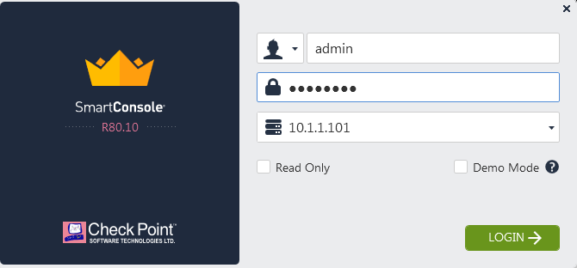
SmartConsole Access
Logging into the SmartConsole
Multiple Administrator Access
Permissions Profiles

Slide 6
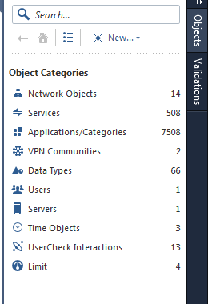
Object Creation
Creating New Objects and Services
Create a Network Object
Create a Node Object
Create a Group of Objects

Slide 7
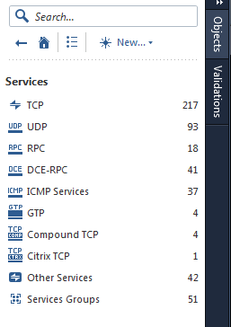
Service Creation
Creating Services
Creating Custom Services
Creating Service Groups

Slide 8
Rule Base Creation
Rulebase Essentials
Stealth Rule
Clean-up Rule
Rule Base Columns
Rule Base Rows

Slide 9
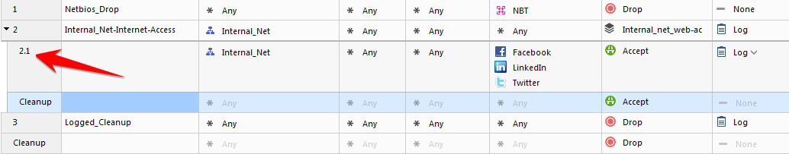
Layers
Ordered Layers
In-line Layers
Implicit Cleanup – Drop or Accept?
Best Practices
White List
Black List

Slide 10
In-Line Layer
Rule 2.1 is an example of an Inline layer. Rule 2 allows traffic from the internal-net to any destination, and any service. Rule 2.1 allows Facebook, Linkedin and Twitter applications from the internal network to anywhere (Internet)

Slide 11
Summary
Designed and Managed a Security Policy
Created a Security Rule-base with Network Objects and Services
Applied the Rule-base policy to enforce a Security Policy, to and from Internal Networks, DMZ and External Networks

Slide 12
Bibliography
Best Practices Rulebase Construction and Optimization California: USA
Check Point Security Management California: USA
Introduction to Security Management SmartConsole
https://youtu.be/LN_PdBZONqU
Security Gateway Creation
https://youtu.be/sHaCr251QM0
Network Object Creation
https://youtu.be/DyNlcSY_rnE
Host Object Creation
https://youtu.be/QpQA8CYkvX8

