Slide 1


Introduction to Security Policy Management
Module 3: Introduction to Security Policy Management Instructor: Kim Winfield

Slide 2
Objectives
Create a security policy rule base and create network and service objects
Design and use pre-defined network objects and services based on the best practices guidelines
Apply security rule-base management best practices

Slide 3
Create a security policy rule base and create network and service objects
Each rule should have a name that describes the intent of the rule
Most rules will have logging of some level, or none if you choose not to log
Source column will be a network, user or groups of users or networks

Slide 4
User Access
Internel User Database
External User Database
User Access

Slide 5
Network, Zone and Node Access
Network objects and Groups of Networks
Zone objects
Host Node and Groups of Host Nodes
Dynamic Object Access and Limitations

Slide 6
Design and use of pre-defined network objects and services based on the best practices guidelines
Best Practices
Name and Comment on all rules
Basic Rules
Cleanup
Stealth
Hit Count
Rule Expiration

Slide 7
Best Practices
Refer to Knowledge Base Solution
https://supportcenter.checkpoint.com/supportcenter/
Enter sk106597 in the search field
The article Best Practices – Rulebase Construction and Optimization
Review this article

Slide 8
Basic Rules
Clean Up
Source Destination Service Action Track
Any Any Any Drop Log
Stealth
Source Destination Service Action Track
Any GW’s Any Drop Log

Slide 9
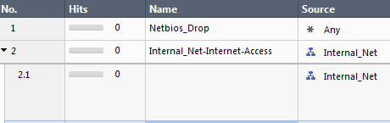
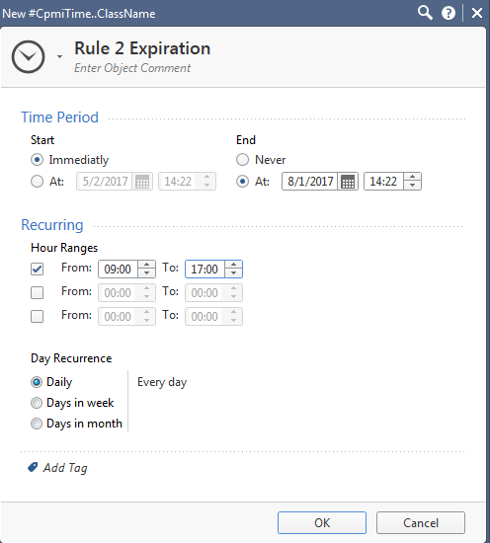
Hit Count and Rule Expiration
Hit Count
Rule Expirtation

Slide 10
Apply security rule-base management
Publish
Install Database
Install Policy

Slide 11
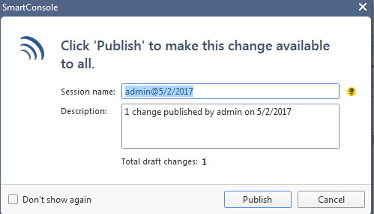
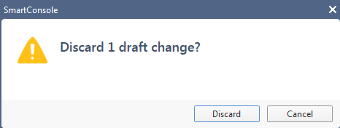
Publish and Discard
Publish Changes
Discard Changes

Slide 12
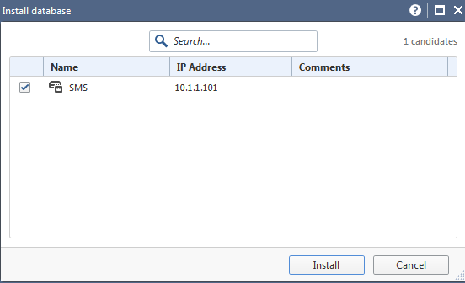
Install Database
Installs all changes of publish actions to management database
Installs database changes to Management Server and Log Servers
Does not install the policy to the gateway

Slide 13
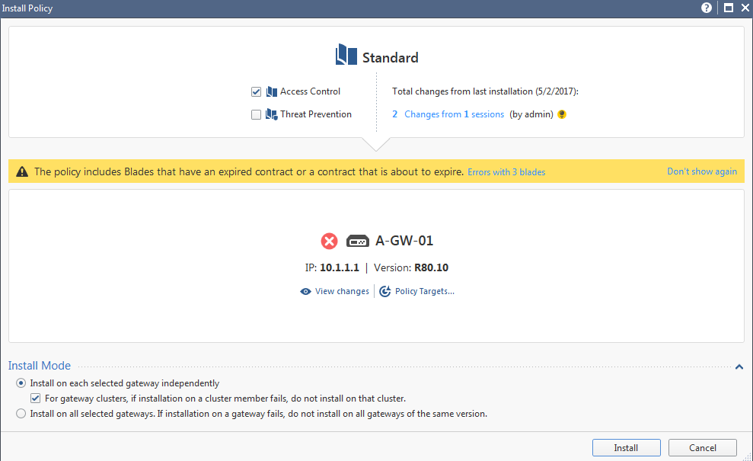
Install Policy
Access Control
Threat Prevention

Slide 14
Summary
Created a security policy rule base and create network and service objects
Designed and use pre-defined network objects and services based on the best practices guidelines
Applied security rule-base management Best Practices

Slide 15
Bibliography
R80.10 Security Management California: USA
Best Practices Rulebase Construction California: USA
Video’s

