Slide 1


Introduction to Threat Prevention
Module 4: Introduction to Threat Prevention Instructor: Kim Winfield

Slide 2
Introduction to Threat Prevention Policy
Create and manage an IPS Policy
Create and manage an Anti-Virus Policy
Create and manage an Anti-Bot Policy
Threat Emulation and Threat Extraction are covered in Module 5

Slide 3
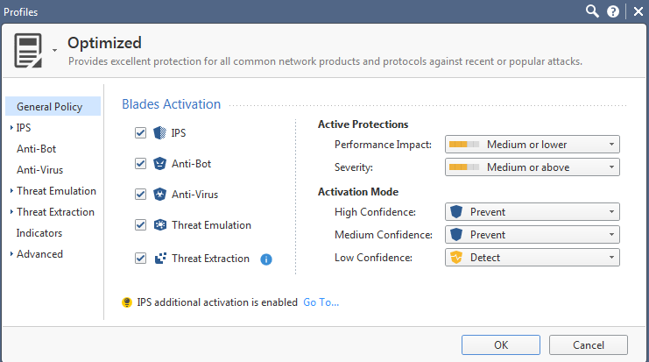
Create and Manage the IPS policy
Enabling the IPS Software Blade
IPS Protections
Updating IPS Protections

Slide 4
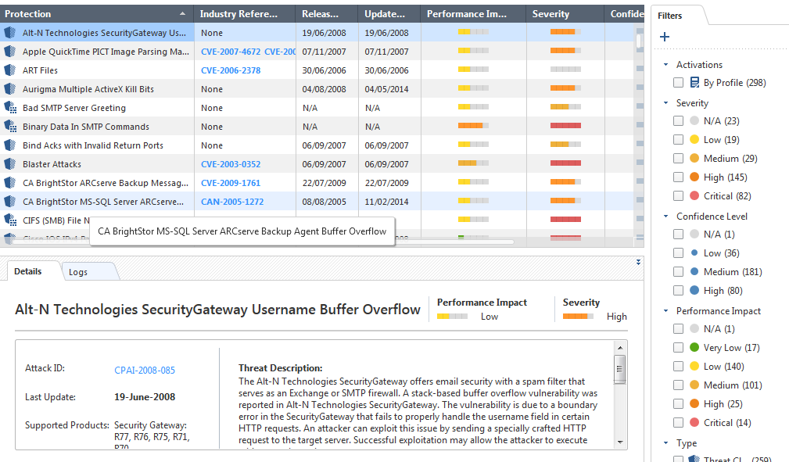
Enabling IPS Protections
Client Protections
Server Protections

Slide 5
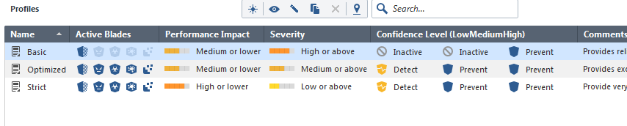
IPS Protections
Browsing IPS Protections
Activating Protections
Editing Core IPS Protections

Slide 6
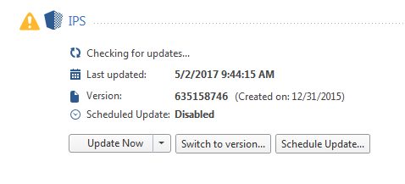
Updating IPS Protections
Scheduling Updates
Reviewing New Protections
Reverting to an Earlier IPS Protection Package

Slide 7
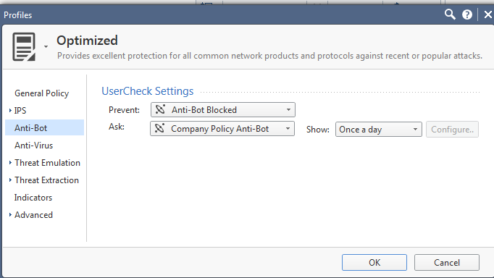
Configuring Anti-Bot Settings
Configuring Anti-Bot Settings
Blocking Bots
Monitoring Bot Activity

Slide 8
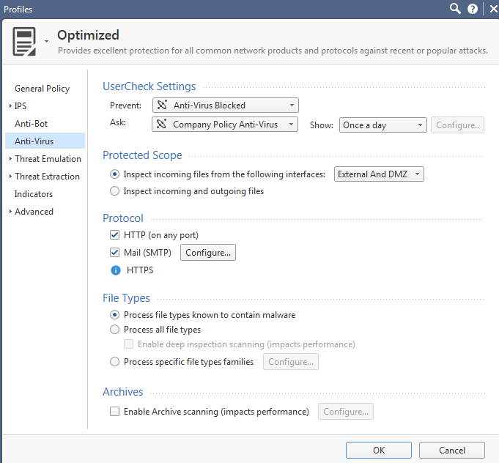
Configuring Anti-Virus Settings
Blocking Viruses
Monitoring Virus Activity

Slide 9
Summary
Created and managed an IPS policy
Created and managed an Anti-Bot policy
Created and managed an Anti-Virus policy

Slide 10
Bibliography
R80.10 Next Generation Security Gateway Getting Started Guide California: USA
R80.10 Threat Prevention Administration Guide California: USA

