Slide 1


Threat Emulation/Threat Extraction
Module 5: Threat Emulation/Threat Extraction Instructor: Kim Winfield

Slide 2
Objectives
Threat Emulation and the concept of Sand Boxing
Threat Emulation as a service in the cloud and local
Threat Extraction when Threat Emulation isn’t enough

Slide 3
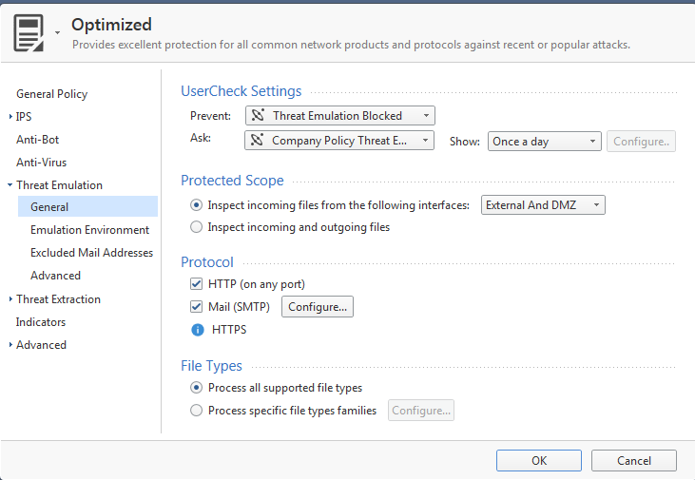
Threat Emulation
To enable Threat Emulation General Settings

Slide 4
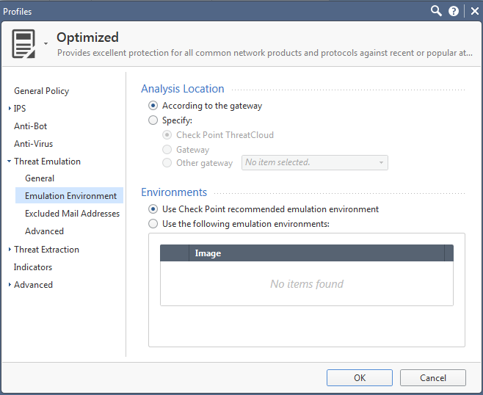
Threat Emulation Cloud and Local Implementation
To Select Emulation Location
Either Local or Cloud or another Gateway
Choose Environments
Windows Operating Systems

Slide 5
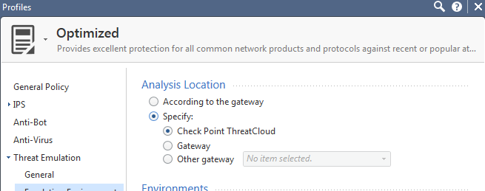
Threat Emulation
Cloud Emulation
Service Contract for Threat Emulation is required
Internet Access from the Gateway where Cloud Emulation is enabled
Select Check Point Threat Cloud in SmarConsole

Slide 6
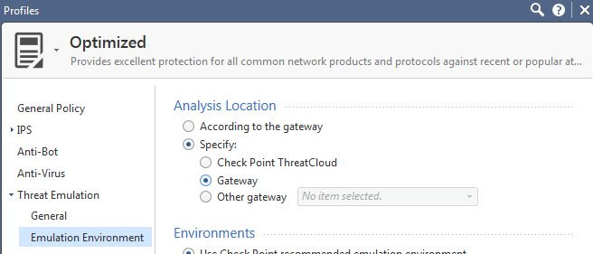
Threat Emulation
Local Emulation
Select This Gateway
Download of the Virtual Environments Selected will take several hours depending on speed of the internet connection

Slide 7
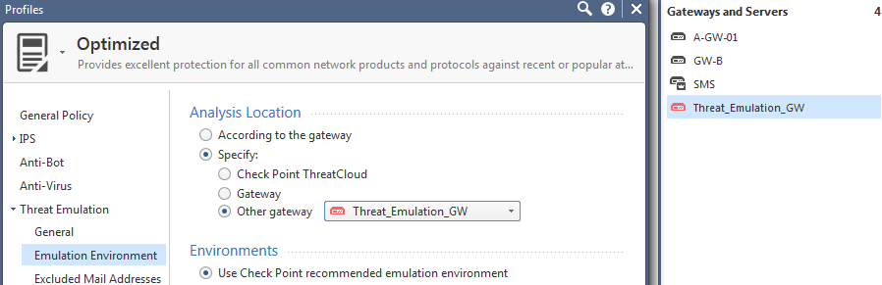
Threat Emulation
Local Emulation
Select This Gateway
Download of the Virtual Environments Selected will take several hours depending on speed of the internet connection

Slide 8
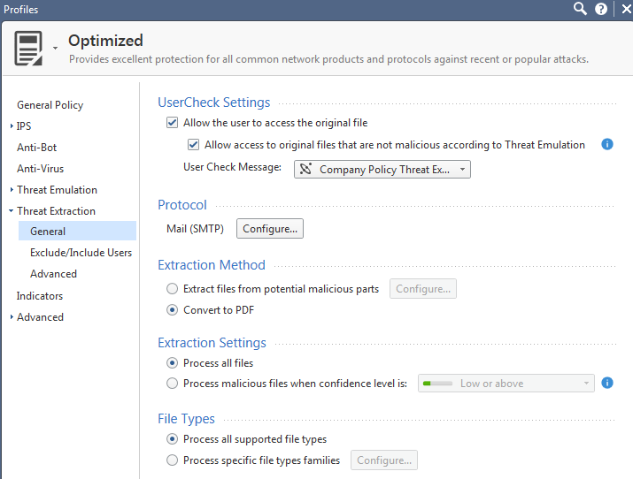
Threat Extraction
Threat Emulation Identifies potential threats and removes them.
Threat Extraction Identifies potential threats and cleans the document by removing the potential threat and returning a readable document to the user.

Slide 9
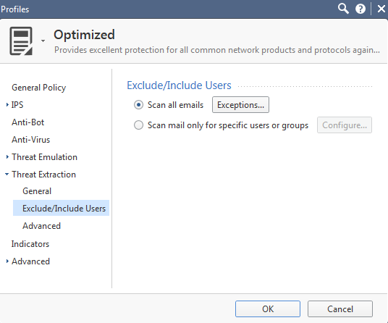
Threat Extraction
User Inclusions and Exclusions
All E-mail is scanned with Exceptions or
Mail can be scanned for only specific users and groups

Slide 10
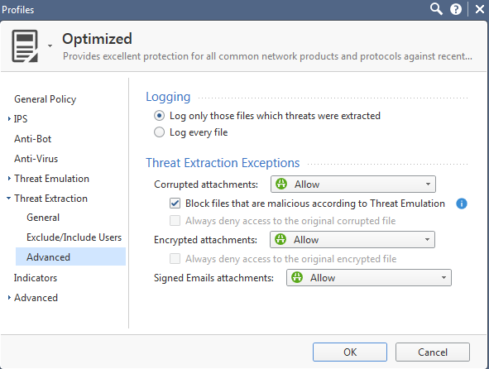
Threat Extraction
Advanced Settings for Logging
Log only files which threats were extracted
Log every file
Threat Extraction Exceptions
Handling of Corrupted attachments
Encrypted attachments
Signed e-mail attachments

Slide 11
Summary
Used Threat Emulation to Sand Box Potential Attacks
Configured a Cloud Implementation of Threat Emulation and learned the requirements for Local Emulation
Used Threat Extraction to clean infected documents

Slide 12
Bibliography
R80.10 Threat Prevention Admin Guide California: USA

