Slide 1


Module 7 CoreXL and SecureXL
Module 7: CoreXL and SecureXL Instructor: Kim Winfield

Slide 2
Objectives
Comprehend the effects of CoreXL for Multiple Core Firewalls
Apply SecureXL for packet and session rate acceleration of firewall traffic
Utilize CoreXL and SecureXL in performance tuning for firewalls

Slide 3
CoreXL
Firewall Instance
Multiple Core Servers
Leveraging Multiple Firewall Instances for increased performance

Slide 4
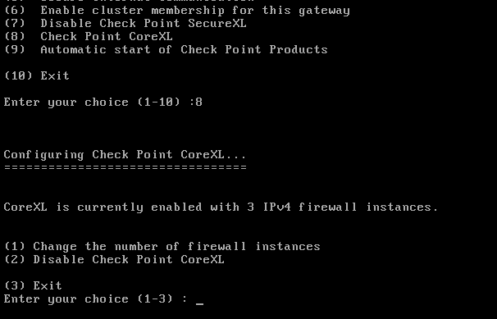
CoreXL
Firewall Instance Replication across multiple core gateways
Example to the right
3 Firewall Instances
1 Secure Network Distributor

Slide 5
CoreXL
Secure Network Distributor
Default distribution of cores
1 Distributor for 4 core Security Gateways
2 Distributor for 8 core Security Gateway
Depending on performance issues the number of instances can be changed using cpconfig
Clustered Security Gateways need to have the same number of firewall instances

Slide 6
SecureXL
Accelerating Traffic that has been inspected by the firewall
State information is maintained
Packet Rate Acceleration
Session Rate Acceleration

Slide 7
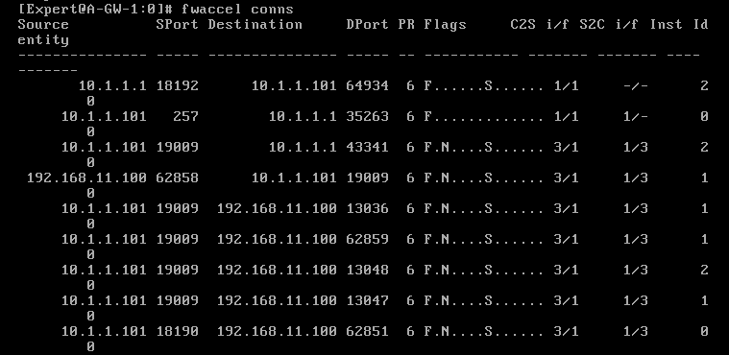
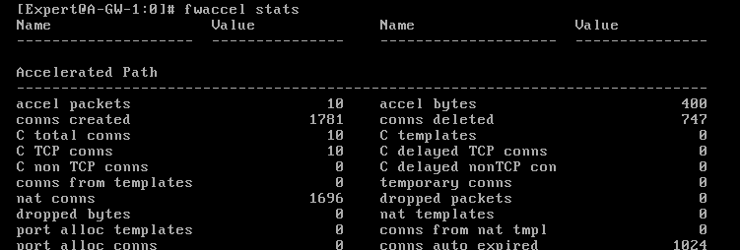
SecureXL
Packet Rate Acceleration
SecureXL Table

Slide 8
SecureXL
Session Rate Acceleration
Templates
Source Port is not checked in rulebase so an asterisk replaces the source port
When packet matches the other 4 fields, a connection is created from the template

Slide 9
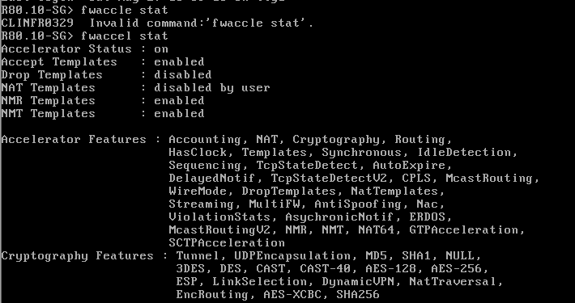
Performance Tuning
Performance Pack
SecureXL Templates
NAT Templates
Delayed Notification

Slide 10
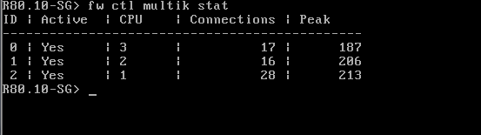
Performance Tuning
Performance Pack
CoreXL
fwaffininity.conf
fw ctl affinity
fw ctl multik stat

Slide 11
Performance Tuning
Multi-Queue
Make Sure SecurXL is enabled
Make sure that the network interfaces support Multi-Queue
Examine CPU Utilization
Examine CPU roles allocation
Decide if more CPU’s can be allocated to the SND

Slide 12
Summary
Implemented CoreXL for a multiple core Security Gateway
Implement SecureXL for connection and session rate acceleration
Performance Tuning of Security Gateway by modifying the rulebase, SecureXL and CoreXL

Slide 13
Bibliography
Check Point R80.10 Security Gateway Technical Administration Guide California: USA
Check Point R80.10 Security Gateway Performance Tuning Administration Guide California: USA

