Slide 1


Identity Awareness
Module 8: Identity Awareness Instructor: Kim Winfield

Slide 2
Objectives
Configure Identity Awareness to provide user access to network resources
Enable Captive Portal to identify users
Use Identity Awareness and Captive Portal with a Security Policy

Slide 3
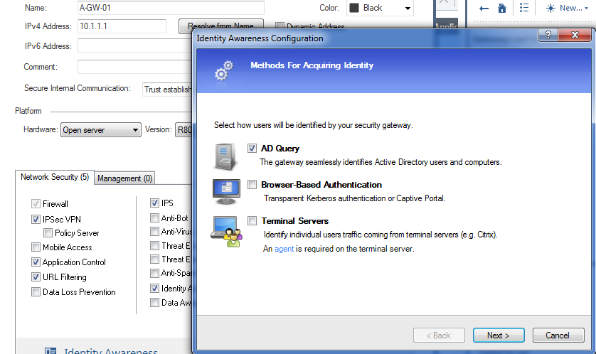
Identity Awareness
Enabling Identity Awareness
Gateway Side Configuration
Identity Awareness Wizard
AD Query
Browser Based Authentication
Captive Portal
Terminal Servers

Slide 4
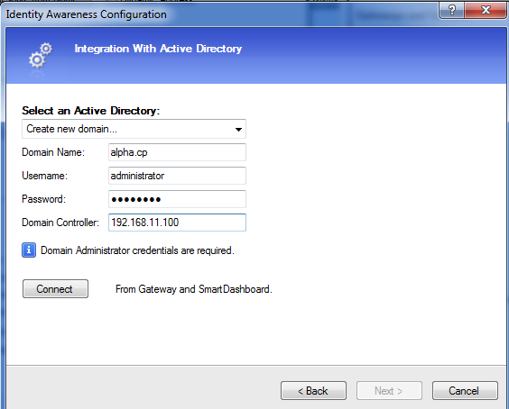
Identity Awareness
Defining the AD Server

Slide 5
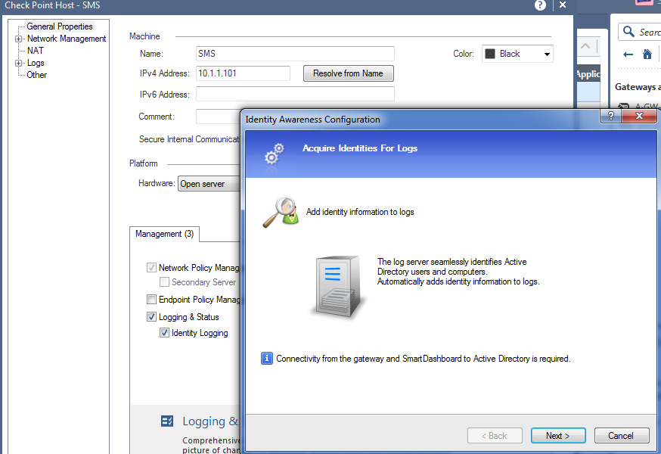
Identity Awareness Identity Logging
Management Server Configuration

Slide 6
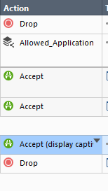
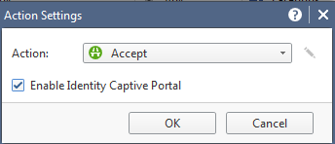
Captive Portal
Ideal when using AD query with Non-Windows Clients

Slide 7

Captive Portal
Captive Portal Connection
Connection from Client intercepted by the firewall
Redirect to the Client for Authentication

Slide 8
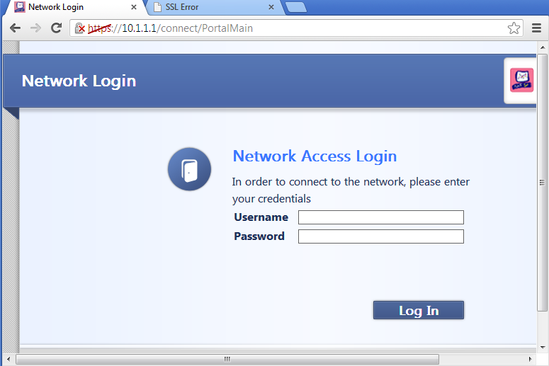
Captive Portal
Browser Login Page

Slide 9
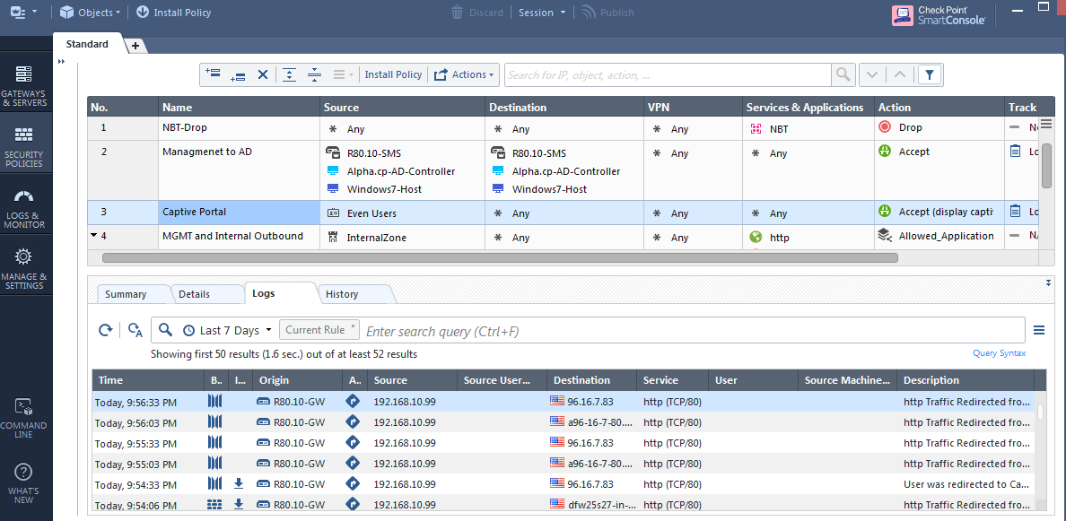
Identity Awareness and Captive Portal in a Security Policy
Captive Portal Rule
Log with Portal Redirect

Slide 10
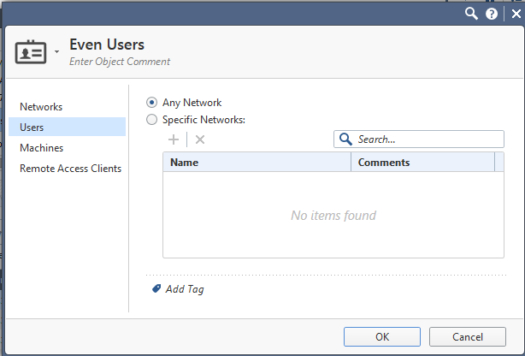
Captive Portal in Rulebase
Access Roles
Network
Users
Machines

Slide 11
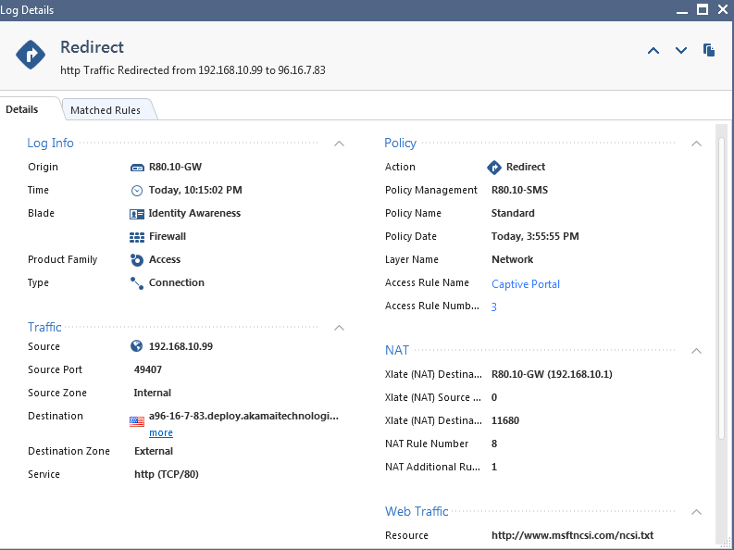
Captive Portal
Captive Portal Redirect
Detailed Log

Slide 12
Summary
Configured Identity Awareness
Configured Captive Portal
Created a rule base that used Identity Awareness and Captive Portal

Slide 13
Bibliography
Check Point R80.10 Identity Awareness Administration Guide
California: USA

