Slide 1


Application Control/URL Filtering
Module 9: Application Control/URL Filtering Instructor: Kim Winfield

Slide 2
Objectives
Create and implement an Application Control Policy
Create a URL Filtering Policy to block undesirable web sites for employees
Use SSL Inspection to inspect traffic to Secure Web Sites

Slide 3
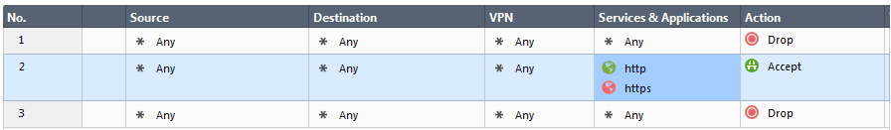
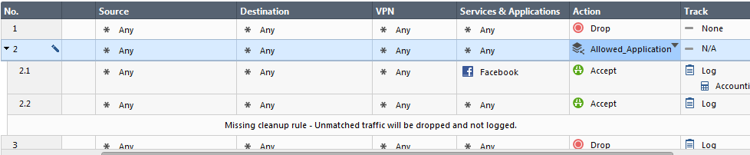
Application Control
Traditional Firewall policies only limit traffic by destination IP address and Service
Application Control allows access based on application signatures

Slide 4
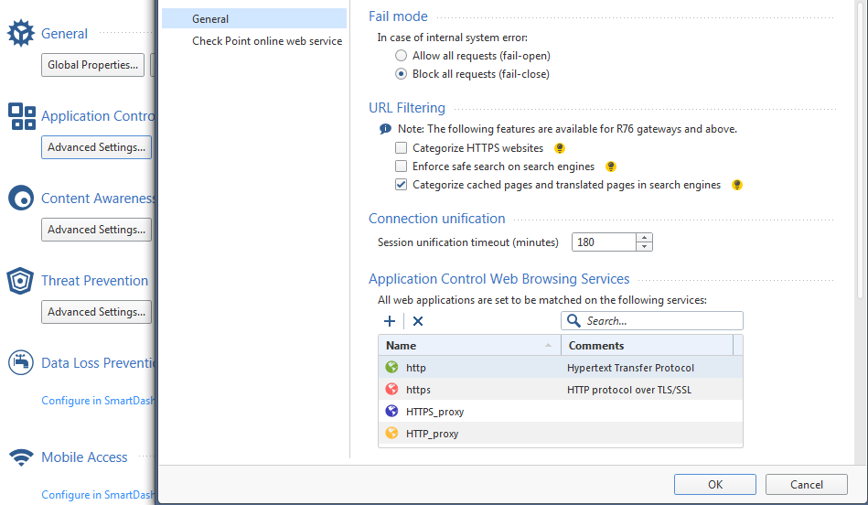
Application Control
Manage Settings
Blades

Slide 5
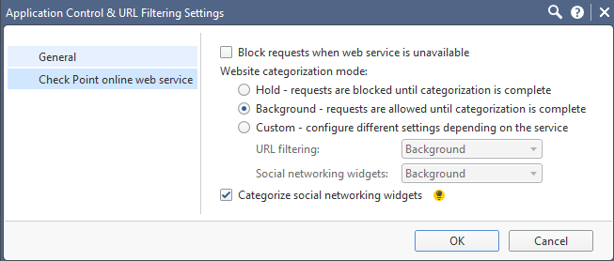
Application Control
Settings for Online Web Service
Hold
Background
Custom

Slide 6
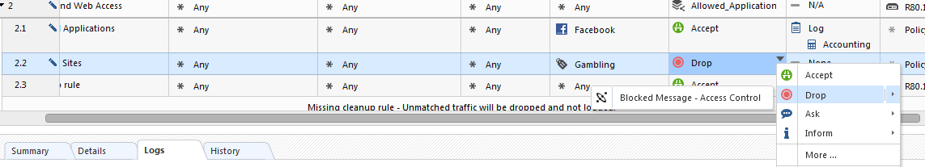
URL Filtering
Allowing or Blocking Traffic based on category
Block Message that can be customized.
Blocking Gambling Sites

Slide 7
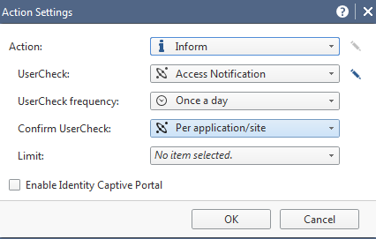
URL Filtering
Additional Options for Action Column
Accept
Drop
Ask
Inform

Slide 8
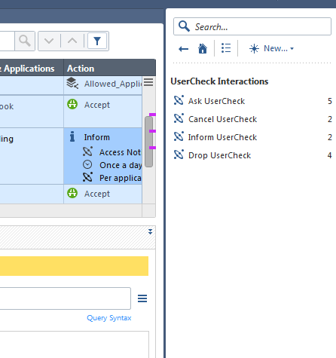
URL Filtering
User Check Interactions
Ask UserCheck
Cancel UserCheck
Inform UserCheck
Drop UserCheck

Slide 9
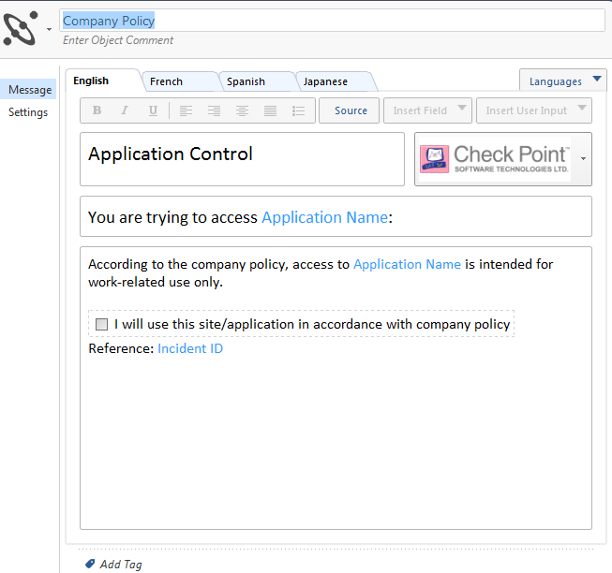
URL Filtering
User Check
Ask UserCheck
Company Policy Page

Slide 10
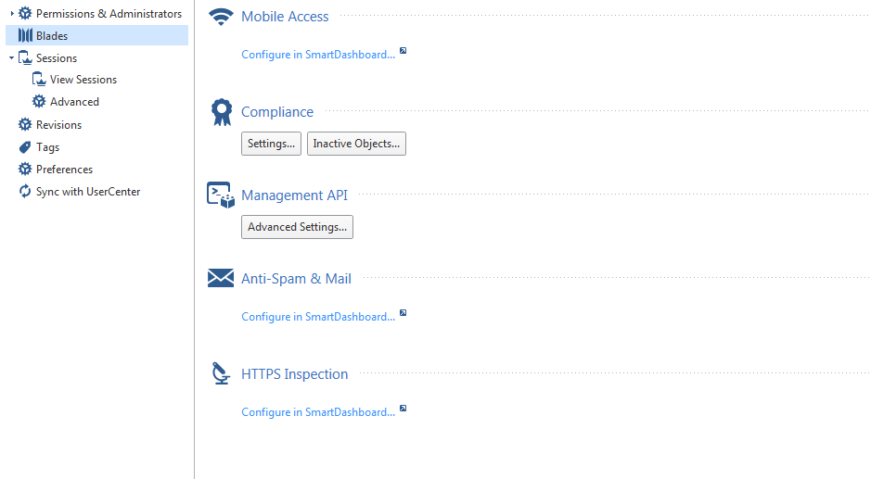
HTTPS Inspection
Configured in SmartDashboard
Legacy Dashboard Configuration

Slide 11
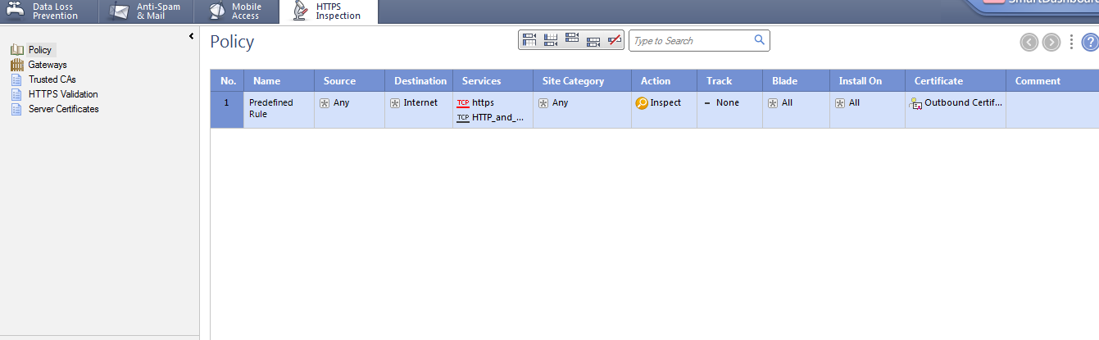
HTTPS Inspection
Policy
Gateways
Trusted CA’s
HTTPS Validation
Server Certificates

Slide 12
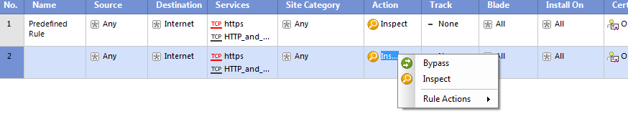
HTTPS Inspection Policy
Rule Actions
Inspect
Bypass
Banking Sites
HealthCare Sites

Slide 13
Summary
Created and implemented an Application Control Policy
Created a URL Filtering Policy to block undesirable web sites for employees
Used SSL Inspection to inspect traffic to Secure Web Sites

Slide 14
Bibliography
R80.10 Next Generation Security Gateway Getting Started Guide California: USA
Check Point R80.10 Security Gateway Technical Administration Guide California: USA
R80.10 Security Management Admin Guide California: USA

