Slide 1

Using our positioning layout build this site. … use a color scheme from here :
https://hookagency.com/blog/website-color-schemes/ create this overall layout.
Images are on moodle

Slide 2
Include some clear space here
R2 Image logo here with about
1.5 inch space here
And honest Jack’s auto here
R3 Make these edges line up (use fixed px)

Slide 3
R7 Make sure all images are properly sized and display text if graphics are turned off.
R4 Make a 2px gap here and 5 px here
R6 build these boxes with the images … all line up with a 10px gap between them
R5 - Create this box with the image … in center of this area and color the border

Slide 4
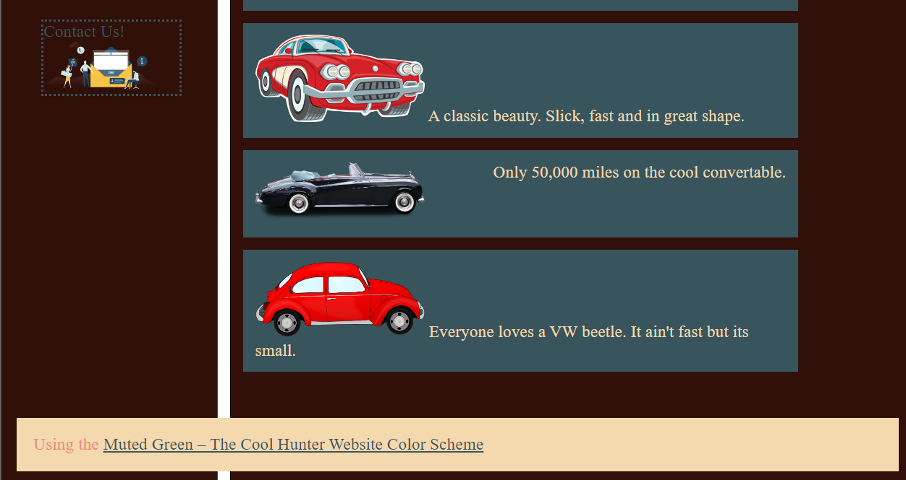
R8 – Include this footer the bottom w/ a link to https://hookagency.com/blog/website-color-schemes/ and indicate which color scheme you are using
R9- Put a space 5-7px space around the footer
R10- Stylize the link color and the visited color

Slide 5
Publish your pages and images to your 45.55.136.114 site. Make sure it works there.
Upload all your files and put the URL in the comments section on moodle.
Make sure that URL is correct.

