Slide 1
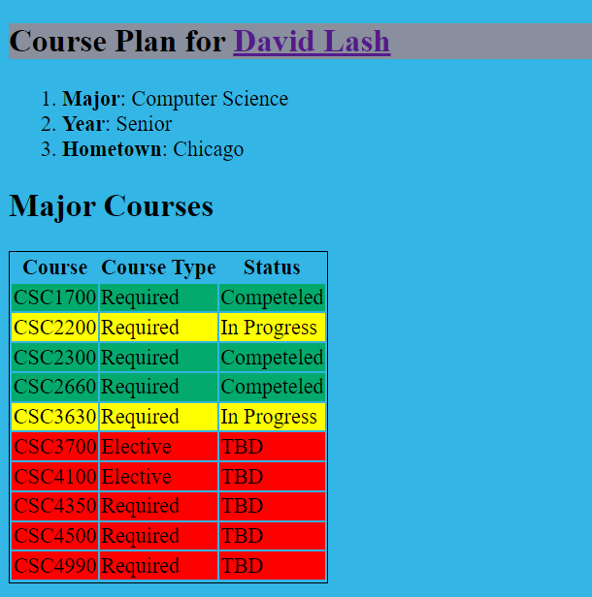

Build the following page and publish to your Aurora Account on the production web server
R1 Make this your name with facebook grey background
R2 Make a navigation bar under here.
Make the nav items: Home and Projects
R3 Build this enumerated list with your info for Major, Year and Hometown
R14 Create an external CSS file with classes for completed, inprogress, tbd
R4 Make this an H2 and then build this table where you list each required course and elective you are planning to take.
R5 Make status
Completed -> green background
In Progress -> Yellow Background
Red -> TBD
And use the proper class.
Use the facebook colors for background colors:
https://usbrandcolors.com/facebook-colors

Slide 2
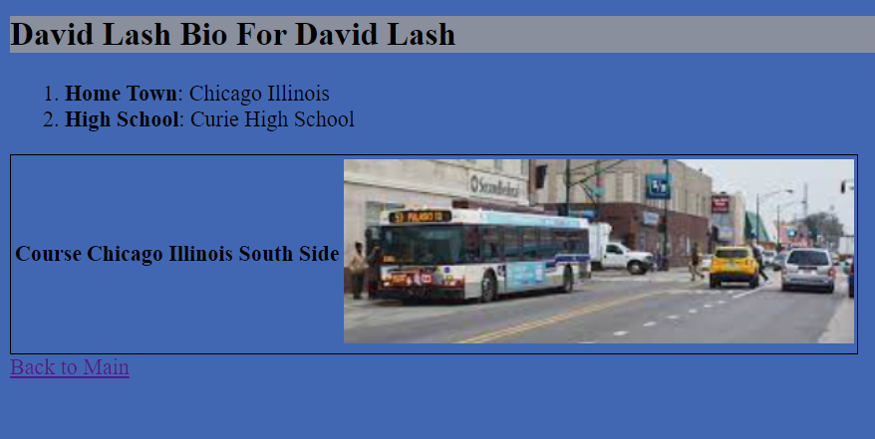

R6 Change this header to a project name you complete. If you don’t have anything yet, make it a name of a project you would like to do.
You don’t need to include this
Instead R7 -> include a nav bar here with
Home Project here
R8 – Create a single cell table with image about your project … make this a very short write up about the project
R9 Make this a link back to previous page

Slide 3
Additional requirements
R10 – Include a comment on each page that includes
Author: Your Name
Course: CSC2200 Fall
R11 – Publish your pages to the course web server at 45.55.136.114 and make sure it works properly
R12 – Put all your images in a sub folder of your HW called imgs
R13 – Make sure you pages work properly on the course web server. Put the URL to your published pages in the COMMENTS OF THE YOUR ASSIGNMENT AND UPLOAD ALL OF YOUR PAGES Make sure your pages work correctly on the 45.55.136.114 site

Slide 4
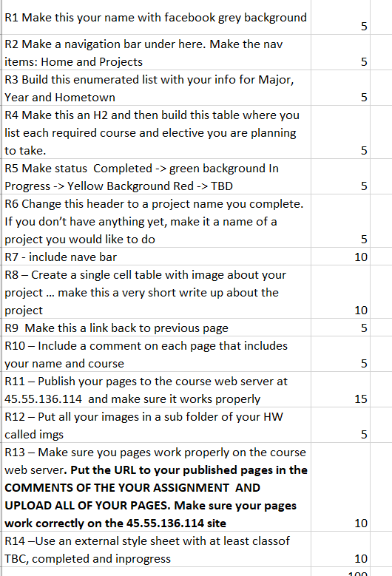
HW1 Rubric

