Slide 1
CSC2200 Project – BattleShip Vs Computer
Create a modified version of the classic game battleship as described by the first
1 minute 12 seconds of this video:
https://www.youtube.com/watch?v=q0qpQ8doUp8
Watch this video for overview of rules
Your ships will be built using these types
Type | Size
Aircraft Carrier | 5
Battleship | 4
Submarine | 3
Cruiser | 3
Destroyer | 2

Slide 2
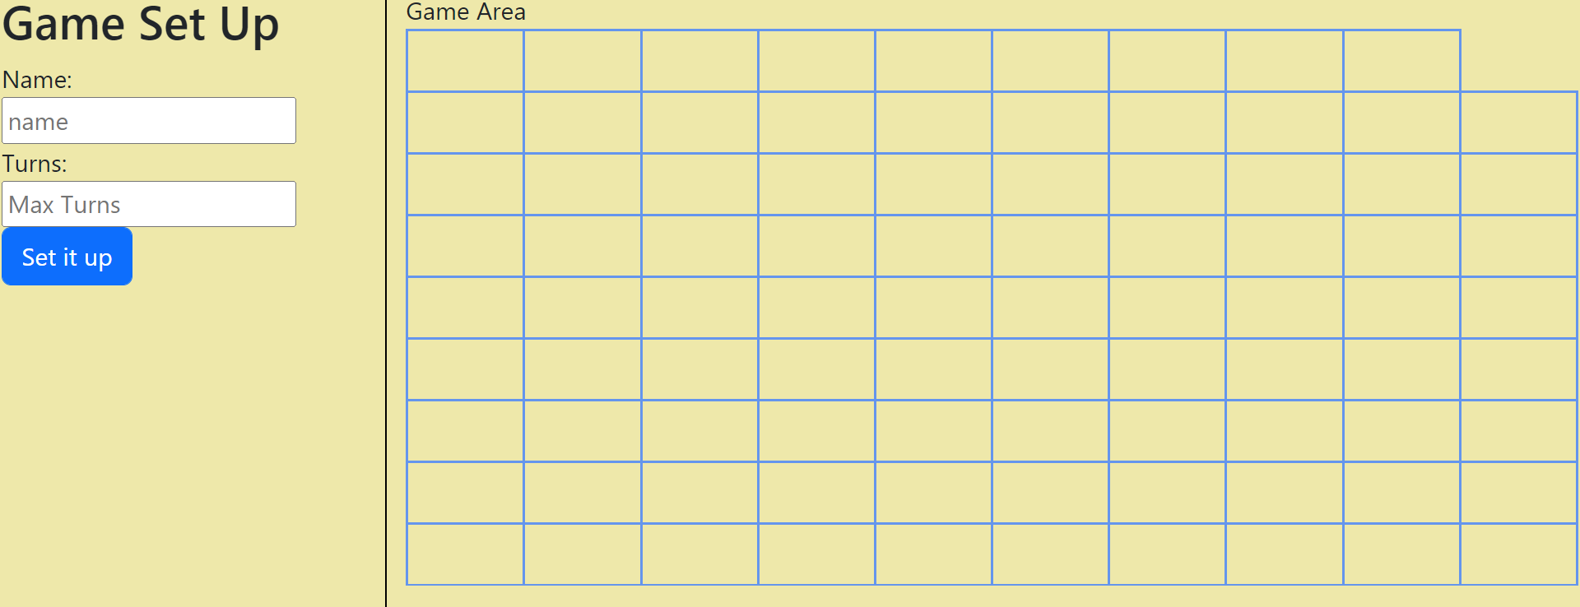

Support a game set up ‘mode’ and gather
Users name
Max Number of turns of the game.
Max sure max turns is a valid number from 1-100. Output a message in red if not valid on DOM(not an alert)
R2 - Draw a 10x10 grid here … in each square put something that looks like water. Here is the water icon
(NOTE I only put the water icon in the first 3 rows. YOU NEED TO PUT THEM IN ALL CELLS….
Make sure your icon has a blue color.
R3 – OnClick of the set it up button, randomly add all 5 ships to the board (BUT DO NOT SHOW them to the user)

Slide 3
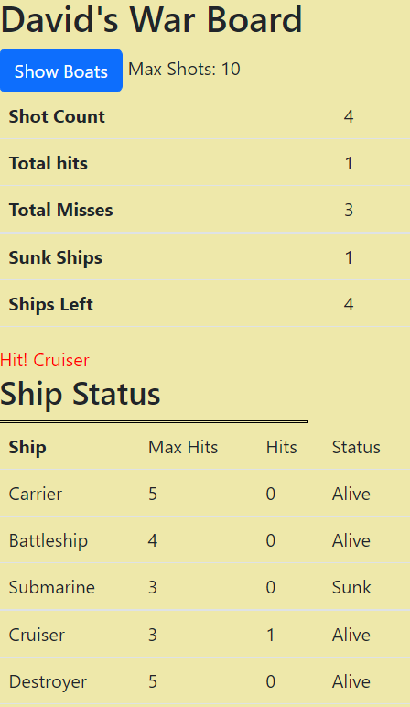



R4 – After user clicks set up …. Show users name and max number of misses
R5 – When the user clicks a square determine if it’s a hit or miss
If a miss, change the square
to something red like this.
And increment the miss counts and show a status message here
R6 – If user clicks a square where a ship is hidden
Alert the user that it is a hit and indicate the kind of ship
E.g., Hit 1 on battleship and show that same message in blue
In this area
and increment the hit counts

Slide 4
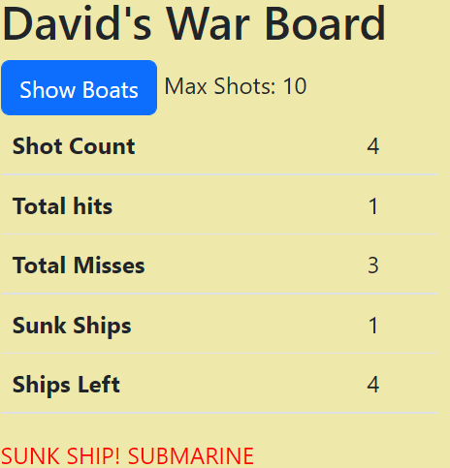
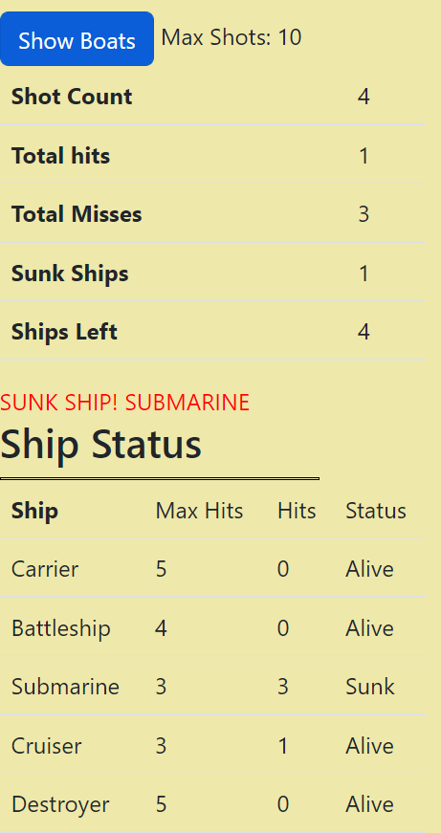

This X means a hit here .. .this symbol means a ship that was sunk
R7 – when the user sinks a ship change the sunken ships icons
Update the counts and print an appropriate message
and increment the hit counts

Slide 5
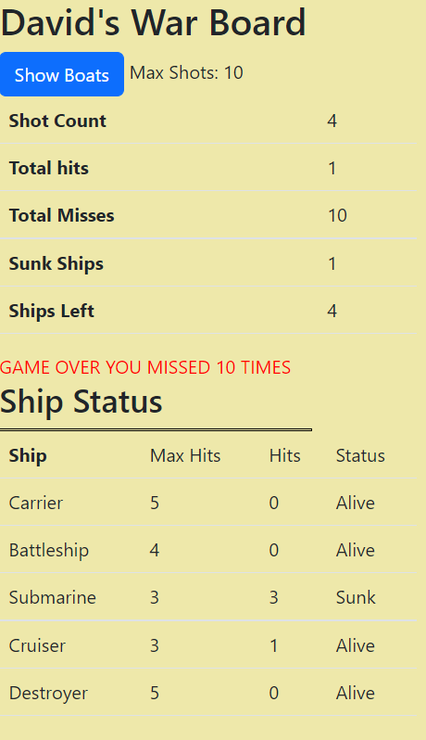
R8. Continue playing the game until the user sinks all the ships
Or runs out of misses
Indicate game over and if user tries to click a square show an
Error message

Slide 6

R9. When you click show boats … show the location of the boats here. When you click it again. Go back to the previous game screen (that’s right, it is a cheat)

Slide 7
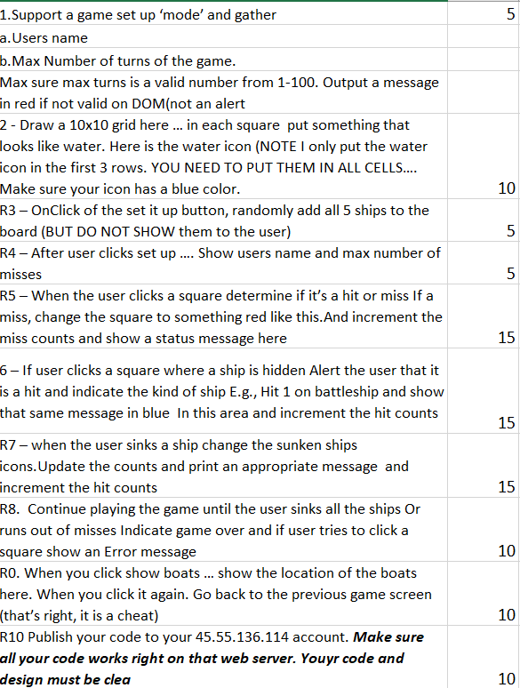
R10 Publish your code to your 45.55.136.114 account. Make sure all your code works right on that web server.

