Slide 1
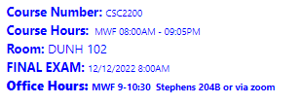
CSC2200 - Web Application Development
David Lash – F2022
Introduction
Notes:
1

Slide 2















Who am I ?
Where I went to school
Where I taught
Where I worked
My contact info:
  Phone: 630-370-9313
  E-mail: dlash@aurora.edu

Slide 3
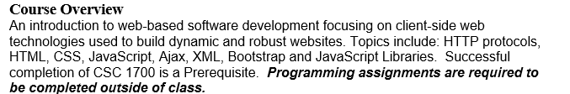
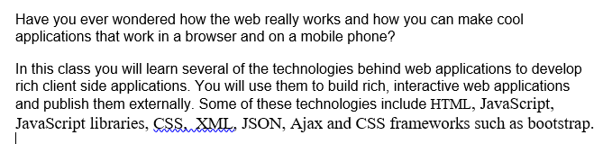
Course Description
CSC2200 - Web Application Development
  4 semester hours

Slide 4
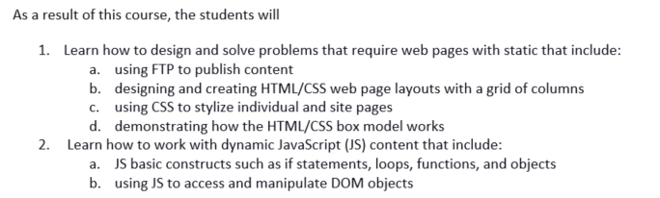

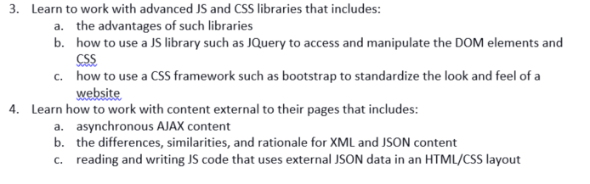
Course Objectives

Slide 5
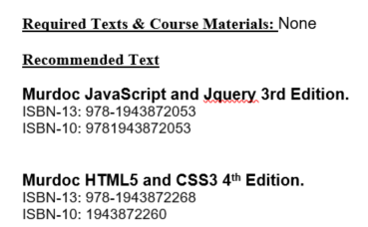


Slide 6
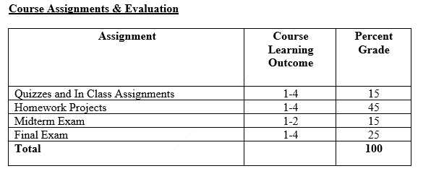

Grade breakdown
Notes of the week turn-in
In Class works are intended to reinforce material and let you practice… 3 types:
- In class assignments
- Quizzes – low stakes
- Course notes … due weekly
HW will be larger in scope and directly related to objectives.
Notes:
10

Slide 7
15% for quizzes and In class work
This part of grade is made up of 3 things:
Online quizzes – take as many times as needed BUT
  Need to be completed the week they are assigned
  Once closed … they do NOT reopen
  Want the questions? Copy them down while completing the quiz.
Weekly ‘Notes’ –
  I will stop about 5 minutes early each class.
  Write down main points and a question or 2
  Once closed … they do NOT reopen
There are lots of these activities about 30 …
That are worth about ½ points each… .miss a couple no
problems

Slide 8
Tools to Manage your Learning
Metacognition – thinking about your learning process.
  What is your process? How do you learn?
For example, if you can explain what your strengths are in academic writing, or exam taking, or other types of academic tasks, then you are metacognitively aware.
Skills ->
1. Planning – When will you review? Do HW? When is MT?
2. Self-questioning – (did I miss something? Is this study process good? Why did I miss this question?)
3. Self-Monitoring – Learning practice. Mnemonic aids. Code Practice.

Slide 9
Using Tools in This Course
Retrieval
  – interrupt the process of forgetting
  The more difficult the retrieval practice, the better it is for long-term learning
Interleaving
  Mixing up topics as you learn
  Better to mix up than do all 1 topic. \
Feedback
  You have to know what you don’t know
  Active part of metacognition
Spacing
  Space out learning
  Cramming helps short-term -> Spacing long term.

Slide 10
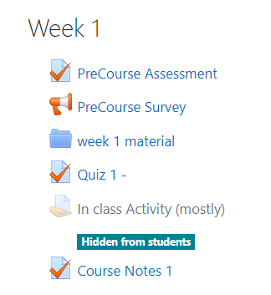
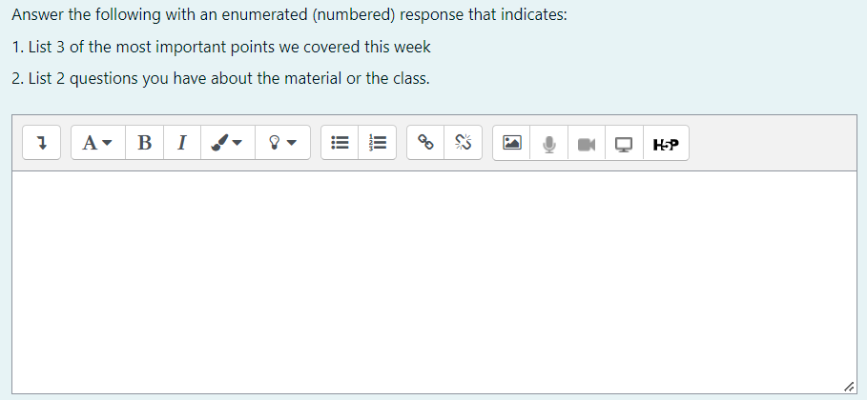
Weekly notes
A Chance for you to
- reflect and recall
- provide feedback to me

Slide 11
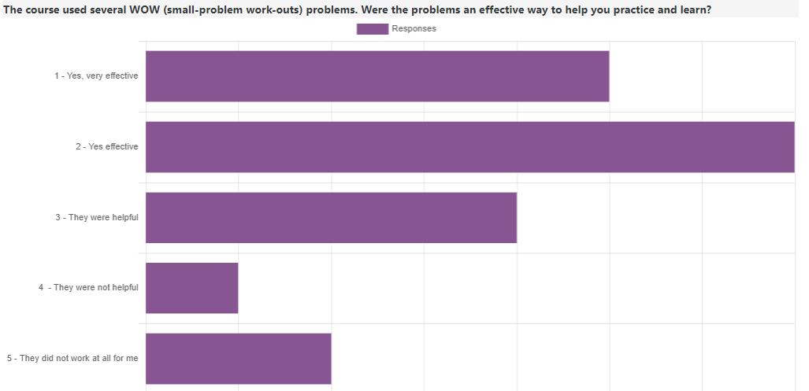
Work out of the Week0 - WOW
Helps with making sure I am on the right track
Why did you like or not like the WOW mini-problems?
I thought it was the best way to learn because it took the material we learned and gave us something similar to do ourselves.
I liked it because it was a way of practicing to be faster and solve little things of the code.
I liked the WOWs since it was a good, small way to test the students for concepts that we just learned.
Good little challenge
they were pretty easy but taught us important things

Slide 12
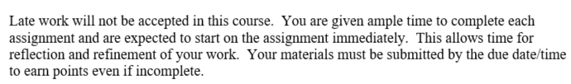
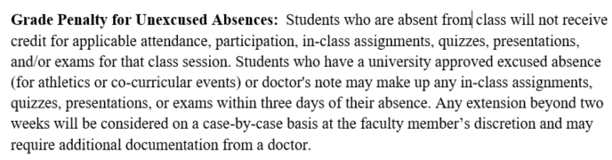
Late and Missed
When I give you 2 weeks… don’t wait until last minute!
We will do things in class … you need to be here … once it is due …it is not accepted!
Be proactive … let me know when you have an approved excuses absence!

Slide 13

You need a working PC (not a tablet or chromebook or phone)

Slide 14
Late and Missed
When I give you 2 weeks… don’t wait until last minute!
We will do things in class … you need to be here … once it is due …it is not accepted!
Be proactive … let me know when you have an approved excuses absence!

Slide 15
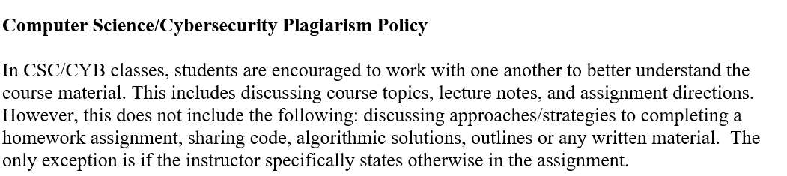
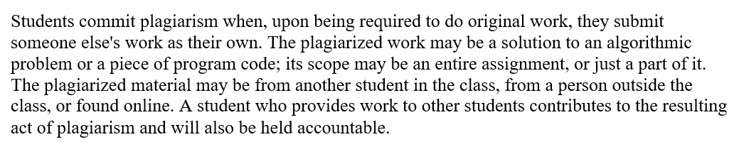
Plagiarism Policy

Slide 16
You need a working PC (not a tablet or chromebook or phone)

Slide 17
35% is midterm and Final
Midterm about week 8
  Expect to program on the midterm
  Liklely MC
Final is week 16
  Expect to program and create pages
  It is cumulative

Slide 18

Did you like the course notes?

Slide 19
What I expect …
Pro-active learning and participation
  Going beyond lectures
  Keeping track of your grade
  Getting things done on time
In-class practice is not enough.
Just like …. You cannot learn to play piano by only practicing at rehearsals or lessons
You will never make the sports team if you only practice during practices.
E.g., … In class we code-a-long and do several html examples of creating web pages
Do you practice before the next class? How do you make sure the learnings ‘sink-in’?

Slide 20
45% HW and/or Project(s)
A series of HWs due about every other week.
Last 2 HW will be a mini-project … (last semester built a game)
Vital to stay up-to-date with homework

Slide 21
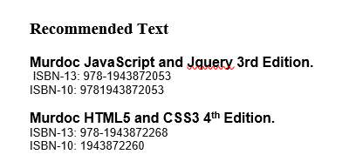
Text Books

Slide 22

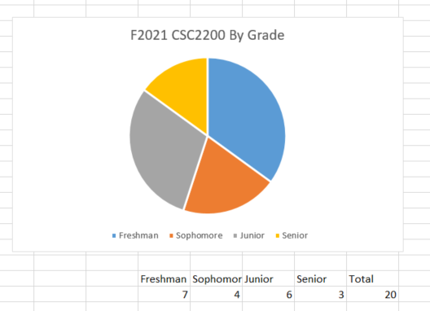
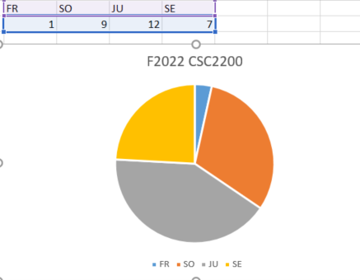
Course Composition

Slide 23
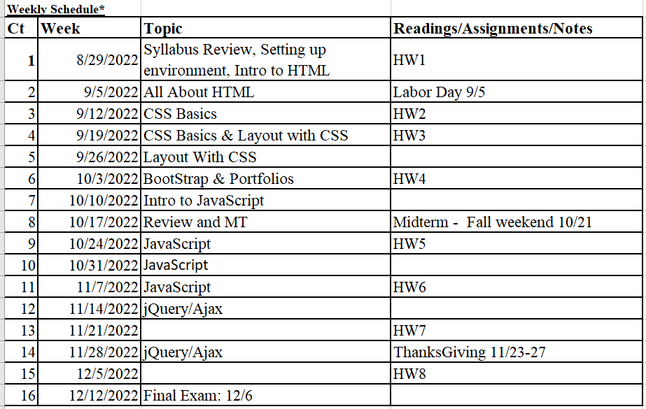
Course Schedule

Slide 24
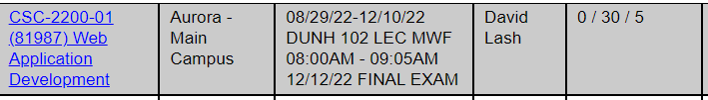
Final Exam

Slide 25
Quick Break out room
Introduce yourself …
    perhaps exchange contact information.
    reflect upon the best and worst CSC classes they have taken
    describe what made those courses successful for them, or not.
    Appoint someone to report back to group

Slide 26
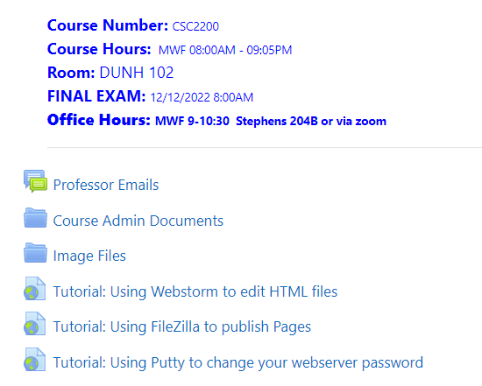
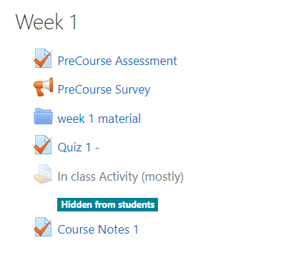
Quick note about moodle
Overall course info
Set to send you email
Syllabus, notes, etc
Image files we will use in GUIs
3 videos I recorded about installs
PreCourse Survey and assessment
Per week … might have a quiz
There will be in class activities to turn in
Course material ppt files and excel files
Assignment for handing in notes

Slide 27


Recommendations to future CSC2200 Students

Slide 28
A little about you and where you are at
Do the course moodle survey now
Pre-class assessment

Slide 29
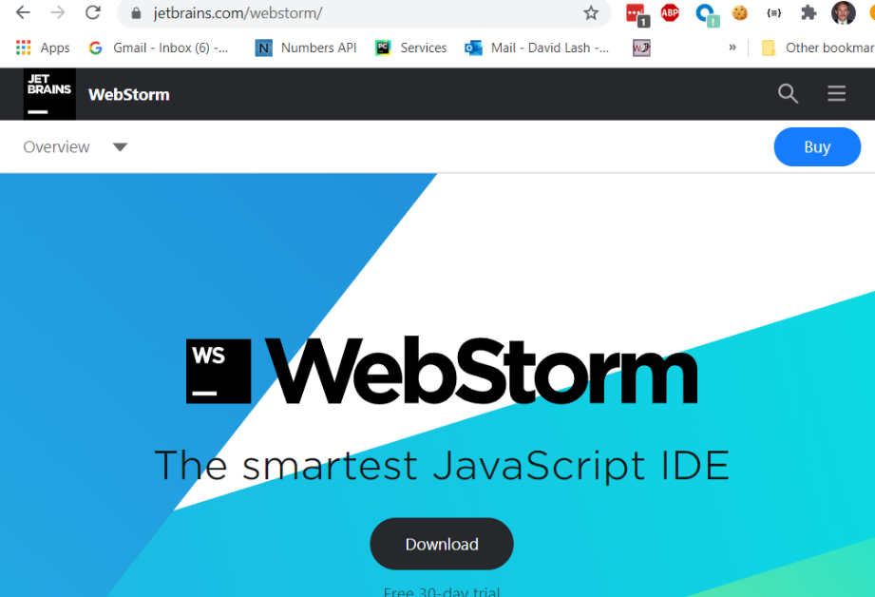
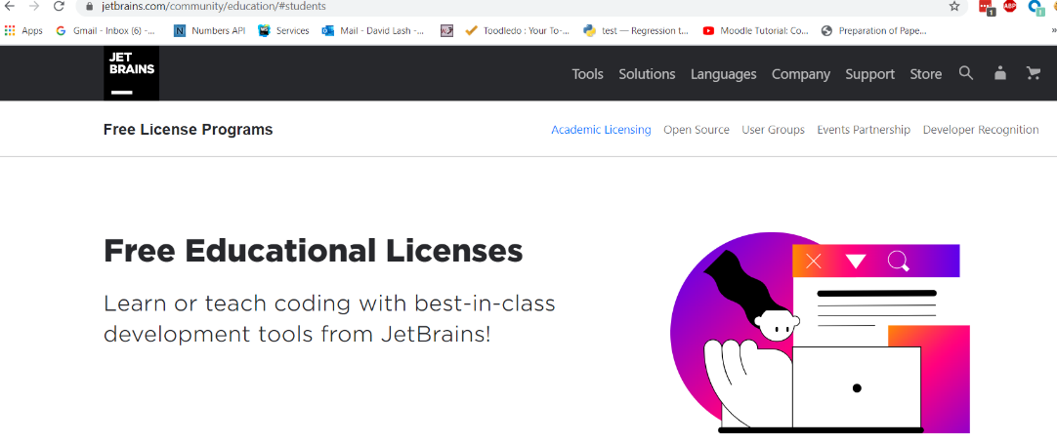
There are many development tools that you can use to develop html/JS Applications
- We will use webstorm
1. https://www.jetbrains.com/webstorm/ apply for your free student edition: https://www.jetbrains.com/community/education/#students ... https://www.jetbrains.com/shop/eform/students

Slide 30
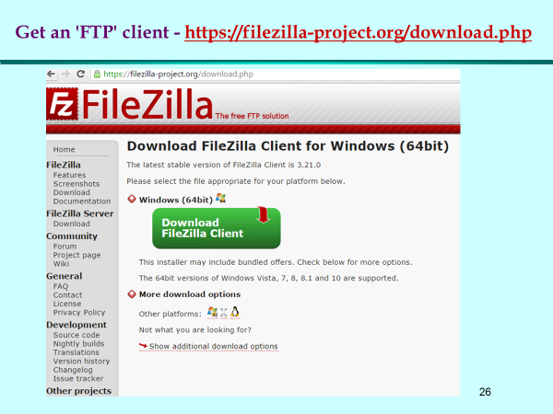
Need to download filezilla
Get filezilla:
https://filezilla-project.org/download.php

Slide 31
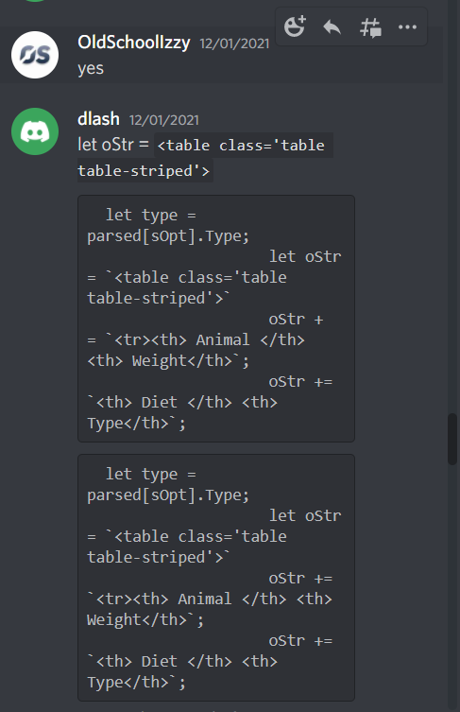
You need to download discord
Windows download: https://discord.com/download
This is the class discord invite:
https://discord.gg/HHdHe6yG
Set your discord handle to your email Handle … Need to know who I am talking
(or I might boot you)

Slide 32
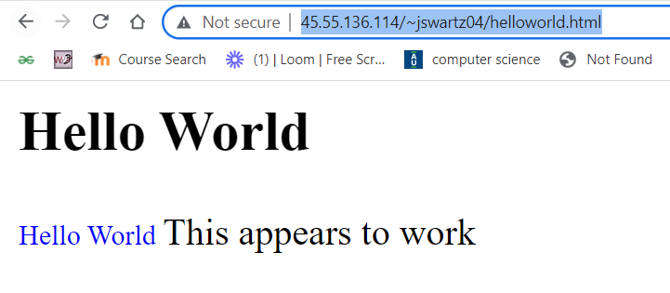
Webserver accounts
nalbert01
lbarbosa01
ebarraza01
abecker03
nboes01
jcamacho02
ccappelli01
jcarrillo05
mcherry03
dcrisanto01
adeltoro05
egarcia14
dllamas01
amagana06
amartinez21
amusielak01
anakashima01
enava02
aperez37
rpotter02
ulloa01
kroye01
aruacho01
jswartz04
gthompson06
jtorres12
cvalencia02
ivilla02
twarner04
I have created the following accounts on our class web server
http://45.55.136.114
You need to check them now:
Goto
http://45.55.136.114/~yourhandle
E.g.,
http://45.55.136.114/~jswartz04
Then click: http://45.55.136.114/~jswartz04/helloworld.html
This tilde character is required
Should see this
You have a password: $pass='webclass1';
More about this later

