Slide 1
PROJECT HUB
REVOLUTIONIZING PROJECT COLLABORATION
A platform where ideas come to life through collaborative project creation and management.
By GENIUSE

Slide 2
Project creation and display on the All Projects page
Request and approval system for joining projects
Personalized My Projects page
Workspace with chat functionality and file sharing
Account creation for project initiation
Goals of PROJECT HUB
Empowering users to collaborate seamlessly on projects

Slide 3
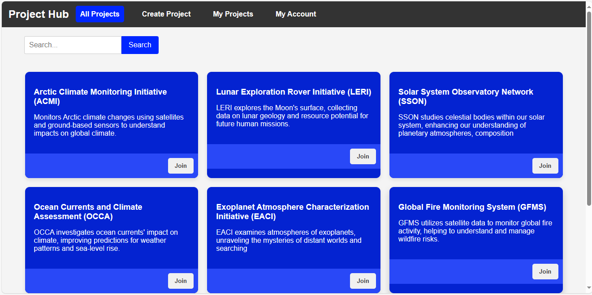
Showcase all ongoing projects.
Overview of each project.
Easy navigation and search functionality.
Requesting to join a project.
Creator’s approval process.
Display on My Projects upon acceptance
All Project Page

Slide 4
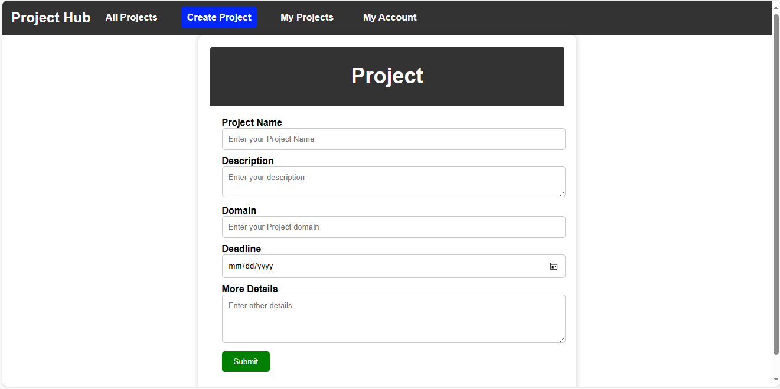
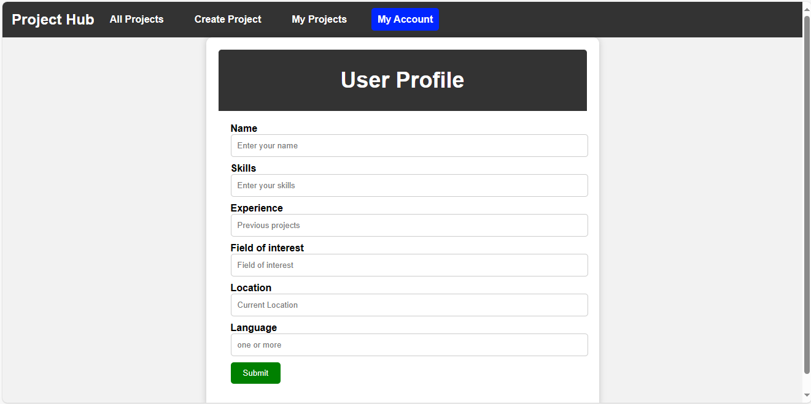
Project Creation & Account Creation Page
Seamless project creation process.
User-friendly account creation process
& project creation process

Slide 5
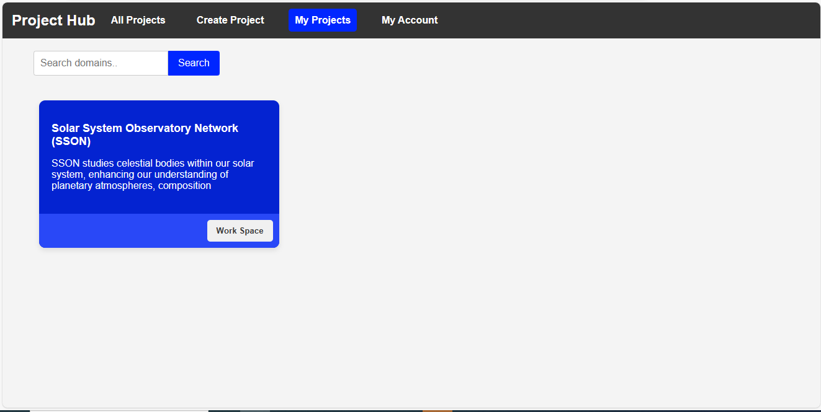
Personalized dashboard for each user.
Displaying approved projects and created projects.
Quick access to project details.
My Project Page

Slide 6
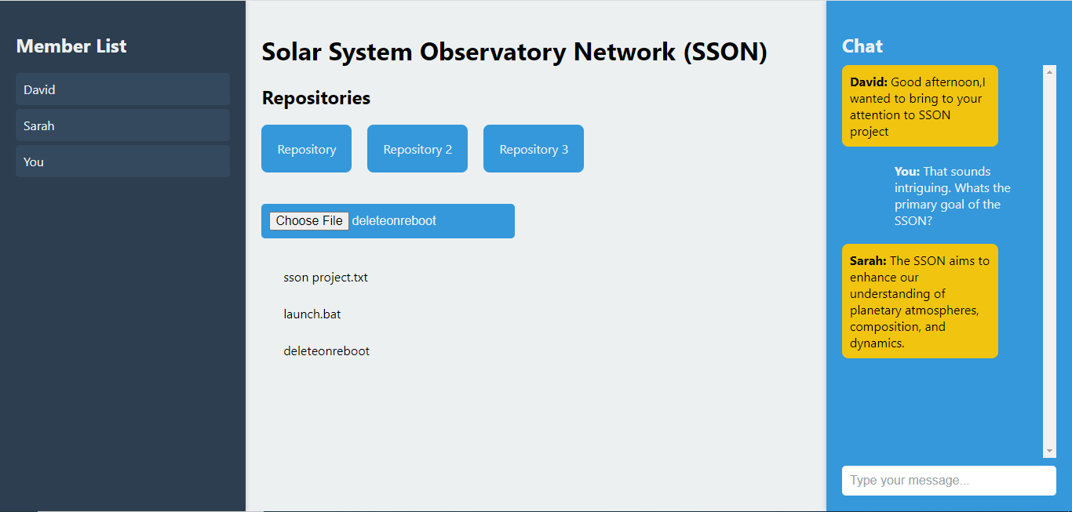
Collaborative workspace for project teams.
Real-time chat for communication.
File-sharing functionality for easy collaborations.
Workspace

Slide 7
Call to Action : Encourage viewers to sign up and
start their collaborative journey on Project Hub.
Stay Connected: Provide chat , workspace and files
in a single page to stay connected.
User Friendly: Provide easy user friendly interface
CONCLUSION
Summary of Project Hub’s
Unique features.
Closing statement: Highlight the platform’s potential to bring ideas to life though collaboration

