Slide 1

Predicting Customer Traffic for Coffee Shops
Edwin Sutrisno
June 21, 2020

Slide 2
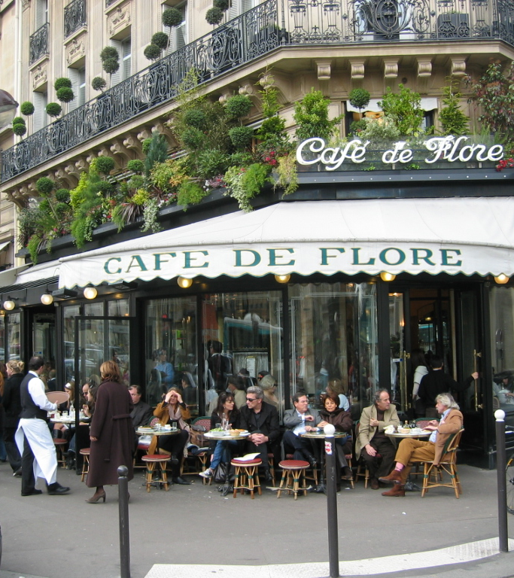
Business Background
Location is a known important factor for a business to attract customers
Successful coffee shops offer some insights on the characteristics of their locations
By building a predictive model, we can predict if a location will be suitable to establish a new coffee shop
Predictive model will give the factors that are important in getting high customer traffic to the business
This Photo by Unknown Author is licensed under CC BY-SA

Slide 3
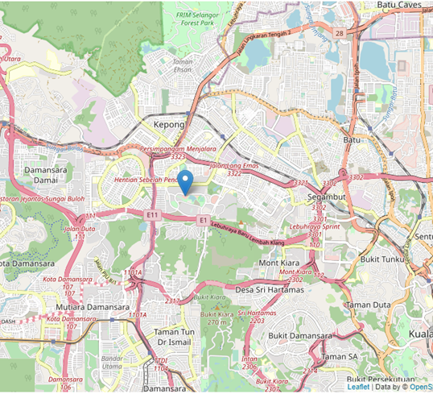
Data Source
Foursquare provides free open-source data about venues such as coffee shops
The location in study is an area in the West of Kuala Lumpur, Malaysia

Slide 4
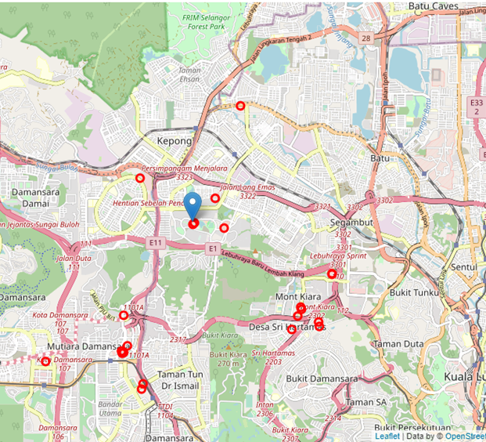
Coffee Shop Location Search
The two most popular coffee shop chains in the city are Starbucks and the Coffee Bean & Tea Leaf
We search for these two chains to collect data for training
Use the Foursquare’s “search” API to identify their ID’s and geo-locations (red circles)
Search Radius = 4 km

Slide 5
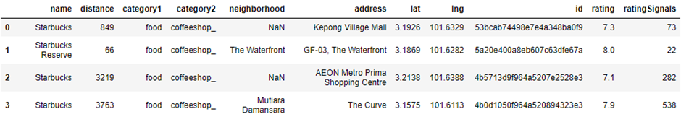
Customer Traffic Data
The search API only provides the locations and unique ID for each venue
Customer traffic data is obtained by querying for the venue’s details using the “venue” API on Foursquare
https://api.foursquare.com/v2/venues/{venueID}
There is not an exact data for customer traffic but the returned venue details has a “ratingSignals” field which can be used as a substitute

Slide 6
Data Cleaning
Venues returned by Foursquare are not all accurate
Manual search on Google Maps found that some shops did not exist
Some shops were duplicates
Data had to be manually cleaned because there was not a hard-rule to identify the false data
The cleaned data set has 22 coffee shops

Slide 7
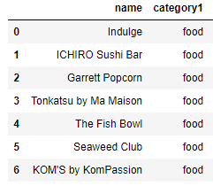
Features for Traffic Modeling
Features for modeling are the counts of different businesses that are nearby a coffee shop location
Use the “explore” API to search for nearby venues within 120 m radius and loop the search for all 22 coffee shops in the data set
Neighbors Example
All Neighbor Categories
1. Arts & Entertainment | 5. Nightlife
2. Building | 6. Parks & Outdoors
3. Education | 7. Shops
4. Food | 8. Travel

Slide 8
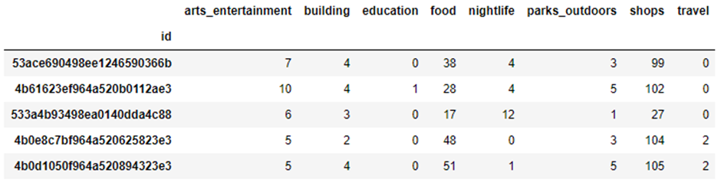
Features Table
A table of count of neighbors in each category where each row is a coffee shop

Slide 9
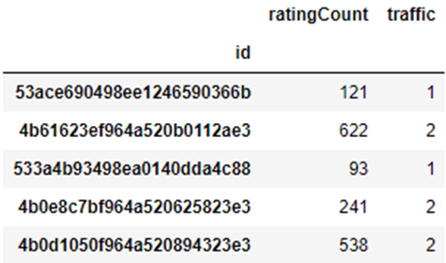
Target Variable Preprocessing
The rating count data represents customer traffic however there will be some issues to use the raw values directly in the model:
rating count is highly inaccurate because not all customers reported a rating, so its raw values may be perceived as detailed variations by a model
rating count does not have an upper limit and it continues to increase over time, so after some level a higher number is no longer relevant
To address the issues above, the rating count is transformed into 3 levels of customer traffic:
rating count < 50 is Low Traffic (score 0)
rating count 51-149 is Medium Traffic (score 1)
rating count 150+ is High Traffic (score 2)

Slide 10
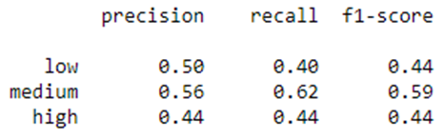
Decision Tree Classification Model
A decision tree is chosen for the classification model because it offers the ability to show the split of the features which can tell the important features to predict
To maximize the available data (22 samples) a leave-one-out cross validation approach was used to generate the test accuracy
The overall accuracy = 54%

Slide 11
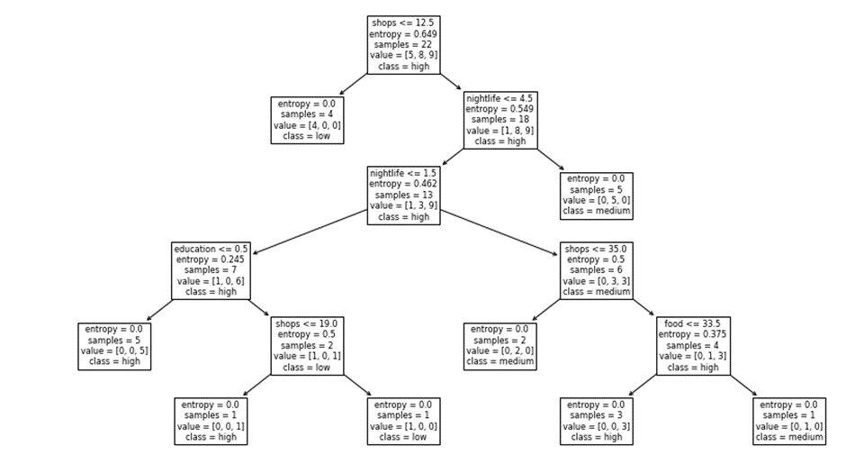

Slide 12
Result Discussion
Decision Tree showed that the number of shops took the top position in predicting customer traffic, followed by nightlife.
A leaf node with 5 samples of "high" (left most) is a pure node with the highest samples of high traffic compared to other leaf nodes. The path to get to this node is:
If the number of nearby shops >= 13, and
number of nearby nightlife venues >= 5, and
number of nearby education venues >= 1, then the customer traffic will be high
It is quite easy to understand the above path in real-life situation. If a coffee shop is surrounded by many shops, near nightlife attractions and a college, then it can attract a wide spectrum of customers from daytime shoppers, night goers and students.

Slide 13

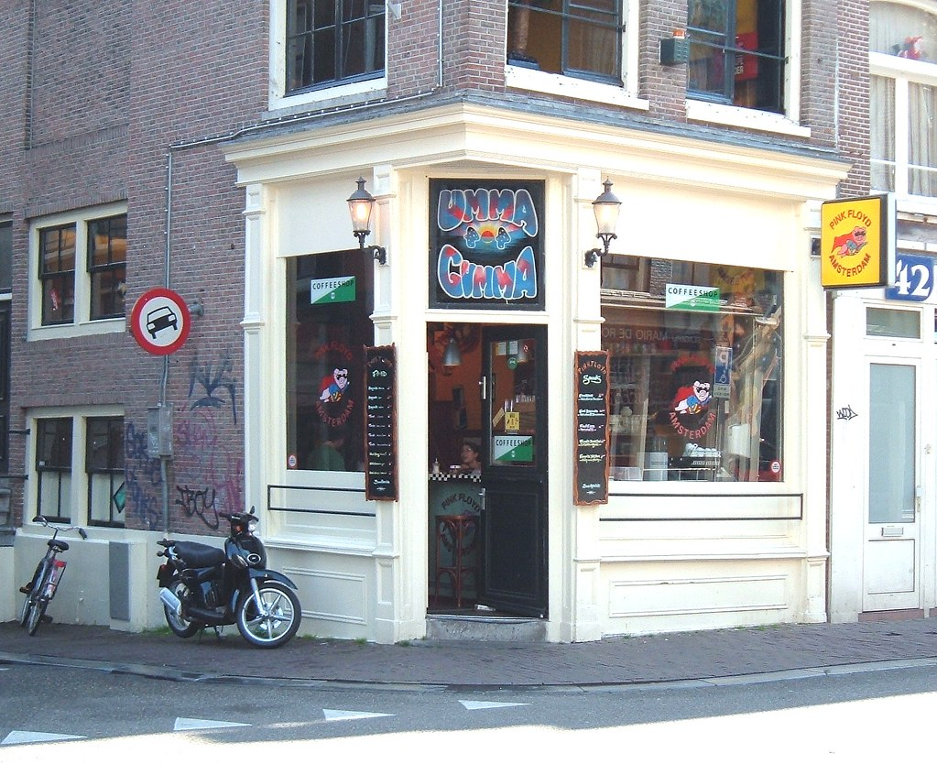
Future Application
Use the model to predict the traffic outcome for a given new location
OR
Use Foursquare to search all locations in the city for shops, nightlife, and education and apply a k-means clustering to find clusters which satisfy the criteria and place a new coffee shop there
This Photo by Unknown Author is licensed under CC BY-NC-ND

Slide 14
Conclusion
A decision tree classifier model was built to predict customer traffic using open-source data collected from Starbucks and The Coffee Bean & Tea Leaf locations around west of Kuala Lumpur area
The model gave a reasonable quality prediction despite the limited amount of data and data quality issues in the Foursquare open-source database
Among the key factors that drove customer traffic are the number of neighboring shops, nightlife attractions, and educational places
Further improvement to the model can be done by collecting more data from additional sources such as Google Maps and conducting more rigorous data cleaning

