Slide 1
Jot!
A Lese-Wolf Productions

Slide 2
Functional Requirements
User Management
Provide users a registration, login, deletion
Entity Management
Selection and gathering of data
Sharing of data
Viewing, managing and removal of data

Slide 3
Non-functional Requirements
System
Linux-based server
Server side software – PHP
Database storage for entities and information
Client side – Windows pc, android and ios device
Language (js/wrappers), java, objective c

Slide 4
More NFR
Encryption
All data will be encrypted on server and decrypted on device
User management
Only registered users shall store and retrieve
Users shall be allowed to store no more than allocated amount of data per account

Slide 5
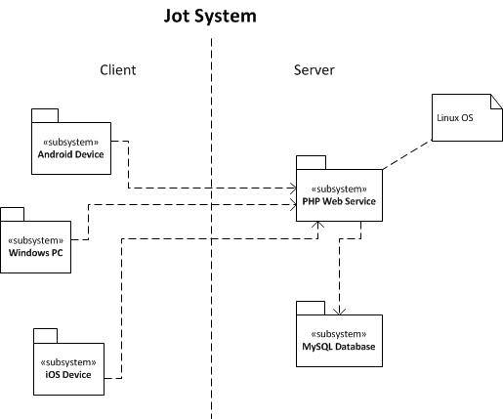
System Architecture

Slide 6
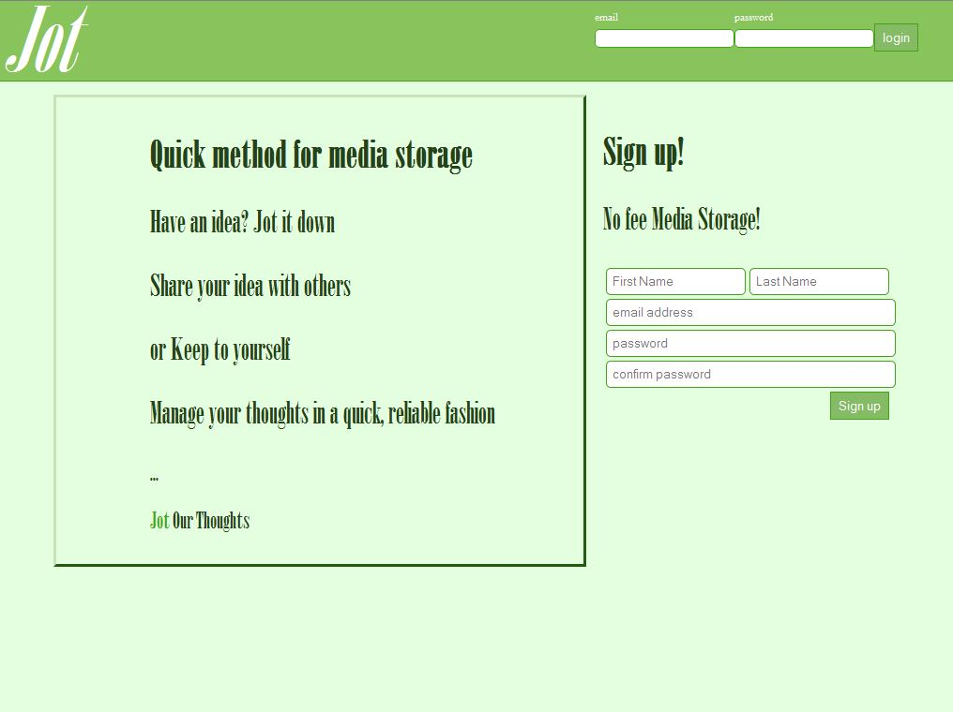
Jot prototype

Slide 7
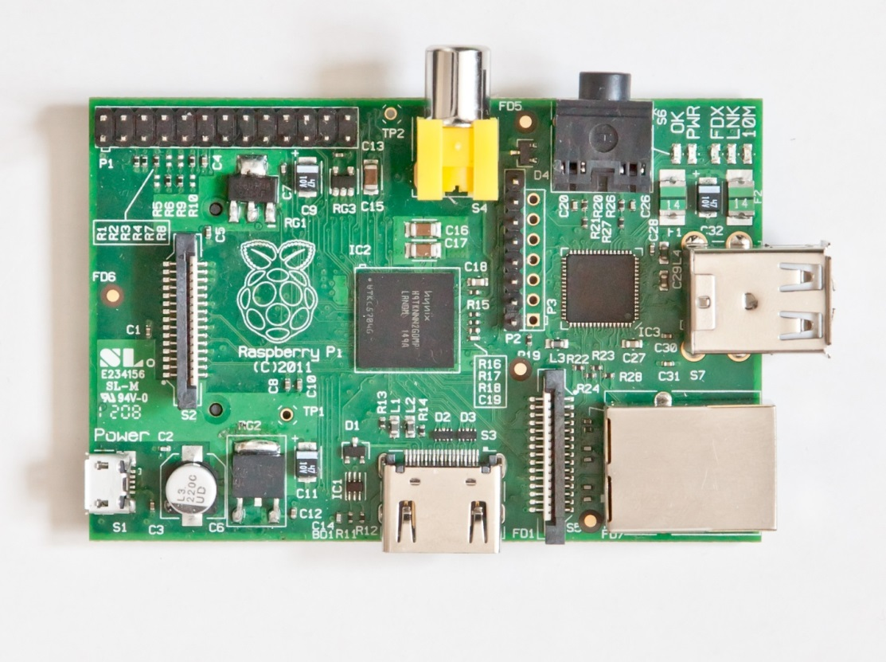
Raspberry Pi Module

Slide 8
Raspberry PI desc.
This device, chosen for its novelty, is easily configured to run Debian Linux OS. The OS and all applications reside on a 16GB SD memory card. This is of sufficient size for the class project, but not practical for a “full production” system due to its limited memory.

