Slide 1
Jot!
Mark Lese, Dustin Wolf

Slide 2
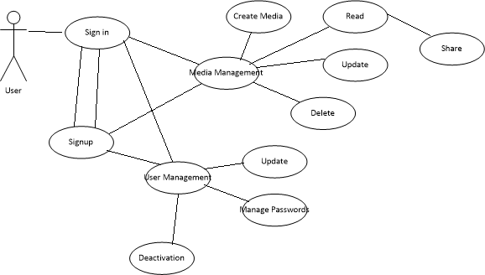
Use case

Slide 3
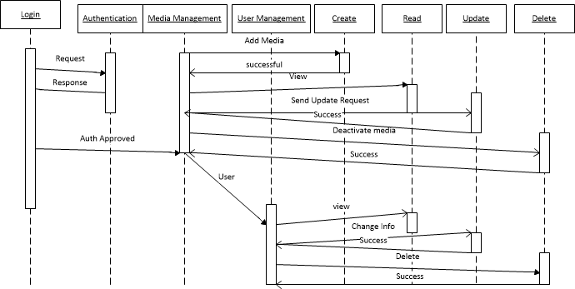
Sequence

Slide 4
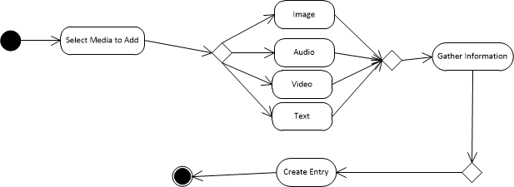
Activity

Slide 5
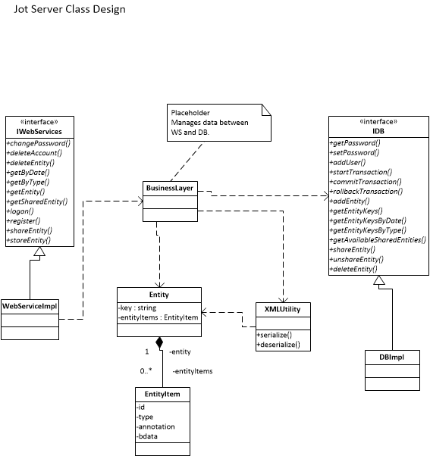
Class (server)

Slide 6
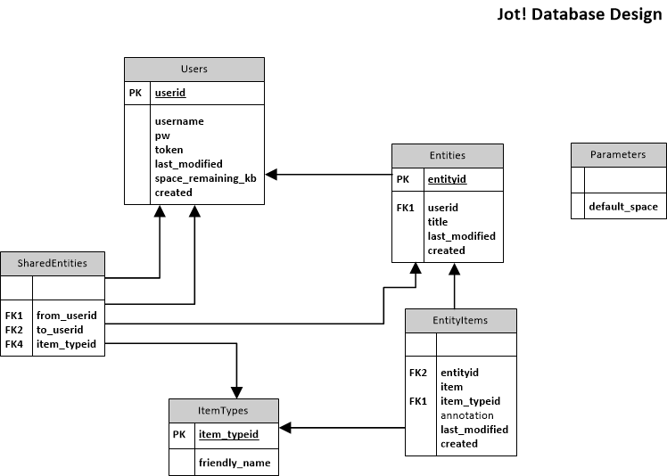
DB Design

