Slide 1
Education in Illinois and Chicago
Comparing Cost-Effectiveness Across Districts
Ed Wise

Slide 2
Big decisions
Living in Chicago provides many obvious advantages
One of the challenges is living in the city on a budget
Challenges are magnified after starting a family
Balancing quality of life, budget and access to education is difficult
Does CPS provide a quality and cost-effective option when compared to districts outside of the city?

Slide 3
Data sources
Cook County Data Catalog (pretty impressive but declining) (My data is from 2013)
Illinois State Board of Education (Exhaustive Data Sources)

Slide 4
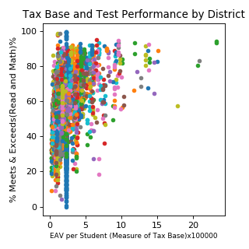
Tax Base And Test Performance
CPS
Chart shows relationship between tax base and testing performance across the state of Illinois with color indicating school district. Tax base is lacking for the number of students CPS has to support.

Slide 5
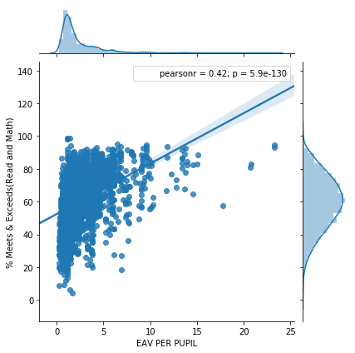
Outside of Chicago the relationship between tax base and performance is considerable.

Slide 6
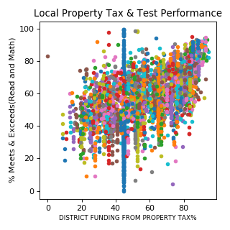
Proportion of budget collected Through Property Taxes
CPS
Chart shows relationship between % of funding from local property taxes and testing performance. Here we see that the % of funding coming from local property taxes for CPS is modest. There are several considerations, such as the rich and poor neighborhoods in Chicago cancel each other out, but it seems difficult to overcome an undersized tax base with this modest rate.

Slide 7
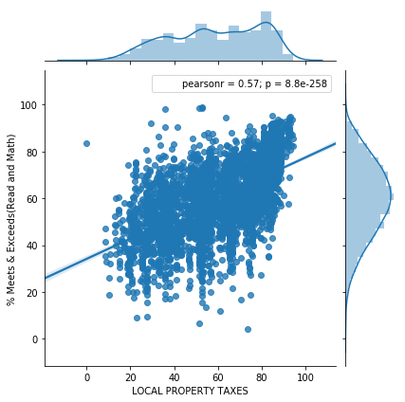
Across the state there is a moderate to strong relationship between funding from local property taxes and testing performance. There are several possible drivers for this relationship. For one, the districts to the right of the X-axis are probably more affluent comminuties.

Slide 8
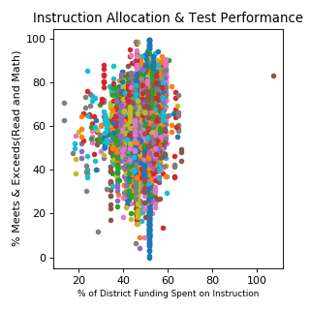
Proportion of budget Spent on instructors
CPS
Chart shows relationship between % of funding spent on teachers and testing performance. CPS is a little above middle of the road in spending no instructors but the relationship seems weak if existent at all.

Slide 9
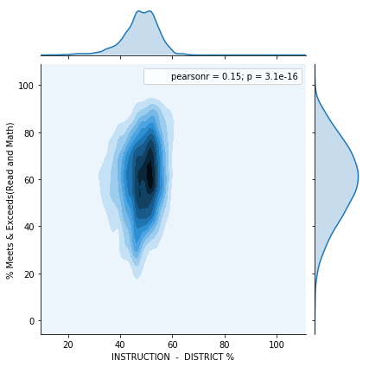
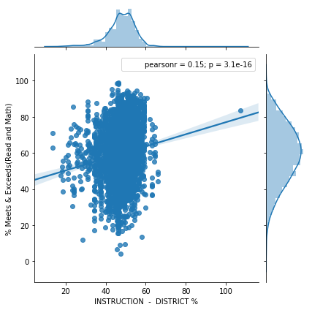
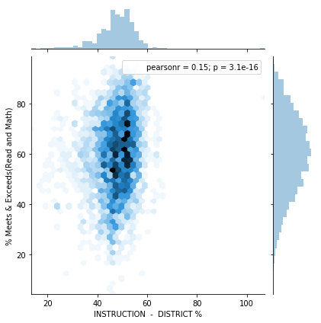
As suspected from the previous chart the relationship between % of funding spent on instruction and testing performance is weak.

Slide 10
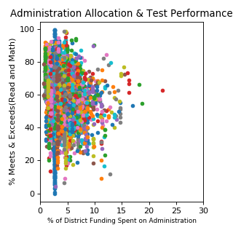
Proportion of budget collected Through Property Taxes
CPS
Chart shows relationship between % of funding spent on teachers and testing performance. CPS does manage the district very efficiently relative to other districts.

Slide 11
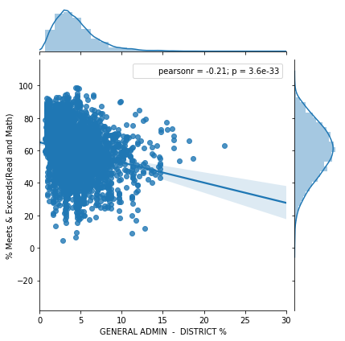
Spending little on administration is a plus as the relationship between administrative spending and test performance is negative.

Slide 12
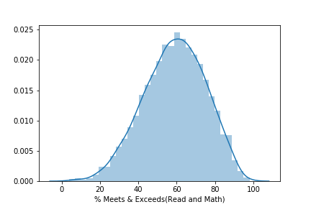
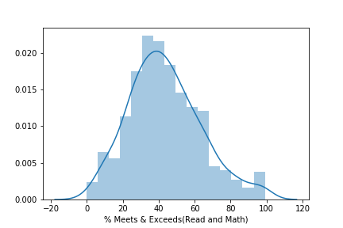
Comparing the performance of CPS vs NON-CPS districts does show that non-Cps districts perform better. This was confirmed with a significant students t-test result showing that non-cps schools had a greater rate of meeting performance standards (by about 17%)
NON-CPS Performance Distribution
CPS Performance Distribution

Slide 13

Conclusions
1. Not surprisingly, the CPS is strained as the tax base is too small to support the school system.
2. The funding from property taxes is modest and that stream of funding may need to grow.
3. Despite these challenges the CPS district does put its funding in the right place as teachers are paid above the state average and the administrative budget is relatively small.
4. I hypothesize that the real budget strain for families comes from the inflated cost of housing in CPS areas with strong schools.
This Photo by Unknown Author is licensed under CC BY

Slide 14
Next steps
My next steps in the series of analysis would be to compare the relationship between property value and school performance in the CPS district.
This Photo by Unknown Author is licensed under CC BY

