Slide 1

Laravel
Trainer: Edward

Slide 2
Last Session
What we covered in the last session
Data-Entry Form
Data Validation
CSRF – Security
“old” function
Eloquent Where
“compact” function

Slide 3


Session Topics
1. Eloquent Scope
2. Relations – an Intro

Slide 4
Today’s learning
When we complete today’s session, you will learn to …
Eloquent Scope
Mass Assignment
Relations
One to many

Slide 5

Eloquent Scope
Eloquent is able to handle many different database drivers behind the scenes.
Eloquent Scopes offer a way of extracting a part of a query from your controller and into your model to simplify your queries and keep them cleaner.
Which queries qualify to be scoped? If you find yourself repeatedly writing eloquent queries with the same logic then query scopes is the way to go.
Model
We have got introduced to the concept of “Model”.
The Customer model extends the Model.

Slide 6
Eloquent Scope
Creating new scopes for our “complete” and “incomplete” filters.
Scope creation follows a convention – it always starts with scope and then the name of the scope as follows:
public function scopeActive($query)
{
return $query->where( 'active', 1 );
}
This scope can be used in the place of our query by referencing the name of the newly created scope.
$activeCustomers = Customer::active()->get();

Slide 7
Mass Assignment
Reorganising and Cleaning Code.
All the validated data in the Controller is held in a variable called “$data” which we aren’t using.
Customer::create($data);
Enabling Mass-assignment
There are two approaches to enabling mass assignment –
We can specify (whitelist) which columns can be mass assigned.
protected $fillable ['name', 'email', 'active'];
The next one is by adding $guarded property in model class: …
protected $guarded = [];

Slide 8
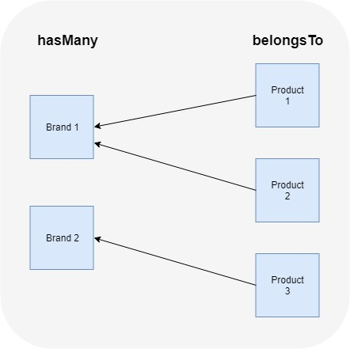
One to Many Relationship
Eloquent Relation – One to Many
Eloquent “hasMany” Relationship
Eloquent “belongsTo” Relationship

Slide 9
One to Many Relationship
Towards understanding One to Many relation let us associate our Customers with a Company.
A new Model and migration
php artisan make:model Company -m
Companies migration file
$table->string(‘name’);
$table->string(‘phone’);
Mass assignment
protected $guarded = [];

Slide 10
One to Many Relationship
A “Company has many customers”
In the Company model return
public function customers()
{
return $this->hasMany(Customer::class);
}
“a Customer belongs to a Company”
In the Company model return
public function company()
{
return $this->belongsTo(Company::class);
}

Slide 11
One to Many Relationship
Foreign Key.
A FOREIGN KEY is a field (or collection of fields) in one table, that refers to the PRIMARY KEY in another table.
In order to link the customer to a company the customer table needs to store the company id…
$table->integer('company_id’);
Migration with a new option
php artisan migrate:fresh
Input data with Tinker
$c = Company::create(['name'=>'ABC Company', 'phone'=>'123-123-1234']);

Slide 12
One to Many Relationship
Data-Entry Form
To draw an association with the customer to a company the customer table needs to store the company id…
<div class="form-group">
<label for="company_id">Company</label>
<select name="company_id" id="company_id" class="form-control">
@foreach ($companies as $company)
<option value=" {{$company->id}} "> {{$company->name}} </option>
@endforeach
</select>
</div>

Slide 13
One to Many Relationship
Data-Entry Form
We need to edit our control file with the necessary changes …
$companies = Company::all();
pass that value into the return statement
return view(‘index.customers', compact('activeCustomers', 'inactiveCustomers', 'companies'));
Validation
'company_id'=> 'required’

Slide 14
Tinkering
Use tinker to see the relationship at work
$company = Company::first();
$company->customers
$customer=Customer::first();
$customer->company

Slide 15
One to Many Relationship
Edit the View file to reflect the changes made
@foreach ($activeCustomers as $activeCustomer)
<li> {{$activeCustomer->name}} <span class="text-muted">({{$activeCustomer->company->name}})</span> </li>
@endforeach
@foreach ($inactiveCustomers as $inactiveCustomer)
<li> {{$inactiveCustomer->name}} <span class="text-muted">({{$inactiveCustomer->comapany->name}})</span> </li>
@endforeach

Slide 16
Wrap-up
We got to know …
Eloquent Scope
Mass Assignment
Relations
One to many
Questions.

Slide 17

Thank You!

