Slide 1
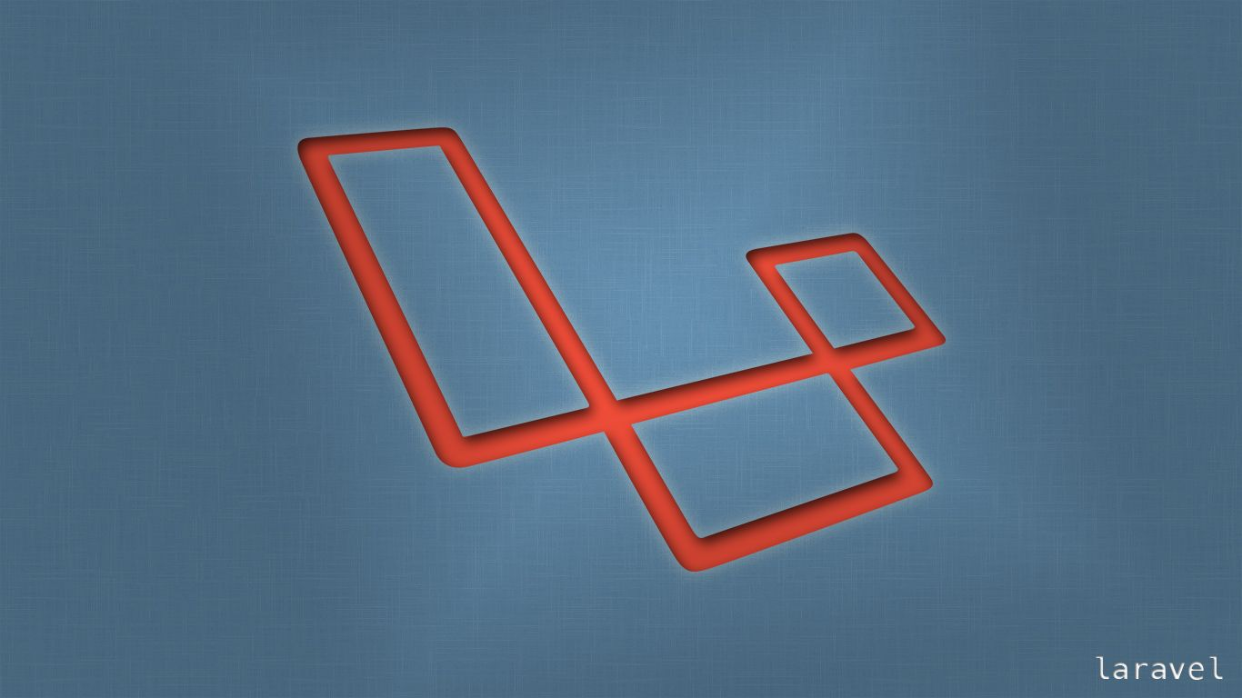
Laravel
Trainer: Edward

Slide 2
Last Session
What we covered in the last session
Eloquent Scope
Mass Assignment
Relations
One to many

Slide 3


Session Topics
1. Resource Controllers
2. Accessors

Slide 4
Today’s learning
When we complete today’s session, you will learn to …
Actions handled by Resource Controllers …
Index
Create
Store
show
Accessors

Slide 5
Resource Controllers
Resource Controller – are typical to perform the same sets of create, read, update, or delete actions against each resource in an application.
Resource Controllers have a Verb, the URI, and then the action which is the name of the method in the controller and finally the route name.
Verb | URI | Action | Route Name
GET | /photos | index | photos.index
GET | /photos/create | create | photos.create
POST | /photos | store | photos.store
GET | /photos/{photo} | show | photos.show
GET | /photos/{photo}/edit | edit | photos.edit
PUT/PATCH | /photos/{photo} | update | photos.update
DELETE | /photos/{photo} | destroy | photos.destroy

Slide 6
Resource Controllers
Action : index
The index method basically gives your Resource List.
In our Controller the index function matches with the index action of populating a Resource List.
Verb | URI | Action | Route Name
GET | /photos | index | photos.index
GET | /photos/create | create | photos.create
POST | /photos | store | photos.store
GET | /photos/{photo} | show | photos.show
GET | /photos/{photo}/edit | edit | photos.edit
PUT/PATCH | /photos/{photo} | update | photos.update
DELETE | /photos/{photo} | destroy | photos.destroy

Slide 7
Resource Controllers
Action : create
A “create” Controller calls for a “customers.create” action
customers.create route is what will hit the create form.
What we have in our “index” is a combination of form and list which needs to be separated.
Following on the convention the “resource” folder needs to be appropriately named customers.
Verb | URI | Action | Route Name
GET | /photos | index | photos.index
GET | /photos/create | create | photos.create
POST | /photos | store | photos.store
GET | /photos/{photo} | show | photos.show
GET | /photos/{photo}/edit | edit | photos.edit
PUT/PATCH | /photos/{photo} | update | photos.update
DELETE | /photos/{photo} | destroy | photos.destroy

Slide 8
Resource Controllers
Action : create
Create logic in the Controller.
The corresponding view in the Customers folder.
What goes into the create file is the form we had in our previous index file.
The index view will just have the resource list.
For the “CRUD” cycle to make sense a link to the create form will have to created in the index file.
Verb | URI | Action | Route Name
GET | /photos | index | photos.index
GET | /photos/create | create | photos.create
POST | /photos | store | photos.store
GET | /photos/{photo} | show | photos.show
GET | /photos/{photo}/edit | edit | photos.edit
PUT/PATCH | /photos/{photo} | update | photos.update
DELETE | /photos/{photo} | destroy | photos.destroy

Slide 9
Resource Controllers
Creation of the route for the create controller…
To reflect the changes the companies variable to be moved into the create function in the create controller.
Finally we cannot “return back” any longer, we redirect it to customers
since we moved our “form” for customers inside of a folder for the same the reference in the post action should be changed as so …
form action="/customers" method="post"
Verb | URI | Action | Route Name
GET | /photos | index | photos.index
GET | /photos/create | create | photos.create
POST | /photos | store | photos.store
GET | /photos/{photo} | show | photos.show
GET | /photos/{photo}/edit | edit | photos.edit
PUT/PATCH | /photos/{photo} | update | photos.update
DELETE | /photos/{photo} | destroy | photos.destroy

Slide 10
Resource Controllers
Let us change our index function to remove the filtering of Active and Inactive
We saw how we could display ‘0’ and ‘1’ which texts of our choice – which is not a bright way of doing things.
Verb | URI | Action | Route Name
GET | /photos | index | photos.index
GET | /photos/create | create | photos.create
POST | /photos | store | photos.store
GET | /photos/{photo} | show | photos.show
GET | /photos/{photo}/edit | edit | photos.edit
PUT/PATCH | /photos/{photo} | update | photos.update
DELETE | /photos/{photo} | destroy | photos.destroy

Slide 11
Resource Controllers
Accessors and Mutators.
Accessors are used to format attributes when you retrieve them from the database, while mutators format the attributes before saving them to the database.
The active field is a good candidate for applying accessor functionality.
get[attribute_name]Attribute(), is the way you can create an accessor.
Verb | URI | Action | Route Name
GET | /photos | index | photos.index
GET | /photos/create | create | photos.create
POST | /photos | store | photos.store
GET | /photos/{photo} | show | photos.show
GET | /photos/{photo}/edit | edit | photos.edit
PUT/PATCH | /photos/{photo} | update | photos.update
DELETE | /photos/{photo} | destroy | photos.destroy

Slide 12
Resource Controllers
Action : store
The next action in the Controller sequence is the store method.
We have implemented the store method.
Generally the store method directs to the show method for the newly created resource.
Verb | URI | Action | Route Name
GET | /photos | index | photos.index
GET | /photos/create | create | photos.create
POST | /photos | store | photos.store
GET | /photos/{photo} | show | photos.show
GET | /photos/{photo}/edit | edit | photos.edit
PUT/PATCH | /photos/{photo} | update | photos.update
DELETE | /photos/{photo} | destroy | photos.destroy

Slide 13
Resource Controllers
Action : show
The URI format for the show Controller calls for a get method to “resources/{resource}”.
Route::get('customers/{customer}', [CustomersController::class, 'show']);
Any thing that comes after the “resources” / “{resource}” goes into a variable in our case the customer variable.
Verb | URI | Action | Route Name
GET | /photos | index | photos.index
GET | /photos/create | create | photos.create
POST | /photos | store | photos.store
GET | /photos/{photo} | show | photos.show
GET | /photos/{photo}/edit | edit | photos.edit
PUT/PATCH | /photos/{photo} | update | photos.update
DELETE | /photos/{photo} | destroy | photos.destroy

Slide 14
Resource Controllers
Action : show
The route hits the show method in the Controller.
public function show($customer)
{
dd($customer);
}
To see the out put of our above debugging we create clickable link for each of the names on our index page.
Verb | URI | Action | Route Name
GET | /photos | index | photos.index
GET | /photos/create | create | photos.create
POST | /photos | store | photos.store
GET | /photos/{photo} | show | photos.show
GET | /photos/{photo}/edit | edit | photos.edit
PUT/PATCH | /photos/{photo} | update | photos.update
DELETE | /photos/{photo} | destroy | photos.destroy

Slide 15
Resource Controllers
Action : show
Checking this out in our browser, should output the returned id.
<div class="col-4"> <a href="/customers/{{ $customer->id }}">{{ $customer->name }}</a> </div>
Verb | URI | Action | Route Name
GET | /photos | index | photos.index
GET | /photos/create | create | photos.create
POST | /photos | store | photos.store
GET | /photos/{photo} | show | photos.show
GET | /photos/{photo}/edit | edit | photos.edit
PUT/PATCH | /photos/{photo} | update | photos.update
DELETE | /photos/{photo} | destroy | photos.destroy

Slide 16
Resource Controllers
Action : show
Using find function on the id from the link We should see all attributes related to the id.
public function show($customer)
{
$customer = Customer::find($customer);
dd($customer);
}
Verb | URI | Action | Route Name
GET | /photos | index | photos.index
GET | /photos/create | create | photos.create
POST | /photos | store | photos.store
GET | /photos/{photo} | show | photos.show
GET | /photos/{photo}/edit | edit | photos.edit
PUT/PATCH | /photos/{photo} | update | photos.update
DELETE | /photos/{photo} | destroy | photos.destroy

Slide 17
Resource Controllers
Action : show
Now that we have our data we can return it to a view “customers.show”.
public function show($customer)
{
$customer = Customer::find($customer);
return view('customers.show', compact('customer'));
}
Verb | URI | Action | Route Name
GET | /photos | index | photos.index
GET | /photos/create | create | photos.create
POST | /photos | store | photos.store
GET | /photos/{photo} | show | photos.show
GET | /photos/{photo}/edit | edit | photos.edit
PUT/PATCH | /photos/{photo} | update | photos.update
DELETE | /photos/{photo} | destroy | photos.destroy

Slide 18
Resource Controllers
Action : show
Let us create our view customers.show
In our customers folder, create a file named show.blade.php
Now that the view have been successfully displayed
What happens if we input a value that is not in our database .
Verb | URI | Action | Route Name
GET | /photos | index | photos.index
GET | /photos/create | create | photos.create
POST | /photos | store | photos.store
GET | /photos/{photo} | show | photos.show
GET | /photos/{photo}/edit | edit | photos.edit
PUT/PATCH | /photos/{photo} | update | photos.update
DELETE | /photos/{photo} | destroy | photos.destroy

Slide 19
Resource Controllers
Action : show
If we “dd” we see that we are returned “null”.
public function show($customer)
{
$customer = Customer::find($customer);
dd($customer);
return view('customers.show', compact('customer'));
}.
The easiest way to solve this is to use where instead of request.
$customer = Customer::where('id', $customer)->firstOrFail();
Verb | URI | Action | Route Name
GET | /photos | index | photos.index
GET | /photos/create | create | photos.create
POST | /photos | store | photos.store
GET | /photos/{photo} | show | photos.show
GET | /photos/{photo}/edit | edit | photos.edit
PUT/PATCH | /photos/{photo} | update | photos.update
DELETE | /photos/{photo} | destroy | photos.destroy

Slide 20
Resource Controllers
Action : show
Route Model Binding – Laravel best
… if you had named the ‘wild-card’ variable '/customers/{customer}’ in route customer and the input parameter variable of “show” exactly the same then …
… if you simply type hint Customer in the function
public function show(Customer $customer)
{
return view('customers.show', compact('customer'));
}
Verb | URI | Action | Route Name
GET | /photos | index | photos.index
GET | /photos/create | create | photos.create
POST | /photos | store | photos.store
GET | /photos/{photo} | show | photos.show
GET | /photos/{photo}/edit | edit | photos.edit
PUT/PATCH | /photos/{photo} | update | photos.update
DELETE | /photos/{photo} | destroy | photos.destroy

Slide 21
Resource Controllers
Eloquent Accessors
Accessors are used to format attributes when you retrieve them from the database, while mutators format the attributes before saving them to the database.
REST-ful store
Third from the REST-ful Controller formats, saves data into the database.
REST-ful show
This method is for displaying individual record.
Route-Model Binding
Type-hinting a keyword and Laravel does the rest for you.

Slide 22
Wrap-up
We got to know …
Actions handled by Resource Controllers …
Index
Create
Store
show
Accessors
Questions.

Slide 23

Thank You!

