Slide 1
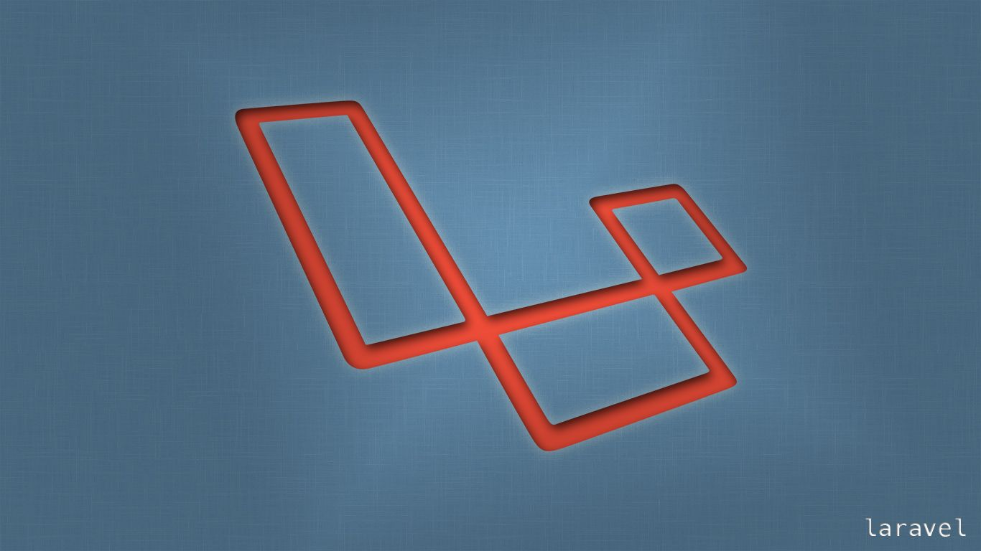
Laravel
Trainer: Edward

Slide 2
Last Session
What we covered in the last session
Configuring Laravel Events and …
Listeners

Slide 3


Session Topics
1. One to Many
2. Many to Many

Slide 4
Today’s learning
When we complete today’s session, you will learn …
One to many relationship
Many to many relationship

Slide 5
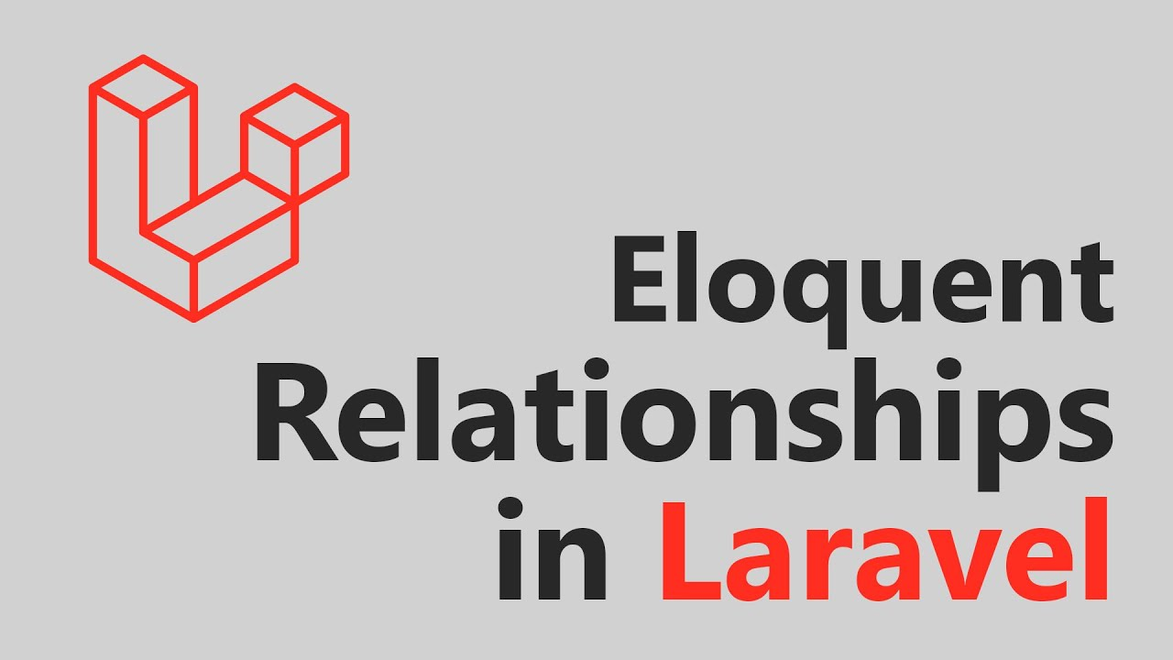
Eloquent Relationships
An Eloquent relationship is a very important feature in Laravel that allows you to relate the tables in a very easy format.

Slide 6
Eloquent Relationships
An Eloquent relationship is a very important feature in Laravel that allows you to relate the tables in a very easy format.
This is the most commonly used relation in Eloquent ORM. A one-to-many relationship in Laravel defines as a Single model owning multiple models.
Let us take the example of a user having many posts.
A user has many number of posts. But a post belongs to a user. Let us work on a fresh installation of Laravel.
php artisan make:model Post -m

Slide 7
Eloquent Relationships
Mass assignment
protected $guarded = [];
Migration
Schema::create('posts', function (Blueprint $table) {
$table->id();
$table->unsignedBigInteger('user_id');
$table->string('title');
$table->text('body');
$table->timestamps();
});

Slide 8
Eloquent Relationships
Setting up the Relationship
In the post model
public function user()
{
return $this->belongsTo(User::class);
}
In the user model
public function posts()
{
return $this->hasMany(Post::class);
}

Slide 9
Eloquent Relationships
Web Routes to try out the relationships
Route::get('/', function () {
$post = new Post([
'title'=>'Awesome Title',
'body'=> 'An example body text'
]);
dd($post);
});
We have created data for the post model but we have not saved it

Slide 10
Eloquent Relationships
To save the data let us create a user
$user = User::factory()->create();
$post = new Post([
'title'=>’Awesome Title',
'body'=> 'An example body text',
'user_id' => $user->id,
]);
$post->save();
dd($post);

Slide 11
Eloquent Relationships
Let us check out the short form for this
$user = User::factory()->create();
$user->posts()->create([
'title' => 'title 2',
'body' => 'body text 2'
]);
dd($user->posts);
The user_id is being set for us automatically via ORM.

Slide 12
Eloquent Relationships
Updating
$user = User::factory()->create();
$user->posts()->create([
'title' => 'title 2',
'body' => 'body text 2'
]);
$user->posts->first()->title = 'New Title';
$user->push(); // notice we are calling push on the user
return $user->posts;

Slide 13
Eloquent Relationships
Updating
$user = User::find(3);
$user->posts->first()->title = 'changed New Title';
$user->posts->first()->body = 'changed body text 2';
$user->push();
return $user->posts;

Slide 14
Eloquent Relationships
Many to Many
Laravel Many To Many Relationship relates a record on the table to one or many records in another table and vice versa.
Unlike Laravel One to Many and One to One, the link is a pivot table in this relationship. The pivot table is a table where you define between the connection between the two tables to link them.

Slide 15
Eloquent Relationships
Many to Many
We will continue to work with out user table and its model but now we will be adding a new independent table for roles.
Typically in an application you are going to have a set number of roles that a user could be attached to or detached to as they gain or lose permission.
Let us focus on the database and the relationship to make this work.

Slide 16
Eloquent Relationships
Roles Table
Let us make a new model for our roles.
php artisan make:model Role -m
Modify the migration
Schema::create('roles', function (Blueprint $table) {
$table->id();
$table->string('name');
$table->timestamps();
});

Slide 17
Eloquent Relationships
Pivot table
In a many to many relationship you have two totally independent tables that are not related to one another. There is a third table what is called a pivot table that connects them. We are not going to have a user_id in the roles table and in the same way we are not going to have a roles_id in the user table. We will have a third table for that.
Lets get that table created.

Slide 18
Eloquent Relationships
Migration
What is the convention in naming a pivot table? We maintain the alphabetical order.
php artisan make:migration create_role_user_table --create role_user
What would be the table definition?

Slide 19
Eloquent Relationships
Migration
Schema::create('role_user', function (Blueprint $table) {
$table->id();
$table->unsignedBigInteger('role_id');
$table->unsignedBigInteger('user_id');
$table->timestamps();
});
Timestamps are optional.
Let us add a couple of roles very quickly in our roles table.

Slide 20
Eloquent Relationships
The Many to Many Relation
in the user class
public function roles()
{
return $this->belongsToMany(Role::class);
}
In the role class
public function users()
{
return $this->belongsToMany(User::class);
}

Slide 21
Eloquent Relationships
Let us create a user
Route::get('/', function () {
User::factory()->create();
return User::first();
});

Slide 22
Eloquent Relationships
Attach Roles
Route::get('/', function () {
$user = User::first();
$roles = Role::all();
$user->roles()->attach($roles);
dd($roles);
});
We see that user of id 1 has been attached a role of id 1 & 2

Slide 23
Eloquent Relationships
Detach Roles
Let us detach the first role
Route::get('/', function () {
$user = User::first();
$roles = Role::first();
$user->roles()->detach($roles);
dd($roles);
});

Slide 24
Eloquent Relationships
Timestamps
Let us make the timestamps work
public function roles()
{
return $this->belongsToMany(\App\Models\Role::class)->withTimestamps();
}
Same change to be done in the user model too

Slide 25
Eloquent Relationships
Timestamps
Route::get('/', function () {
$user = User::first();
$roles = Role::first();
$user->roles()->attach($roles);
dd($roles);
});
Check out the changes in the database

Slide 26
Eloquent Relationships
Let us add some more roles into our database
(Modify user, delete_comments, edit comments)
Route::get('/', function () {
$user = User::first();
$user->roles()->attach([1,3,5]);
dd($user->roles);
});
We notice a problem and the problem is our user has a duplicate
The solution to this problem is another method that Laravel has called sync

Slide 27
Eloquent Relationships
Sync
Instead of attach let us use sync
Route::get('/', function () {
$user = User::first();
$user->roles()->sync([1,3,5]);
dd($user->roles);
});
Instead of 1, 3, 5 let us attach 2 & 4

Slide 28
Eloquent Relationships
Synch without detach
You want to add roles but do note want to delete
Route::get('/', function () {
$user = User::first();
$user->roles()->syncWithoutDetaching([3]);
dd($user->roles);
});

Slide 29
Eloquent Relationships
The relation works in the reverse too
Route::get('/', function () {
$role = Role::find(3);
$role->users()->sync([2]);
});

Slide 30
Wrap-up
We got to know …
Events &
Listeners
Questions.

Slide 31

Thank You!

