Slide 1

Laravel
Trainer: Edward

Slide 2
Last Session
What we covered in the last session
One to Many Relationship …
Many to Many Relationship

Slide 3


Session Topics
1. Many to Many – pivot data
2. One to One

Slide 4
Today’s learning
When we complete today’s session, you will learn …
Manage pivot table data in Many to Many relationship
One to One Relationship

Slide 5
Eloquent Relationships
Attaching extra data to the pivot table
Sometimes there is relational data that is only relevant if two things are in sync with each other.
Let us have a field to store the name of the person who assigns the role maybe..
$table->string('name’);
Run migrate fresh to update the above changes to the database.
Next we need a user in the database, let us quickly create one using tinker
\App\Models\User::factory()->create();
Also add a role to the roles table

Slide 6
Eloquent Relationships
At this point we can assign a role like we have been doing…
We fetch the user and assign the role’s id
Now that we have a user, we can fetch that user and assign the role with the id
Route::get('/', function () {
$user = User::first();
$user->roles()->sync([1]);
;
But instead of passing an id, we could use the id as key and pass in the data like so...
$user->roles()->sync([
1 => ['name' => 'Ravi']
]);;
Check this out database to make sure we have the data in the pivot table.

Slide 7
Eloquent Relationships
Retrieving extra data in the pivot table…
$user = User::first();
dd($user->roles);
We don’t find the extra field in data set returned …
Let us get single record from the collection using first(), we get a single instance retuned
If you use the pivot keyword like so, we get to see the pivot data …
dd($user->roles->first()->pivot->name);
Still we don’t get to see our data …

Slide 8
Eloquent Relationships
Retrieving extra data in the pivot table…
The way to make Laravel know of the extra data is via the definition in the model …
return $this->belongsToMany(\App\Models\User::class)->withPivot(['name'])->withTimestamps();
return $this->belongsToMany(\App\Models\Role::class)->withPivot(['name'])->withTimestamps();
And now we should see the extra data …
Check it out in the browser

Slide 9
Eloquent Relationships
To just target and return the name…
$user = User::first();
dd($user->roles->first()->pivot->name);
Only the name is returned now …
Check it out in the browser

Slide 10
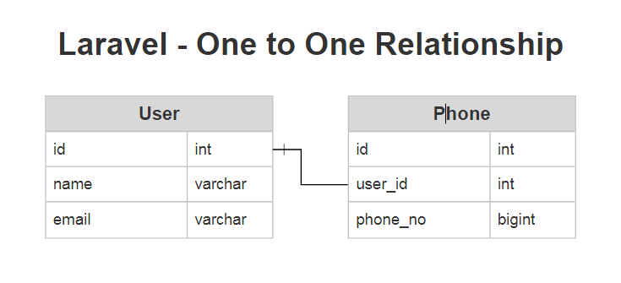
Eloquent Relationships
One to One
When one table refers to single row in another table that is called a one-to-one relationship.
One to one relation is rare. It is very much necessary to understand this relation

Slide 11
Eloquent Relationships
Model and migration
php artisan make:model Phone -m
Model
protected $guarded = [];

Slide 12
Eloquent Relationships
For a one to one relationship each record in the database needs to reference the user, so we can make them connect. Typically you would want to index any of your foreign keys
$table->id();
$table->string('phone');
$table->unsignedBigInteger('user_id')->index();
$table->timestamps();
$table->foreign('user_id')->references('id')->on('users');
The foreign key directive is going to setup a foreign key at the database level. Not only at the php level but at the database level as well.

Slide 13
Eloquent Relationships
The relation definition in the respective models
User model
public function phone()
{
return $this->hasOne(Phone::class);
}
Phone model
public function user()
{
return $this->belongsTo(User::class);
}
The table that has the reference in this case the user_id is the one that gets the belongs to the table that you are reference is the one that gets the has one method.

Slide 14
Eloquent Relationships
To put this to work.
php artisan migrate
Saving a record through the relations phone model
$user = User::first();
$phone = new Phone();
$phone->phone = '67548937';
$user->phone()->save($phone);
dd($user->phone)

Slide 15
Wrap-up
We got to know …
ORM Relations
One to One
One to Many
Many to Many
Keywords like attach, detach, sync, pivot etc.
Questions.

Slide 16

Thank You!

