Slide 1

Laravel
Trainer: Edward

Slide 2
Prerequisites
What are the requirements to get you started in learning Laravel …
PHP (Knowledge of PHP programming)
As we go along get to understand OOP (classes, objects, properties, methods, dependencies, traits, and other “keywords.”)
Stop reading, start writing. (In fact, after finishing every lesson or section, immediately try it in practice.)
Google and StackOveflow
Participate in discussion forums and have a mentor!

Slide 3
What do you take-away from today’s session…
When we complete today’s session, you will learn to …
Scaffold an empty Laravel Project
Create a few Routes for your brand new Laravel application
Create HTML “view” pages for your application …

Slide 4
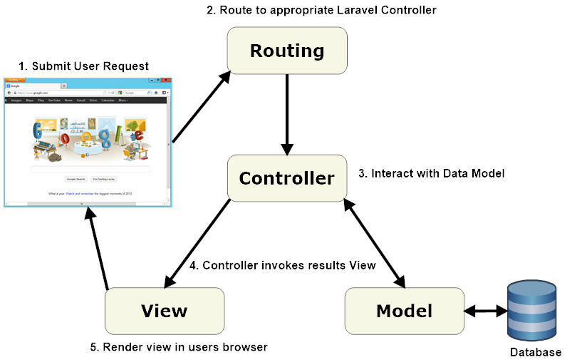
MVC Framework
PHP Framework
Follows the MVC (Model – View – Controller Pattern
divides the logic of a web application into three distinct areas, or concerns: model, view, and controller.
Makes the development process easy with best practices in place.

Slide 5
Features of Laravel
Innovative Template Engine
“Artisan” - Automating Programming Tasks
Database Migration
MVC Architecture Support
Eloquent ORM (active record implementation)
Resource Controllers
Authentication

Slide 6





Course Outline
Lesson 1. Environment Setup
Lesson 2. Routes – a glimpse
Lesson 3. Views – a glimpse

Slide 7

Environment Setup
We will cover these skills:
Laravel Ecosystem Setup
XAMPP
Composer
Artisan

Slide 8
Development Tools
Laravel Homestead
Laravel Homestead is an official, pre-packaged Vagrant box that provides you a wonderful development environment without requiring you to install PHP, a web server, and any other server software on your local machine. Vagrant provides a simple, elegant way to manage and provision Virtual Machines.
Laravel Sail
Laravel Sail is a light-weight command-line interface for interacting with Laravel's default Docker development environment. Sail provides a great starting point for building a Laravel application using PHP, MySQL, and Redis without requiring prior Docker experience.

Slide 9

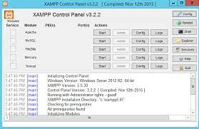
XAMPP
XAMPP is the most popular PHP development environment
XAMPP is a completely free, easy to install Apache distribution containing MariaDB, PHP, and Perl. The XAMPP open-source package has been set up to be incredibly easy to install and to use.
Download xamp at https://www.apachefriends.org/

Slide 10

Composer
Composer is an application-level dependency manager for the PHP programming language that provides a standard format for managing dependencies of PHP software and required libraries. It was developed by Nils Adermann and Jordi Boggiano, who continue to manage the project.
Download Composer at https://getcomposer.org/download/

Slide 11

Laravel
Laravel is a free, open-source PHP web framework, created by Taylor Otwell and intended for the development of web applications following the model–view–controller architectural pattern and based on Symfony. https://en.wikipedia.org/wiki/Laravel
Laravel Installation
composer create-project laravel/laravel example-app
alternatively …
composer create-project --prefer-dist laravel/laravel:^7.0 blog
Artisan
Artisan is the name of the command-line interface included with Laravel. It provides several helpful commands for your use while developing your application.

Slide 12
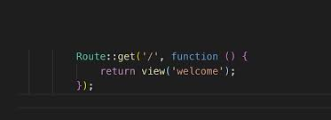
Routes
After this session you get to know :
the concept of Routes in Laravel

Slide 13
Routes
Route – is how you tell Laravel to respond to the different addresses…
The most basic Laravel routes accept a URI and a Closure, providing a very simple and expressive method of defining routes. It makes the routes easy and convenient to understand and working on it.
Route::get('/', function () {
return view('welcome');
});
Route::get('contact', function () {
return ‘Contact Us’;
});
Route::get('about', function () {
return ‘About Us';
});

Slide 14
Routes
Routes wouldn’t be complete without the mention of Views.
Views are ultimately HTML and CSS that gets rendered in the browser. Views contain the HTML served by your application and separate your controller / application logic from your presentation logic. Views are stored in the “resources”/ “views” directory.
Separation of Concerns
Let us create our views “contact.blade.php”
<h1>Contact Us</h1>
<p>Company Name</p>
<p>123 – 123 - 1234</p>
and edit out routes accordingly…
Route::get('/', function () {
return view(‘contact’;

Slide 15
Routes
Routes can be modified to make the code a little cleaner …
If your only concern is to display a view, then the Route could take on the format like so …
Route::view(‘welcome’, ‘welcome’);

Slide 16

First Lesson Summary
Environment
Composer
XAMPP / LAMP / MAMP / WAMP.
Artisan commands
Routes Routes in Laravel
View as in MVC Views are the presentation part of the MVC.
Here is what we learned

Slide 17
Wrap-up
We learned what it takes to setup a Laravel Development Environment.
We learned that Route is how you tell Laravel how to respond to different addresses.
“get a route accepting the “uri” as a parameter and return me a “view”
Just like the route handling a get request you can have routes handle post request, delete request etc.
We could also pass in some html tags
Notes:
How presentation will benefit audience: Adult learners are more interested in a subject if they know how or why it is important to them.
Presenter’s level of expertise in the subject: Briefly state your credentials in this area, or explain why participants should listen to you.

Slide 18
Wrap-up
We added new routes that returned some text.
Then we saw how we could step up things by adding some HTML
That brought us to the concept of views.
Views introduced us to the naming convention “yourname.blade.php”.
“blade” is a rendering engine that ships with Laravel.
Any view that you create in the views folder follows the naming convention of “yourname.blade.php”.
Notes:
How presentation will benefit audience: Adult learners are more interested in a subject if they know how or why it is important to them.
Presenter’s level of expertise in the subject: Briefly state your credentials in this area, or explain why participants should listen to you.

Slide 19
Wrap-up
Routes are flexible in that - it can be modified to use the view function as in the example Route::view(‘contact’, ‘contact’);.
Questions.
Notes:
How presentation will benefit audience: Adult learners are more interested in a subject if they know how or why it is important to them.
Presenter’s level of expertise in the subject: Briefly state your credentials in this area, or explain why participants should listen to you.

Slide 20

Thank You!

