Slide 1
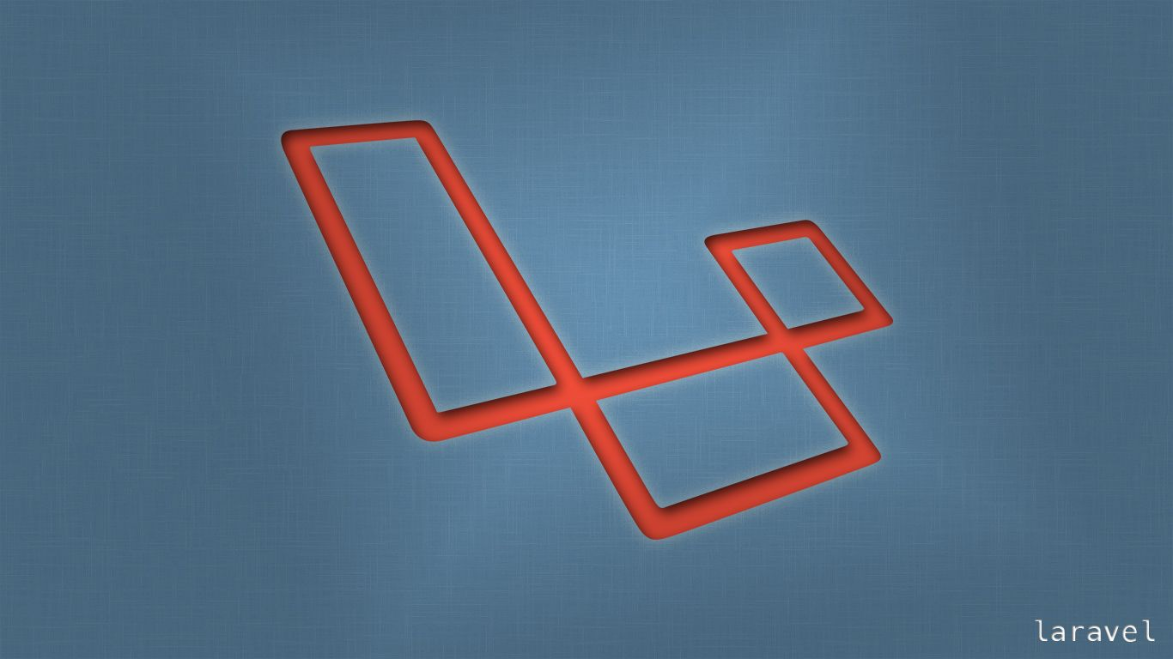
Laravel
Trainer: Edward

Slide 2
Last Session
What we covered in the last session
Passing data to views
Creation of Controller using artisan command

Slide 3
Today’s learning
When we complete today’s session, you will learn to …
Create a template file using the Blade syntax
How to connect to Database

Slide 4
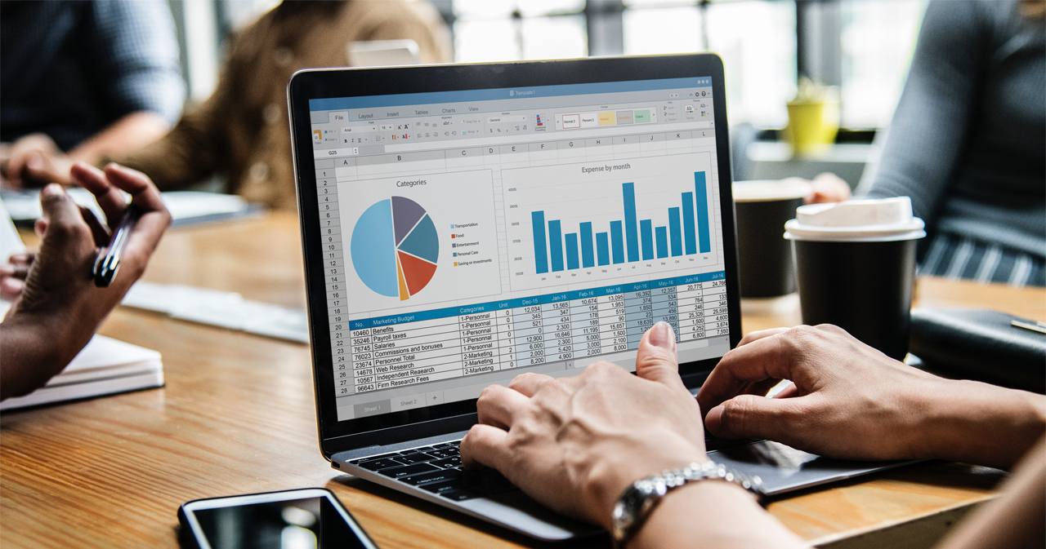

Session Topics
1. Blade Template
2. Connecting to a Database

Slide 5
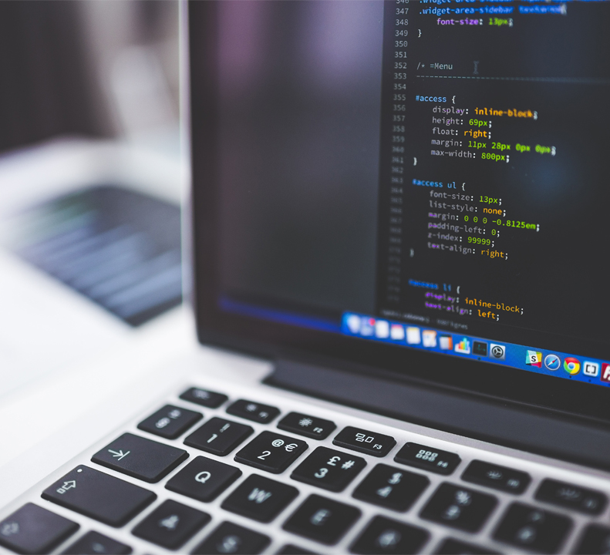
Objectives
We will cover these skills:
Creating blade template file that decides on the general layout of web pages
Get to know the tools provided by Laravel to connect and communicate with Databases.
“Migrations” and how to create Migration files.
“Model” as in Model View Controller
“Tinker” a command line tool that can come in handy to a PHP developer.
“dd” a debugging tool that comes with Laravel

Slide 6

Blade Template
Blade is the rendering engine that Laravel uses to parse HTML.
“layout” file
Basic Navigation for our Web Pages
Apply styling using bootstrap from CDN

Slide 7
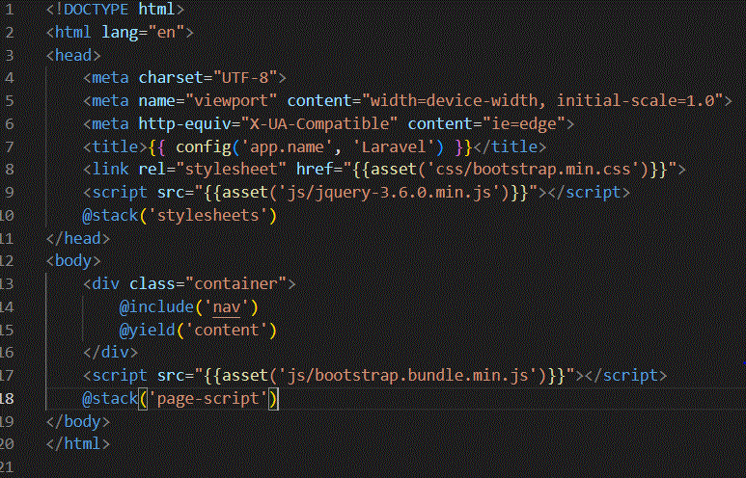
Blade Template
@yield(‘title’) is used to display the value of the title
@section(‘sidebar’) is used to define a section named sidebar
@show is used to display the contents of a section
@yield(‘content’) is used to display the contents of content.

Slide 8
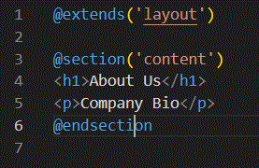
Blade Template
@extends(‘layouts.master’) extends the master layout
@section(‘title’, ‘Page Title’) sets the value of the title section.
@section(‘content’) defines the content section
@endsection ends the content section

Slide 9
Databases
After this part of the session, you will learn …
Data persistency.
Here is where a Database is important.
Laravel can connect with a number of databases.
MySQL, PostgreSQL and SQL Server.

Slide 10
Configuration Files
.env file
.env file is located at the root of our project folder.
Among other settings it stores the settings for database connection.
Edit the file to setup a database connection.

Slide 11
The database configuration file
database.php
Another file where the configuration setting are stored is the database.php inside the config folder.

Slide 12
Migrations
Why migrations
“Migrations” – the version control for your database
When you need to “migrate” your files (including database) from your development environment to the production environment, you wouldn’t want to run into issues handling the right version you want to target.
If you made a change to column, a table or you made a change to one of your tables you wouldn’t want to do that all over again.
Migration is good tool to have when working as a part of a TEAM.

Slide 13
Migrations
Why migrations
php artisan migrate
Laravel ships with a few migrations out of the box.

Slide 14
Migrations
What are models
A model represents a single row in your database.
Let us create a “model” for our customers.
My model is a customer(singular) as against my table customers (plural).
To make that model we are going to run a new php artisan command
php artisan make:model
We see that if we pass a flag –m along the command it automatically creates a migration file too
php artisan make:model Customer -m

Slide 15
Migrations
Let us examine the new files create by artisan:
Model and Migration
Let us edit our migration file to add a customer field that will hold the data that we have been hard coding via our route and controller files …
$table->string('name’);
Now let us run our newly created migration file
php artisan migrate

Slide 16
Tinker
How do we generate some data inside our customers table?
For that we are going to employ a tool called Tinker
php artisan tinker;
Tinker is a shell which basically runs PHP
Customer::all();

Slide 17
Tinker
Let us create a new Customer
$customer = new Customer();
$customer->name = "Tom";
$customer->save();
Now we have a Customer in our database;
Customer::all();

Slide 18
ORM
We need to replace the hardcoded data with our data from the database:
$customers = Customer::all();
to preview what we are getting from the above statement we have a debug tool in Laravel
dd($customers);
We get the whole row returned. We will fix this by just targeting the name.
We edit our view file as so …
{{$customer->name}}

Slide 19
Wrap-up
We got to know “Migrations” in Laravel, which kind of acts like a version control for database states when developing.
“Model” of the MVC paradigm.
We got to know another great tool from Laravel to tinker around with data - “Tinker”.
Questions.

Slide 20

First Lesson Summary
Blade Creating blade template file that decides on the general layout of web pages
Database “Migrations” and how to create Migration files.
“Model” as in Model View Controller
“Tinker” a command line tool that can come in handy to a PHP developer.
“dd” a debugging tool that comes with Laravel
Here is what we learned

Slide 21

Thank You!

