Slide 1
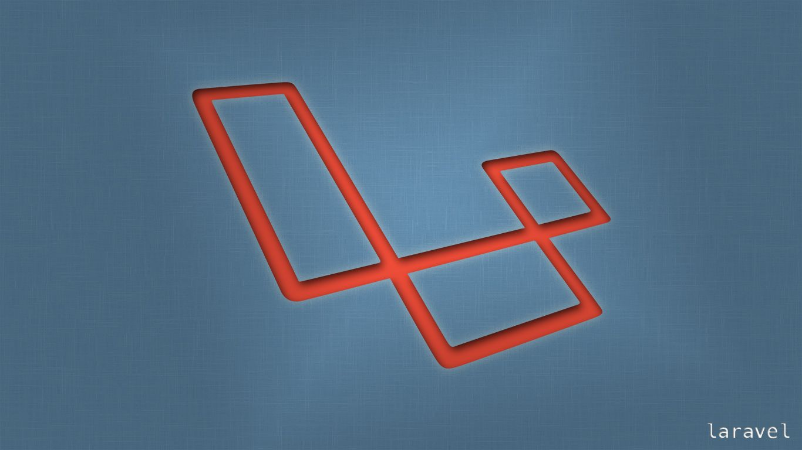
Laravel
Trainer: Edward

Slide 2
Last Session
What we covered in the last session
Setup User authentication that ships with Laravel …
Using Middleware

Slide 3
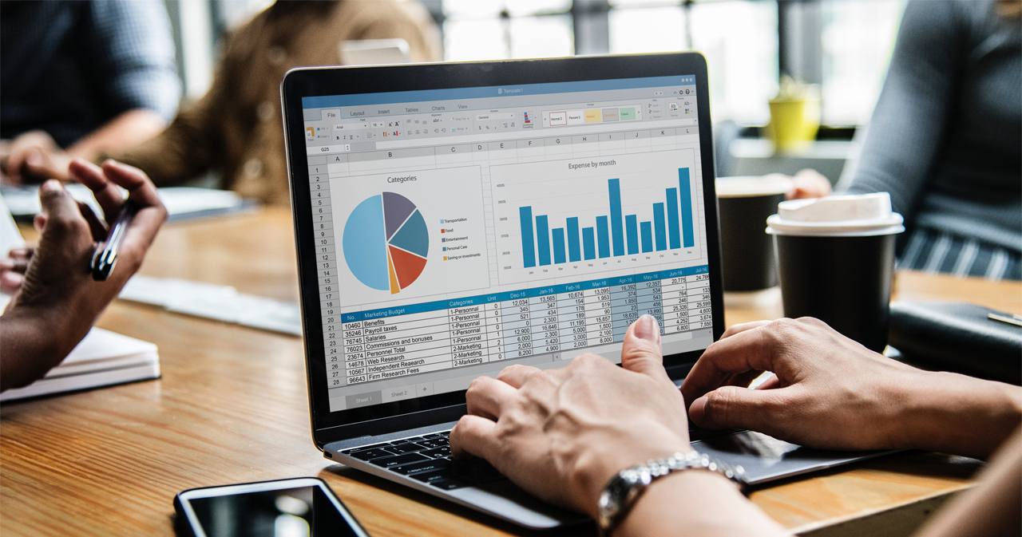

Session Topics
1. Model Factory
2. Database Seeders

Slide 4
Today’s learning
When we complete today’s session, you will learn …
How to configure Laravel Events and …
Listeners

Slide 5
Events and Listeners
What are Events and Listeners
Events provide a simple observer implementation which allows a user to subscribe and listen to various events triggered in the web application. All the event classes in Laravel are stored in the app/Events folder and the listeners are stored in the app/Listeners folder.
The classic example of this would be a new user being registered to your app.
When they do
you are going to send them a welcome email
subscribe them to your newsletter
notify admin that there is a new user

Slide 6
Events and Listeners
We have a Customer Resource
Let us put Events and Listeners to work on new customer creation.
And that would be happening whenever a store method is called
To prepare things let us get to work with Mail.
php artisan make:mail WelcomeNewUserMail --markdown email.new-welcome

Slide 7
Events and Listeners
For the purpose of our exercise, let us keep the mail format very simple
@component('mail::message')
# Welcome new User
@endcomponent

Slide 8
Events and Listeners
To use the Mail class we need out customer email.
The create method will be returning a new Customer Model which can be saved to a variable containing our email.
public function store(){
$customer = Customer::create($this->validateRequest());
Mail::to($customer->email)->send(new WelcomeNewUserMail());
return redirect( 'customers' );
}
… and as for the other two activities i.e., newsletter subscription and notifying admin for the purpose of our exercise let us use pseudo code to output a dump.

Slide 9
Events and Listeners
The store function
public function store(){
$customer = Customer::create($this->validateRequest());
Mail::to($customer->email)->send(new WelcomeNewUserMail());
//Register to Newsletter
dump(‘Newsletter Subscription');
//Notify Admin
dump(‘Notification to Admin');
// return redirect( 'customers' );
}
In order to see the mail “subscription” and “notify admin” dumps, the return redirect has to commented out

Slide 10
Events and Listeners
Checking ‘mailtrap’ should show us our mail.
There is possibly a lot many things that can be done when a user is registered.
The Controller file is not the place for whatever actions follows a user registration.
“Events” are the place to refactor and organise our concerns.
When a new customer is registered one would expect to see minimum line of code in the controller, ideally a single line here a call to the event.
event(new NewCustomerHasRegisteredEvent());
So, an Event is announced and the “listeners” can take it up from there …

Slide 11
Events and Listeners
Event is a simple a ‘trigger’ in this case a new customer.
As a response to the new customer creation we have a listener each for the subsequent actions.
We have one event and three listeners.
Let is explore the command to create an event. Check out the commands for making events and listeners.
Creating the Event NewCustomerHasRegisteredEvent
php artisan make:event NewCustomerHasRegisteredEvent

Slide 12
Events and Listeners
Event is a simple a ‘trigger’ in this case a new customer.
As a response to the new customer creation we have a listener each for the subsequent actions.
We have one event and three listeners.
So how do we create these, there are two ways to do this
the manual way
Laravel has a solution to do it one command which we will explore towards the end.

Slide 13
Events and Listeners
Let is explore the command to create an event. Check out the commands for making events and listeners.
Creating the Event NewCustomerHasRegisteredEvent
php artisan make:event NewCustomerHasRegisteredEvent
Exploring through out directory we find under the apps directory an events folder.
Inside the folder we have the NewCustomerHasRegisteredEvent.

Slide 14
Events and Listeners
Event class accepts arguments, example most of the time relevant data will be passed coming from a controller.
This instance we can pass the customer variable into the Constructor method.
event(new NewCustomerHasRegisteredEvent($customer));
and initialize the variable.
public $customer;
public function __construct($customer)
{
$this->customer = $customer;
}
We need only the constructor function in the listener, so the rest could be cleaned up.

Slide 15
Events and Listeners
Listener
Next lets make a listener for the first of our activity i.e., welcoming our new user.
php artisan make:listener WelcomeNewCustomerListener;
This creates a new directory for Listeners and inside of that the listener class.
Now that we have a listener, let us welcome the new customer. So let us welcome our new customer and all I have to do is grab the
Mail::to($customer->email)->send(new WelcomeNewUserMail());
From the controller and bring it to the listener right into the handle method

Slide 16
Events and Listeners
Listener Class
class WelcomeNewCustomerListener
{
/**
* Handle the event.
*
* @param object $event
* @return void
*/
public function handle($event)
{
Mail::to($event->customer->email)->send(new WelcomeNewUserMail);
}
}
Ensure all relevant namespaces are being used.

Slide 17
Events and Listeners
How to tie-up all of these together?
We have events, listeners, but nothing is talking to each other. For the connection to happen we use Laravel’s “Event service provider”.
The concept of service provider has not been discussed yet. Just understand that services provider is a means to connect with the different functionalities in our application.
Event service provider can be found inside the folder named “Providers”.
Inside the event service provider there is array meant to do “listeners mapping” for our application.
What that means is we have to connect out event with each of the listeners.

Slide 18
Events and Listeners
We have the new “customer has registered event” and the “welcome new customer listener” like so
protected $listen = [
\App\Events\NewCustomerHasRegisteredEvent::class => [
\App\Listeners\WelcomeNewCustomerListener::class,
],
];
Now we are connected when the “new customer has registered” event occurs we need to run the “welcome new customer” as well.
Let us check this out in the browser…

Slide 19
Events and Listeners
All along we have been doing things manually, now there is a way to generate the listener files in Laravel.
You could come to the event service provider and give it the class names that you want it to make
The next of the activities would be
Newsletter subscription – and
Alert mail to the admin
the activities for which we were doing with pseudo code…

Slide 20
Events and Listeners
We input class names to the event service provider like so
protected $listen = [
\App\Events\NewCustomerHasRegisteredEvent::class => [
\App\Listeners\WelcomeNewCustomerListener::class,
\App\Listeners\RegisterCustomerToNewsLetter::class,
\App\Listeners\NotifyAdminViaSlack::class,
],
];

Slide 21
Events and Listeners
Those are two new listeners we don’t have.
We are going to generate them automatically, however we have to provide the full namespace for this to work properly.
Artisan has a command to generate to event
event:generate
Event generate will look at the event service provide and generate any of the classes that it doesn’t find.
php artisan even:generate

Slide 22
Events and Listeners
You should find the newly created listener classes inside the listener folder.
Let us distribute the activities into the relevant listeners now
The handle method of notify admin –
public function handle(NewCustomerHasRegisteredEvent $event)
{
dump('Slack message here!');
}
}

Slide 23
Events and Listeners
The handle method of register customer to newsletter –
public function handle(NewCustomerHasRegisteredEvent $event)
{
dump('Registered to Newsletter');
}

Slide 24
Events and Listeners
The handle method of register customer to newsletter –
public function handle(NewCustomerHasRegisteredEvent $event)
{
dump('Registered to Newsletter');
}
And our controller file is now clean with just three lines of code
Later if we decide we want drop any of the activities, it is as simple as changing the listener in the even service provider.
Let us check the changes in the browser.

Slide 25
Wrap-up
We got to know …
Events &
Listeners
Questions.

Slide 26

Thank You!

