Slide 1
Marketing Analytics Dashboard
Demand Forecasting, Promotion Effectiveness & Price Elasticity
Group B: Edward Lim, Fabricio Rodriguez Peña, Rafia Al-Jassim, Rathes Waran, Wenyuan Yun

Slide 2
Agenda
01 Problem Statement & Dataset Overview
02 Demand Forecasting
03 Promotion Effectiveness
04 Price Elasticity
05 Recommendations & Next Steps

Slide 3
Pricing + Promotion Strategy Drivers
Data Overview
1
Demand Forecasting
What is the expected demand for each SKU in the coming weeks?
44
100
SKUs analysed
Weeks of data
2
Promotion Effectiveness
Do feature promotions increase sales, and by how much?
RAW DATA
4,400 rows × 8 cols | 44 SKUs × 100 weeks
PROCESSED DATA
4,312 rows × 48 cols
PERIOD
Oct 2016 – Sep 2018 (weekly)
3
Price Elasticity
How sensitive is each SKU's demand to price changes?
Key Data Features
price
feat_main_page
trend
quarter
price_change

Slide 4
How the Dashboard Works
Self-Contained
4 Interactive Tabs
Built With
Pipeline
Single HTML file — no server or installation required
Guide → Forecasting → Promotions → Price Elasticity
Python (scikit-learn, statsmodels) + Plotly.js interactive charts
Raw Data → Python (Naïve baseline + 3 ML models
) → HTML Dashboard
Data Processing Pipeline
Raw Sales Data
44 SKUs × 100 weeks
Data Cleaning
Outlier removal, imputation
ML Models
RF, MLP, Linear Reg
Scan*Pro OLS
Promo + Price analysis
HTML Dashboard
Interactive Plotly.js
Dashboard Outputs
Demand Forecasts
12-week predictions with confidence intervals
Model Comparison
Naïve (Moving Avg) vs. RF vs. MLP vs. Linear Reg accuracy metrics
Promotion Impact
SKU-level lift from feature placements
Price Sensitivity
Elasticity coefficients and revenue scenarios

Slide 5
Dashboard:
Demand Forecasting
What is the expected demand for each SKU in the coming weeks?

Slide 6
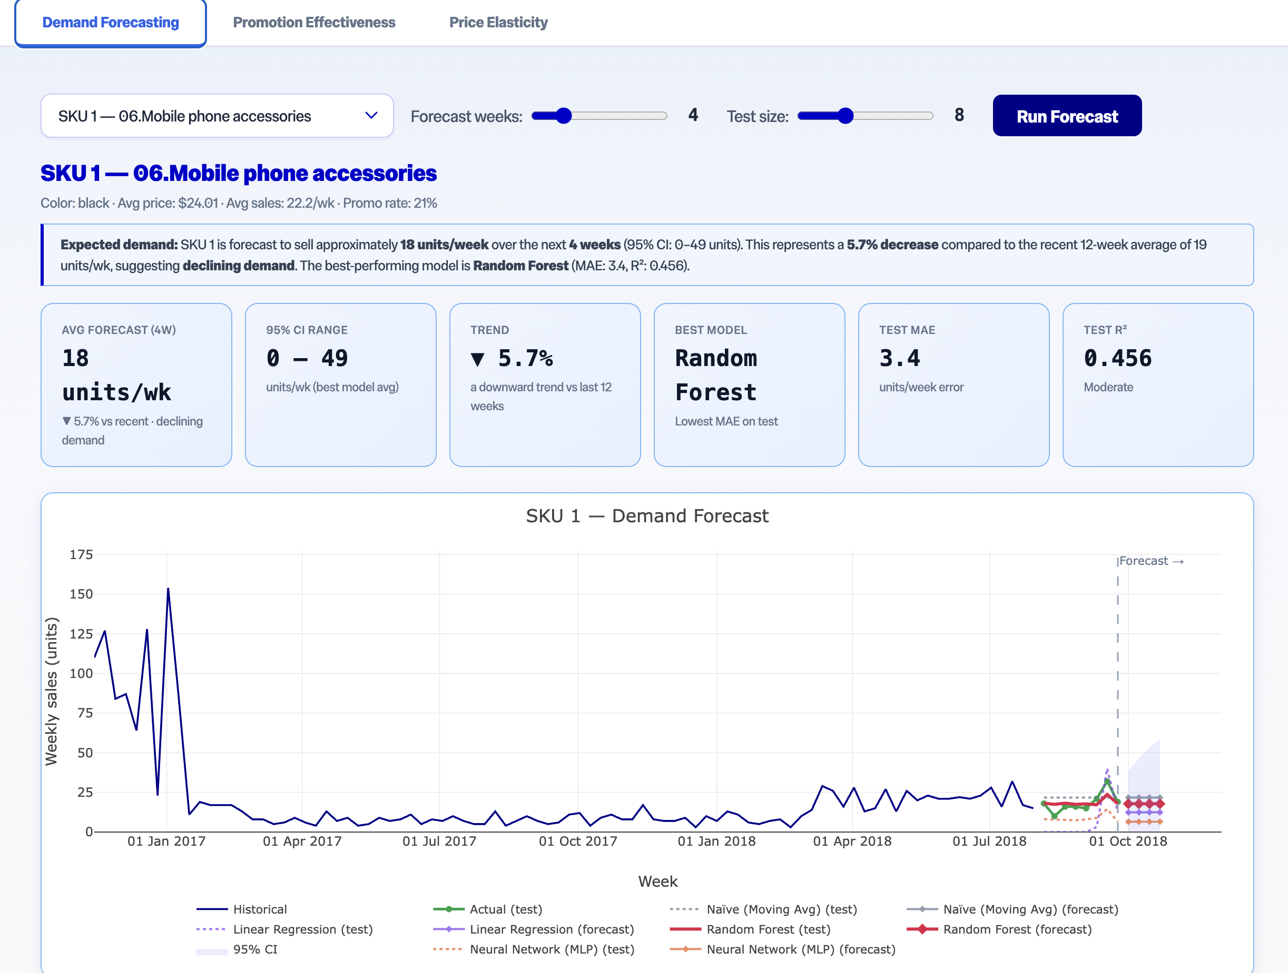
Demand Forecasting — 4 Competing Models per SKU
1
Models
Naïve (8-wk Moving Avg), Linear Regression, Random Forest (100 trees), MLP Neural Net (64→32)
2
Approach
Temporal train/test split; best model selected by lowest MAE per SKU
3
Output
12-week point forecasts with 95% confidence intervals for each SKU
4
Sensitivity
Adjustable test window (4–16 weeks) to validate robustness

Slide 7
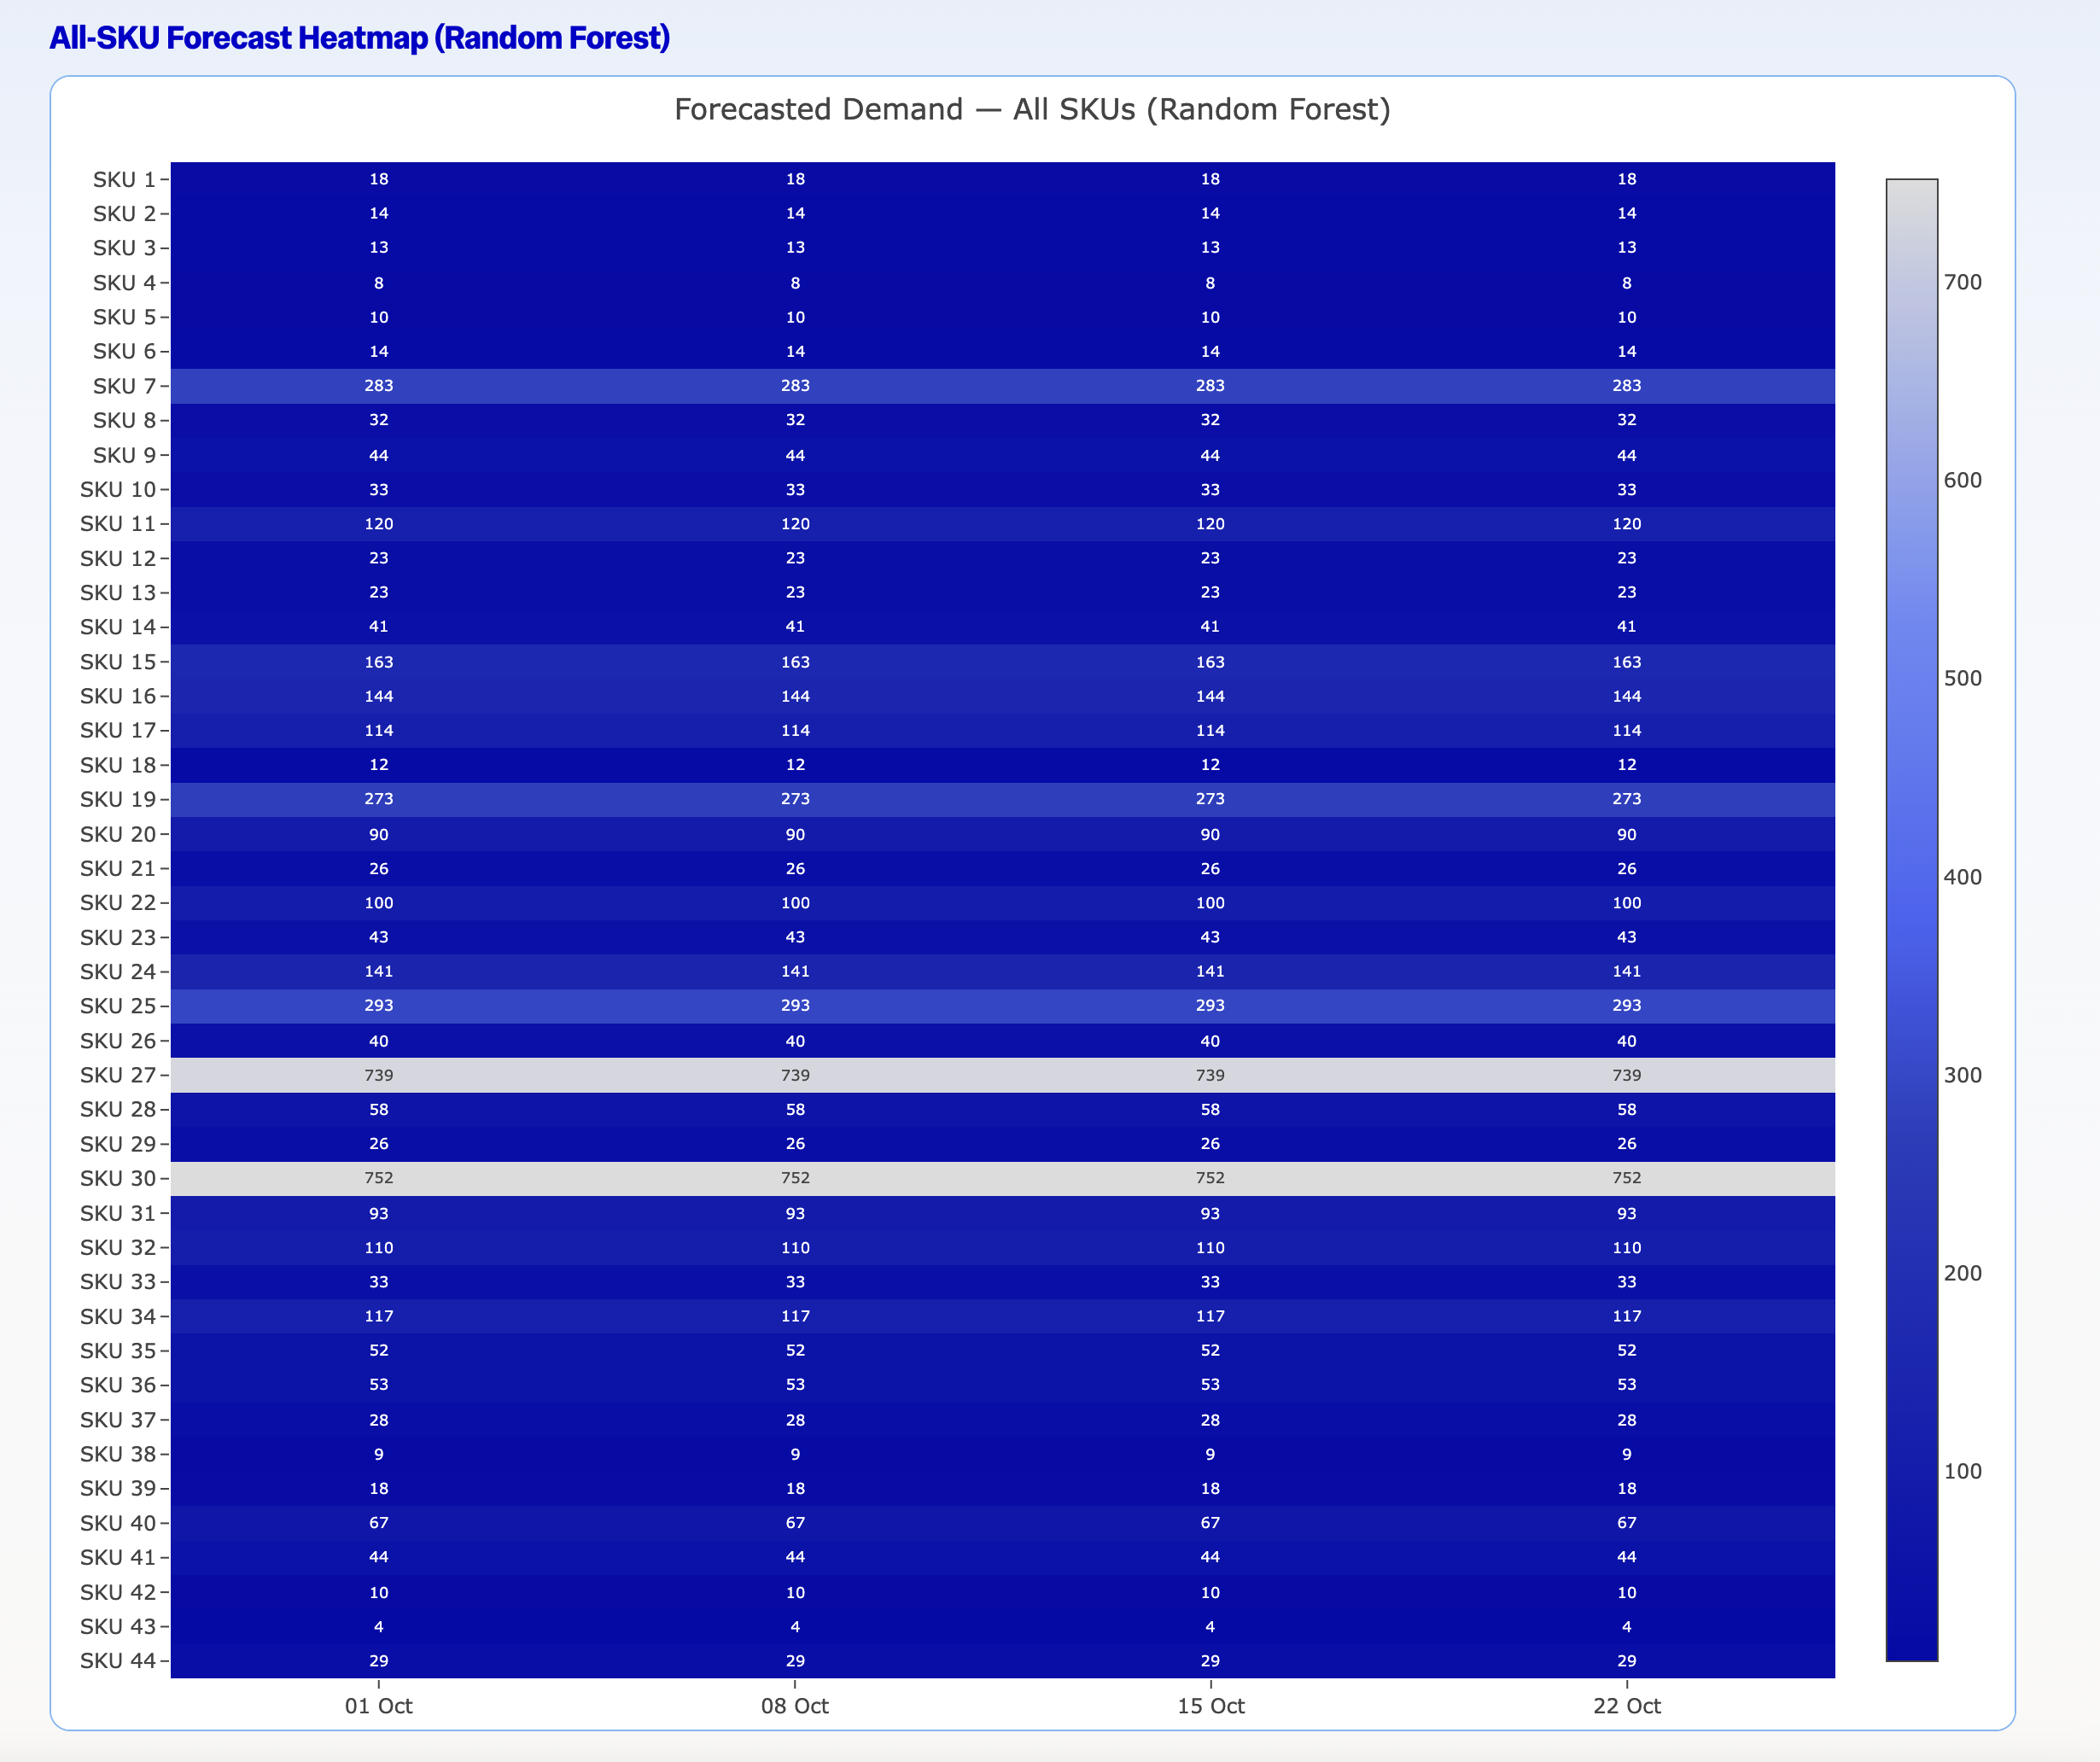
Demand Forecasting — Forecast Detail
Best Model by SKU (308 configurations)
36 %
Random Forest
27 %
Naïve (move avg)
20 %
Linear Regression
Key Takeaways
→ RF wins ~6 in 10 scenarios
→ Confidence widens beyond 6 weeks
→ All 3 models retained per SKU
308
Configs
4–6 wk
Reliable
44
SKUs

Slide 8
Dashboard:
Promotion Effectiveness
Do feature promotions increase sales, and by how much?

Slide 9
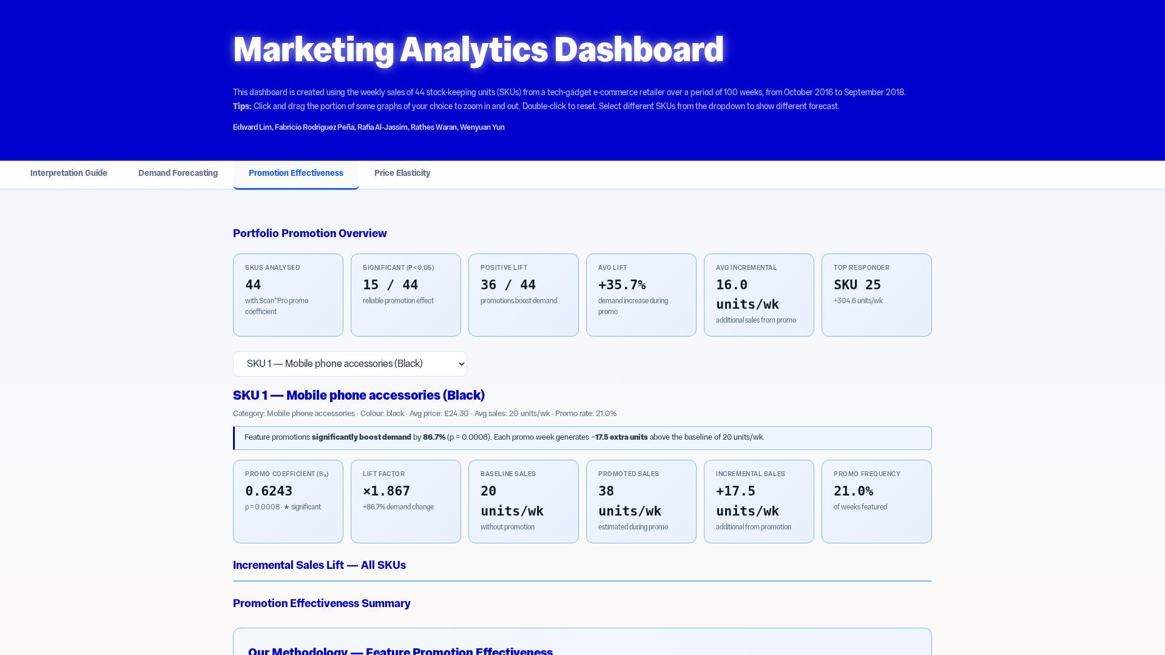
Do Promotions Work? Measuring the Sales Lift
Model
Scan*Pro log-log OLS per SKU
Lift = exp(β₂) − 1 | p<0.05
Portfolio Results
19/44
SKUs show significant promo lift
+68.5%
Average demand increase during promos
+141.3
Top SKU (SKU 11) extra units/week
→ Concentrate budget on 19 responsive SKUs

Slide 10
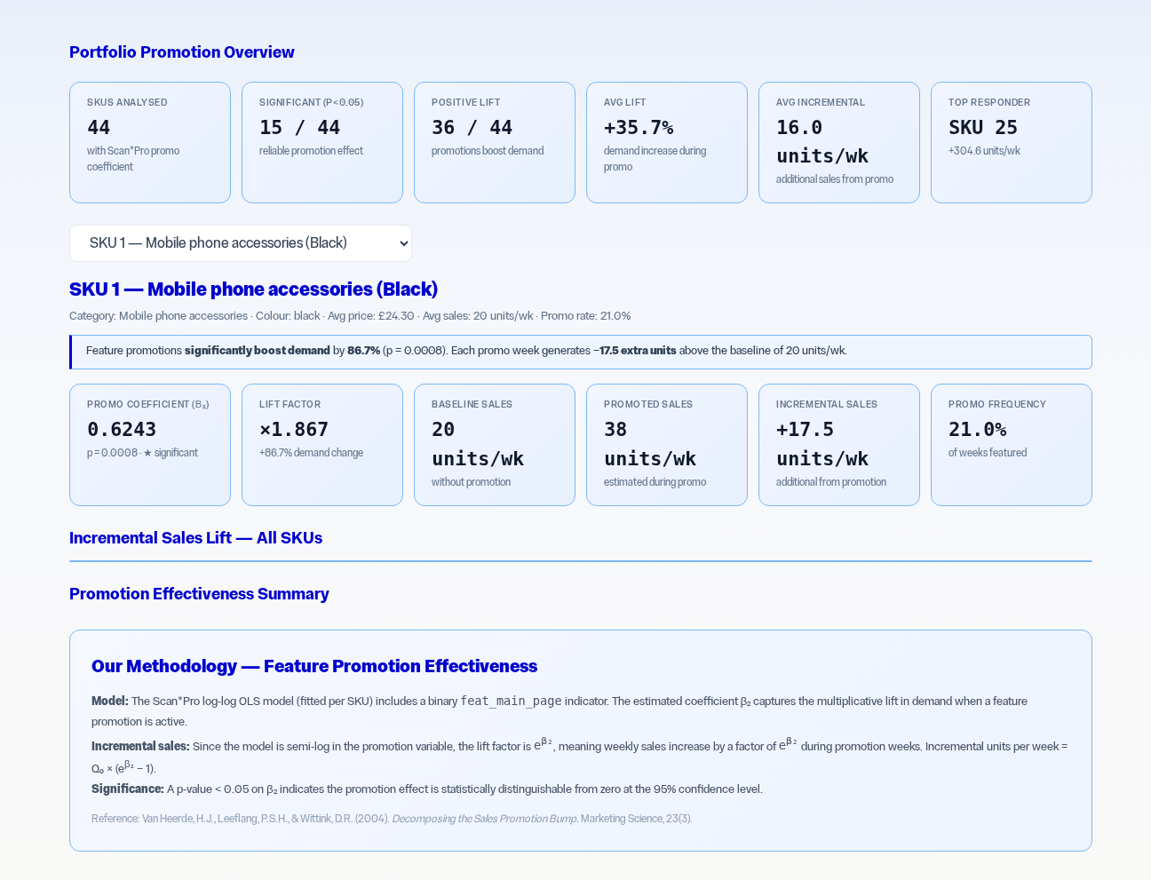
Promotion Strategy — Invest or Cut?
6 SKUs
9 SKUs
Highly Effective
Moderately Effective
Increase frequency
Maintain current level
12 SKUs
17 SKUs
Inconclusive
Ineffective
Requires more data
Redirect budget
→ Focus promo budget on 19 responsive SKUs
19/44 Significant
+68.5% Avg lift
+141.3 Top SKU/wk

Slide 11
Dashboard:
Price Elasticity
How sensitive is each SKU’s demand to price changes?

Slide 12
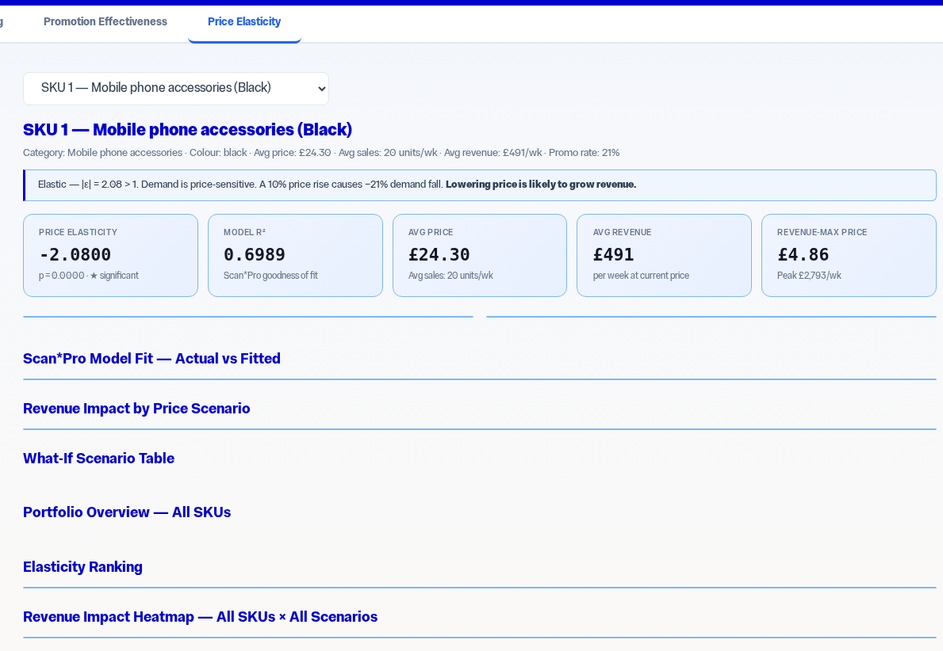
Price Sensitivity — Who Responds to Price Changes?
Scan*Pro OLS β₁ = price elasticity
32 SKUs
12 SKUs
Elastic (|e| > 1)
Inelastic (|e| < 1)
Lower price → higher revenue. Volume gains outweigh margin loss.
Raise price → higher revenue. Minimal demand impact.
−1.72
Avg ε
−4.07
Most sens.
−0.37
Least sens.
91% of results statistically significant
40/44 Significant
32 vs 12 Split

Slide 13
Price Sensitivity — Who Responds to Price Changes?
log(Sales) = α + β₁·log(Price) + β₂·Featured + ε
Model Interpretation
Classification Thresholds
β₁ is the price elasticity of demand: a 1% price increase leads to a β₁% change in unit sales.
|ε| < 1 = Inelastic
1 ≤ |ε| < 2 = Moderately Elastic
|ε| ≥ 2 = Highly Elastic
Scenario Formula
Diagnostics
New Demand = Base × (New Price / Old Price)^ε
New Revenue = New Price × New Demand
Applied to +10%, -10%, +30% scenarios.
39 of 44 price coefficients significant at p < 0.05.
13

Slide 14
Key Findings: Elasticity Distribution
Summary Statistics
Mean Elasticity
-1.53
Median
-1.44
Range
-4.11 to +0.04
Significant
39 of 44
14

Slide 15
Most vs Least Price-Sensitive SKUs
Top 5 Most Elastic
Top 5 Least Elastic
SKU | Elasticity | Product
SKU 19 | -4.110 | Streaming sticks
SKU 33 | -3.610 | Selfie sticks
SKU 30 | -3.341 | Mobile phone acc.
SKU 11 | -3.285 | Streaming sticks
SKU 25 | -2.946 | Selfie sticks
SKU | Elasticity | Product
SKU 10 | +0.040 | VR headset
SKU 37 | -0.138 | Selfie sticks
SKU 22 | -0.279 | Bluetooth tracker
SKU 38 | -0.405 | Mobile phone acc.
SKU 6 | -0.520 | Selfie sticks
Key Insight
Streaming sticks and selfie sticks dominate the highly elastic category — commoditized products with many substitutes. VR headsets and Bluetooth trackers are inelastic — fewer alternatives and stronger brand loyalty.
16

Slide 16
Scenario Testing: +10% Price Increase
-9.1%
15
29
Portfolio Revenue
Impact
Revenue
Gainers
Revenue
Losers
A blanket price increase destroys value. SKU-specific pricing is essential.
Scenario | Most Elastic (SKU 19) Demand Change | Revenue Change | Least Elastic (SKU 10) Demand Change | Revenue Change
-10% Price | +54.2% | +38.8% | -0.4% | -10.4%
+10% Price | -32.4% | -25.7% | +0.4% | +10.4%
+30% Price | -66.0% | -55.8% | +1.2% | +31.4%
17

Slide 17
Feature Promotion: Top 5 SKUs by Incremental Sales
Key Insight
SKU 11 gains +141 units/wk from feature placement alone — no price cut needed.
Ranked by absolute volume impact, not % lift — prioritises business value over statistical artefacts.
18

Slide 18
Managerial Implications
↑
Raise prices on inelastic SKUs
★
Promote elastic SKUs
12 SKUs (27%) have |e| < 1. A 10% increase raises revenue 1–10% per SKU with minimal demand loss.
16 highly elastic SKUs respond strongly to price decreases.
▲
Use feature placements strategically
◆
Adopt SKU-level pricing
Main-page featuring lifts sales 31–246%. A cost-effective alternative to discounting that preserves margins.
Blanket +10% reduces portfolio revenue by 9.1%.
20

Slide 19
Recommendations and Next Steps

Slide 20
Pricing Strategy — Where to Raise and Where to Lower
Elastic SKUs (32) — Lower Price to Grow
Inelastic SKUs (12) — Raise Price Safely
Strategy
Targeted price reductions of 3–5% drive proportionally larger demand gains. Volume increases more than offset the per-unit revenue reduction.
Strategy
Price increases of 5–10% have minimal demand impact. Revenue grows directly from higher margins with negligible volume loss.
−1.72
Avg elasticity
−4.07
Most sensitive (SKU 9)
−0.37
Least sensitive (SKU 41)
12
SKUs safe to raise
Key Insight: Tailored pricing across the 44-SKU portfolio can increase total revenue by optimising each product's position on its demand curve
01 Lower prices on high-elasticity products to capture volume
02 Raise prices on inelastic products to improve margins
03 Combine with promo data to time price changes optimally

Slide 21
Key Takeaways & Next Steps
4 - 6 weeks
15
32/12
reliable forecast window
SKUs with significant lift
elastic vs. inelastic SKUs
Demand Forecasting
Promotion Effectiveness
Price Elasticity
RF and MLP outperform linear models. 4–6 weeks forecasts highly reliable; confidence widens beyond 8 weeks.
Feature promotions significantly boost 15 SKUs. Concentrate promo budget on top responders; reallocate from inconclusive SKUs.
32 elastic vs 12 inelastic SKUs. Tailored pricing can grow total revenue without increasing demand risk.
Future Recommendations
Integrate real-time sales data for live forecasting
A/B test recommended pricing strategies
Explore cross-SKU cannibalisation effects
Extend promo model to test different promo types

Slide 22
Thank You

