Slide 1
Wizeline Data Engineering Bootcamp Challenge
Edgar Alberto Arellano Ruelas

Slide 2
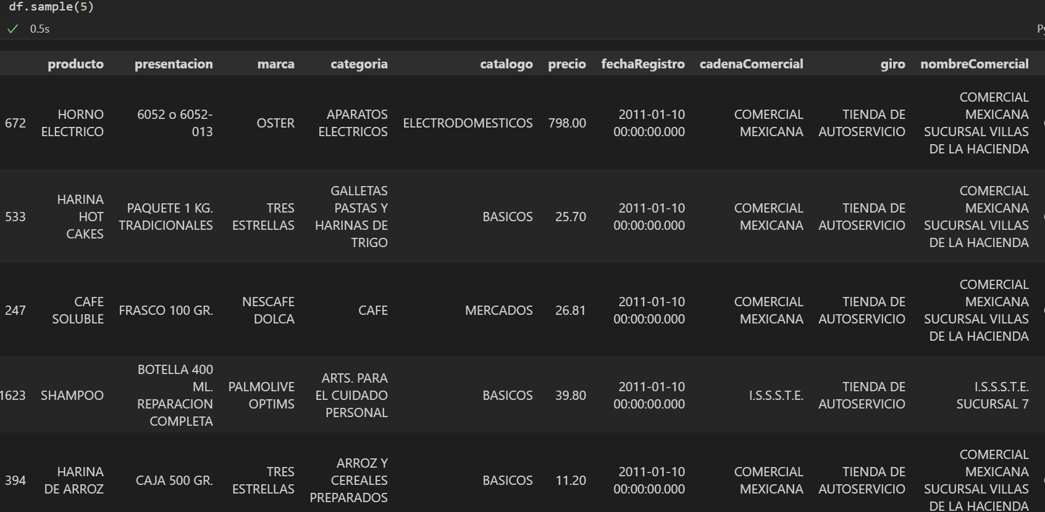
Exploratory Analysis
Sample of the data

Slide 3
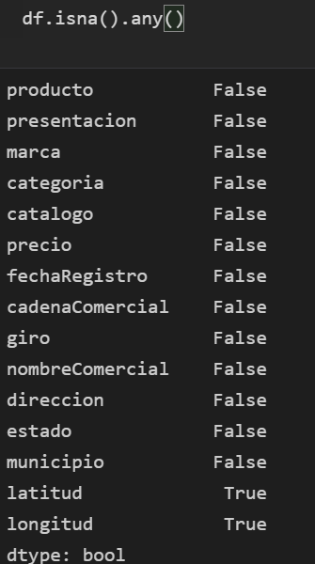
Exploratory Analysis
Check If Any Value is null

Slide 4
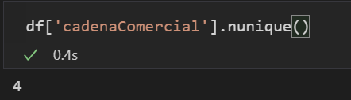
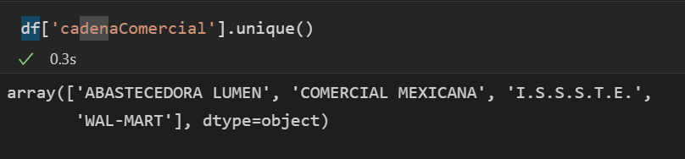
How many commercial chains are monitored, and therefore, included in this database?
Answer : 4

Slide 5
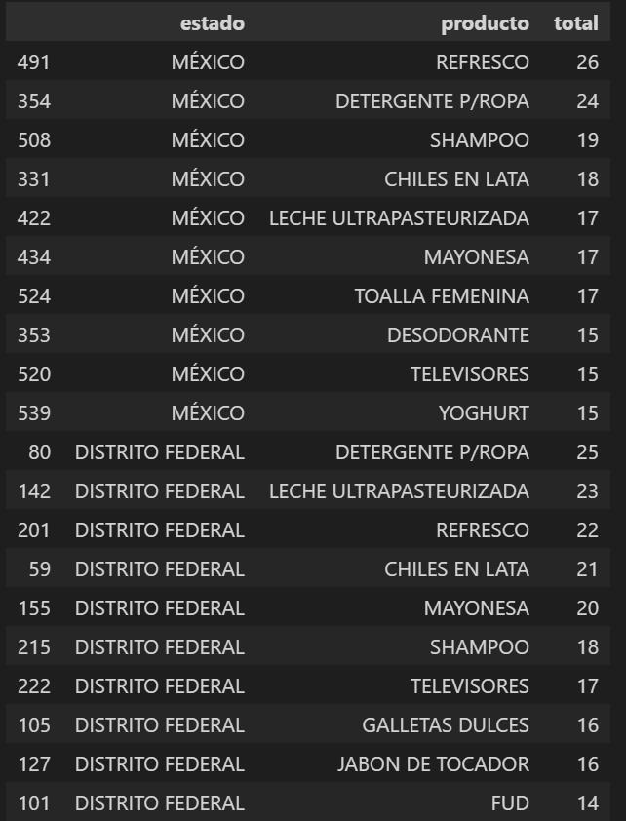
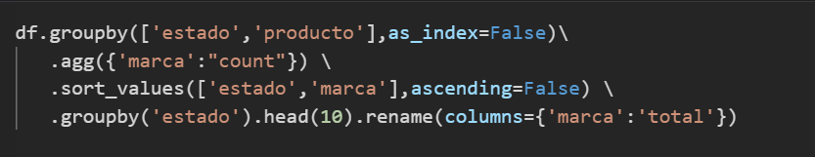
What are the top 10 monitored products by State?

Slide 6
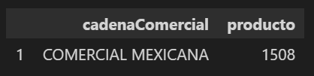
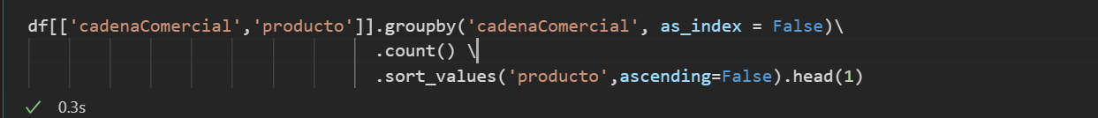
Which is the commercial chain with the highest number of monitored products?
Answer: Comercial Mexicana

Slide 7
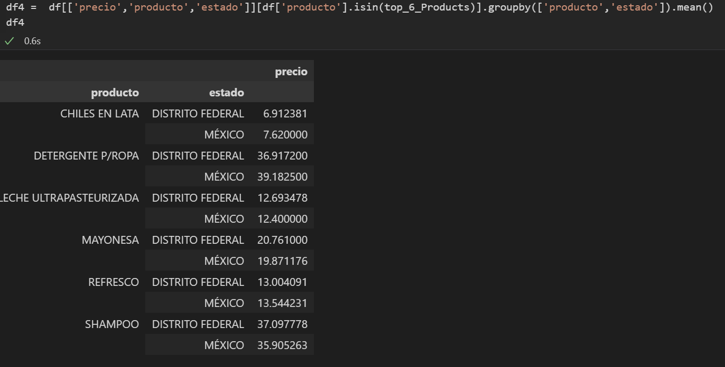
Use the data to find an interesting fact.
Comparative of prices between the top 6 most monitored products in DF vs Mexico

Slide 8
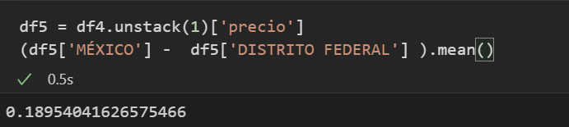
Use the data to find an interesting fact.
Results : The prices in the two states are very similar, in average the prices are 0.18 pesos more high in state of Mexico.

Slide 9
What are the lessons learned from this exercise?
That pandas is a great tool for data analysis but when you have a large amount of data it is necessary to use other alternatives

Slide 10
Can you identify other ways to approach this problem? Explain.
Using parallel processing approach, which consists on breaking up different parts of a task among multiple processors. For example using mapreduce with spark or hadoop

